Slide 1
Safety
Chapter 1

Slide 2
Overview
WHAT YOU WILL LEARN
  How to work safely with robots
  The three conditions that will stop a robot
  The three zones around a robot
  How to insure the safety of people in the danger zone
  Operation of several common safety sensors
  The dangers of electricity
  How to lock out or tag out equipment
  How to deal with emergencies
  Some basic first aid procedures

Slide 3
Robots Require Respect
The three Rs of safety are Robots Require Respect
There are only three conditions that stop a robot:
  The program/driven action is finished
  There is an alarm condition
  There is some type of mechanical failure

Slide 4
Robots Require Respect cont.
Remember:
  You cannot bribe a robot
  You cannot reason with a robot
  It has no remorse or feelings
  It will perform as programmed unless/until one of the three conditions is met
  If you put yourself in the path of the robot that cannot sense your presence, there is a good chance of severe injury or death

Slide 5
Danger Zones
There are three main zones around the robot:
  Safe zone - where a person can pass near a robot without having to worry about making contact with the system.
  Cautionary zone - The area where one is close to the robot but still outside of the work envelope.
  Danger zone - The work envelope, the area the robot can reach and where all the robotic action takes place.

Slide 6
Safe Zone
The safe zone is where anyone can move or pass by the robot without concern
This area is removed from any danger from the robot’s movements and anything it is doing
In the industrial setting this area is often clearly marked and used as a path for people

Slide 7
Cautionary Zone
This area is close to the robot, but outside of the work envelope
Often, this is where the operator, maintenance, engineers, and other concerned persons work
While the robot cannot reach this area, what it is doing could reach or affect this area.

Slide 8
Danger Zone
This is the area the robot can reach and work
This area must be guarded for most industrial robots and anyone in this area MUST have access to an E-stop
  This is an OSHA requirement for caged industrial robots
When guarded, there must be some system to prevent automatic operation when people are in the danger zone

Slide 9
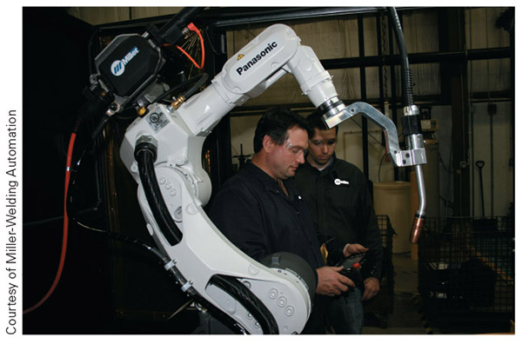
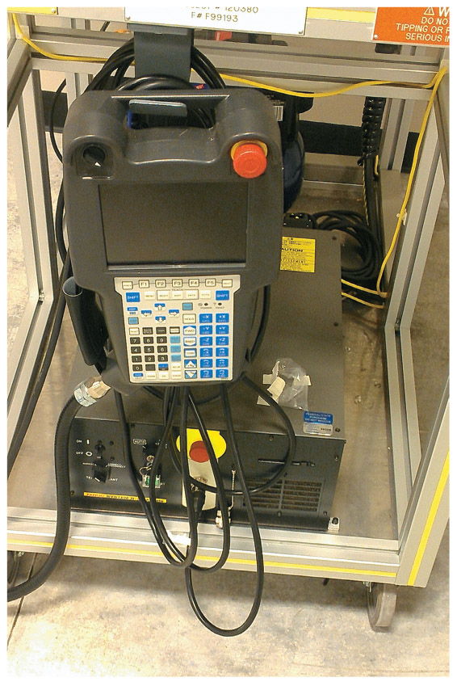
Figure 1-4
Figure 1-2
On the right you can see a teach pendant and the obvious red E-stop button. Entering the danger zone without this is a recipe for disaster!

Slide 10
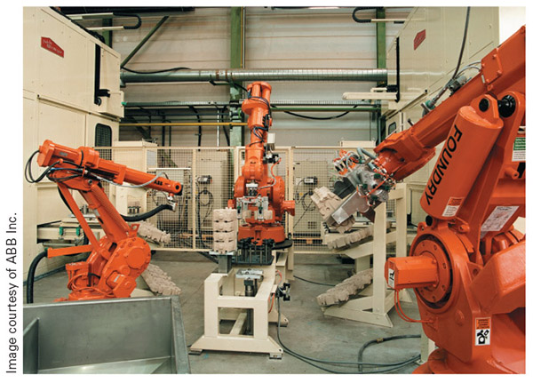
Figure 1-3
You can see the safety cage around these robots in the background

Slide 11
Guarding
Guards are devices designed to protect us from the dangers of a system.
The sole purpose of guarding is to protect people from something dangerous
ANSI/RIA R15.06-2012 is the go to document to determine robotic guarding requirements

Slide 12
Guarding cont.
Two of the common guarding materials use in industry are:
  Expanded metal guarding - metal that is perforated and then stretched to create diamond-shaped holes with eighth-inch pieces of metal around it
  Metal mesh - consists of thick wire welded and/or woven together to create a strong barrier that is easy to see through

Slide 13
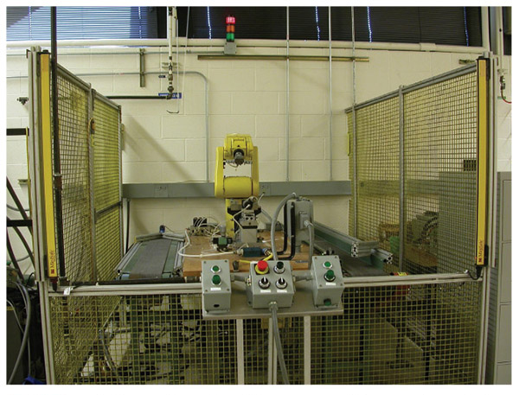
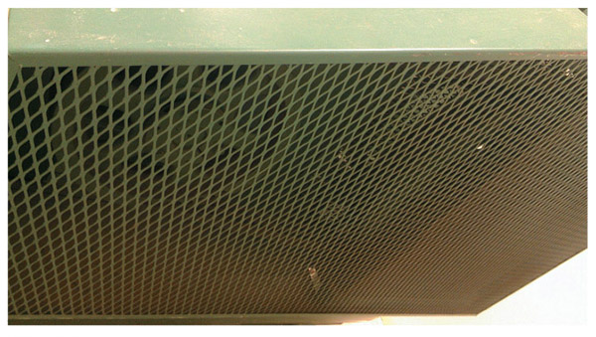
Figure 1-7
Figure 1-6
Above is an example of expanded metal and to the left you can see metal mesh around the robot

Slide 14
Guarding cont.
To work without a cage, the industrial robot requires some way to sense humans near by
Laser grids, cameras, force sensors, or other sensing means are added to the robot system
The Baxter robot that debuted in 2012 was the first cage free robot designed to work in industry

Slide 15
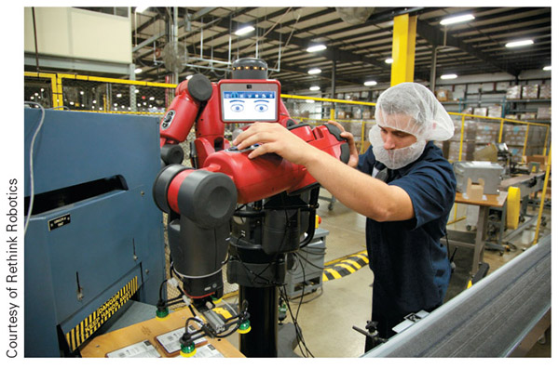
Figure 1-8
Here you can see Baxter working side by side with people in an industrial setting. Notice how there is no protective cage around this robot.

Slide 16
Safety Devices
There are a multitude of devices we use with robots to provide information about the world around them and make the system safer
Proximity switch (prox) - This device generates an electromagnetic field and senses the presence of various materials by changes in this field instead of physical contact

Slide 17
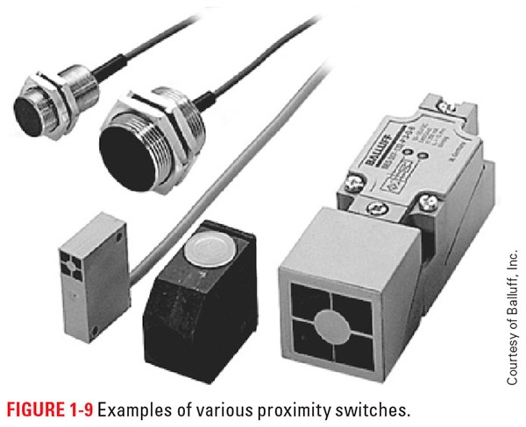
Figure 1-9
These are a few examples of prox switches you might find in use with a robot

Slide 18
Safety Devices cont.
Limit switch - senses the presence or absence of a material by contact with a movable arm attached to the end of the unit
Safety interlock - a system where all the safety switches must be closed or “made” for the equipment to run in automatic mode
  Often prox and limit switches are used in this fashion

Slide 19
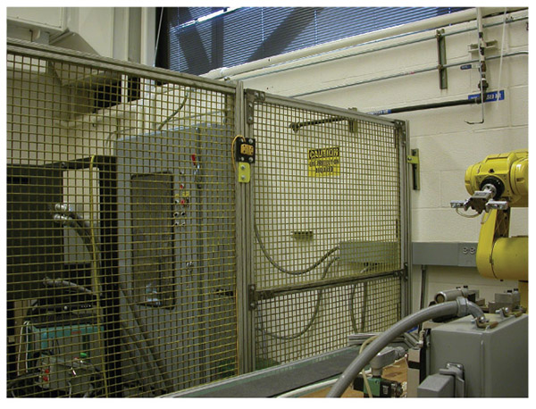
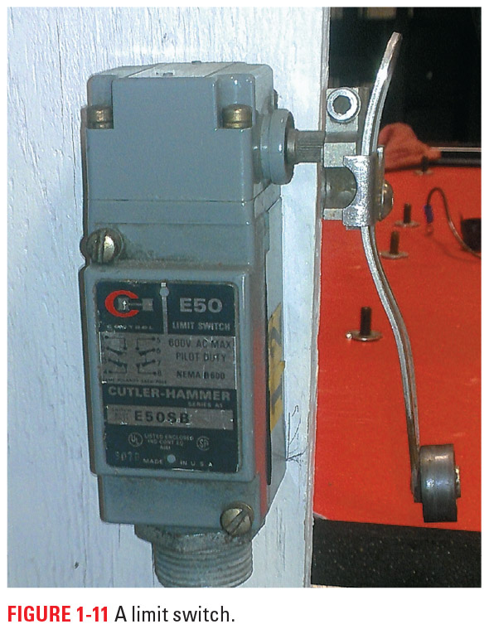
Figure 1-10
Figure 1-11
Above is an example of a limit switch and to the left you can see a yellow interlock switch on the door to access the cage protected area

Slide 20
Presence Sensors
Presence sensors - these sensors detect when a person is inside the danger zone and are tied into the system to prevent automatic operation
  Pressure sensor
  Photo eye
  Laser photo eye
  Light curtain

Slide 21
Pressure Sensors
Pressure sensor - detects the presence or absence of a predetermined or set level of force
  These are often in the form of rubber mats that can be placed in or around danger zones
  When someone steps on the mat, it triggers a set of contacts that are used in turn to send a signal to the robot controller
  There is also a robotic skin version where pressure sensors are attached directly to the robots outer shell
  These are harder to bypass than prox or limit switches, but not infallible

Slide 22
Photo Eye
Photo eye sensor - emits an infrared beam that strikes a shiny surface or reflector, which reflects the light back to a receiver in the
  The emitter and receiver can be in the same housing or separated
  When in a single housing, this is a short range unit that requires something to bounce the light off
  Dirt, airborne dust, and anything else that can interfere with the light emitted/received is a problem

Slide 23
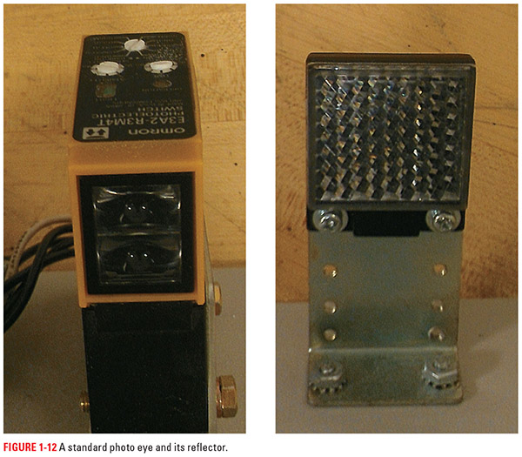
Figure 1-12
Here is an example of a single housing photo eye with emitter and receiver in one unit
Next to it you can see a standard reflector used to return the emitted light

Slide 24
Laser Photo Eye
Laser photo eyes are similar to other photo eyes, except they use a concentrated beam of light
The focused beam of light allows this system to work over larger distances
  The greater the distance the light travels, the more critical the alignment of the system

Slide 25
Light Curtain
When we house the emitter and receiver in separate units, we refer to the system as a light curtain
This system allows for coverage of wide areas and has replaced the traditional pressure mat in many applications
A small misalignment of this system can result in loss of signal due to the distances involved

Slide 26
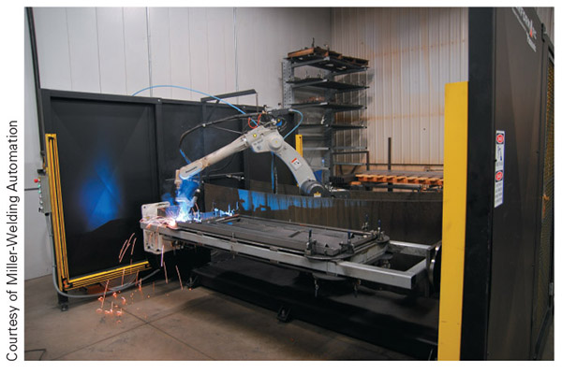
Figure 1-13
The yellow bars above are the light curtains for this system. Notice how one set is mounted along the base and the other vertical, to guard the entrance.

Slide 27
Stops
Stops cease automatic operation
  Hold/Pause buttons work like stops
  Used in non critical situations
E-stops cease operation as well as shutting down many of the operating systems
  These may be cables, red mushroom top buttons, levers, or other setups for easy access
  Used in emergency situations or when immediate shut down is needed

Slide 28
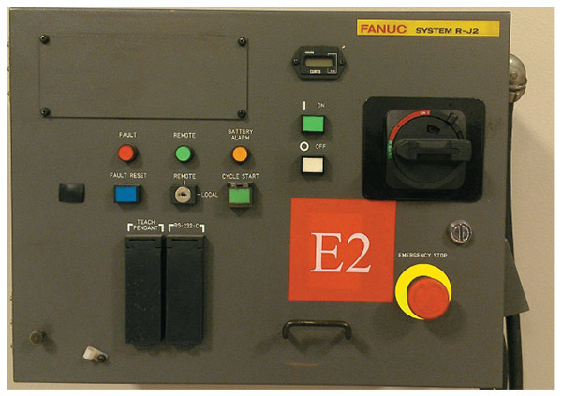
Figure 1-14
Notice how this robot controller has a red E-stop, but not a hold, stop, or pause button.
Those are found on the teach pendant, which also has an E-stop.

Slide 29
Electricity and You
Voltage – This force drives electricity through the system; the greater the voltage, the greater the driving force. We measure this force in volts (V).
Amperage – Amperage is a measurement of how many electrons, or how much electricity, is flowing through a system. We measure this in amps (A).

Slide 30
Electricity and You cont.
Resistance – This is a measurement of how much force is working against, or resisting, the flow of electrons. We measure this in ohms, represented by the Greek letter Ω (omega).
Electricity – This is a flow of electrons from a point with more electrons to a place with fewer electrons. We often control this flow and harness its power to do meaningful work or tasks.

Slide 31
Electricity and You cont.
The three main factors that determine the severity of an electrical shock are:
  The amount of current that passes through the body
  The path that the electricity takes through the body
  The duration of the shock

Slide 32
Amount of Current
The more electrons passing through your body, the greater damage it will do
The flow of electrons is based on the amount of electromotive force (voltage) and the resistance of the path it is following
The greater the force or the lower the resistance, the larger the flowing current

Slide 33
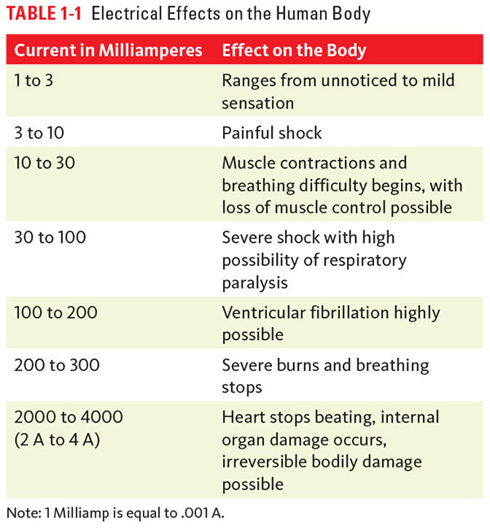

Slide 34
Ohm’s Law
Georg Simon Ohm devised the mathematical relationship between voltage (V), resistance (R) and current (I)
  V = I x R
With this formula one can calculate the amount of current that will flow through something, once the voltage and resistance are known

Slide 35
The Path
Where the electrons flow is just as important as how many flow through
When the current passes through vital organs, the risk of death is greatly increased
Be careful of metal worn on or in the body, as these become great entry or exit points for electricity

Slide 36
Duration
The longer the current passes through the body, regardless of the path, the more damage it is going to do
0.1 amps passing through the heart for one-third of a second can cause ventricular fibrillation
  This is where the heart quivers instead of pumping blood
120V electricity is notorious for locking the muscles in place and causing long duration electrocution

Slide 37
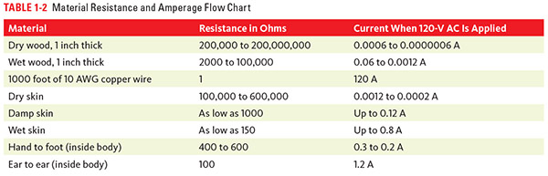

Slide 38
LOTO
LOTO- Lock Out/Tag Out-a methodical process of removing all power from equipment so potential or kinetic energy remains
On January 2, 1990, this process became an OSHA mandated requirement
This process prevents approximately 120 deaths and 50,000 injuries each year

Slide 39
LOTO cont.
Every power source must have an isolation method that can be locked in the off position
Lockouts are used to hold the power source in the blocked or de-energized state
Each person who works on the equipment must put his or her own uniquely keyed lock on each lockout for the machine

Slide 40
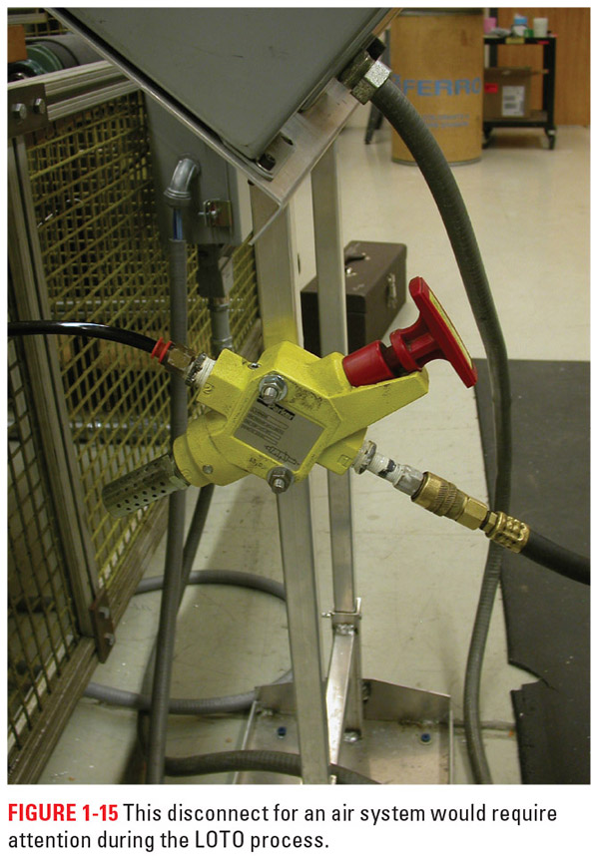
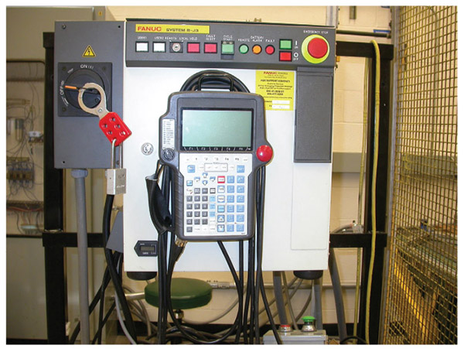
Figure 1-15
Figure 1-16
Above you can see the main power for the controller locked out using a red, multi-lock hasp.
To the left is a disconnect for an air system. To properly lock this out one would need to apply the appropriate hasp to keep it in the blocked position so no air could get through.

Slide 41
LOTO Steps
Notify affected individuals you are about to shut the machine down. This includes operators, employees nearby, and management.
Stop the machine cycle, if necessary.
Turn off or remove all external power supplies and lock them in the off position using lockout devices and a lock with your name on it.
Place appropriate information tags on the equipment, such as “Do Not Run, Under Maintenance.”

Slide 42
LOTO Steps cont.
Verify a zero-energy state. Make sure to account for capacitors, compressed springs, items that could fall, stored fluid pressures, or other potential energy sources.
Perform the necessary repairs.
Once the repairs are finished, remove all tools and any blocking devices or other items you added to the machine for safety reasons.
Once everything is clear, each person working on the robot should remove his or her own lock. The last person can return power to the equipment.

Slide 43
Handling Emergencies
Emergency - a set of circumstances or a situation that requires immediate action and often involves events (or potential events) that have caused injury to people and/or severe damage to property

Slide 44
Rule 1: Remain Calm
If you are upset and acting rashly, you will be of little help and may actually make a bad situation worse
Remember, fear is contagious
Think before you act or speak, and reassure the victim as best you can without lying

Slide 45
Rule 2: Assess the Situation
You will be of no help if you are injured as well, so make sure the area is safe to help before you begin
You may need to do something to make the area safe, but only to the level of your training
If you are unsure how to proceed, seek professional help/advice

Slide 46
Rule 3: Perform to Your Level of Training
Everyone has different levels of skill and training, so make sure you know your limits
DO NOT try things you have seen on TV or just heard about, this can make matters worse!
Again, get help or direction as needed, 911 is a great source of information and help

Slide 47
Rule 4: After it is Over, Talk it Out
Emergencies are high stress situations and there is bound to be some emotional fallout
Seek out someone involved with the situation or a professional you can talk with after it is all over
This is a good time to talk about what went right as well as what went wrong

Slide 48
Bleeding
Almost all bleeding can be stopped in 5 to 15 minutes with direct pressure and applying clean bandages on top of soaked ones
A tourniquet is a tightened band that restricts arterial blood flow to arm or leg wounds to stop severe bleeding
  This is a last resort method as it has lead to tissue damage and even amputations

Slide 49
Burns
A first-degree burn is easily recognizable by the reddening of the skin with a dry appearance
  It is painful and heals in about a week.
A second-degree burn is more severe and often includes blistering of the skin along with reddening or a whitish appearance
  It can look dry or wet; some sensation of the area may be lost; and it can take up to three weeks to heal, with the most severe requiring medical assistance.

Slide 50
Burns cont.
A third-degree burn is a very severe burn; it is often blackened or ash white in appearance; the skin may be leathery; open wounds are often present
  They hurt less at first, as all the nerves are destroyed; it takes months to heal; and requires immediate medical attention.
A fourth-degree burn extends past the skin into the muscle and bone of the victim and has the same characteristic of a third-degree burn.

Slide 51
Minor Burns
When dealing with burns that do not have open wounds, such as first-degree and minor second-degree, you will want to submerge the area in cool water for 10 to 15 minutes or until the pain subsides and then wrap with a dry, nonstick, sterile bandage
  Do not pop any blisters that form
  Seek medical help if the area burnt is a sensitive area or pain persists

Slide 52
Severe Burns
Do not place burns that have open wounds—such as severe second-degree, third-degree, or fourth-degree burns—in water and do not try to remove any clothing that may be stuck in these burns
  Cover with a cool, moist, sterile, nonstick bandage or cloth and seek immediate medical help
  Infection is the number one enemy when dealing with burns, so it is paramount to let the medical professionals deal with cases of broken skin burns

Slide 53
Blunt-Force Trauma
Blunt-force trauma - impact that does not penetrate the skin
The severity of the injury usually depends on the size of the object that hits the person, how much force is behind the impact, and where the impact is on the person’s body

Slide 54
Blunt-Force Trauma Treatment
For minor impact injuries, you may want to apply an ice pack and monitor for continued swelling, discomfort that does not fade, or other signs of serious injury
For major impact injuries, apply an ice pack and seek medical help, as there is an increased chance of internal injury that is not outwardly visible

Slide 55
Broken Bones
Immobilize the limb as best you can with a splint device from your first aid kit.
  If you do not have a splint, you can use materials such as wood, rolled up magazines, or anything rigid placed on either side of the broken bone and held there by a cloth wrap of some kind.
The whole point is to immobilize the injured limb for transport to medical help

Slide 56
Shock/Electrocution
Do not touch the victim until they power is off or they are clear
If you cannot kill the power, use a nonconductive item to knock them free
  A wooden broom handle, rubber trash can, dry nylon rope, etc.
  Do NOT use any part of your body to free them as you will be electrocuted as well

Slide 57
Shock/Electrocution cont.
Once they are free of the circuit and it is safe, see if they are breathing and responsive
If responsive, send them to be checked out by a medical professional
If unresponsive, dial 911 and start CPR if needed

Slide 58
Review
Robots Require Respect! We discussed what happens when you no longer fear the robot as well as how to work safely with robots.
Danger zones. This section outlined the various zones around a robot as well as who could be in those areas.
Guarding. This section talked about how we keep people out of the danger zone.
Safety devices. We discussed some of the devices used to ensure people’s safety around the robot.

Slide 59
Review cont.
Electricity and you. This section outlined the effects that electricity can have on the body and how to work safely with electricity.
LOTO. We covered how to safely power down equipment so we can work on or around it.
Handling emergencies. We talked about emergencies in general and then drilled down into first aid for some injuries that you might encounter.

