Slide 1
Components of the Robot
Chapter 3

Slide 2
Overview
WHAT YOU WILL LEARN
  How hydraulic, pneumatic, and electric power differ
  What the controller does for the robot
  How we use the teach pendant and what you will find on such a device
  How the manipulator of the robot relates to the human body
  The difference between major and minor axes
  How to number the axes of the robot
  How to mount a robot, including some of the options available

Slide 3
Power Supply
The power supply is what provides the force to move the robot around and without it, most robots are useless
There are three main types of power used in robots:
  Electrical
  Hydraulic
  Pneumatic

Slide 4
Electric Power
Electricity - is the flow of electrons from a place of excess electrons to a place of electron deficit; we route these electrons through components to do work
Voltage - a measurement of the potential difference or imbalance of electrons between two points and the force that will cause electrons to flow

Slide 5
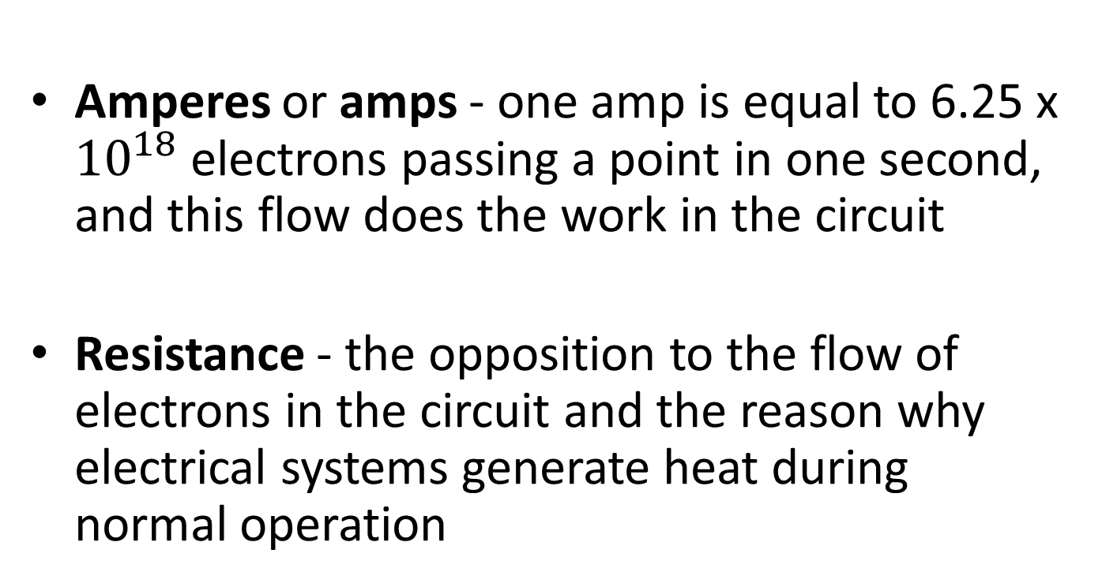
Electric Power cont.
Amperes or amps - one amp is equal to 6.25 x ${10}^{18}$ electrons passing a point in one second, and this flow does the work in the circuit
Resistance - the opposition to the flow of electrons in the circuit and the reason why electrical systems generate heat during normal operation

Slide 6
AC/DC
Direct Current (DC) - Electrons flow in one direction
  This is the voltage we get from batteries, solar panels, thermocouples, and similar sources
Alternating Current (AC) – Electrons flow back and forth in the circuit
  This is the electricity in your home, business, industry, and other generated sources

Slide 7
DC
DC systems have a set polarity or positive and negative orientation because electrons flow in one direction only
  Reversing the polarity of many DC components will result in improper operation and/or damage to the component
The positive side of each component in a circuit hooks to the negative side of the component that precedes it and ultimately back to the positive side of the power supply
  The reverse is true of the negative side, it connects the previous positive terminal and ultimately the negative side of the power supply

Slide 8
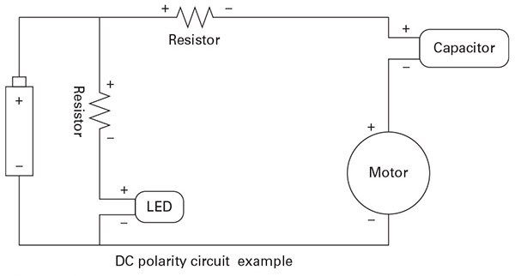
Figure 3-1
Notice how the side that traces back to the positive terminal of the battery is labeled with a +. This is to indicate the polarity of the circuit components

Slide 9
DC cont.
Amp-hours (Ah) – a measure of how many amps a power source can deliver over time
  For example, a 10 amp-hour battery could deliver 1 amp for 10 hours, or 2 amps for 5 hours
To increase the Ah of a system, we hook the power sources in parallel
  When connected this way, we add the Ah of the sources together to find the new total Ah

Slide 10
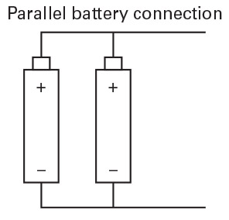
Figure 3-2
To connect DC power sources in parallel, the positives of each are all connected together and the same for the negatives. This allows each supply to give a portion of the electron flow needed and thus the system has increased Ah potential.

Slide 11
DC cont.
To increase the voltage of a system, we hook the sources in series, positive of one to the negative of the next
  To determine the new voltage, add the voltage values of all the sources hooked together in series
If you place a power source in backwards, positive to positive or negative to negative, the backward source actually subtracts from the total
  This can also result in damage to the system or power source in some instances

Slide 12
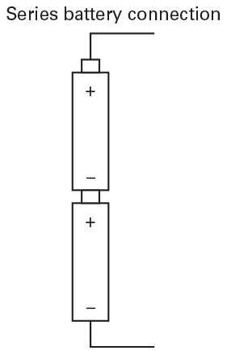
Figure 3-3
Here is an example of how to hook up batteries to increase the voltage. Notice how the positive of one battery touches the negative of the other.

Slide 13
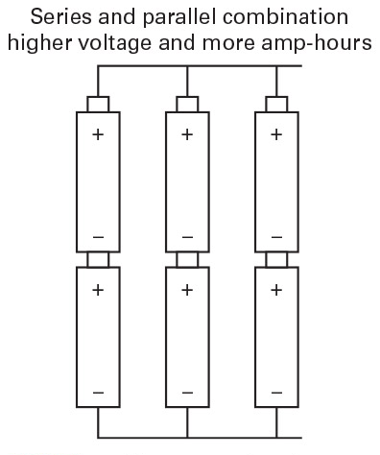
Figure 3-4
Here is an example of a battery bank where each cell is made of multiple batteries in series to raise the voltage. The cells are then connected in parallel to increase the overall Ah of the system.

Slide 14
AC
AC power does not have a set polarity because it is constantly changing the direction it flows through the circuit
  With AC, there is no component polarity to worry about
AC power starts at zero, rises to a positive value, drops back to zero, falls to a negative value, and then rises to zero once more

Slide 15
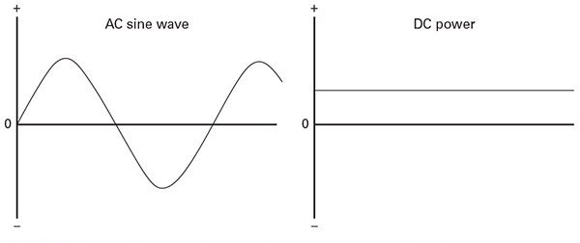
Figure 3-5
DC voltage is consistent, thus the flat line. AC power is always changing, thus the sine wave form

Slide 16
AC cont.
One complete wave from zero to positive to zero to negative and back to zero is called a cycle
In America, we have 60-hertz (Hz) power, or 60 of the sine wave cycles per second
We measure it in Root Mean Square (RMS), which is a mathematical average of the sine wave

Slide 17
Single-phase vs Three-phase
Single-phase AC is AC power that has one sine wave provided to the system via a single hot wire and returned on a neutral wire
  The hot wire tends to have black or red insulation while the neutral should be white or grey in color
Three-phase AC is AC power that has three sine waves that are 120 degrees apart electrically
  Power is returned along the hot wires as well, negating the need for a neutral wire, though sometimes neutral wires are added for extra safety
Both systems should include a ground wire that provides a low-resistance path to the earth for safety reasons
  Grounds are bare copper wire, green insulated, or green with yellow stripes

Slide 18
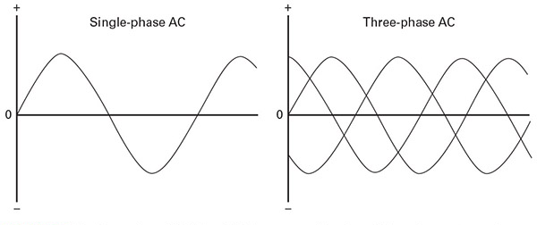
Figure 3-6
Notice how there is only one sine wave on the left, leading to times of no electron flow. The three waves on the right creates a constant flow of electrons with no dead spots.

Slide 19
Hydraulic Power
Hydraulic power involves the use of a non-compressible liquid given velocity and then piped somewhere to do work
These systems generate great amounts of force with precision control
The trade off is the upkeep that goes with a hydraulic system
  Oil cost, replacement, and filtration
  Filter replacement and system cleaning
  Leaks

Slide 20
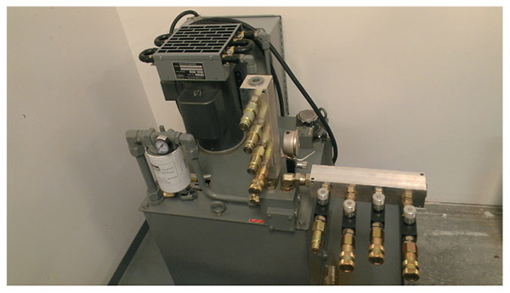
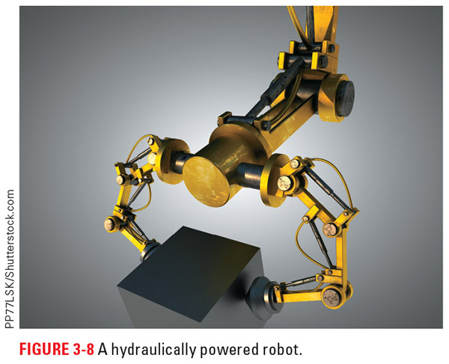
Figure 3-7
Figure 3-8
On the left is an example of a hydraulic system complete with pump, chiller, filter, supply manifold, and return manifold. On the right you can see a hydraulically powered robot, complete with supply lines.

Slide 21
Hydraulic Power cont.
When dealing with hydraulic leaks, there are a few key points to remember:
  Hydraulic oil from a running system may be hot enough to burn skin, so try to avoid direct contact with the oil until you are sure it is safe.
  If a hydraulic oil puddle is uncontrolled, it can cover a much larger area than you might think. Special barrier and damming devices can be applied to help control large spills.
  Leaks that generate an oil mist can be a fire hazard. Most hydraulic oils are stable and take a lot of heat to ignite, except when dispersed as a mist in the air.

Slide 22
Hydraulic Power cont.
  Cleaning up hydraulic oil usually requires the use of some type of absorbing medium.
  You should not allow hydraulic oil to go down any drains connected to the sewer system, as it is a contaminant and will wreak havoc at water treatment facilities or in any natural waterways it might reach.
  When finished with the cleanup, make sure you dispose of any oil and oil-soaked materials properly. See the Safety Data Sheet (SDS) or a supervisor for more information on proper disposal. SDSs tell you about chemicals, their dangers, how to handle them properly, and how to dispose of them

Slide 23
Pneumatic Power
Pneumatic power resembles hydraulic power, but uses a compressible gas instead of a non-compressible liquid
  Because gas is compressible, it is nearly impossible to maintain position mid stroke or any position that is not under constant pressure
Because the gas used in pneumatic power is usually the same air we breath, we can release when we are done
  This is often a loud process and can stir up dust so we use mufflers to slow the air and reduce the noise generated

Slide 24
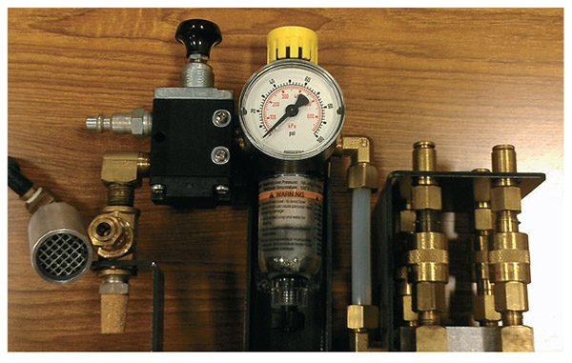
Figure 3-9
On the left side are two mufflers: The gold cone is the muffler for the pressure regulation unit pictured, and the silver cylinder is a muffler for use where needed.

Slide 25
Pneumatic Power cont.
Many early robots were air powered and held position by running into hard stops, which earned them the nick name “Bang Bang” robots
Some of the fastest robots use advanced control systems and air as a main power source for movement
Pneumatics is commonly used to power the tooling of the robot

Slide 26
Which One to Use?
The choice of power source for a robot typically comes down to three questions:
What do we want or need the robot to do?
What do we have available?
Where will the robot work or operate?
Currently, electricity is the power source of choice for a majority of the robots

Slide 27
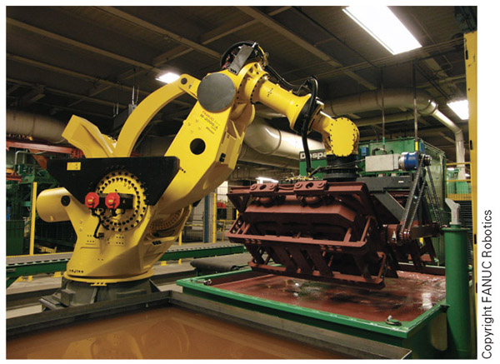
Figure 3-10
In the early years of robotics, a system to move something of this size and weight would have been hydraulically powered. Today we have electric motors that can handle the load just fine

Slide 28
Controller/Logic Function
Controller - the brains of the operation and the part of the robot responsible for executing actions in a specific order under specified conditions
  It takes whatever sensor input is available for the robot
  Makes decisions based on a system of logic filters and commands called a program
  Then activates various outputs as instructed by the program

Slide 29
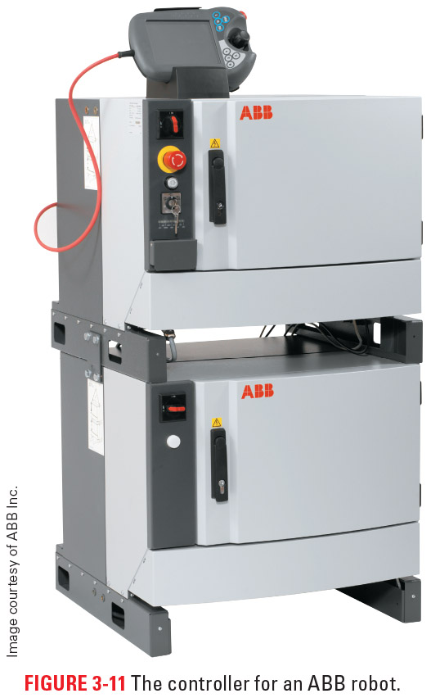
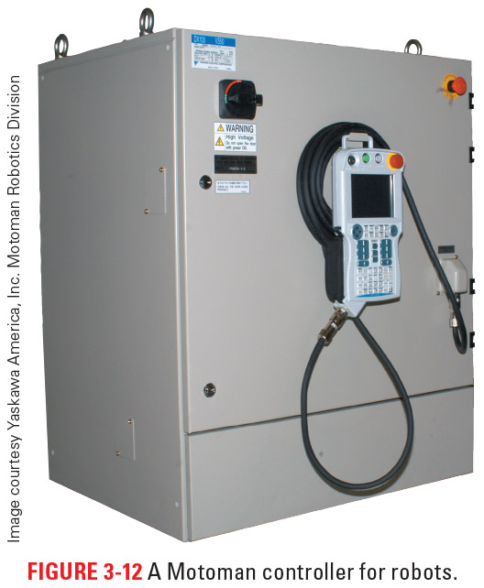
Figure 3-12
Figure 3-11
Here are a couple examples of robot controllers

Slide 30
Controller/Logic Function cont.
Open-loop control system - commands are issued to various systems and it is assumed that the robot performed as instructed
Closed-loop control system - has some means of verifying proper operation
  usually in the form of encoders or other position-sensing devices that confirm commands executed as directed

Slide 31
Controller Levels
First generation - open-loop systems that utilized drums with pegs in them or something similar
Second generation - used relay logic to control motion, but were still open-loop systems
Third generation - used computer control systems and could take advantage of system feedback

Slide 32
Controller Levels cont.
Fourth generation - utilized processors more like modern computers and took advantage of programing languages
Fifth generation - add in artificial intelligence (AI), which is the ability of a computer program to make decisions when there is no clear-cut right answer or to learn from previous events
Sixth generation - utilize complex mathematics to calculate the amperage draw of various motors during motion and then carefully monitor the motors’ operation to create collaborative robot systems

Slide 33
Controller/Logic Function cont.
Controls are responsible for:
  Power distribution
  Storing and executing program data
  Memory management
  Processing information from various sources
  Controlling servos
  Performing diagnostics
  Monitoring inputs and controlling outputs
  Interfacing with other machines and networks exterior to the robot

Slide 34
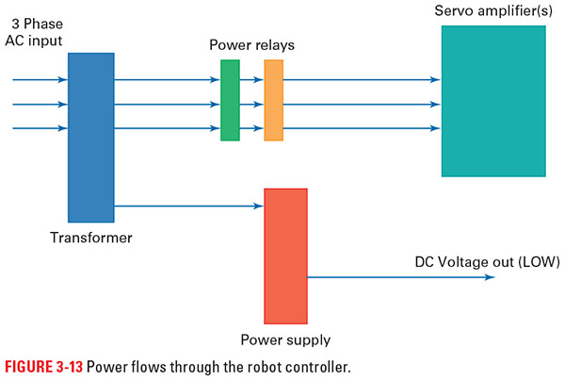
Figure 3-13
Power flow through a controller

Slide 35
Teach Pendant/Interface
Teach pendant – the common human interface device for most robotic systems and is used for:
  viewing alarms
  making manual movements
  stopping the robot
  change/write programs
  start new programs
  perform other day-to-day tasks required to run robots

Slide 36
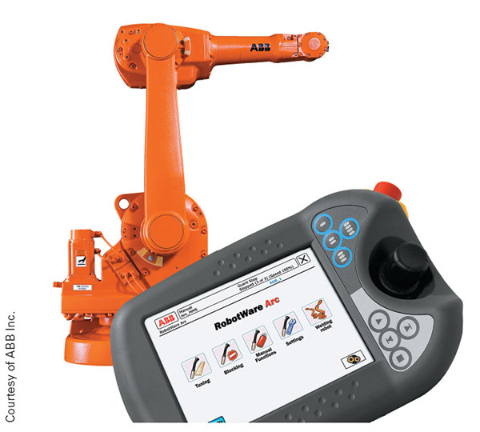
Figure 3-14
Here is an ABB teach pendant used to communicate with the robot and monitor what is going on

Slide 37
Teach Pendant/Interface cont.
OSHA requires operators to take the teach pendant with them whenever they are in the danger zone for all industrial robots except collaborative robots
  With collaborative robots it is still a good idea to have it at hand
Industrial teach pendants have an E-stop and dead man’s switch
The dead man’s switch, usually a trigger- or bumper-type switch on the back of the pendant, is required to move the robot manually
  If you release the switch or press down too hard, the robot stops moving

Slide 38
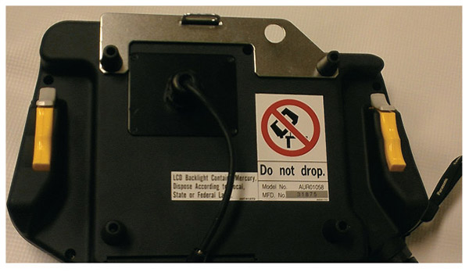
Figure 3-15
The yellow triggers shown here are dead man’s switches. When in manual, at least one of these must be depressed to move the robot.

Slide 39
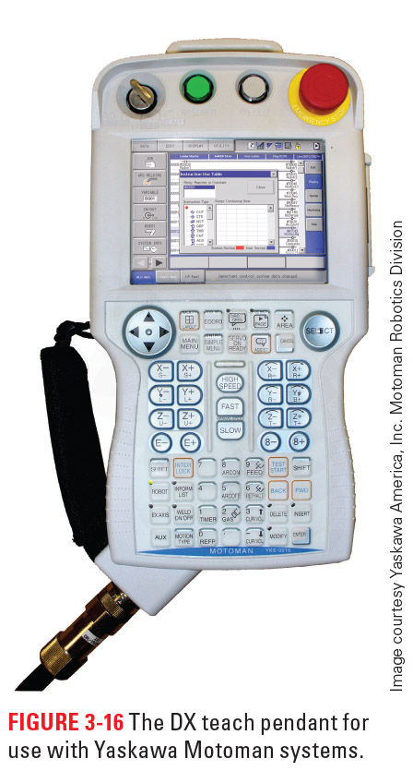
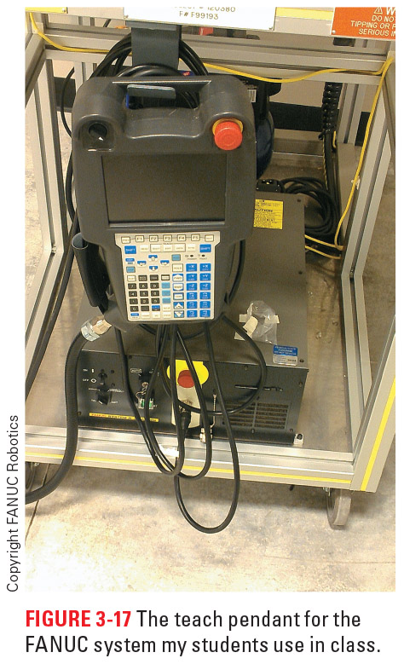
Figure 3-17
Figure 3-16
Here are a couple more industrial teach pendants.
Some collaborative robots, like Baxter, use a tablet instead of a traditional style teach pendant.

Slide 40
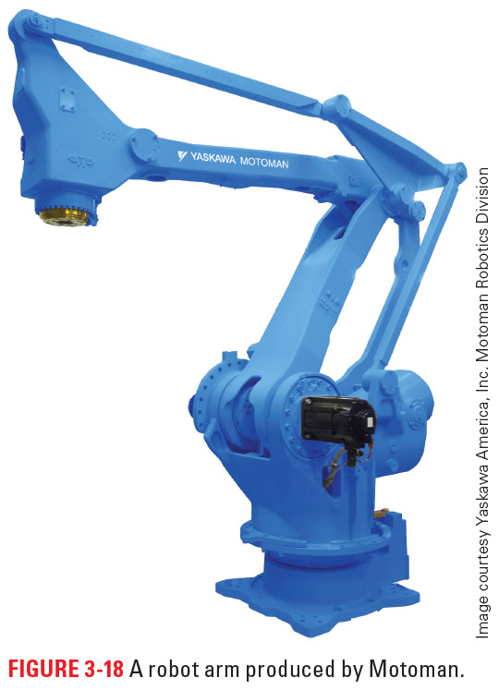
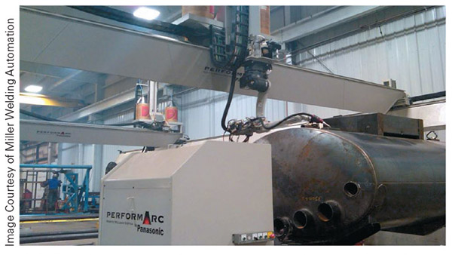
Manipulator, DOF, and Axis Numbering
Manipulators come in all shapes and sizes and are what the robot uses to interact with and affect the world around it
Figure 3-18
Figure 3-19

Slide 41
Degree of Freedom (DOF)
Each axis of the manipulator adds one more way the robot can move or a Degree of Freedom (DOF)
The more DOF of a manipulator has, the greater the flexibility of the system
When it comes to labeling the axes of an arm style robot, we start counting at the base, where it mounts, and then continue to the end where the tooling attaches

Slide 42
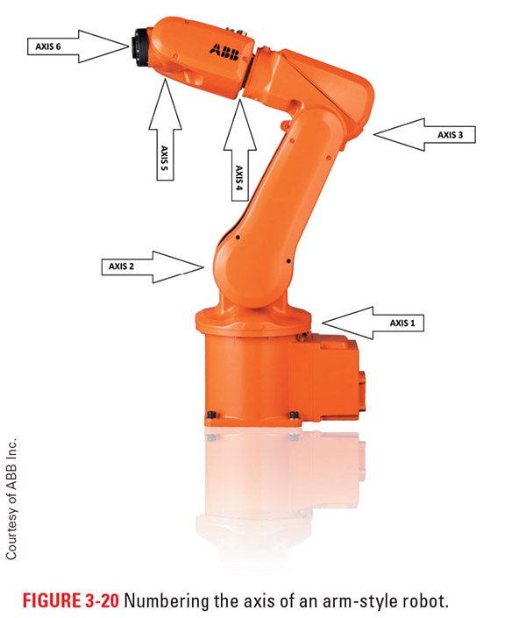
Figure 3-20

Slide 43
Axes
There are two main groupings of the axes we often refer to:
  Major axes - responsible for getting whatever tooling we are using into the general area it needs to be
    Typically axes 1-3 on most robots
    Equated to the motion of the human torso and shoulder
  Minor axes - responsible for the orientation and positioning of robot tooling
    Typically axes 4-6 on most robots

Slide 44
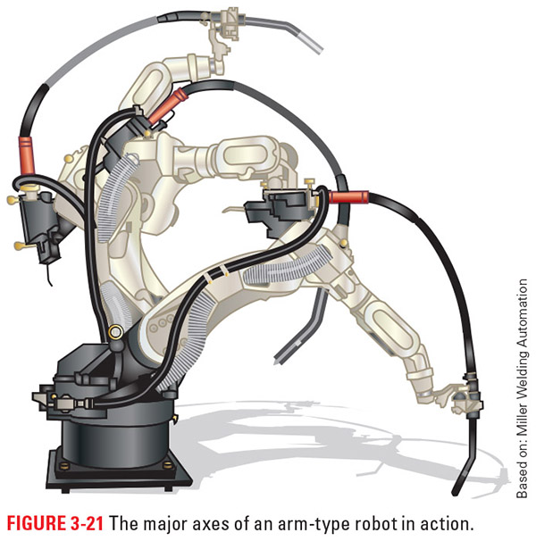
Figure 3-21
Here you can see the major axes at work, getting the tooling near where the work will be done

Slide 45
Axes cont.
We further break down the minor axes into:
  Pitch, (axis 4), which is the up and down orientation of the wrist
  Yaw, (axis 5), which is the side to side orientation of the wrist
  Roll, (axis 6), which is the rotation of the wrist
  These three are often equated to the motion of the human wrist
External axes - axes of motion that often move parts, position tooling for quick changes, or in some other way help with the tasks of the robot
  These are under the control of the robot, but are not part of the manipulator nor counted in the major or minor axes

Slide 46
Parallel-Style Robot Numbering
Because of the circular nature of the base of these robots, the starting point is not nearly as universal as that found in the standard robot arm, so the first thing you need to do is identify axis 1
  use the teach pendant to manually move the robot in joint mode; select axis 1; and see which set of linkages moves
Once you have identified axis 1, the industry standard seems to be to number the other axes, in order, in a counterclockwise direction

Slide 47
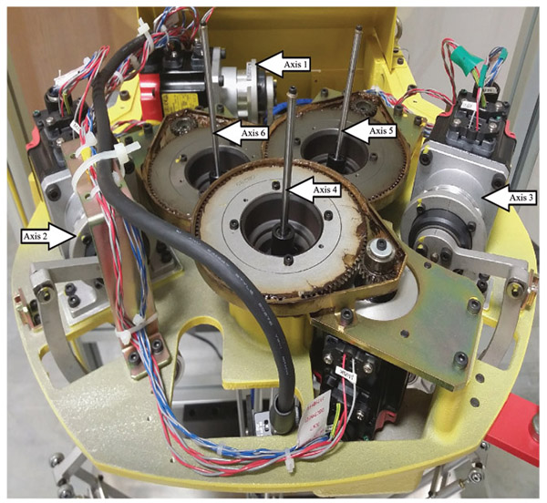
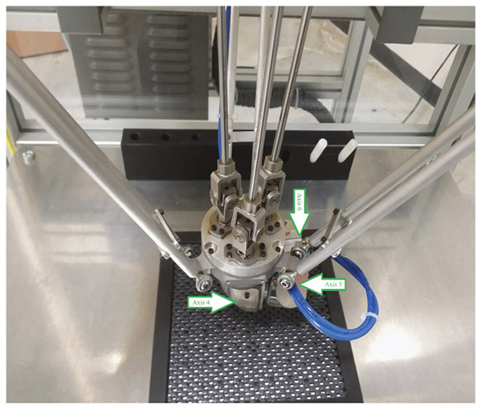
Figure 3-23
Figure 3-24

Slide 48
Base Types
The base is where the robot is mounted and there are several options here as well
For many of the systems used in industry, solid-mount bases are the preferred way to go
  These involve mounting the robot firmly to the floor or other structures using bolts and fastening systems

Slide 49
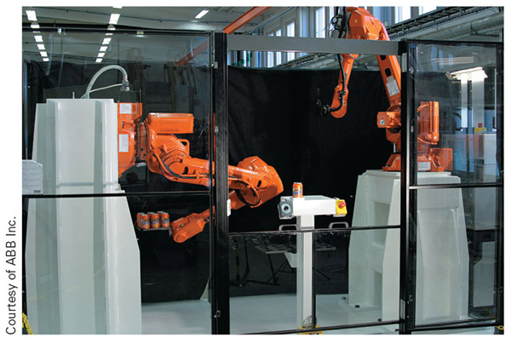
Figure 3-25
Here are a couple examples of solid-mounted robots

Slide 50
Base Types cont.
Here are a few key points to remember with the solid mount base:
  Make sure whatever holds the robot in place is robust enough to bear the forces and weight of the system. Bolts, nuts, mounting plates, and so on all have limits regarding the amount of force they can withstand.
  Make sure what you mount the robot on/to can handle the weight of the system and whatever load it will be maneuvering.
  Check the security/tightness of any mounting hardware periodically, paying special attention to any noted wear.
  Crashes are conditions in which the robot endures unexpected forces, so check the base when you are inspecting the system (especially for wall or overhead

Slide 51
Mobile Bases
Mobile bases - systems used to move the manipulator to various location so that it can perform its functions
We often refer to a linear base with a finite reach as a gantry base
Another common mobile base is the wheeled base
  These systems give the robot the ability to cover large areas and even traverse difficult terrains

Slide 52
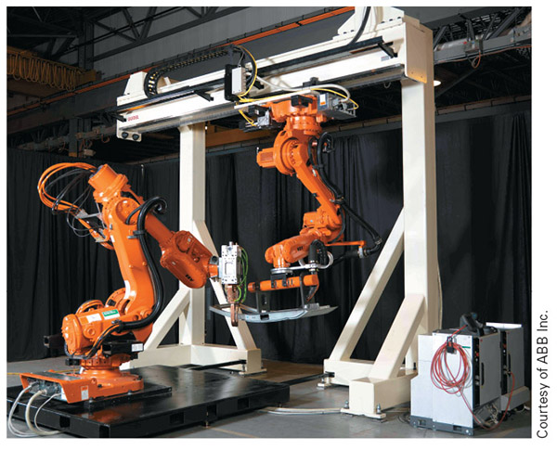
Figure 3-26
The robot mounted to the white, overhead system is a gantry based robot

Slide 53
Review
Power supply. This section focused on the common forces used to run robots and provided information about how each of these power sources works.
Controller/logic function. We learned about the brain of the robot and its importance.
Teach pendant/interface. This section explored how we communicate with the robot, direct its actions, or make changes to its operation.
Manipulator, degrees of freedom, and axis numbering. We learned how to number axes, how we move the robot around, and what degrees of freedom are.
Base types. We saw to mount the robot and the benefits of each base type.

