Slide 1

The Lean A3

Slide 2
The A3 Method
A3 refers to a European paper size that is roughly equivalent to an American 11-inch by 17-inch tabloid-sized paper. The A3 format is used by Toyota as the template for three different types of reports:
  Proposals
  Status reports
  Problem solving

Slide 3
What and Why A3?
Anytime you wish to clearly tell a story, especially when you wish to simplify or clarify a complicated issue
Can be used as a jumping off point for Kaizen
Provides a clear and concise method of reporting information
Method of operation is visible and accessible to all
A continuous improvement activity
Use to teach problem-solving
Creates efficient working environment

Slide 4
The A3 Method
There is no “magic” in the steps through which the structured A3 Problem Solving template takes a team. These steps are basically:
  Identify the problem or need
  Understand the current situation/state
  Develop the goal statement – develop the target state
  Perform root cause analysis
  Brainstorm/determine countermeasures
  Create a countermeasures implementation plan
  Check results – confirm the effect
  Keep the plan in place!

Slide 6
Example – Files Mgmt A3

Slide 7
NEG/ECP Transportation Air Quality Committee

Slide 8
The Problem Solving Template (A3)
The A3 Problem Solving template lays out an entire plan, large or small, on one sheet of paper.
It should be visual and extremely concise.
It should tell a story, laid out from upper left-hand side to lower right, which anyone can understand.
What is important is not the format, but the process and thinking behind it.
It fosters dialogue.
It develops problem solvers.

Slide 9
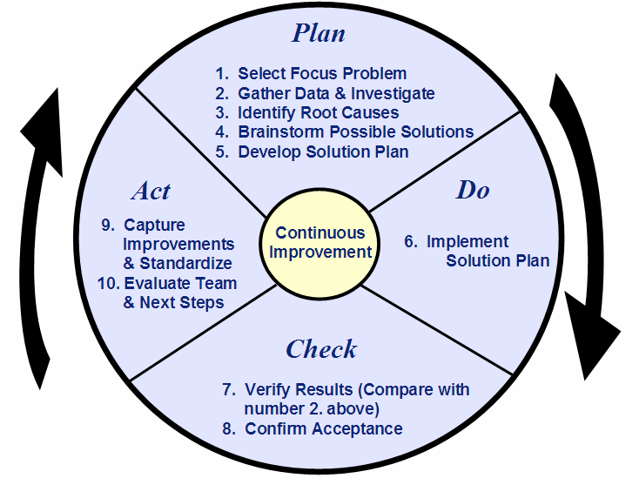
Plan-Do-Check-Act
Notes:
^{Process Coach Training}
^{Instructor Notes}
Corporate Training & Development
Contact: Dianne Douville – (978) 750-2534
^{Module 8-9}
^{December 2005 – Rev. 1}

Slide 10
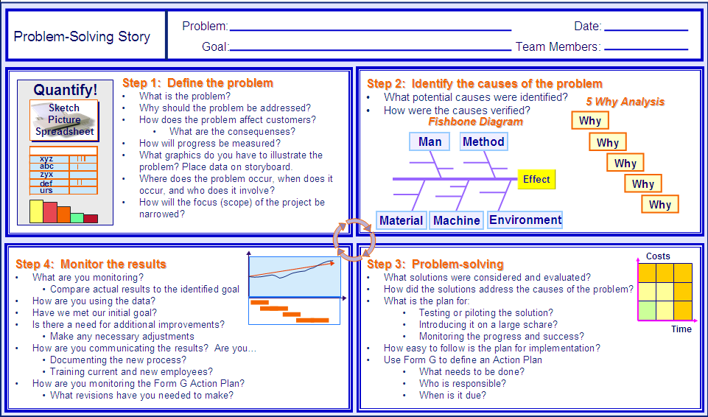
Problem-Solving Story
Notes:
^{Process Coach Training}
^{Instructor Notes}
Corporate Training & Development
Contact: Dianne Douville – (978) 750-2534
^{Module 8-10}
^{December 2005 – Rev. 1}
Backgroupd is shortened to the Problem, Target condition/Goal Statement is abbreviated to goal
Step 1 is analagous to the problem statement
Step 2 is Root cause analyses
Step 3 is the Implementation plan
Step 4 is the Follow up

Slide 11
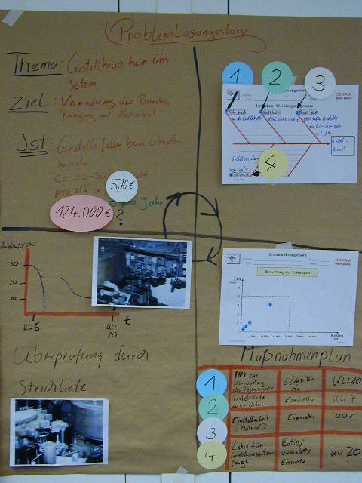
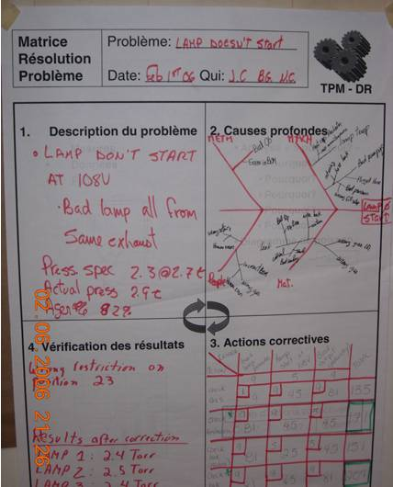
Problem solving story - manufacturing

Slide 12
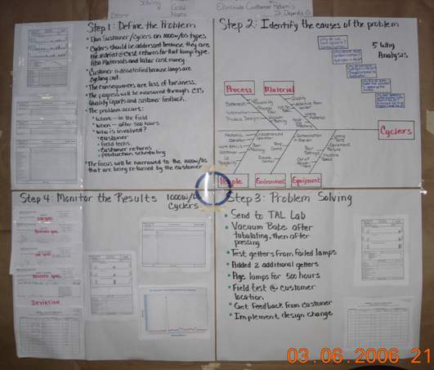
Problem solving story - manufacturing

Slide 13
Additional reading
Understanding A3 Thinking: A Critical Component of Toyota's PDCA Management System (2008),
Durward K. Sobek II
Understanding A3 Thinking: A Critical Component of Toyota's PDCA Management System [Hardcover]
Durward K. Sobek II. (Author),
Art Smalley (Author)
› Visit Amazon's Art Smalley Page
Find all the books, read about the author, and more.
See search results for this author
Are you an author? Learn about Author Central
(Author)
(27 customer reviews)

Slide 14
Final thoughts
A3s are deceptively simple.
A3 reports — and more importantly the underlying thinking —embody a critical core strength of a lean company.
A3s serve as mechanisms for managers to mentor others in root-cause analysis and scientific thinking, while also aligning the interests of individuals and departments throughout the organization by encouraging productive dialogue and helping people learn from one another.

