Slide 1
Maintenance and Troubleshooting
Chapter 11

Slide 2
Overview
WHAT YOU WILL LEARN
  What preventive maintenance is
  Common preventive maintenance tasks for electrical, hydraulic, pneumatic, and mechanical systems
  The dangers of arc flash and the personal protective equipment needed to work safely around electricity
  The basics of the troubleshooting process
  How to deal with robot crashes
  Tips to help with the repair process
  Why swapping parts is not necessarily fixing the robot
  Precautions before starting a robot after repairs

Slide 3
Preventative Maintenance
Preventative maintenance (PM) is the practice of changing out parts and doing repairs in a scheduled fashion before the equipment breaks down or quits working
  The literature for many commercial robots, especially the industrial varieties, includes a schedule of PMs
  Tasks are often broken down into daily, monthly, quarterly or every three months, semiannually or every six months, yearly, and over a span of years

Slide 4
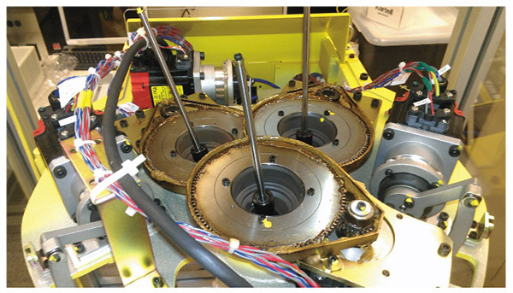
Figure 11-1
The tightening of electrical connections, inspection of gears, and lubrication are all tasks that fall into the PM field

Slide 5
PMs
We schedule PMs based on the previous performance of equipment
  At some point, the equipment runs under normal operating conditions and someone keeps careful records of part failures.
  Each time something breaks, wears out, loosens up, or ceases to function properly, it is recorded somewhere
  Over weeks, months, and years, this creates a pool of data that can be analyzed for trends or patterns of failure

Slide 6
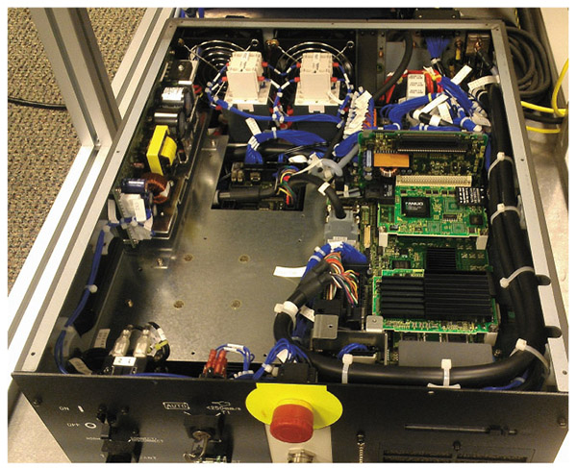
Figure 11-2
Tightening all electrical connections and reseating cards is a common yearly PM

Slide 7
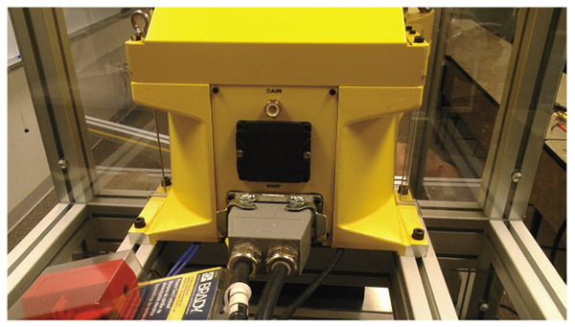
Figure 11-3
The black cover on the back of this FANUC robot holds the backup batteries in place. Failure to replace these as directed is a great way to loose the home position for the robot axes and possibly programs as well.

Slide 8
Hydraulic PMs
Hydraulic systems require:
  Periodic monitoring of the fluid for contaminants
  Periodic (commonly at the one-year mark) replacement of the oil
  Periodic testing of the oil for the proper consistency and chemical makeup
  Checks for leaks
  Filter changes
  Gas charge checks for accumulators, which are devices used to store hydraulic pressure and then release it back into the system as needed

Slide 9
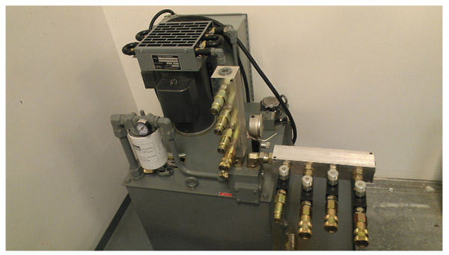
Figure 11-4
Don’t forget to check any cooling systems tied to the hydraulics for accumulated dirt and clean as needed. If there is a fan on the cooling system, make sure it is in good working order.

Slide 10
Pneumatic PMs
Pneumatic (or air) systems have their own checks as well:
  Check for leaks
  Filters
  Damage
  Lubricators that add oil into the compressed air as it passes
  Mufflers for damage or clogs
  Water and dirt fall out of the air in the reservoir tank of a pneumatic system, so they need periodic cleaning and draining

Slide 11
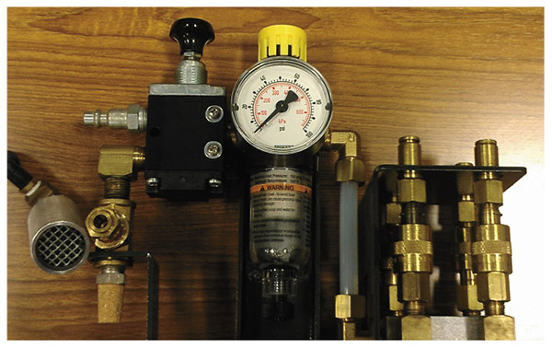
Figure 11-5
During PMs is a good time to double check that all the pressure regulators are set properly and in good working order. If they have manual drains, this is a good time to clean those out as well.

Slide 12
Mechanical PMs
For mechanical systems common PMs include:
  Greasing and lubrication
  Make sure gears are meshing properly
  For belt and chain drives, the PM includes making sure that any stretching is within a given tolerance
  Make sure nothing is rubbing against the metal skin of the robot or contacting things such as electrical wires and fluid power hoses

Slide 13
Arc Flash
Arc flash occurs when a short of some kind in the electrical system ionizes the air and creates an explosion complete with intense heat, shrapnel, and pressure waves
  The heat produced can exceed 35,000°F (19,500°C), which is hot enough to vaporize copper and cause instant second- and third-degree burns
  It can propel shrapnel at a staggering speed of 700 miles (1130 km) per hour or more
  The pressure waves created by an arc blast (i.e., an arc flash explosion) can exceed 2160 ft/lb², which is well over the 1720 ft/lb² threshold at which massive internal injuries and death occur
  It also generates intense, blinding light and sound waves exceeding 140 decibels, enough to rupture unprotected eardrums

Slide 14
Arc Flash cont.
Arc flash in essence is two power leads shorting together, possibly involving the ground as well
  The longer the flow continues, the greater the damage and the chances of an arc blast
Some of the major causes are:
  Tools or conductive parts touching two lines at once
  Closing into faulted lines and loose or damaged connections
  Conductive dusts and other impurities can also create a bridge between power leads
  Door or cover removal/installation
  Switch contact opening/closing
  Person-driven movement including use of test equipment

Slide 15
Arc Flash cont.
If we kill the power, there can be no arc flash
The only justification for live work is life support systems or instances where shutting down the power creates a greater hazard than the risk of arc flash
  Testing for troubleshooting purposes is exempt from this
The NFPA 70E, is the go-to source of information for all things arc flash

Slide 16
Arc Flash PPE
While the specifics depend on the energy level, there is a basic PPE setup that will work for most instances:
  An arc-rated long-sleeve shirt with arc pants or arc-rated coveralls, all at a minimum arc rating of 8 cal/cm²
  Flash arc suit hood or arc-rated face shield and arc-rated balaclava
  Standard PPE including hard hat, electrical gloves, leather protective gloves, leather work boots with safety toe, safety glasses, and ear plugs that go into the ear canal

Slide 17
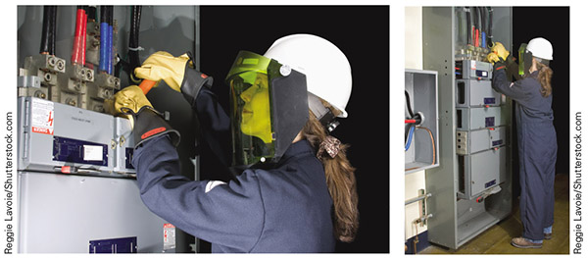
Figure 11-6
You can see the equipment called out in the standard PPE requirements for arc flash in these two pictures

Slide 18
Arc Flash PPE cont.
Some tasks, such as working with the main bus bar or dealing with circuit breakers in a motor control center, will exceed the protective level of the general kit
You should wear the clothing mentioned previously with the following modifications:
  You must wear the arc flash suit hood; then, over the other clothing, you add the arc flash suit, which includes another jacket and pants
  Arc flash suits are rated for specific calorie event levels, with 40 and 80 being common ratings
  Once you have powered down the system, properly verified that no electricity is present in the system, and applied lockout/tagout (LOTO) precautions, you can remove the suit and work as you normally would

Slide 19
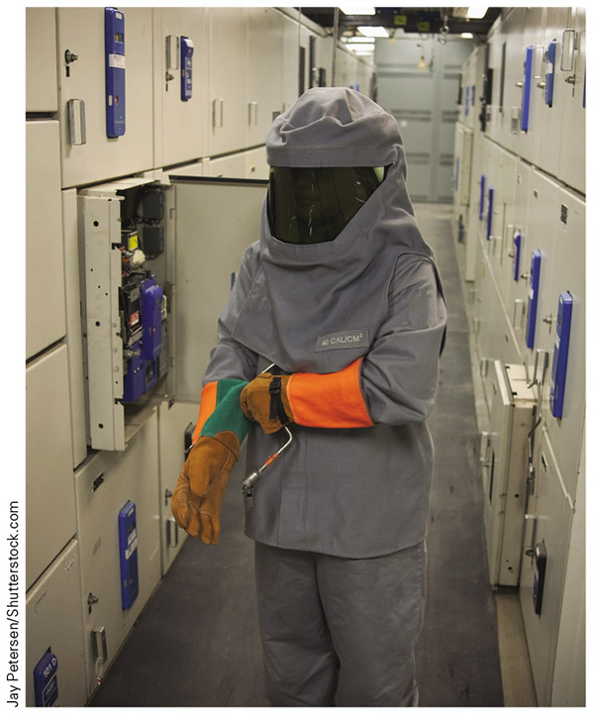
Figure 11-7
Here is an example of the arc flash suit you would need to wear over the other protective gear for working with high energy systems

Slide 20
Troubleshooting
Reactive maintenance mode - we have to figure out what is wrong and do something to get the system back to normal running condition
Troubleshooting - the logical process of determining and correcting faults in a system or process
The basic steps are:
  Analyzing the problem
  Gathering information
  Finding a solution
  Responding to continued problems

Slide 21
Analyzing the Problem
Before we can fix a problem, we have to know what the problem is
We have to figure out what the problem is and gather enough information to make an informed decision
There are several different areas we can draw information from during the process of determining what is wrong with the system in the analyzing phase

Slide 22
Operators
The person or people who were operating the equipment just before the fault often have valuable information
They can tell you valuable information, such as:
  What the machine was doing before the fault
  What they were doing before the fault
  Any abnormal behavior they have noticed prior to the fault

Slide 23
The Equipment/System
See what the equipment or system can tell you
The system may have:
  Lights to indicate what portions of the machine are running or alarmed out
  Display messages and/or information on teach pendants or user screens
  Alarm codes that you can look up in a manual
It is important to get as much of this information as possible before you begin to fix the problem

Slide 24
Personal Observations
Another way we gather information is with our own observations
  The point in the process where the equipment stops can provide information
  Make sure to engage all five of your senses with this portion
  The troubleshooter has to decide which of the clues are relevant and which are circumstantial

Slide 25
Diagnostic Tools
Performing tests using specialized equipment is another way to gather useful information
Track the power - Know which components should have power and verify if they do
  If you are not sure of the level of power, use the highest test setting
  Make sure to pay attention to polarity in DC circuits

Slide 26
Power Failure
Another way we find the root cause of the problem is to track the power and find where it disappears
  To use this method of troubleshooting you have to know how the system works, how the various components work, and understand how they are all interconnected
  This often requires the use of the schematics and wiring diagrams that came with the equipment

Slide 27
Continuity
When we check continuity, we are looking for an unbroken electrical connection between two points
  If there is an unbroken path, we get a resistance reading in ohms telling us how hard it is for electricity to pass between the two points
  Lower value readings indicating an easier path for electricity to pass through
  If there is a broken path or no path for electricity to flow between the two points, the meter should show either infinite resistance or OL

Slide 28
Continuity cont.
When performing continuity checks, the meter uses its internal battery to send a small amount of electricity through the system
Because of this, the tested system must be powered down!
  If you do a continuity check on a system that has power supplied to it, there is a high probability that you will damage the meter, the battery, or both as system power feeds back into the meter

Slide 29
I/O
To determine what the I/O does, you need something that correlates the address in the table to the device it is tied to
If you know the terminal in the controller, you can trace it manually
Once you know what the I/O data represents, you must next understand how the system or program uses the data

Slide 30
Manuals
Manual(s) - the book(s) that come with a piece of equipment or system that gives you more detailed information on how it works
You may find:
  General diagrams of portions of the equipment
  Exploded views of assemblies
  Technical instructions necessary to install or remove sensitive parts of the equipment
  Troubleshooting tests
  Preventative maintenance recommendations
  Other information relevant to the piece of equipment

Slide 31
Technical Support
A wonderful, but often overlooked resource is the manufacturer of the equipment
  A few minutes with the manufacturer’s tech support or a repair technician could save you hours or days of work trying to find the solution
  The downside to manufacturer tech support is that there may be a cost involved
  The best course of action is to call tech support and ask if there is a fee for the service and, if so, if your company has a service agreement

Slide 32
Technical Support cont.
You need to have some key pieces of information ready when contacting tech support:
  Make and model of the equipment
  Serial numbers or build numbers
  Controller types
  User interface type
  Teach pendant type
  Any other specific information you can gather about the equipment before contacting them

Slide 33
Internet Searches
There is a vast wealth of information online that has been posted by companies, professionals, technicians, and others that you can access quickly and easily
  If you do a vague search, your results are likely to be vague as well
  Be as specific as possible
  Do not be afraid to try different searches and search engines

Slide 34
Guidelines for Troubleshooting Failure
Guideline 1: Do not get frustrated
Guideline 2: Reevaluate the information, adding in what you have learned
Guideline 3: Try, try again
Guideline 4: “Once you eliminate the impossible, whatever remains, no matter how improbable, must be the truth” (Doyle 2012).
Guideline 5: Back to the drawing board

Slide 35
Crash Recovery
In the industrial setting, there is a high probability that eventually the robot will make unexpected contact or crash
There are five key steps to follow:
  1. Determine why the robot crashed
  2. Get the robot clear of the crash or impact area
  3. Determine how to prevent another crash
  4. Check the alignment of all equipment involved in the crash
  5. Determine what to do with the parts involved in the crash

Slide 36
Step 1: Determine Why The Robot Crashed
You have to know why the robot crashed to prevent it from happing again
Make sure you gather all the facts you can before moving the robot and losing clues
If you cannot determine the root cause, make sure to keep a record of what happened to help with future troubleshooting

Slide 37
Step 2: Get The Robot Clear Of The Crash
When getting the robot clear, be careful not to cause more damage
This is a good time to use the right hand rule or brake releases on the robot (if present)
In severe cases, you may have to use tools to separate the robot from whatever it hit, change settings in rarely used menus, or even move various motors by hand

Slide 38
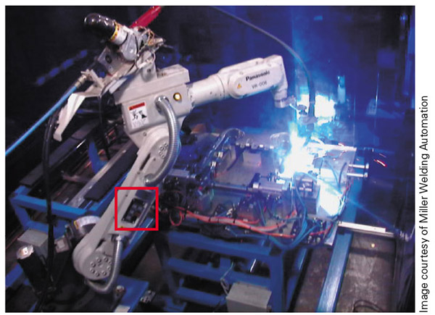
Figure 11-8
The red box highlights the break release on the pictured Panasonic robot. Watch out for falling axes if you use these.

Slide 39
Step 3: Determine How To Prevent Another Crash
This is where we prevent a repeat incident
This may require modification of the robot, program, and/or work envelope
If you could not find a root cause in step one, do the best you can here
No matter what, be cautious when you finally start the robot back up

Slide 40
Step 4: Check The Alignment Of All Equipment Involved in the Crash
Make sure to check the alignment of all tooling and fixtures involved in the crash and correct as needed
If you find the program out of position the next time you try to run it, then most likely something is still misaligned
This step may coincide with the third step

Slide 41
Step 5: Determine What To Do With The Crash Parts
Sometimes we can rework parts involved in a crash, as long as we don’t have to remove them
If the part is beyond salvage, dispose of it properly and notify the proper persons
In many cases a replacement for the scrapped part in needed

Slide 42
When Crash Recovery Is Completed
Starting the robot up for production after a crash is a lot like starting it up for the first time that day
It is best to run through the program once in manual to verify operation
Stay close for the first cycle or two and make sure the robot is running properly
Pay close attention to the robot’s operation, looking for anything abnormal

Slide 43
Repair Tips
Before you remove a part or unwire a system, snap a few pictures
Keep all the parts together
When deciding where to place the parts, be aware of things such as:
  Areas where people are still working
  Any openings that parts could fall into
  Areas where parts could roll under the machine
  Places where the parts might fall on you or others
  Anything else that could cause problems

Slide 44
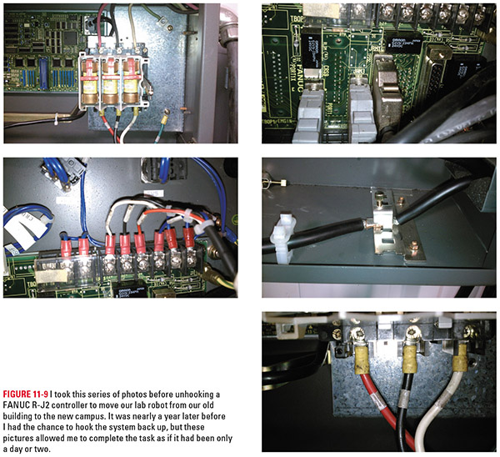
Figure 11-9
This set of pictures was used to rewire a FANUC robot controller a year after it had been removed from service and moved

Slide 45
Repair Tips cont.
Get help before you need it, not after you have created an emergency
When you enlist help, make sure everyone is on the same page
Take good notes
  This information is very beneficial six months or a year later, when you run into a similar problem
  This is one of the main purposes behind the technician’s journal

Slide 46
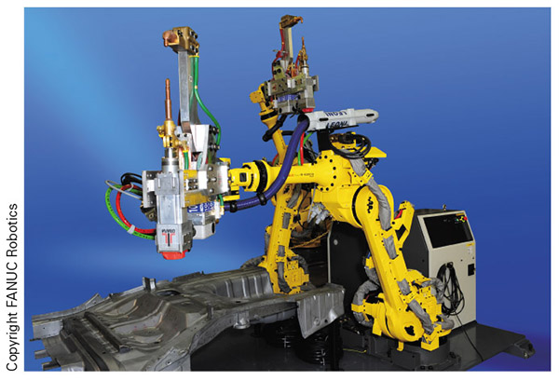
Figure 11-10
Imagine the bad day you would have if you removed the last bolt that holds on this massive tooling and had to deal with the weight and bulk by yourself!

Slide 47
Repair Tips cont.
Break the mold - just because that is the way it has always been done does not mean it is the best way!
Search the Internet for information from reputable sources
When you discover a gem of knowledge, glean a new insight, or create a new process, make sure to record it in your technician’s journal

Slide 48
Parts Swapping vs. Fixing the Problem
To truly fix the robot or other equipment, we have to figure out why it failed in the first place
  Sometimes this is due to the part in question’s failing; in these cases, swap and go is the right path
  For everything else, try to answer the question, “Why did it fail?”
  Failure to do this can result in repeated damage to certain components and a possible cascade effect, where other components and systems are damaged as well

Slide 49
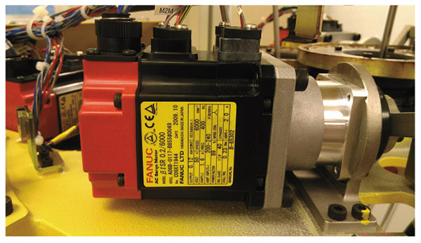
Figure 11-11
Servo motors like this one do wear out, but they are also destroyed by problems with the robotic system. It can be very costly not to find that mistake before it takes out several motors.

Slide 50
Precautions Before Running the Robot
Once repairs are complete, there are a few things you need to do to make sure that everything is ready to go
  Check the system for tools, spare parts, and foreign objects before putting on the covers
  Make sure that everyone is clear and all the covers are in place
  After power up, check for any alarms or unusual action by the system
  Load in the proper program and start the robot back into normal operation
  Spend some time with the equipment after start-up just watching the system

Slide 51
Review
Preventive maintenance. Preventive maintenance includes those tasks we perform to prevent the robot from breaking down and increasing operational time.
Arc flash. This section provided a basic introduction to this dangerous situation and is meant as a primer that encourages you to learn more.
Troubleshooting. You got a look at the basic steps of the troubleshooting process to start your journey into the technical field of your choice.
Crash recovery. This section described a methodical, step-by-step approach to dealing with robot crashes.

Slide 52
Review cont.
Repair tips. I shared some tips and tricks I have picked up over my years working in various maintenance roles.
Part swapping versus fixing the problem. We discussed the difference between changing parts and truly fixing the machine.
Precautions before running the robot. This was about what to do before powering the robot up and immediately thereafter

