Slide 1
Screws and Barrels
Heart of the Molding Process

Slide 2
Agenda
Processing
Screw design variables and types
Screw tip (valve) design variables and types
Component wear
Resin factors

Slide 3
Processing

Slide 4
Shot Capacity Calculation
Shot capacity is the ratio of the barrel capacity divided by the shot capacity with adjustments for material density. For example, you have a machine with a 10 oz barrel. Your shot is 1.25 oz’s of Nylon, what is your shot capacity? Said another way, how much of your barrel are you using?
% Shot Capacity = shot wt. x PS density / PA density / barrel capacity x 100
Runner and parts weigh 3 oz
Barrel capacity is 10 oz
PS (polystyrene) density 1.06
PA (nylon) density is 1.14
% Shot Capacity = (3 x 1.06/1.14) / 10 x 100 = 28%
What if we didn’t use the densities of the material?

Slide 5
Resident Time Calculation
Shot capacity is the ratio of the barrel capacity divided by the shot capacity with adjustments for material density. For example, you have a machine with a 10 oz barrel. Your shot is 1.25 oz’s of Nylon, what is your shot capacity? Said another way, how much of your barrel are you using?
Resident Time (RT) = barrel capacity / shot wt x PS density / PA density x cycle time / 60
Runner and parts weigh 3 oz
Barrel capacity is 10 oz
PS (polystyrene) density 1.06
PA (nylon) density is 1.14
Cycle time is 14 s
RT = 10 / (3 x 1.06 / 1.14) x 14 / 60 = .83 minutes
What if we didn’t use the densities of the material?

Slide 6
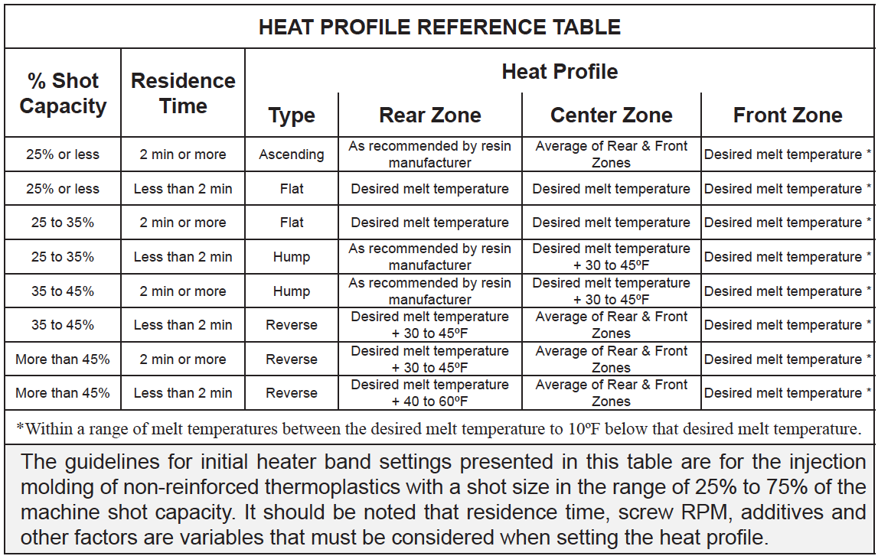
Heat Profile Reference Table

Slide 7
Screw design variables & Types
Screws, Types & Tips

Slide 8
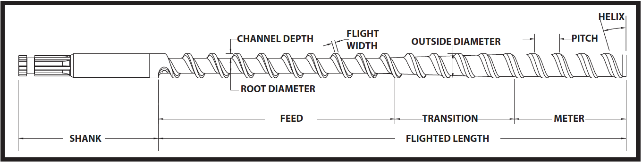
Screw Design Variables
Variables
Length over Depth (L/D)
Screw Profile: 10-5-5 (10 Feed, 5 Transition, 5 Meter)
Channel Depth
Compression Ratio

Slide 9
Screw Design Variables
Length of Depth (L/D)
Ratio of the flighted length of the screw to its outside diameter
Typical L/D is 20:1
Effect: the larger the ratio…
More shear heat can be uniformly generated in the plastic without degradation
Greater the opportunity for mixing, resulting in a better homogeneous melt
Greater the residence time of the plastic in the barrel possibly permitting faster cycles of larger parts

Slide 10
Screw Design Variables
Screw Profile
The length in flights of each of the three sections of the screw. For example, a “10-5-5” screw indicates 10 flights of feed, 5 of transition and 5 of metering.
Effect: the length of each zone has an impact on how a resin reaches “condition”.
Longer feed zone creates a greater potential throughput
Longer transition zone results in less shear heat and more time to compress the resin
Shorter metering zone allows less time to assure an isothermal melt quality

Slide 11
Screw Design Variables
Channel Depths
The channel depth in the metering zone is dependent on the material being processed. The depths in the feed and transition areas are dependent on the compression ratio and screw profile.
Effect: the depth of the channel effects the amount of shear heat and the screw throughput. A shallow channel…
Increases exposure of the material to metal surfaces
Increases shear heat exerted on the material
Reduces potential throughput of material by the screw

Slide 12
Screw Design Variables
Compression Ratio
The ratio of the channel volume in the feed section of the screw to the channel volume of the metering section of the screw. Typical ratios for thermoplastic materials is 1.5:1 to 4.5:1. A 2.5:1 to 3.0:1 is deemed a GP screw. Thermoset materials range from 1.0:1 to 1.3:1 and are mainly meant to convey the material.
Effect: higher compression ratios result in…
Shear heat imparted to the resin
Heat uniformity of the melt
Potential stress in some resins

Slide 13
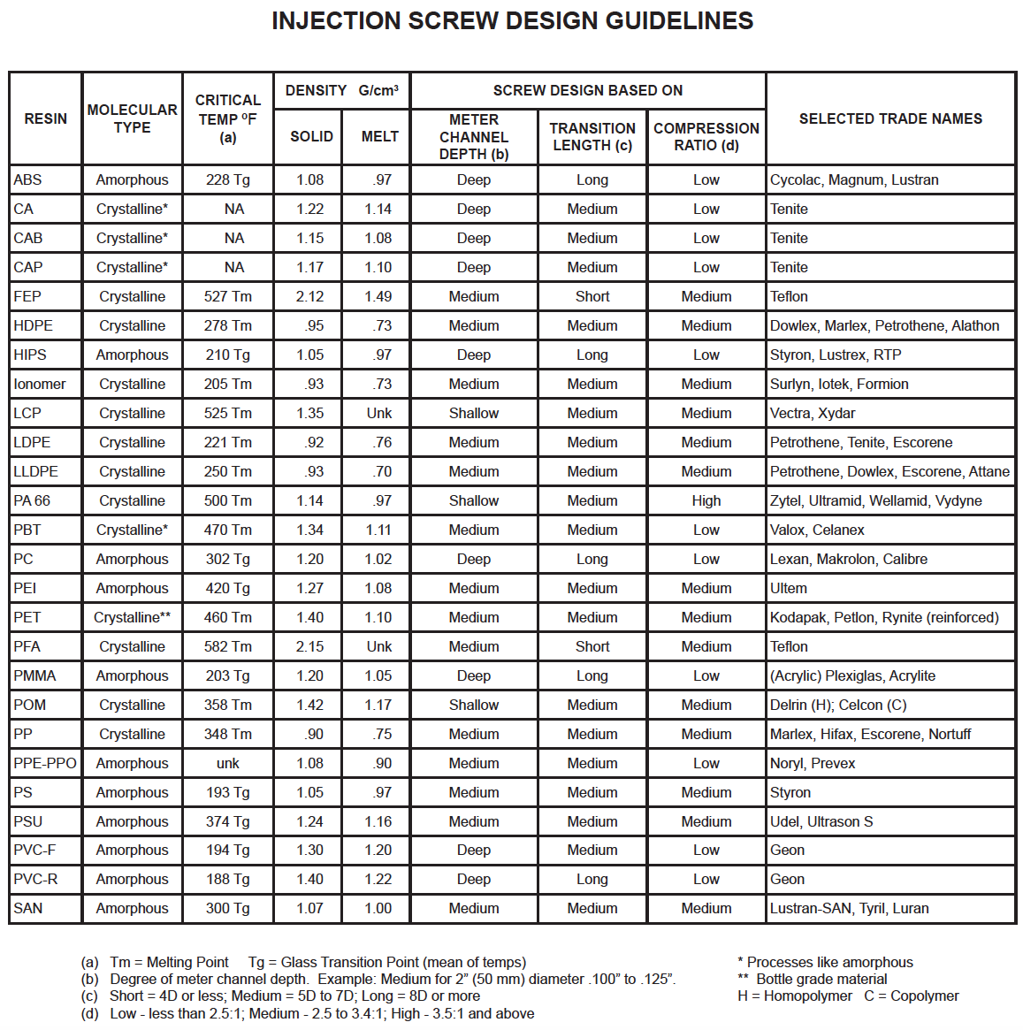
Injection Screw Design Guideline

Slide 14
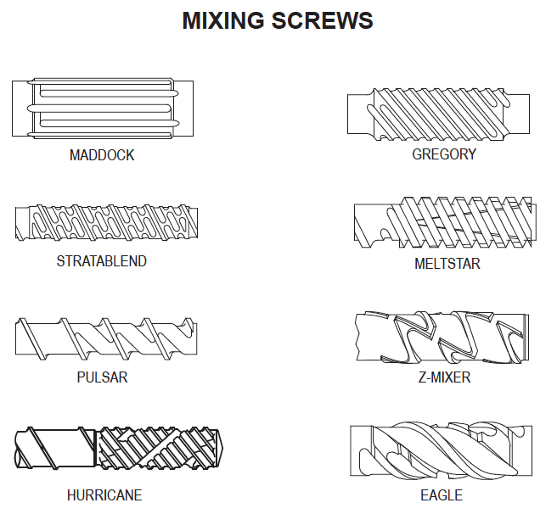
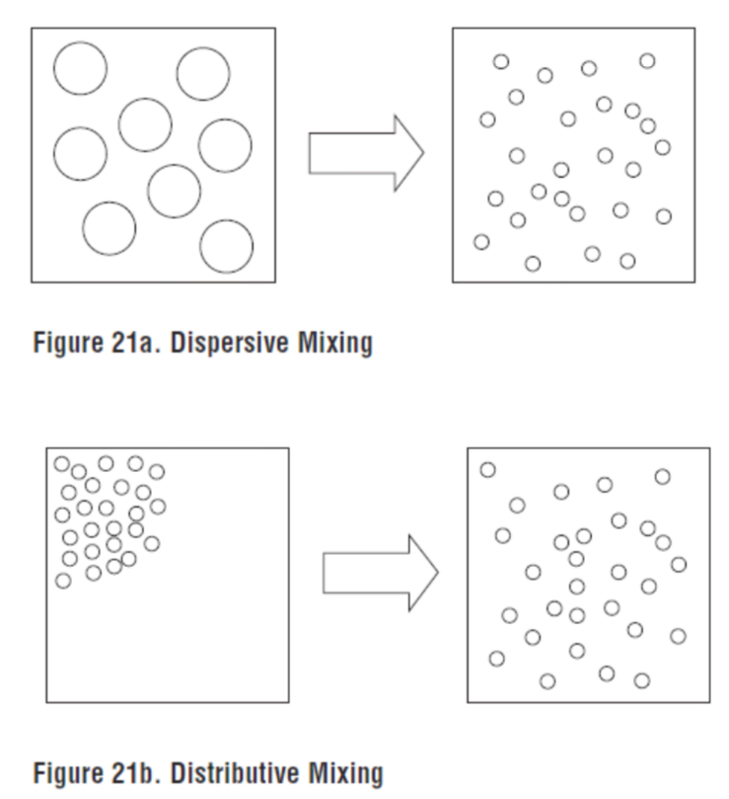
Mixing Screws
Benefits of mixing screws:
Achieve distributive mixing of melt (colorant)
Provide dispersive mixing of melt (glass fibers)
Uniform melt quality

Slide 15
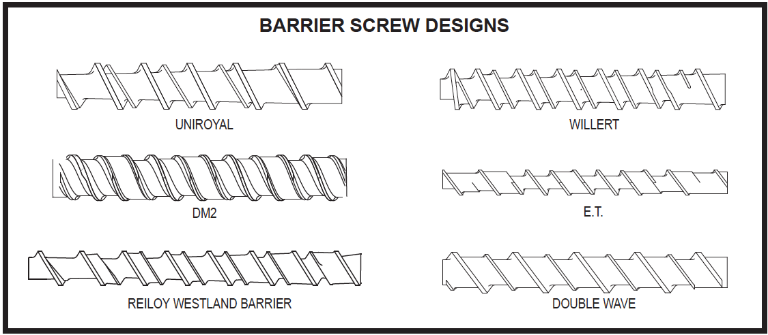
Barrier Screws
Barrier screws provide better control of the melting process. This is accomplished by the solids in the material bed are captured by the barrier flight, in the transition section of the screw, where they are retained until melted at which time the ‘move’ over the barrier into the melt channel.

Slide 16
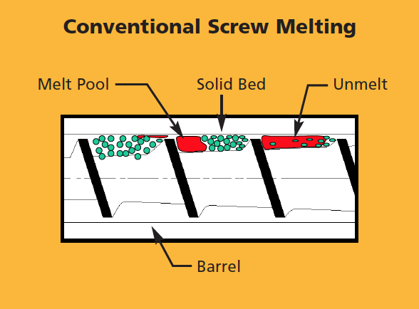
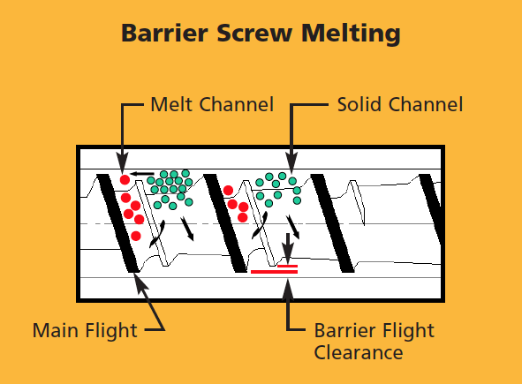
Barrier Screws

Slide 17
Valve design variables & Types
Shut-off and Pass

Slide 18
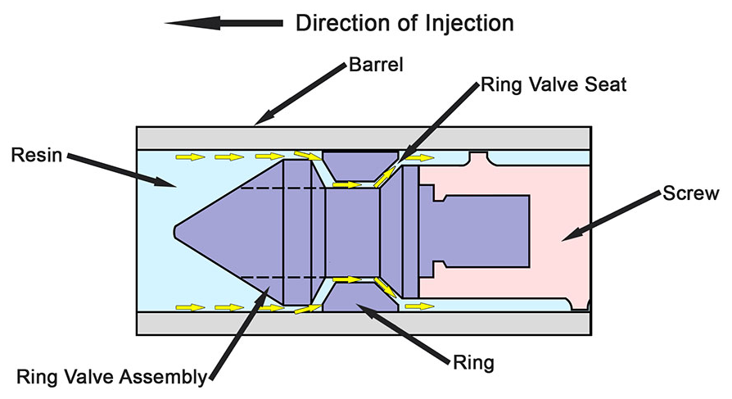
Valve Operation

Slide 19
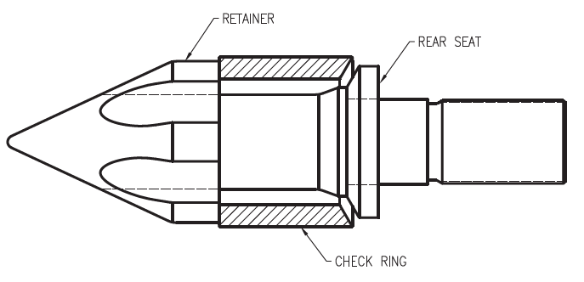
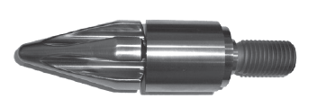
Three Piece Valves
Three Piece Free Flow Valve
Components:
Retainer (screw tip)
Check ring
Rear seat
Pro: Free flow of material, check ring does not rotate with the screw
Con: Entire valve is a wear item

Slide 20
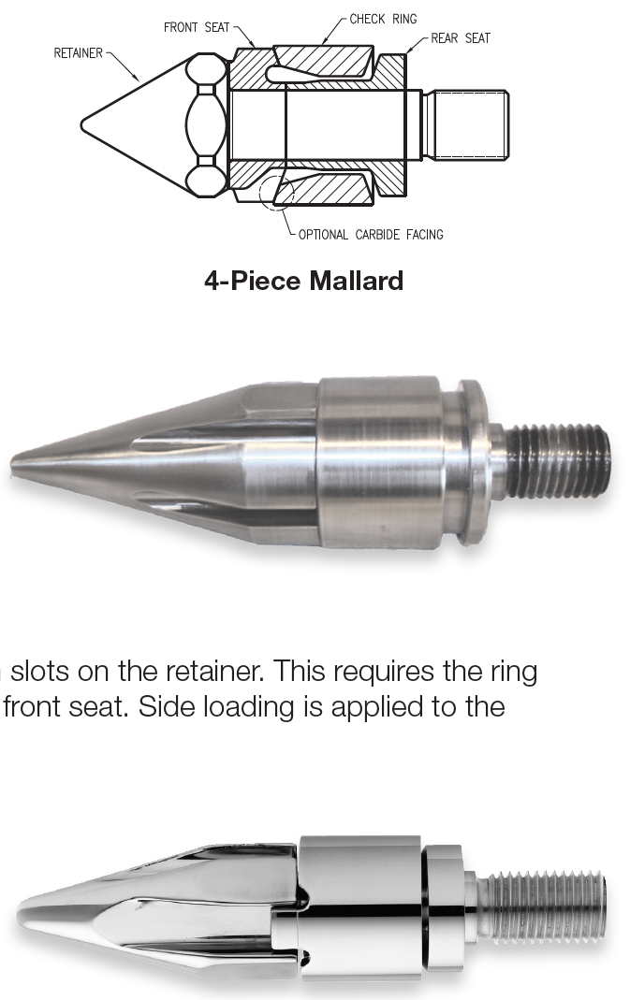
Four Piece Valves
Four Piece Free Flow Valve
Components:
Retainer (screw tip)
Front seat
Check ring
Retainer seat
Pro: Replaceable front seat, check ring does not rotate with the screw
Con: Restricts flow

Slide 21
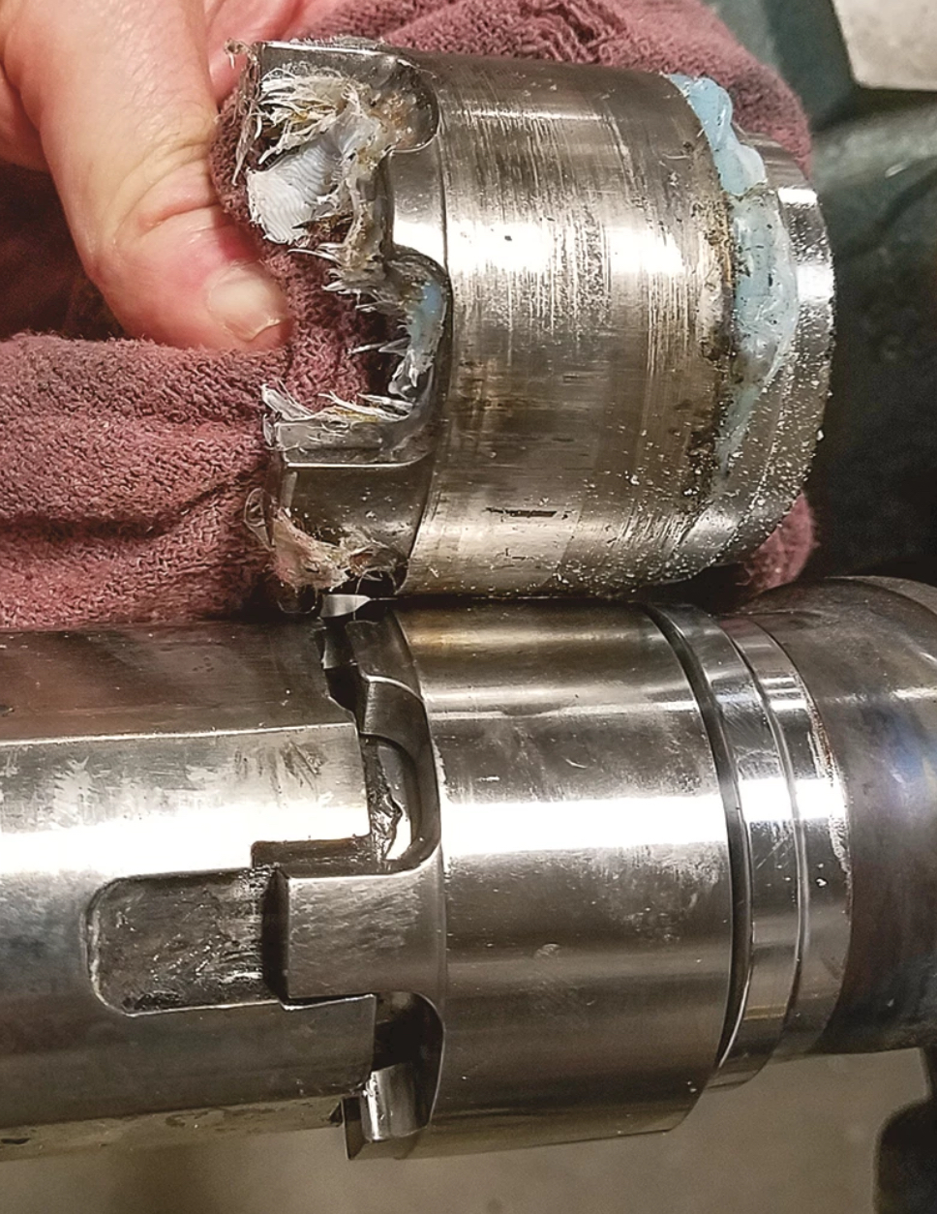
Locking Valves
Locking Flow Valve
Components:
Retainer (screw tip)
Check ring
Retainer seat
Pro: Check ring seal, less leaking of the valve
Con: Check ring rotates with the screw causing barrel wear

Slide 22
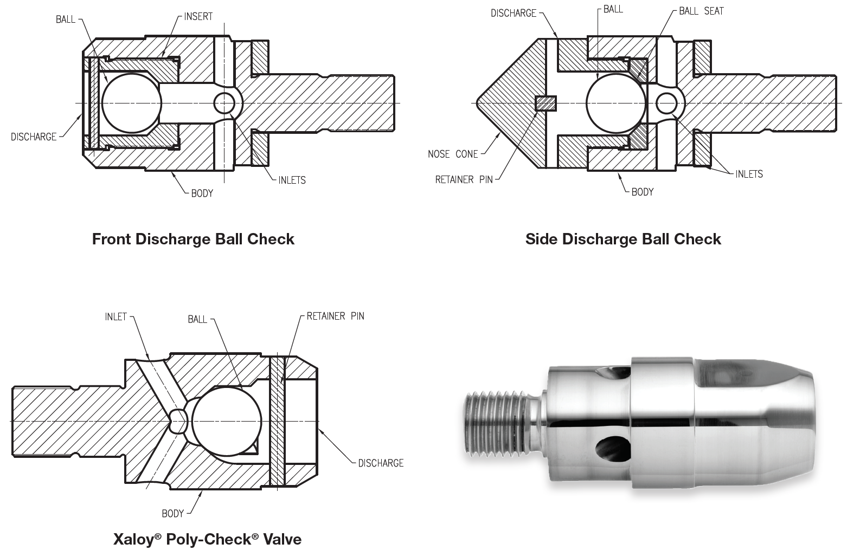
Ball Shut-off Valves
Ball Shut-off Valve
Components:
Valve body
Check ball
Retainer pin
Pro: Good shut-off for use with high flow materials
Con: Contaminates not allowing the ball to seat

Slide 23
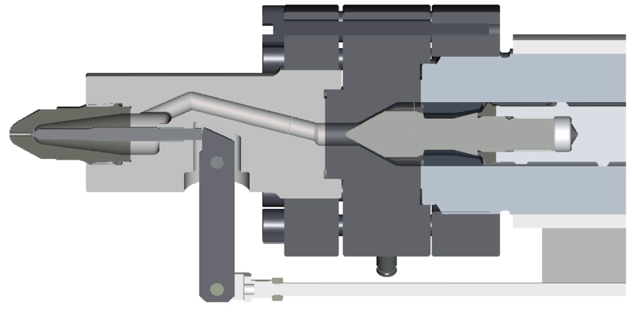
Mechanical Shut-off Valves

Slide 24
Component wear
You Wear on Me

Slide 25
Barrels - Pressure Vessel
A pressure vessel is a “closed” container designed to hold gases or liquids at a pressure substantially higher or lower than the ambient pressure.
What components are required to
pressurize the vessel?

Slide 26
Factors Affecting Component Wear
Screw, barrel and drive alignment
Straightness of screw and barrel
Uniformity of barrel heating
Material fillers
Improper support of the barrel
Corrosion caused by polymer degradation
Corrosion caused by additives
Excessive back pressure
High screw speeds (RPM)

Slide 27
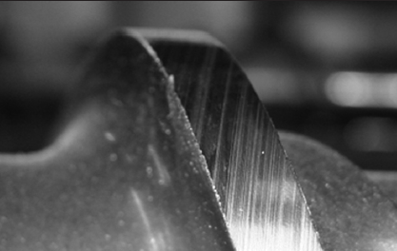
Adhesive Wear
Adhesive occurs when two metals rub together with sufficient force to cause the removal of material from the less wear resistant material.
Causes for Adhesive wear are:
Improper screw design - unmelted pellets causing screw deflection
Wrong materials for the components
Incorrect heat profile causing screw deflection

Slide 28
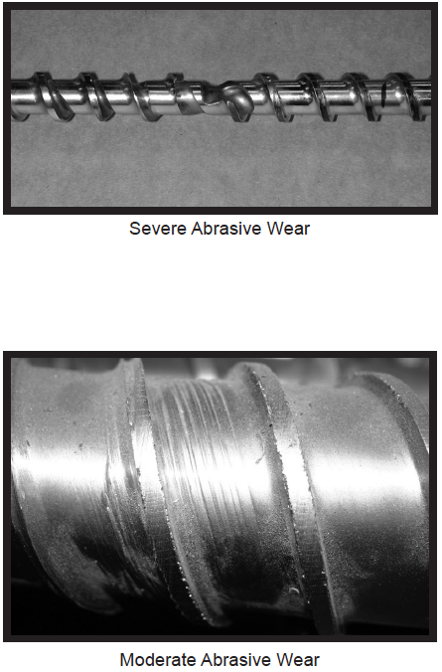
Abrasive Wear
Abrasive wear occurs when a foreign or abrasive particles in the resin come into contact with the screw and barrel that most often occurs in the transition area of the screw.
Causes for Abrasive wear are:
Wrong materials for the components
Incorrect heat profile causing greater shearing in the material
Failure to use hopper magnets
Material fillers such as glass and carbon fillers

Slide 29
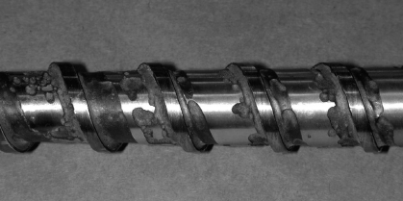
Corrosive Wear
Abrasive wear occurs when a foreign or abrasive particles in the resin come into contact with the screw and barrel that most often occurs in the transition area of the screw.
Causes for Abrasive wear are:
Wrong materials for the components
Incorrect heat profile causing greater shearing in the material
Failure to use hopper magnets
Material fillers such as glass and carbon fillers

Slide 30
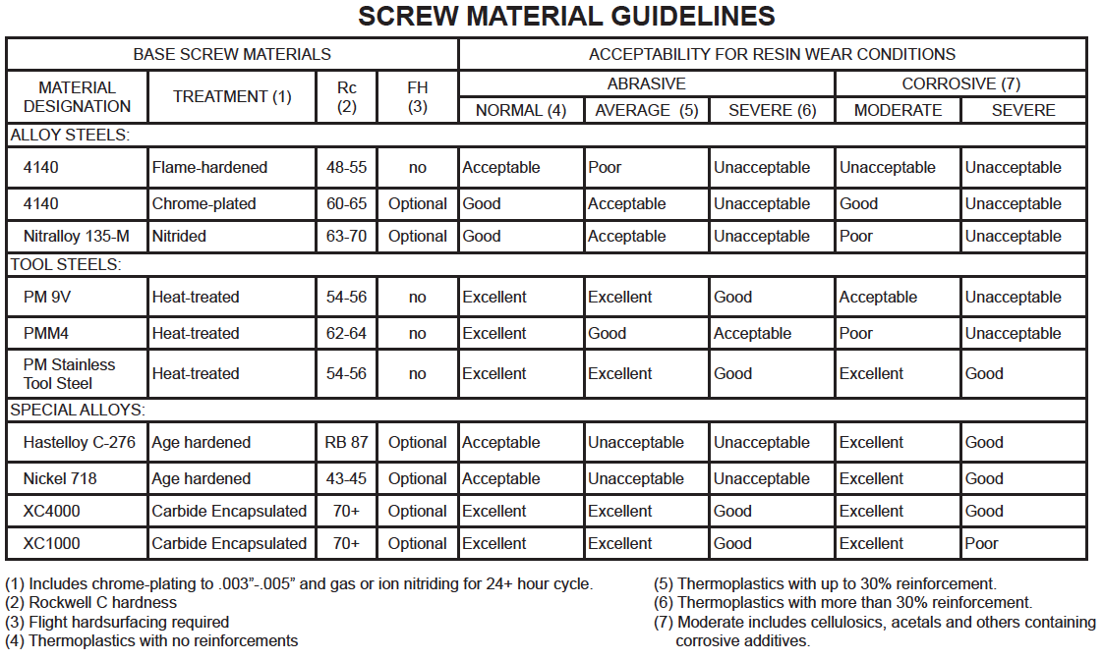
Material Guidelines for Improved Wear

Slide 31
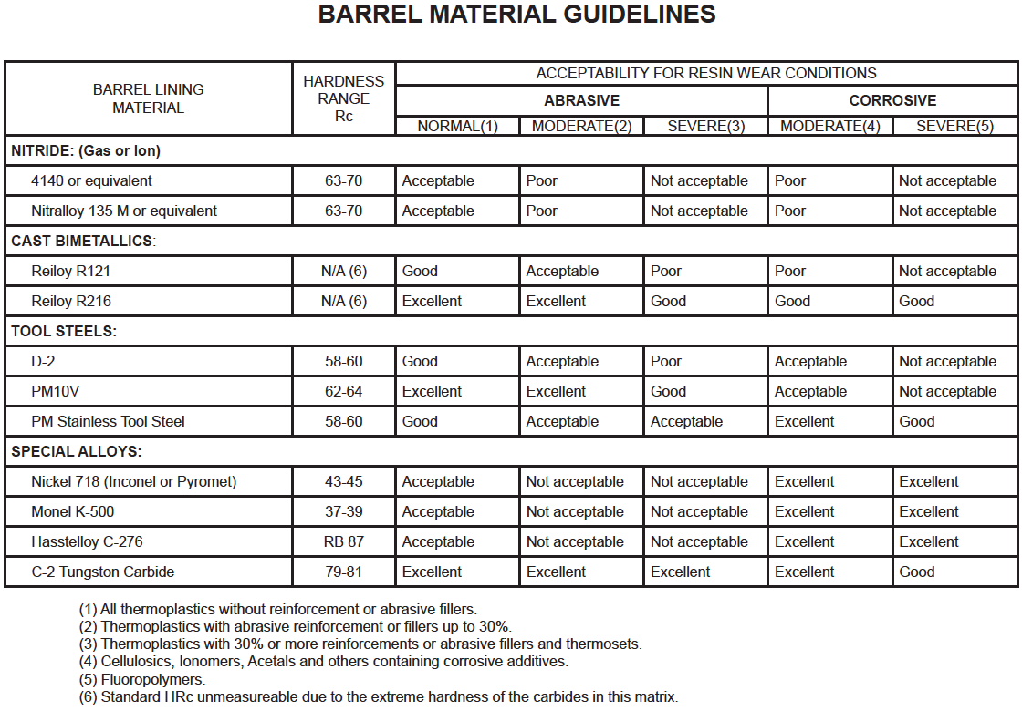
Material Guidelines for Improved Wear

Slide 32
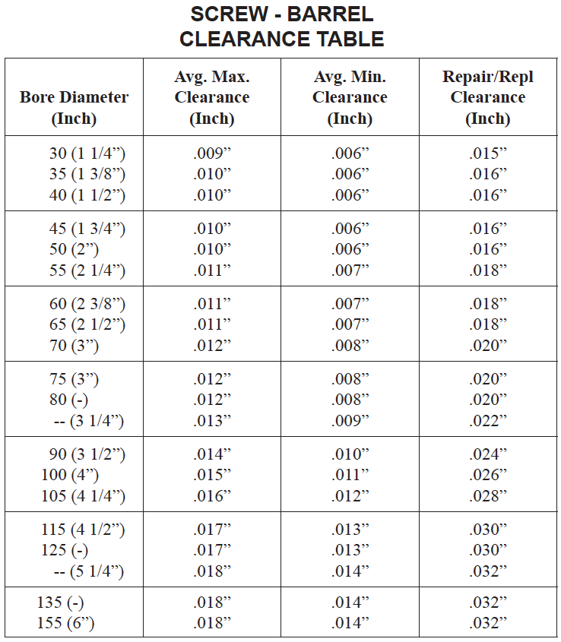
Screw-Barrel Clearance Table
What is shown is total clearance and what we typical state is a “per side” clearance.
“Per side” clearance is calculated by dividing the total clearance in half.
For example, for a 1.5” diameter screw, the max clearance per side is 0.005”

Slide 33
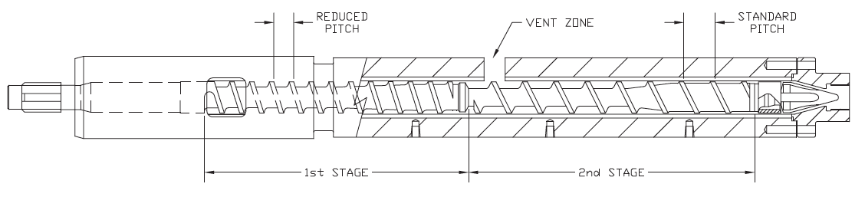
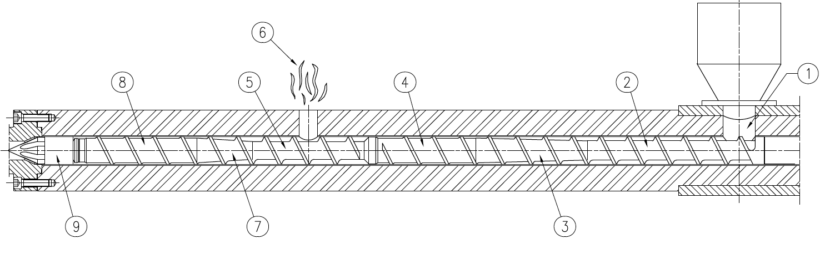
Vented Barrels

