Slide 1

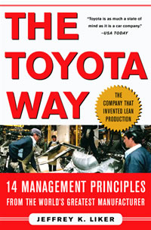
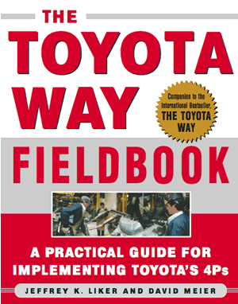
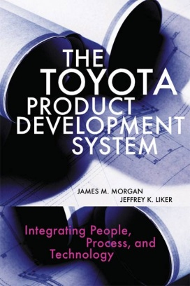
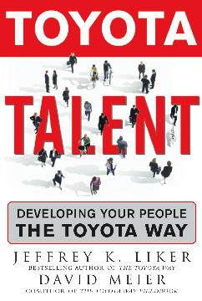
Lessons Learned from the Toyota Way
Presented by:
Jeffrey K. Liker
University of Michigan
Western Massachusetts APICS Keynote

Slide 2
Words of Wisdom
“It is not the strongest nor the most intelligent of the species that survives, but the one that is most adaptable to change”
-Charles Darwin-

Slide 3
“4 P” Model of the Toyota Way
Problem
Solving
(Continuous
Improvement and Learning)
Continual organizational learning through Kaizen
Go see for yourself to thoroughly understand the situation. (Genchi Genbutsu)
Make decisions slowly by consensus, thoroughly considering all options; implement rapidly (Nemawashi)
Grow leaders who live the philosophy
Respect, develop and challenge your people and teams
Respect, challenge, and help your suppliers
People and Partners
(Respect, Challenge and Grow Them)
Adding Value to Customers &
Society
Create process “flow” to surface problems
Level out the workload (Heijunka)
Stop when there is a quality problem (Jidoka)
Use pull systems to avoid overproduction
Standardize tasks for continuous improvement
Use visual control so no problems are hidden
Use only reliable, thoroughly tested technology
Process
(Eliminate Waste)
Philosophy
(Long-term Thinking)
Base management decisions on a long-term philosophy, even at the expense of short-term financial goals

Slide 4
Base management decisions on a long term philosophy, even at the expense of short-term financial goals
1
Toyota mission:
Contribute to the economic growth of the country in which it is located (external stakeholders)
Contribute to the stability and well being of team members and partners (internal stakeholders)
Contribute to the overall growth of Toyota

Slide 5
Principle One
1
“The most important factors for success are patience, a focus on long term rather than short-term results, reinvestment in people, product, and plant, and an unforgiving commitment to quality.”
-Robert B. McCurry,
former Executive V.P., Toyota Motor Sales

Slide 6
“4 P” Model of the Toyota Way
Problem
Solving
(Continuous
Improvement and Learning)
Continual organizational learning through Kaizen
Go see for yourself to thoroughly understand the situation. (Genchi Genbutsu)
Make decisions slowly by consensus, thoroughly considering all options; implement rapidly (Nemawashi)
Eliminate Waste through Flow
& Standardization
Grow leaders who live the philosophy
Respect, develop and challenge your people and teams
Respect, challenge, and help your suppliers
People and Partners
(Respect, Challenge and Grow Them)
Create process “flow” to surface problems
Level out the workload (Heijunka)
Stop when there is a quality problem (Jidoka)
Use pull systems to avoid overproduction
Standardize tasks for continuous improvement
Use visual control so no problems are hidden
Use only reliable, thoroughly tested technology
Process
(Eliminate Waste)
Philosophy
(Long-term Thinking)
Base management decisions on a long-term philosophy, even at the expense of short-term financial goals

Slide 7
Lean Manufacturing
is a manufacturing philosophy which shortens the time between the customer order and the product build / shipment by eliminating sources of waste.
Business as Usual
CUSTOMER
ORDER
Waste
PRODUCT
BUILT & SHIPPED
Time
Lean Manufacturing
CUSTOMER
ORDER
PRODUCT
BUILT & SHIPPED
Waste
Time (Shorter)

Slide 8
Product Lead Time
Value Added Time is only a very small percentage of the Lead time.
Traditional Cost Savings focused on only Value Added Items.
LEAN FOCUSES ON NON-VALUE ADDING ITEMS.

Slide 9
Before Lean: Organization By Machine Type With Convoluted Flow
No Organization and No Control

Slide 10
After Lean: U-Shaped One-Piece Flow Cell
Organization and Control
Build to
Takt Time!

Slide 11
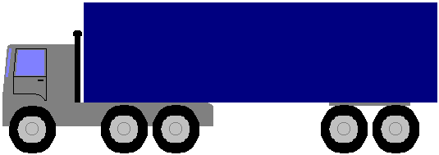

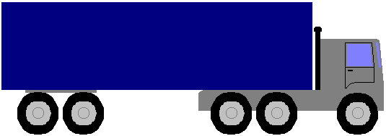
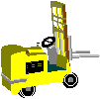
Simplified Pull System
Downstream processes withdraw what they need when they need it.
Empties +
production kanban
Empties + withdrawal
kanban
A
B
C
D
E
F
G
H
PULL
Customer Plant
New product
Needed
Components + kanban
Supplier Plant
Preceding processes replenish what is taken away.

Slide 12
Value Stream Perspective
Get away from isolated perspective / improvements
Process 1
Process 2
Process 3
Kaizen
Kaizen
Kaizen

Slide 13
Why Focus on Flow?
“If some problem occurs in one-piece-flow manufacturing then the whole production line stops. In this sense it is a very bad system of manufacturing. But when production stops everyone is forced to solve the problem immediately. So team members have to think, and through thinking team members grow and become better team members and people.”
-Teruyuki Minoura, former President, Toyota Motor Manufacturing, North America

Slide 14
Lean Tools to Support Flow
5S-Visual Workplace
Total Productive Maintenance
Quick Changeover
Standardized Work
Quality Methods

Slide 15
What is a Visual Workplace?
When anyone can walk into a workplace and visually understand the current situation.
4
Notes:
3
Purpose: Make sure people understand what is meant by a visual factory
Main Points:
Anyone can understand these things, not just someone who has worked in the area for twenty years.
Imagine if you could bring someone in off the street and see if they could understand what is produced, where things belong, what the process is, etc, just by looking around
It is valuable to have an outside person your team to be able to look at things with a critical eye

Slide 16
Describe this area...

Slide 17
Describe this area...

Slide 18
What is TPM?
Total Productive Maintenance (TPM)
is
Productive Maintenance with
EVERYONE’s participation
Maintenance=Teachers, Doctors of Equipment
Operators=Clean, inspect, routine repair

Slide 19
Why Quick Change Over?
Change Over
Difference in average inventory level with more changeovers
Average inventory levels
Inventory level
Time
The more quickly we changeover, the more our inventory levels decrease. This helps accomplish our goal of waste elimination.

Slide 20
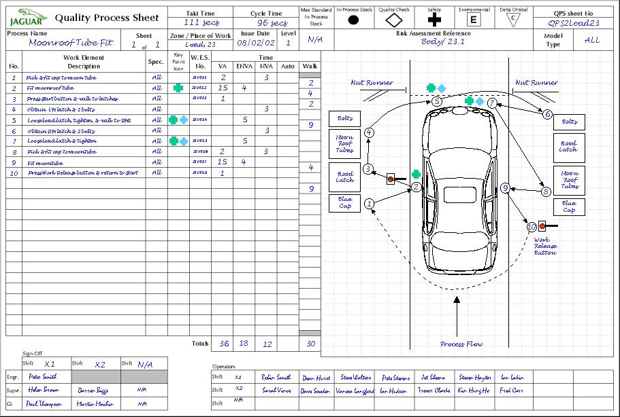
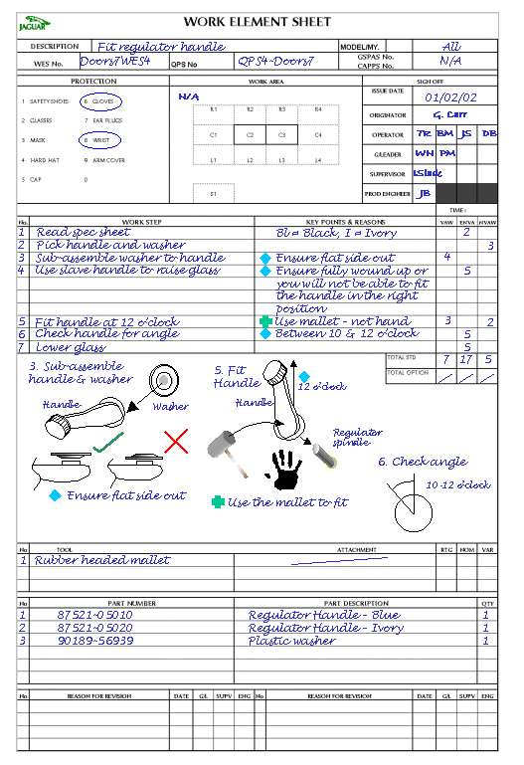
Standard Work Tools
Standardized
Work Chart
Detail of each
Process Step
Takt
90s
1
2
3
4
5
Assembly Process #
Work Element Sheet
Stack Chart
(Yamazumi)
Detail of the Elements
of each Process Step
A Visual Tool for Balancing Processes
Notes:
standardized work chart ties together the Takt time,working sequence and standard in process stock
Standardised work chart provides an”index” for the element sheets.
Yamazumi board provides a visual representation of the way elements can be combined to make a process.
Allows elements to be moved to rebalance to Takt time.

Slide 21
Standardized tasks are the foundation for continuous improvement and employee empowerment
6
“Today’s standardization…is the necessary foundation on which tomorrow’s improvement will be based. If you think of “standardization” as the best you know today, but which is to be improved tomorrow-you get somewhere. But if you think of standards as confining, then progress stops.”
Henry Ford, Today and Tomorrow, 1926

Slide 22
“4 P” Model of the Toyota Way
Problem
Solving
(Continuous
Improvement and Learning)
The heart & soul of
The Toyota Way
Continual organizational learning through Kaizen
Go see for yourself to thoroughly understand the situation. (Genchi Genbutsu)
Make decisions slowly by consensus, thoroughly considering all options; implement rapidly (Nemawashi)
Grow leaders who live the philosophy
Respect, develop and challenge your people and teams
Respect, challenge, and help your suppliers
People and Partners
(Respect, Challenge and Grow Them)
Create process “flow” to surface problems
Level out the workload (Heijunka)
Stop when there is a quality problem (Jidoka)
Use pull systems to avoid overproduction
Standardize tasks for continuous improvement
Use visual control so no problems are hidden
Use only reliable, thoroughly tested technology
Process
(Eliminate Waste)
Philosophy
(Long-term Thinking)
Base management decisions on a long-term philosophy, even at the expense of short-term financial goals

Slide 23
People and Partners
Respect, Challenge, and Grow Them:
9. Grow leaders who thoroughly understand the work, live the philosophy, and teach it to others
10. Develop exceptional people and teams who follow your company’s philosophy
11. Respect your extended network of partners and suppliers by challenging them and helping them improve

Slide 24
One-Piece Flow Demands Team Work!
x
x
x
x
x
Traditional Western Team
x
x
x
x
x
x
x
x
x
x
x
x
Need
help?
Need
help?
Toyota Way Team
X
Workcell

Slide 25
Principle Five: Stop & Fix Problems
“Mr. Ohno used to say that no problem discovered when stopping the line should wait longer than tomorrow morning to be fixed. Because when making a car every minute we know we will have the same problem again tomorrow.”
-Fujio Cho, President, Toyota Motor Corporation

Slide 26
1
2
3
4
5
6
7
8
9
1
0
1
1
1
2
1
3
1
4
S
T
O
P
B
U
T
T
O
N
S
T
O
P
B
U
T
T
O
N
(
S
T
O
P
T
H
E
L
I
N
E
A
U
T
H
O
R
I
T
Y
)
(
S
T
O
P
T
H
E
L
I
N
E
A
U
T
H
O
R
I
T
Y
)
5
4
Abnormality
Station 5
Team Leader

Slide 27
Typical Toyota Organization to support Continuous Improvement
Team Size
Team Member
{ 5 - 8 }
Kaizen
Team Leader
{ 3 - 4 }
Group Leader
{ 5 - 8 }
Asst. Manager
{ 4 - 10 }
Manager
Source: Bill Costantino, former group leader, Toyota, Georgetown.
Notes:
5/13/95 Conversation with Charles Luttrell, Assembly A/M
Charles is A/M for Assembly Trim Area. He has 6 GLs reporting to him.
His largest and smallest groups are shown above.
He said Assembly is shooting for 1 TL for every 4.5 TMs. This goal is based on years of experience as to what is a manageable team size.
Their target for TLs is that they should be on-line 50% of the time. Not up to 50%, but actually on-line 50% of their time.
Chassis Area has 1 A/M with 5 groups.
Final Area A/M has 6 groups.
In addition, each A/M has a functional responsibility for the department; I.e. cost, productivity, quality, etc. They sit on ad hoc committees and perform other activities for the whole shop regarding their functional area.

Slide 28
How Do we Develop People?
Research in occupational training shows that individuals retain about:
10 % of what they read
20 % of what they hear
30% of what they see
50% of what they hear and use
70% of what they say
90% of what they say and do
Notes:
Adult students learn faster by seeing and hearing
than by hearing alone.
Adult students learn even faster when doing is added to seeing and hearing
Adult students tend to remember more of the tasks they do than of the things they are told.
An effective teaching technique for adult learners will:
Stimulate thought
Lead to discussion
Show how to….
Arouse continuing interest in the learners

Slide 29
Job Instruction Training is designed to teach
people how to do a particular job by:
        Hearing (what to do)
        Seeing (how it is done)
        Using (what was learned)
        Saying (what was learned)
        Doing (the task)
        REPEATEDLY !!

Slide 31
Bumper Trimming Job Breakdown Sheet

Slide 32
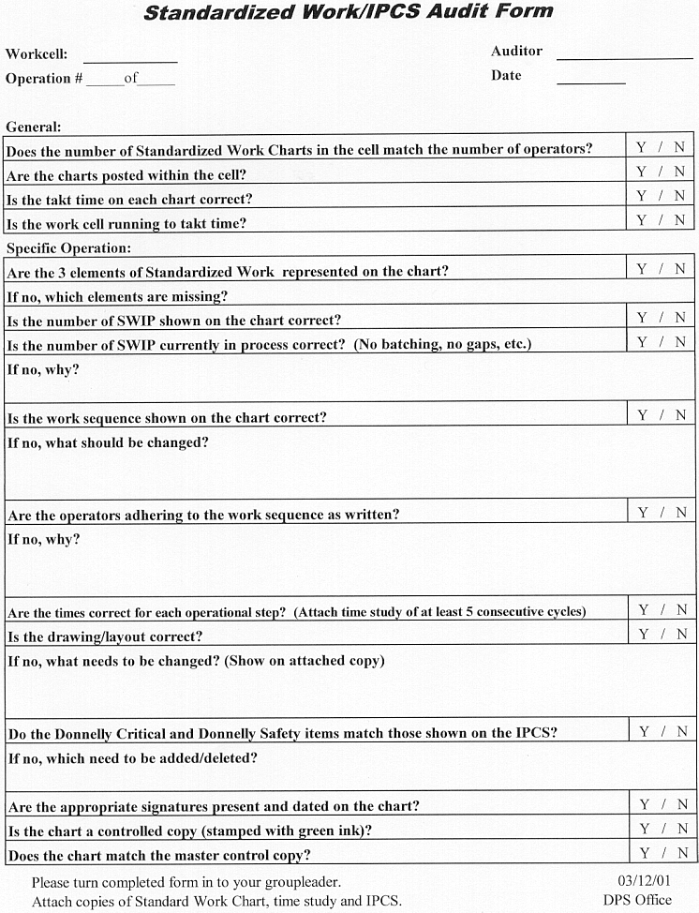
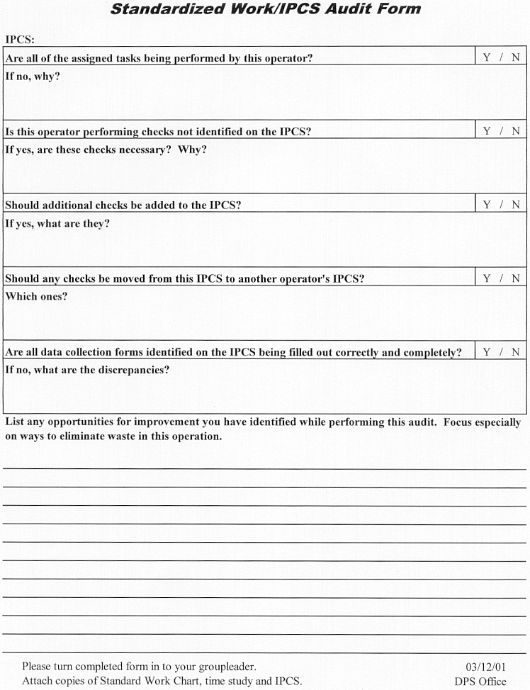
Auditing Standardized Work
Notes:
Standardized Work Audit

Slide 33
Roles and Responsibilities

Slide 34
Toyota Way Principles in 4P Model
The dynamic of
The Toyota Way
Problem
Solving
(Continuous
Improvement and Learning)
Continual organizational learning through Kaizen
Go see for yourself to thoroughly understand the situation. (Genchi Genbutsu)
Make decisions slowly by consensus, thoroughly considering all options; implement rapidly (Nemawashi)
Grow leaders who live the philosophy
Respect, develop and challenge your people and teams
Respect, challenge, and help your suppliers
People and Partners
(Respect, Challenge and Grow Them)
Create process “flow” to surface problems
Level out the workload (Heijunka)
Stop when there is a quality problem (Jidoka)
Use pull systems to avoid overproduction
Standardize tasks for continuous improvement
Use visual control so no problems are hidden
Use only reliable, thoroughly tested technology
Process
(Eliminate Waste)
Philosophy
(Long-term Thinking)
Base management decisions on a long-term philosophy, even at the expense of short-term financial goals

Slide 35
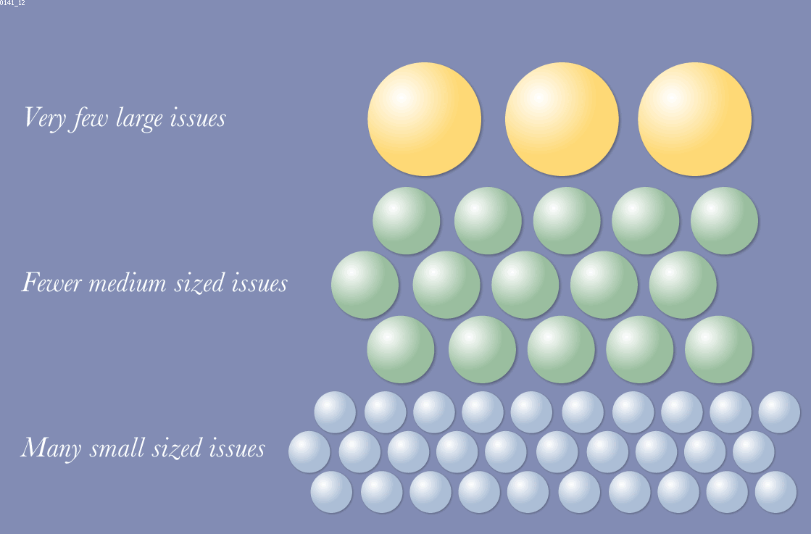
Typical Improvement Opportunities Available

Slide 36
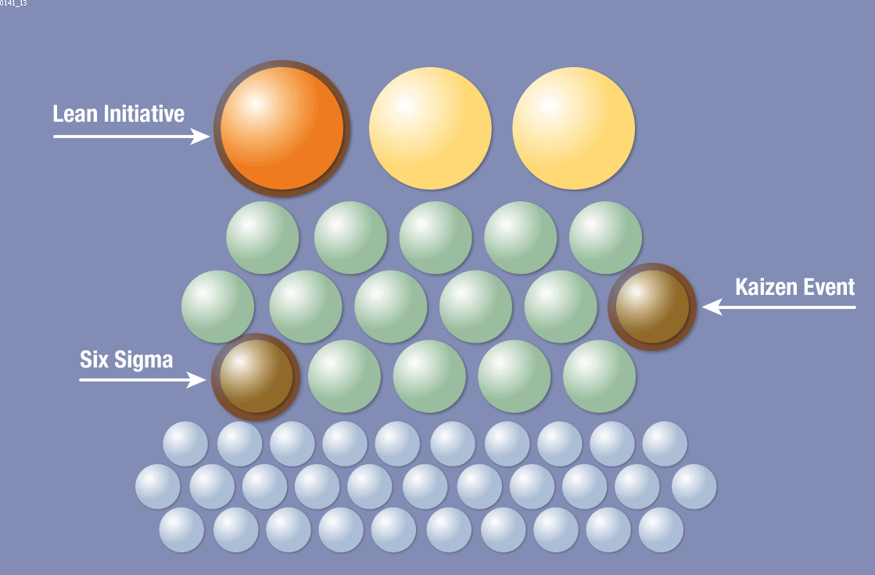
Improvement Approaches of Typical Companies

Slide 37
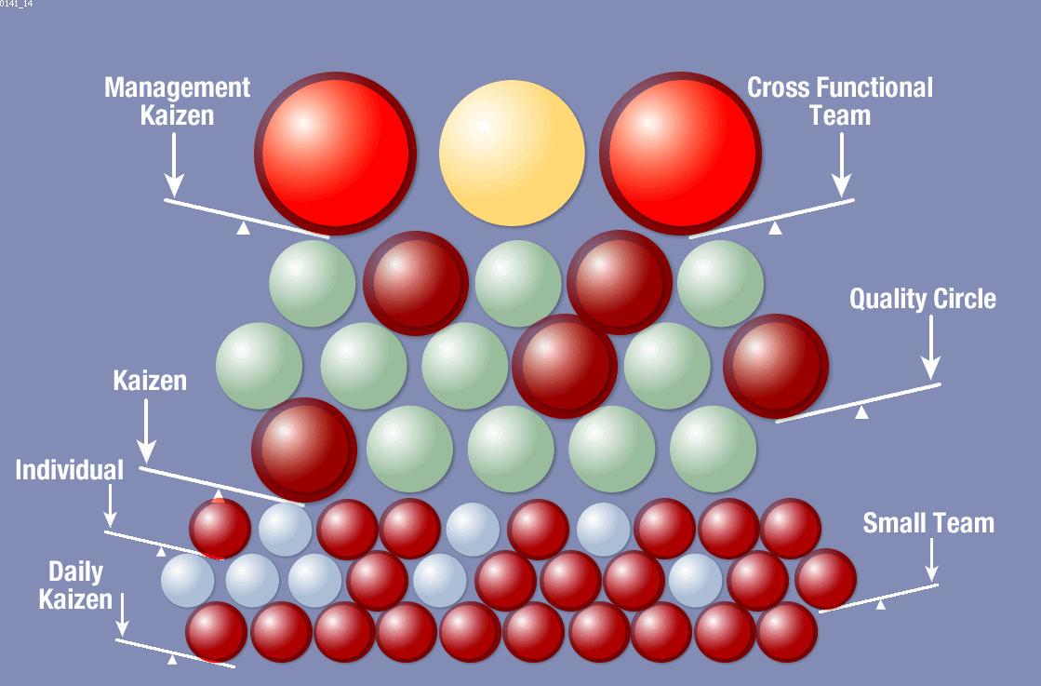
Toyota Leverages Opportunities at all Levels

Slide 38
Most common mistake
Jumping from “problem” to “solution” without clear understanding and analysis
PROBLEM
SOLUTION

Slide 39
Principle Twelve
Genchi Genbutsu
12
“Observe the production floor without preconceptions and with a blank mind. Repeat “why” five times to every matter.”
-Taiichi Ohno

Slide 40

“No Problem” is problem
Problems are opportunities to learn
Hiding problems undermines the system

Slide 41
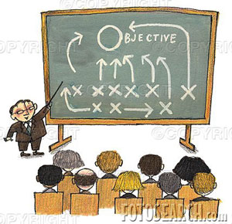

Learning from the Toyota Way

Slide 42
Characteristics of Effective Lean Transformation
Top Down Directive that this is the new way.
Bottom-up involvement in concrete projects with clear results.
Develop internal experts through learning by doing.
Expert sensei to guide the process and teach.
Learning philosophy: every project, activity, is a chance to learn.
Start with value stream transformation projects.
Build on successes to transform broader organization and culture over time---YEARS!

Slide 43
Why is this hard to do?
Traditional organizations in fire fighting mode
No clear vision of the future state
culture change is hard
Organizational change is disruptive
Management has to change its role from managing from the office to deeply understanding processes!

Slide 44
Lean is…
“A long journey that needs commitment, patience, long-term thinking, positive mindset and attitude, and continuous improvement which are merged together as operational excellence and as a strategic weapon.”
Let’s start the journey and Do our Best!

