Slide 1
Kaizen
Strive for Perfection

Slide 2
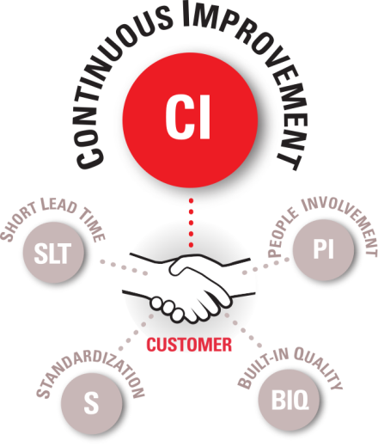
KAIZEN: Strive for Perfection

Slide 3
PDCA Roadmap
PLAN
CHECK
Analyze the Situation
A3 Management
Customer CTQs
Data Collection
MSA
Run Charts
Box Plots
Scatter Diagrams
Normality Testing
Process Capability
Graphical Analysis
7 Waste
SIPOC
Process Mapping
FMEA
Cause & Effect Diagram
5WHY
Select Team
OpEx Leadership
Team Empowerment
Facilitative Leadership
Stakeholder Analysis
Change Management
Evaluate
Graphical Analysis
Control Chart
Targets
Baseline Data
DO
Countermeasures
Kaizen/ Trystorming
Workplace Organization
Standard Work
Visual Mgmt
Poka Yoke
Select Countermeasures
Implementing Solutions
Implement Flow & Pull
ACT
Institutionalize
Standard Work
Control Plan
Change Management

Slide 4
Learning Objectives
Upon completion of this module you will be able to:
Define Kaizen
Demonstrate the phases of Kaizen Event
  Planning
  Execution
  Close (Follow-up)
Explain Kaizen success guidelines
Recognize barriers to event success

Slide 5

What is Kaizen?
Kai – result or change
Zen – good or goodness
Teams focused on a topic for multiple days (typically 3-5 days depending on scope)
Teams are cross-functional from many parts of the business
Major team roles are team member, team leader, facilitator, participant
Focused on improving a process where the process happens (gemba kaizen)
Document
Reality
Do It
Again
Celebrate
Make this
the Standard
Identify
Waste
A New Way Of Life
Measure
Results
Plan
Countermeasures
Reality
Check
Make Changes
Verify Change

Slide 6
Phases of a Kaizen Event
Planning
3 weeks prior to event
Define & Measure
Event
2 - 5 days
Measure, Analyze, Improve, & Control
3 weeks after as needed
Follow-up
Control

Slide 7
Kaizen Compass
Planning
Event
Follow-up
3 Weeks | Day 1 | Day 2 | Day 3 | Day 4 | Day 5 | 3 weeks
Initiation (Plan) | Analysis & Observation (Plan & Do) | Operation Review & Execution (Do) | Execution (Do) & Implementation | Implementation & Control (Check) | Operation Review | Execute (Do) Control (Check) Standards (Act)
Steps 1-5 | Steps 6 | Step 7 | Step 8 | Step 9 | Step 10 | Step 11-12
Form Kaizen Team Identify Problems @ worksite (waste, customer complaints, difficult tasks, etc) Set Theme for Improvement Set Targets (May wait until after step 6) Establish project timeline/schedule Create Current State VSM | Identify current operations Validate Current State VSM VA/NVA Decomp. Load Charts Floor Space Spaghetti Diagram Standard Work 6S Audit SIPOC Process Map etc… | Analyze Underlying factors Revaluate improvement theme Reevaluate Targets C&E Diagrams 5 WHY Develop Countermeasures | Develop countermeasures and implementation plan Test countermeasures Provide change details (documentation or workflows) Assign Responsibility Implement countermeasures Visual Management | Implement countermeasures cont. Standardize new procedures/process Review and future planning Identify remaining problem Document open issues and to-do items (Kaizen Newspaper) Enable process owner to continue kaizen action Dashboards | Summary Items: Reasons for choosing theme Targets established Project timeline Initial investigation results Analysis of underlying factors. List of countermeasures proposed Testing and implementation results Follow-up and future planning Lessons learned | Monitor visual controls/dashboards to ensure control Address issues as they occur (that day) Schedule walkthroughs with process owner Continue work on to-do list (Kaizen Newspaper) DO NOT BACK OFF! Complete final A3 summary

Slide 8
Kaizen Planning
3-4 weeks prior
3 weeks
2 weeks
1 week
1 day

Slide 9
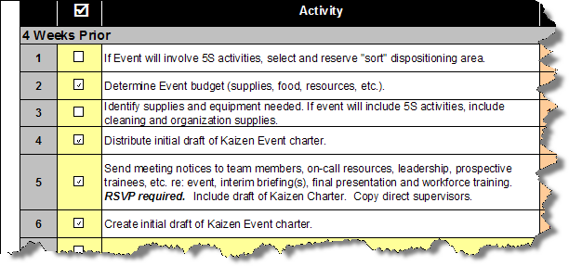
3-4 Weeks Prior

Slide 10
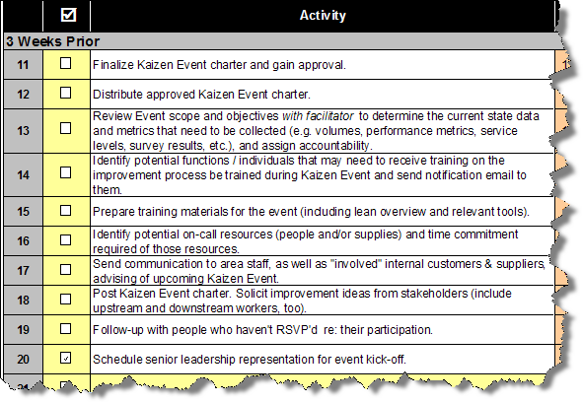
3 Weeks Prior

Slide 11
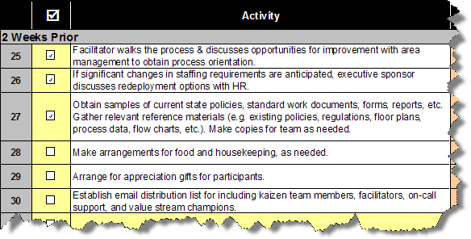
2 Weeks Prior

Slide 12
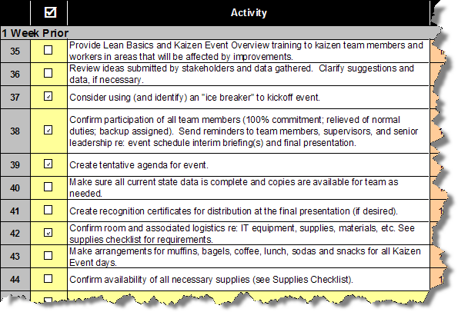
1 Week Prior

Slide 13
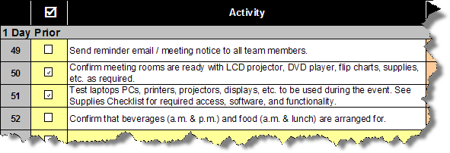
1 Day Prior

Slide 14
Event Leaders’ Roles & Responsibilities
Executive Sponsor
Provide support throughout the process
Address high-level policy, regulatory or financial issues
Assist the Champion and Facilitator in removing obstacles to the team’s success
Hold the Champion accountable for measurable improvement of the target process
Share results with Sr. Leadership team and relevant external shareholders.

Slide 15
Event Leaders’ Roles & Responsibilities
Champion / Process Owner
Assist with event planning
Provide support throughout the process
May or may not be on the team
Hold team accountable for results and follow-up activities (Kaizen Newspaper)
Assist with establishing event scope, objectives, and boundaries, team formation, planning checklist items

Slide 16
Event Leaders’ Roles & Responsibilities
Facilitator
Internal
Lead the entire Kaizen Event process
Lead planning activities, create and approve the event RA3
External
Provide assistance to internal staff with planning and follow-up, lead the Kaizen Event itself.
Provide guidance with planning activities, create and approve the event RA3
Ensure checklist task are being completed on time, approve RA3

Slide 17
Event Leaders’ Roles & Responsibilities
Facilitator (internal or external)
Establish daily agenda
Assign tasks
Assist team with applying lean six sigma principles and tools
Monitor progress
Meditate disagreements
Prepare team for interim briefings and final presentation
Seek assistance from Team Leader and Champion as needed
Distribute Kaizen Newspaper
Lead post event team meetings
Lead (or delegate) 30 day audits
Ensure sustainability plan is completed and distributed
Ensure the Champion is transitioning responsibility for managing and monitoring the improved process to area managers/personnel

Slide 18
Event Leaders’ Roles & Responsibilities
Team Leader
Assist facilitator during the event as needed
Assist with planning if requested by Champion
Assist facilitator when processes are unclear
Access the Champion for assistance if facilitator is focused on another activity
Serve as tie breaker when differences of opinion arise regarding current state
Attend follow-up meetings

Slide 19
Event Scoping
1. Value Stream
2. Event Name
3. Specific conditions
4. Process trigger
5. First step
6. Last step
7.Event Boundaries & Limitations
Specify the value stream the team will be focused on improving
Should be referred to by a name that’s easily recognized.
Essential scope narrowing information, what service function ex: one geographic location, one customer group, etc.
The activity that triggers the action in the first step to occur. How do the people who perform the first step know to begin work?
This is the first activity within the range of the process steps the Kaizen Team will focus on.
This is the final activity within the range of the process steps the Kaizen Team will focus on.
Any process elements the team in not authorized to alter.

Slide 20
Kaizen Team Formation
Minimal leadership/ management representation
5 – 6 people ideal team size
Cross-functional composition
Process Stakeholders
Subject Matter Experts
Outside Eyes
Union Representatives (if required)

Slide 21
Stakeholder Analysis
Stakeholder - Someone affected by the project or may be needed in the future to implement eventual solutions.
O = Current Level of Support X = Desired Level of Support
Are Your Stakeholders Supportive Of Your Project?

Slide 22
Stakeholder Analysis
Terrorist
Yeah, But
Lets it Happen
Helps it happen
Makes it happen
Are your Stakeholders Supportive of your Project?

Slide 23
Response to Relinquishing Workers

Slide 24
Kaizen Logistics
Location of Kaizen Event
Start and End Times
Will you provide food?
Kaizen Event Supplies Checklist
Team recognition
Breakout room/space
Interim briefings – Team Leader meetings
Workforce training
Final Report out

Slide 25
Communication
Pre-Event
Explain how the activity is relevant to today’s business needs
Form the strongest Kaizen Team possible
“Legitimize” the team, and demonstrate that team members have leadership’s full support and have been granted the authority to make change
Set the stage so the team can start quickly and maintain momentum throughout the Event with no delays.
Assure the correct people attend key activities that occur during the Event.
Minimize rumors and reduce anxiety.

Slide 26
Process Performance Data
Final Preparation
Customer demand – current volume
Order frequency
Current performance
Market Expectations
Staffing
Customer and workforce satisfaction

Slide 27
Additional Relevant Information
Final Preparation
Written policies and procedures
Process tracking tools
Current job aids, work tools, flowcharts, etc.
Relevant regulations, accreditation standards or audit reqs
Organization charts
Drawings of work space
Performance reports
Competitive analysis, market trends, benchmark reports

Slide 28
Kaizen Execution

Slide 29
PDCA Role in Kaizen Event Project & Event

Slide 30
5 Day Event
Day 1
Kick off meeting (Process Owner)
Document Reality/Identify Waste
Day 2
Kick off meeting
Document Reality
Day 3
Kick off meeting
Day 4
Kick off meeting
Verify Change and Measure Results
Day 5
Final Report Out
Celebrate!
Plan Countermeasures
Closing Meeting (15 minutes)
Complete Counter Measures
Develop Implementation Plan
Kick off meeting
Reality Check
Begin Implementation
Closing Meeting (15 minutes)
Standardize the New Process
Complete Implementation
Closing Meeting (15 minutes)
Try-storm

Slide 31
Kaizen Day 1
Kick off meeting (Process Owner)
  Review goals and objectives
  Review Scope and Boundaries
  Review Kaizen Plan
  Review Task List
Document Reality/Identify Waste
  Observe the process
  VA/ NVA Analysis
  7 Deadly Wastes
  Establish Takt Time
  6S Audit
  Before Kaizen Data into Results Tracking Sheet
Closing Meeting (15 minutes)
  Review progress with sponsor/ leadership
  Review Day 2 Plan

Slide 32
Kaizen Day 2
Kick off meeting
  Review Goals and Objectives
  Review Task List
  Day by Hour Plan
Document Reality
  Spaghetti diagram
  Time observation
  Standard Work Combination Sheet
  Operator Load Chart/ TT-CT Bar Chart
  Combine and eliminate tasks

Slide 33
Kaizen Day 2
Plan Countermeasures
  Focus on what can be completed during the event
  Validate demand (Takt times)
  Level the work
    Determine manpower requirements (ΣCycle Time/Takt Time)
    Determine process capacity (Longest Cycle Time/ Available Time)
  Eliminate excess inventory
    Minimize WIP
    Determine Standard WIP
  Optimize process, material and information flow
  Create pull
  Create To/ Do List (What, Who and When)
Try Storm
Closing Meeting (15 minutes)
  Review progress with sponsor/ leadership
  Review Day 3 Plan

Slide 34
Kaizen Day 3
Kick off meeting
  Review Goals and Objectives
  Review Task List
  Day by Hour Plan
Complete Counter Measures
  Determine Standards
  Determine Visual Controls
Develop Implementation Plan
  What, Who and When
  Day by Hour Planning

Slide 35
Kaizen Day 3
Reality Check
  Validate Counter Measures/ Implementation Plan
    Mentor & Process Owner
    Trial Runs and Adjustments
  Course corrections are ok
Begin Implementation
  Bias for action
  Implement countermeasures
  Periodic process checks
Closing Meeting (15 minutes)
  Review progress with sponsor/ leadership
  Review Day 3 Plan

Slide 36
Kaizen Day 4
Kick off meeting
  Review Goals and Objectives
  Review Task List
  Day by Hour Plan
Complete Implementation
Verify Change and Measure Results
  Observe New Process to Validate Improvements
  Make Final Adjustments
  Document Quantifiable Improvements
  Did We Achieve Kaizen Goals and Objectives?

Slide 37
Kaizen Day 4
Standardize and Control
  Visual Controls/ Dashboards to Sustain the Gains
  Standardize the New Process
    Communicate
    Train
  Kaizen Newspaper
    Problem, Action, Person Responsible, Due Date
    Make It Visible
Closing Meeting (15 minutes)
  Review progress with sponsor/ leadership
  Review Day 4 Plan

Slide 38
Kaizen Day 5
Final Report Out
  Everyone Presents
  Introduce Team
  Review Goals and Objectives
  Review Current State
  Themes for Improvement/ Journey to Future State
  Review Future State
  Quantitative Improvements
  Kaizen News Paper
  Q&A
Celebrate!

Slide 39
Kaizen Close & Follow-up
First Week After Event
Ensure completion of documentation for standard work
Ensure Visual Control Boards, SWIP, 6S, etc. are in place
Eliminate any problems each day
Schedule walkthroughs multiple times each day with the Process Owner
Kaizen Newspaper - Work on to-do list
DO NOT BACK OFF!
Second Week After Event
Confirm standard work is posted
Continue reviews with Process Owner, Management
Continue to eliminate problems and improve work area
Kaizen Newspaper - Work on to-do list
Sustain-DO NOT BACK OFF!
Third Week After Event
Process Owner reviews process control boards, SWIP, 6S, etc.
Schedule reviews with management at defined frequencies and ensure controls are in place to sustain improvements

Slide 40
Guidelines for a Successful Kaizen Event
  Set goals and objectives
  Plan the event – preparation is essential
  Set a daily plan – work the plan
  100% commitment to the event
    No cell phones, pages, laptops, daily work
    Plan for your absence from your daily job
  No part-time participation - Either you are in or you are out
  No observers – you learn by doing
  Keep the team focused and together
  Be on time and available
  Honor your commitment to the team improvement process

Slide 41
Barriers to Event Success
Team not supported by management (no effective, involved sponsorship)
Event scope too large, confusing
Event objectives not significant or conflict with others
No clear measure of results
Team too large (ideal: 5-8)
Event not aligned with priorities of the business
Team not trained
Data not readily available
Event not using Lean Six Sigma methodology

Slide 42

Standard Kaizen Tools
Use in every workshop!
Tool | This tool will help you
A3 | Drives problem-solvers to address the root causes of problems which surface in day-to-day work routines.
7 Waste | Identify processes steps that do not add value to the final output.
SIPOC | Identify all relevant elements of a process improvement project before work begins
Process Map | Differentiate between the activities in a process
Cause & Effect (fishbone) | Identify a set of related causes that lead to an effect/problem
5-Why Diagram | Drive toward root causation
Brainstorming | Collect a large number of ideas from SMEs
Visual Management | makes product flow, operations standards, schedules, and problems instantly identifiable to anyone.
6S Workplace Organization | Provides anyone with the ability to distinguish between normal and abnormal conditions at a glance
Standard Work | Visual tool used to understand how a process is working, how the process might be improved, and provide control to produce products or services safely and efficiently, using human movement as the basis.
Control | Provides mechanism for monitoring key factors

