Slide 1
End-of-Arm Tooling
Chapter 5

Slide 2
Overview
WHAT YOU WILL LEARN
  What robot tooling is and how we use it
  The varieties of grippers commonly used in industry
  The math required to figure out the amount of force a gripper needs to generate
  Other types of tooling found in industry
  How robots use multiple tooling
  The ways tooling can flex to align with out-of-position parts

Slide 3
What is EOAT?
End-of-arm tooling (EAOT) - the devices, tools, equipment, grippers, and other tooling at the end of a manipulator that the robot uses to interact with and affect the world around it
  EOAT is the “doing” portion of the robot that works in conjunction with the positioning aspects of the system
  These are purchased separately from the core robotic system in most cases

Slide 4
Grippers
Gripper - a type of EOAT that applies some force in order to secure parts or objects for maneuvering that has one or more of the following characteristics:
  They are capable of gripping, lifting, and releasing parts
  They may be capable of sensing the presence of the part
  The weight of the gripper itself must be kept to a minimum
  Ideally, it must retain the part even if power is lost
  The design should be as simple as possible

Slide 5
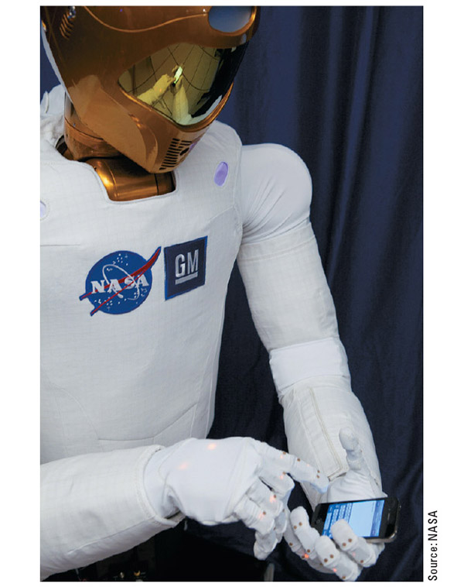
Figure 5-1
Here is an example of a high end gripper system that gives the Robonaut the same gripping and manipulating options as its human counterparts

Slide 6
Grippers cont.
There are two common types of gripper motion:
  Parallel grippers have fingers that move in straight lines toward the center or outside of the part to close and grip
    Good for a wide range of parts
  Angular grippers have fingers that hinge or pivot on a point to move the tips outward to release parts or inward to grip parts
    Good for consistent sized parts

Slide 7
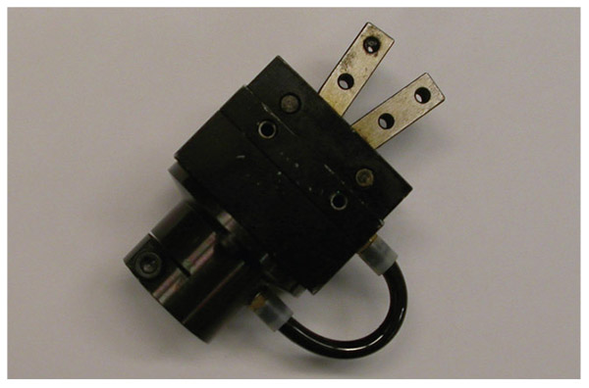
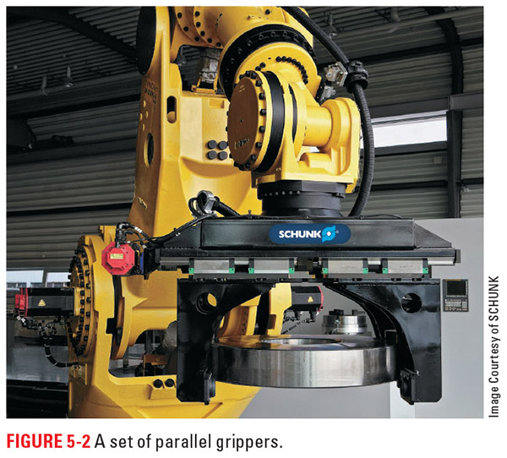
Figure 5-3
Figure 5-2
Above is an example of Parallel motion while to the left you can see an angular gripper

Slide 8
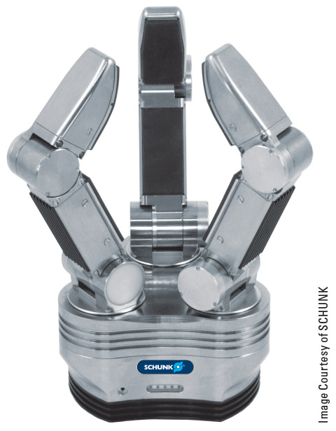
Figure 5-4
Fingers, sometimes called jaws, are the part of the gripper that moves to hold parts
The tooling base is the part that attaches to the robot and holds the mechanisms to move the fingers
This angular gripper has an extra joint in each finger to make it more like our hands

Slide 9
Gripper Power
Grippers can be moved by electrical, hydraulic, or pneumatic power
  Pneumatic is fairly common with electrical close behind
There are three ways we can power gripper motion:
  Power open and power close
  Power open and spring close
  Spring open and power close

Slide 10
Gripper Fingers
Often grippers are purchased with generic fingers to allow the customer to modify them as needed and to save on cost
The number of fingers is often related to the task of the gripper:
  Two-finger grippers give side-to-side centering
  Three- and four-fingered will center the part in two directions consistently
  Certain four-fingered grippers and grippers having five or more fingers are great for working with parts that have unique shapes and proportions

Slide 11
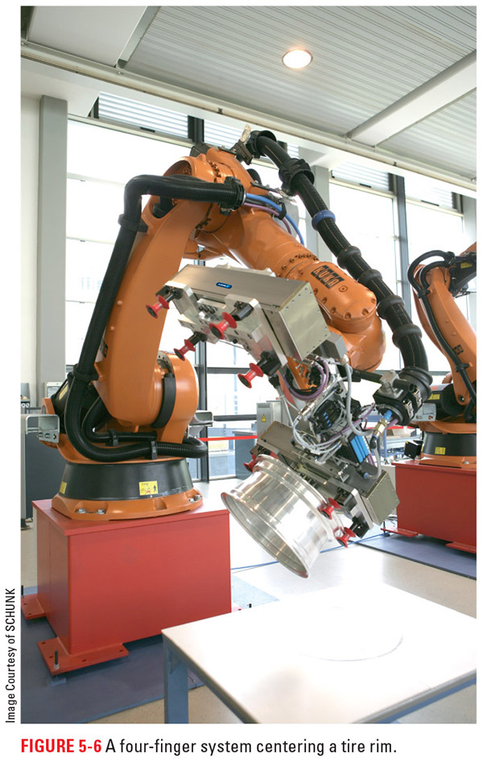
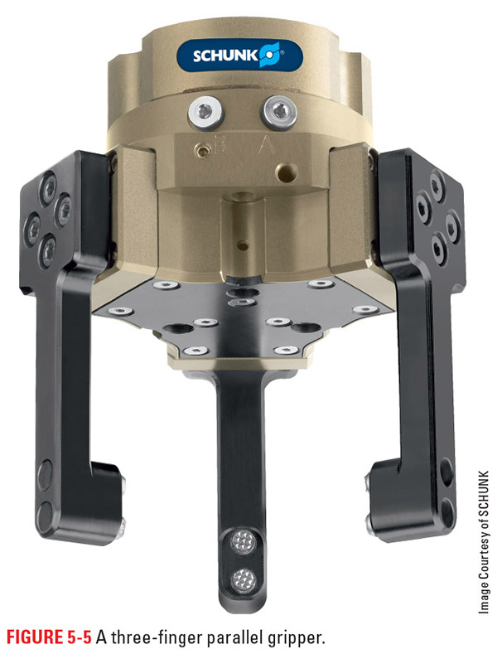
Figure 5-5
Figure 5-6
On the left you can see a three fingered gripper and to the right is a four finger variety, both of which are good at centering the part in two directions

Slide 12
The Four Rules for Choosing a Gripper
The tooling must be capable of holding, centering, and/or manipulating the range of parts the robot works with
There needs to be some way of sensing when a gripper has closed on the part or if it is empty
  Advanced grippers can determine the amount of force exerted on the part as well, which is very beneficial when working with delicate materials
The weight of the gripper should be kept as light as possible, as this weight is deducted from the robot’s total payload
The gripper must have proper safety features built in for the environment in which it works and the parts with which it works

Slide 13
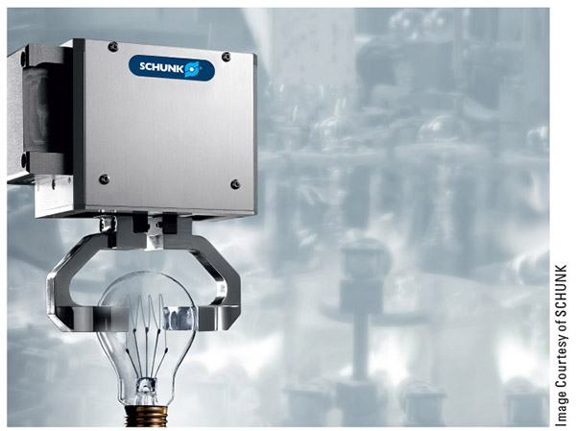
Figure 5-8
Force sensing means the difference between the impressive feat pictured and a broken bulb

Slide 14
Gripper Force
A gripper must be able to generate enough force to hold the parts it will work with while moving and manipulating them
There are several factors to consider:
  Part size, shape, and center of gravity
  The direction(s) of motion
  Friction
  Size of the gripper
  Safety factors

Slide 15
Gripper Force cont.
Center of gravity - where we consider the mass to be centered
  When this is outside the gripper, the amount of force needed is considerably greater
Friction - the force resisting the relative motion of two materials sliding against each other
  It acts as a resistance to slippage of the part
Safety factor - the margin of error we build into the process

Slide 16
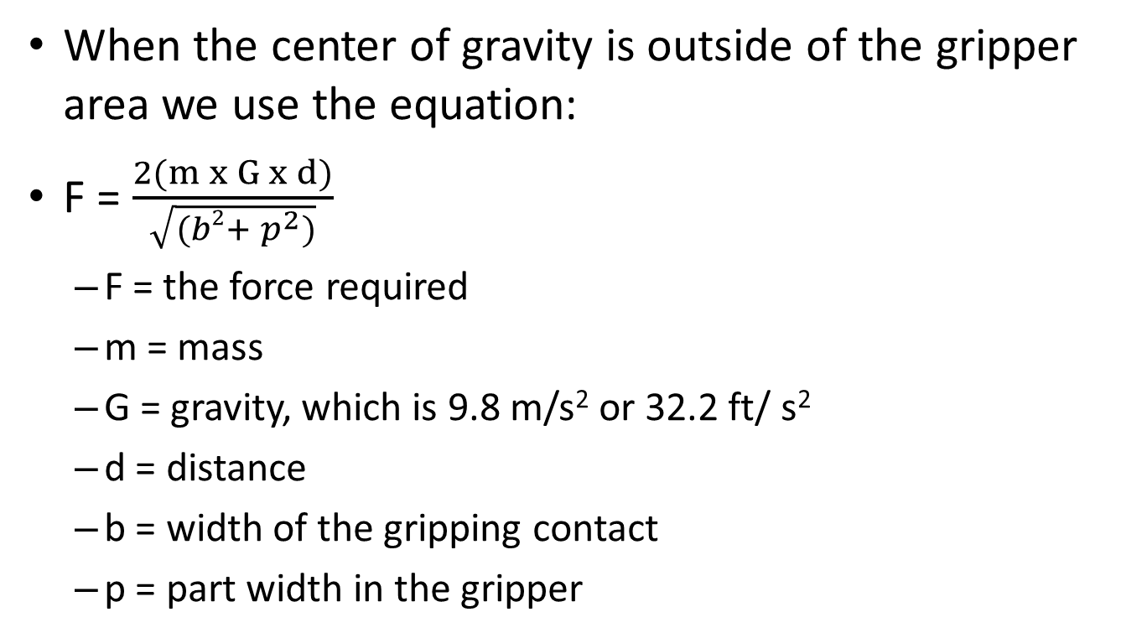
Figuring Force
When the center of gravity is outside of the gripper area we use the equation:
F = $\frac{2(m x G x d)}{\sqrt{(b2+ p^{2})}}$
  F = the force required
  m = mass
  G = gravity, which is 9.8 m/s² or 32.2 ft/ s²
  d = distance
  b = width of the gripping contact
  p = part width in the gripper

Slide 17
Figuring Force cont.
Next we figure in acceleration by multiplying the force required by the amount of acceleration created by the robot motion in Gs
We divide this by the coefficient of friction of the fingers
Lastly we take the above answer and multiply it by the safety factor

Slide 18
Centered Force
When we have the center of gravity inside the gripping area of our tooling, the math becomes easier
We start with Fr = W x G
  Fr = required force
  W = weight of part
  G = gravitational force, including acceleration

Slide 19
Centered Force cont.
We take our answer and divide it by the number of gripper fingers involved and then plug it into the following formula to find the normal force required:
N = F/µ,
  F = friction force
  µ = coefficient of friction
  N = normal force - the force that an object pushes back with when it is acted on by a force

Slide 20
Centered Force cont.
Lastly we multiply the previous answer by the safety factor to determine the total force needed
From the chapter, the examples demonstrate how having the center of gravity outside of the gripping area drastically increases the force needed to maintain part control

Slide 21
Payload
Payload - a specification of a robotic system that informs the user how much the robot can safely move
  This is often specified in Kilograms
Anything we add to the robot, such as EOAT, reduces the amount of force that we have to move parts

Slide 22
Payload Math
Ap = P – Wt
  Ap = available payload
  P = specified payload capacity for robot
  Wt = weight of the EOAT and any added peripheral systems or equipment attached to the robot besides the core system

Slide 23
Magnetic Grippers
Though not fingered, electromagnets fall into the gripper family due to their ability to move metals that contain iron
  These systems consist of a coil of coper wire wrapped around or in an iron core
  When voltage is applied to the system, a magnetic field is created
  When the voltage is removed, the magnetism goes away and the iron part is released

Slide 24
Vacuum Grippers
Vacuum grippers work by creating a pressure that is less than atmospheric or an area of low pressure
  Because the air around us exerts pressure all the time, it holds the object against the low pressure created by the vacuum gripper
  These systems are well suited to large flat objects or other items that the motion of a fingered gripper might damage
  Many of these types of grids have individual control of the vacuum grippers, allowing the programmer to turn on only the grippers needed, saving on both operating cost and maintenance

Slide 25
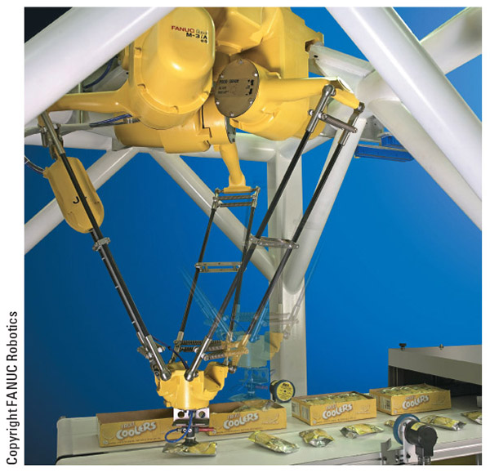
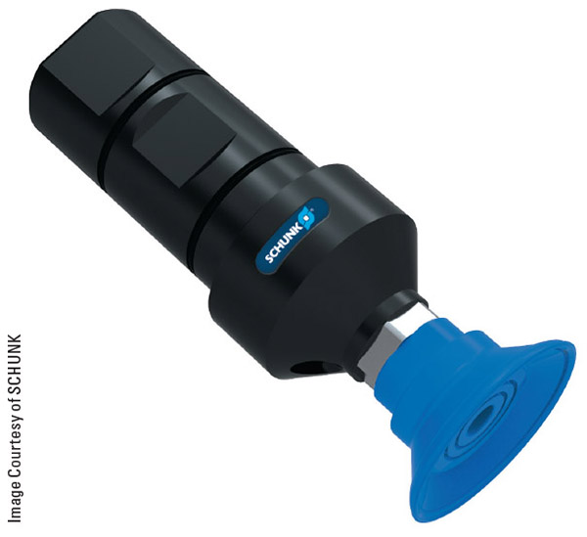
Figure 5-11
Figure 5-10
Here you can see a close-up of a vacuum gripper as well as one of these systems in operation

Slide 26
The Venturi Effect
The Italian physicist Giovanni Venturi first discovered that when air is forced though a conical nozzle, its velocity increases and the pressure decreases
  When using Venturi valves, we pass compressed air though a conical Venturi orifice
  As the air passes from the restricted area to the larger area, the pressure falls and the velocity increases
  Because of the large difference between the conical restriction and the line after it, an intense reaction is created that sucks the stationary air out of the area of the vacuum cup or wherever the air opening is attached into the main line after the Venturi valve

Slide 27
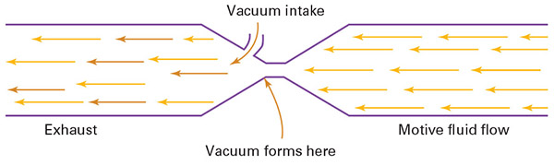
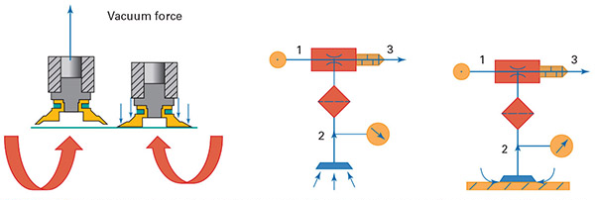
Figures 5-12 and 5-13

Slide 28
Venturi Vacuum Generators
Venturi vacuum generators have many advantages:
  They do not have any vibration, heat generation, or moving parts
  The vacuum turns on and off immediately with the air supply
  Multiple Venturi valves in series can increase the vacuum generated
  This approach works well in harsh environments
  The low-cost systems are much less expensive than other mechanical systems
  The Venturi valves are easy to repair, replace, or change out
  The Venturi valve is often located in the vacuum cup, reducing air consumption and improving response time
  Venturi vacuum systems are lightweight and mobile, and do not require an electrical connection

Slide 29
Balloon Grippers
Balloon-type grippers work by inflation or deflation to grip the part
These grippers once worked by placing the deflated balloon or flexible bladder inside of some portion of the part and then inflating it with air
An advancement in this technology has been to fill the balloon or flexible bladder with coffee grounds or a similar substance
  The effect is a gripper that holds parts securely in much the same way that a human hand does in terms of rigidity and flexibility

Slide 30
Pin and Mandrel Grippers
Pin and mandrel grippers are similar to the balloon- or bladder-type gripper
The pin gripper fits around a projection on the part and then inflates the bladder to create pressure against the part
The mandrel gripper works in the same fashion, only it fits on the inside of the part and presses outward against the walls of the part to create the gripping force

Slide 31
Welders
Welding gun - the tube-like tool that people or robots use to direct the electrically charged wire used to fuse metal during welding operations
MIG welder - uses electrically charged metal wire, fed through the welding gun, to fuse metal together and provide shielding for the wire from oxygen by an inert gas like carbon dioxide (CO₂)
Laser welder - uses intense beams of light to create the high temperatures needed to melt and fuse two pieces of metal together, without the need for the traditional welding gun
  Laser welders need specialized power supplies and other equipment to generate the intense beam of light and may consume a gas like carbon dioxide in the process

Slide 32
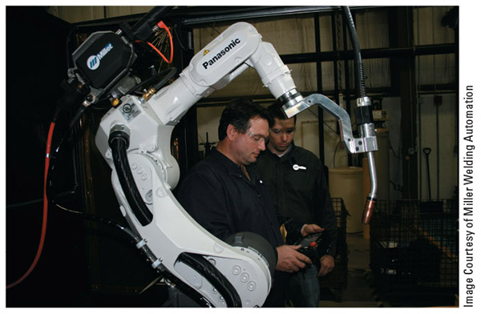
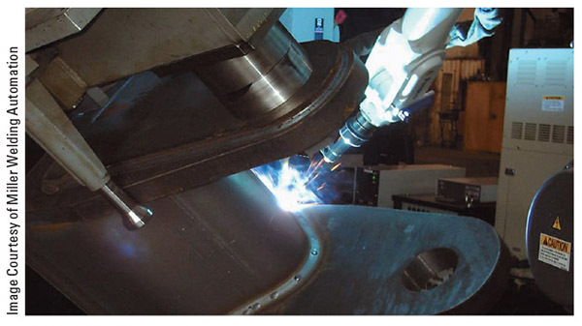
Figure 5-15
Figure 5-14
Once set up, robotic welding systems can finish weld after weld with minimal human input

Slide 33
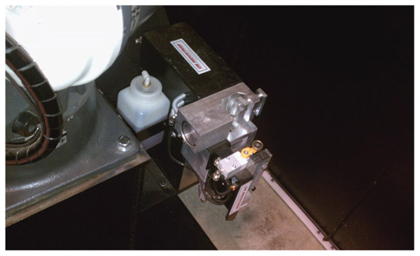
Figure 5-16
Many manufacturers of robotic welding torches have designed automatic cleaning equipment to periodically clean out the torch, remove any excess slag, and add antispatter compound to reduce the probability of slag adhering to the welding torch

Slide 34
Spot-welding
Spot-welding uses a device called a gun, which resembles a large copper clamp
It fuses metal together by passing current from one tip to the other, through the material fused
The weld controller provides a weld schedule that includes weld voltage, weld current, pressure, and gun time, which is the amount of time that current flows through the spot-welding gun tips

Slide 35
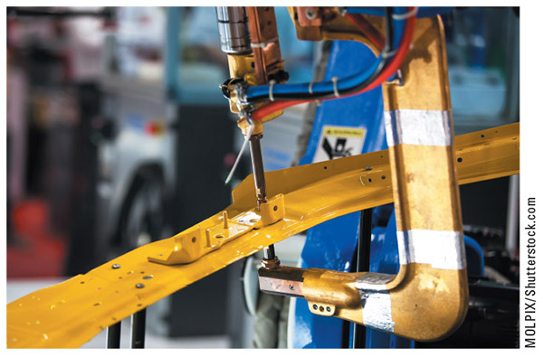
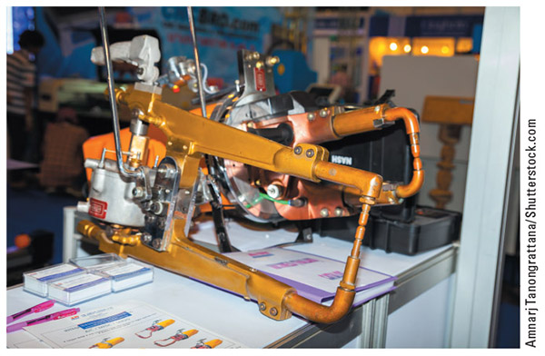
Figure 5-17
Figure 5-18
The “C”-type gun consists of a fixed tip and a movable weld tip resembling a large C clamp (left)
In the “X”-type gun, the jaws form the letter “X” and act like a scissors (right)

Slide 36
Ultrasonic Welding
Ultrasonic welding uses high-frequency vibrations, above the realm of human hearing, to generate heat via friction, which in turn fuses materials together in processes such as:
  General-purpose sewing
  Lacing and quilting
  Filters
  Medical disposables
  Cuffs and sleeves
  Ribbons and trims
  Ballistic vests and body armor

Slide 37
Ultrasonic Welding cont.
An ultrasonic welding system differs in the way the weld is produced, thus, we find a different set of equipment involved in the process:
  A power supply
  A transducer
  A booster
  A horn
  An anvil or nest

Slide 38
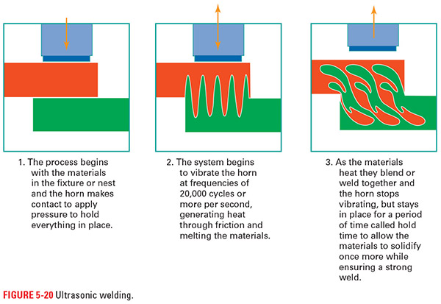
Figure 5-20

Slide 39
Sprayers
Sprayers are another tooling common in industry
Originally, these systems applied liquid paint in the auto industry, but the technology has broadened considerably
  Powders
  Liquids
  Adhesives
  Anything sprayable

Slide 40
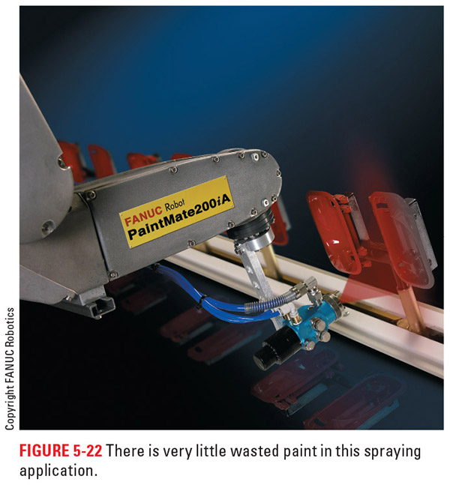
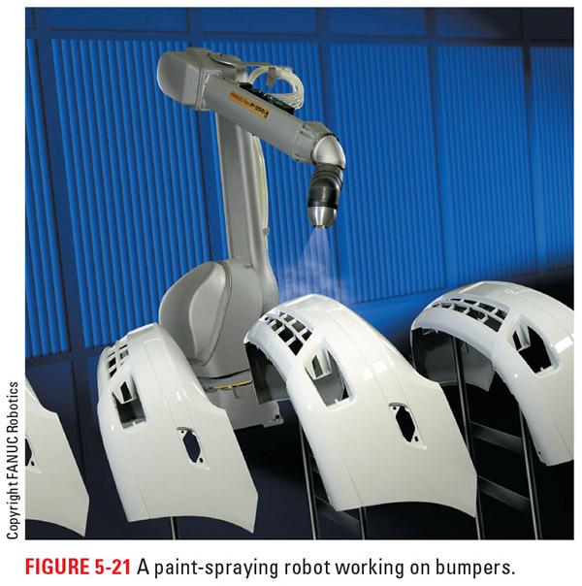
Figure 5-22
Figure 5-21
Painting and other spraying applications are a perfect fit for robotics, given their precision and repeatability

Slide 41
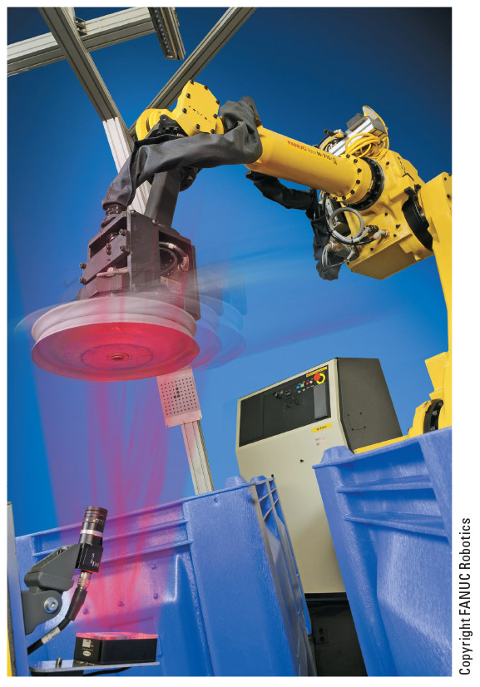
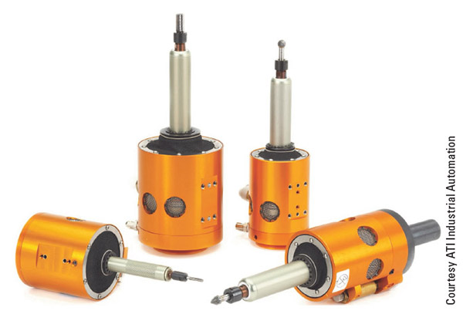
Figure 5-24
Figure 5-23
With the addition of some sensors we can turn a robot into an inspection system to make sure the part is right every time before it goes on its way (left)
Or we can use tooling that spins and use a robot to machine parts

Slide 42
Multiple Tooling
When more than one tooling is needed there are a few options
  The operator can change the tooling as needed
  We can mount multiple tools on the robot
  We can use some form of automated tool change system
Each method has its strengths and weaknesses

Slide 43
Operator Method
Having the operator change out the tooling works well for situation where changes happen infrequently
  This method will involve shutting the robot down for a time
  There may be a need to offset programs due to variance in how the tooling is attached
  It is also common to use this method to replace tooling damaged by normal wear or unprogrammed contact

Slide 44
Multi Tool Method
Mounting multiple tools on the robot negates the need to change out tooling, but there are several downsides:
  Payload of the robot is reduced
  Possible difficulty positioning the robot
  This method often requires specialized tooling bases or tooling systems to allow for the multiple functionality

Slide 45
Automatic Tool Changers
First, the system will need quick change adaptors that provide a quick method to align and attach/detach tooling
  On part of this system attaches to the robot and this is where signal, electrical, pneumatic, and other connections from the robot attach
  The other part attaches to the tooling
  The system will also provide for alignment and positive locking between the two

Slide 46
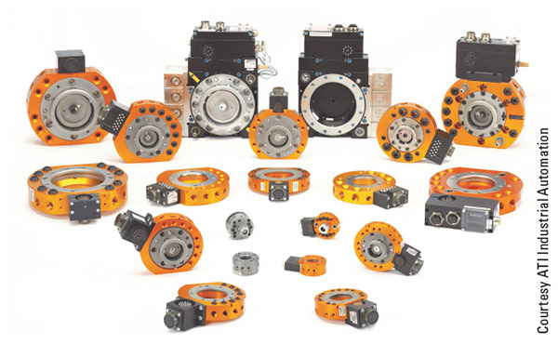
Figure 5-25
Quick change systems come in a wide array of sizes, configurations, and function, but they will all have some way to attach to the robot, some way to hold the tooling, and a form of alignment and latching between the two halves

Slide 47
Automatic Tool Changers cont.
When it comes to actually changing the tools automatically, there are two main options:
  The robot can move the tooling to an empty place in a rack system, drop off the current tooling, and then move to pick up the required tooling
  A separate system can move an empty space to the robot for tooling drop off and then move the needed tooling into position for quick pick up

Slide 48
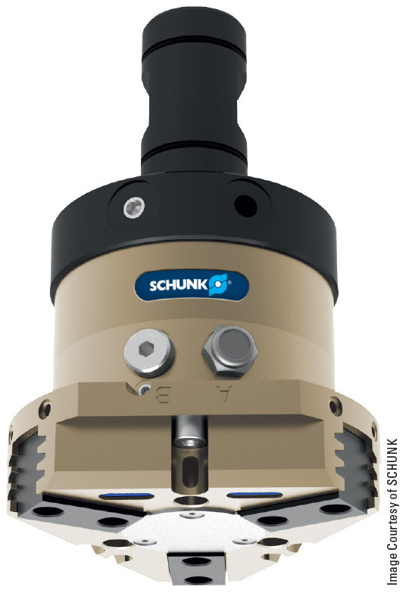
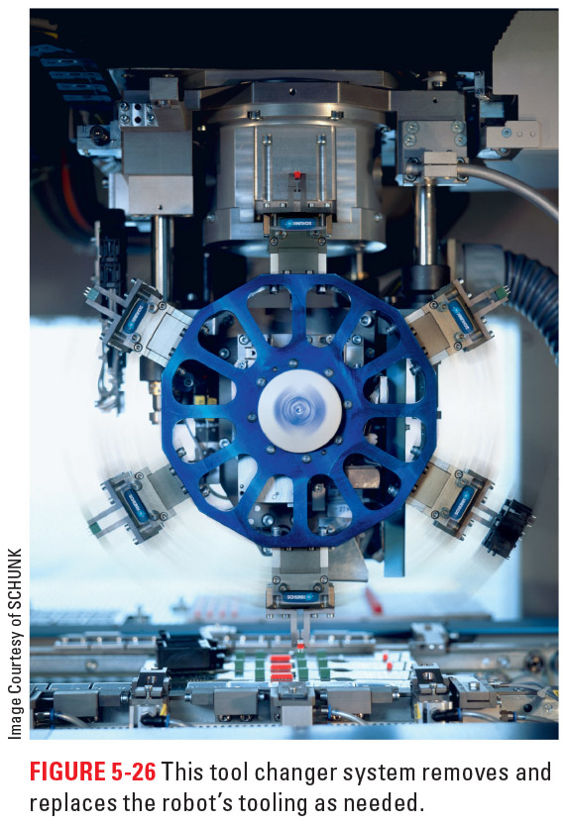
Figure 5-27
Figure 5-26
On the left is another example of tooling optimized for quick change out. On the right is an example of a tool changer system that might be used with a robot.

Slide 49
Positioning of EOAT
The three minor axes are there to orientate the tooling into the proper position for the task it must perform
Remote center compliance (RCC) is a simple way for tooling to respond to parts that are not always in the same position
  RCC devices allow the tooling to shift a little from the center position without causing the robot to alarm out or exerting excessive force on the tooling

Slide 50
RCC
By using springs or materials that can flex systems achieve passive RCC
  Often passive RCCs will have the addition of a shear plate that breaks loose in the case of excessive side force to preserve tooling and prevent damage
  RCCs are good for reaming, taping, or other such operations

Slide 51
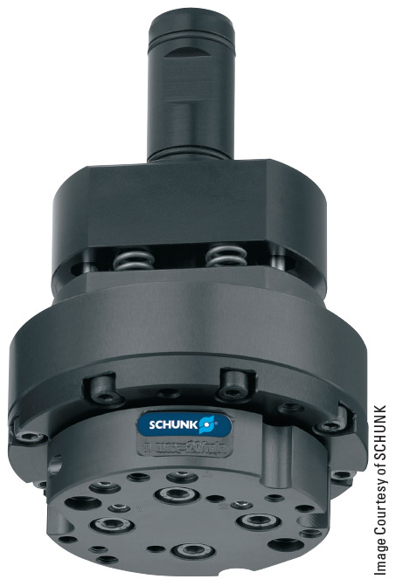
Figure 5-28
Here you can see a passive RCC system

Slide 52
RCC cont.
Active RCCs have sensors inside the unit to detect how much side shift is occurring
  While these RCCs are more complex, they do alleviate the need for a shear plate inside the setup
  If the tooling is being forced too far out of position, the sensor detects this, stops the robot, and sends an error to the teach pendant screen
  Some of these systems can also detect the amount of torque that the tooling is using to perform its tasks

Slide 53
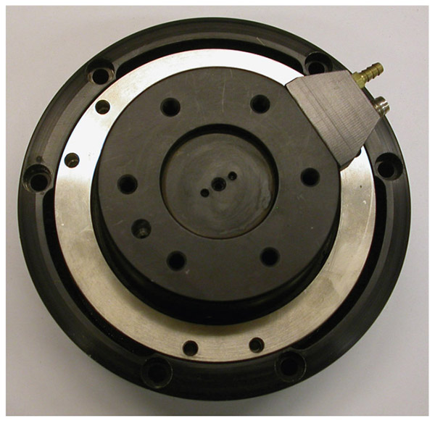
Figure 5-30
With Active compliance devices, like the one pictured, the robot gets live feedback on the tooling positioning and any forces acting on it.
Keep in mind that the more complex the system, the more maintenance or upkeep required, such as calibration, wiring, software, and other such needs.

Slide 54
Vision Systems
A modern solution to the problem of part alignment is the use of vision systems
  The robot uses a camera to take a picture of the part and then compares this picture to sorting criteria predefined by the programmer
  It then runs a subroutine that allows it to offset the tooling in relation to the new part position
  It can also sort items by color, pick specific pieces out a pile of parts, perform quality checks, and carry out many other functions that require visual information

Slide 55
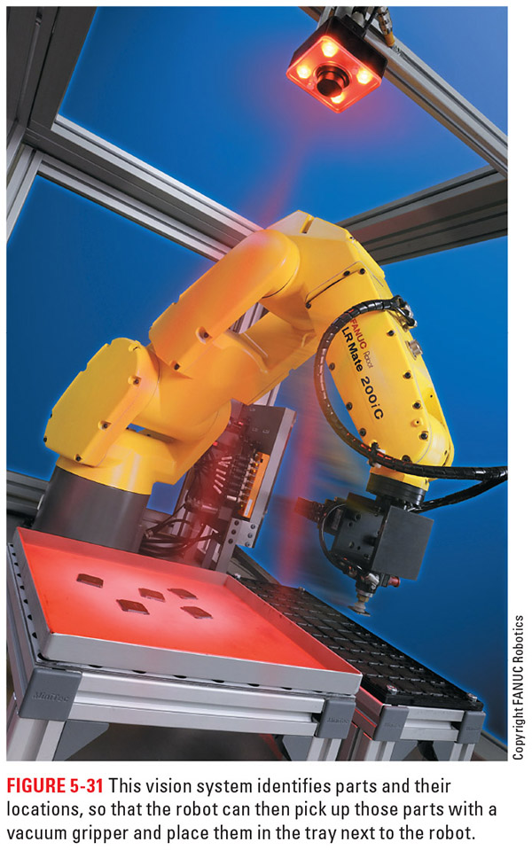
Figure 5-31
Here is a robot taking advantage of a camera system to find parts and then complete its programmed tasks.
The vision system is quickly becoming an industry favorite due to the versatility it adds to the robot.

Slide 56
Review
What is EOAT? In this part of the chapter, we discussed what tooling is and why it is important to the world of robotics.
Types of tooling available. This section covered grippers, welders, spraying guns, suction cups, and other types of tooling for robots, and looked at some of the math involved with tooling.
Multiple tooling. This section described the options for attaching tooling and identified the situations that these options best serve.
Positioning of EOAT. We wrapped up our coverage of tooling by discussing how to deal with misalignments of the part and ways we can shift the tooling to fit the task at hand.

