Slide 1
Programmable Logic Controllers (PLCs) and Human-Machine Interfaces (HMIs)
Chapter 10

Slide 2
Overview
WHAT YOU WILL LEARN
  What PLCs are and why we use them
  How the modern PLC evolved
  The basic components of PLCs and the basics of what they do
  How the PLC scan cycle works
  Some of the common instructions used in PLC programming
  What human-machine interfaces are and why we use them

Slide 3
What Is a PLC?
PLCs have one specific function: They filter the information coming in through the program and either create data or trigger output connections as directed
  They were designed to replace relay logic
  They are specifically designed to withstand the harsh environments found in industry
  They are able to communicate data over various networks
  They provide the ability to monitor system conditions for troubleshooting purposes

Slide 4
Contacts
Contacts are similar to relays, but are generally rated for higher amperage
  They tend to have one to three main contacts and one or more lower amperage contacts called auxiliary contacts
  Auxiliary contacts are used to latch circuits in circuits to maintain power after a pushbutton is released, power other devices at the same time as the main device, or provide voltage signals as needed
Motor starters are contactors with an overload module added used to start motors
  Overload modules, often just called overloads, are designed to allow the large inrush of current needed to start a motor, but change state if the flowing amperage exceeds their set value for more than a few seconds

Slide 5
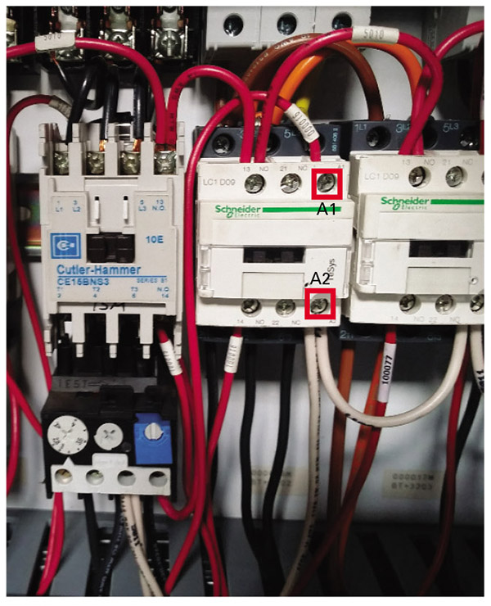
Figure 10-1
The device on the left is a motor starter, since it is a contactor with overloads added (the black module with the blue button and grey dial)
On the right and middle you can see two contactors used to switch 3phase power. The red and white wires go to the coil for the contactor and auxiliary contacts the black wires underneath and the power wires.

Slide 6
Other Contacts
With solid-state relays, contactors, and motor starters, the PLC provides a trigger pulse that causes current flow
  There are no physical contacts to change position
Smart relays that have built-in mini-processors
  These relays can often perform multiple timing functions and may offer the ability to control how outputs act, almost like limited PLC systems

Slide 7
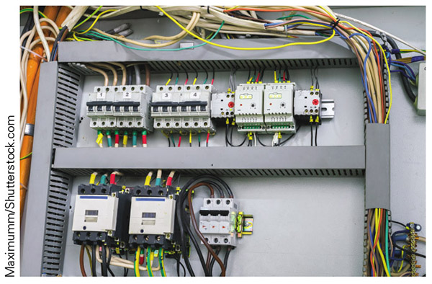
Figure 10-2
Here you can see a couple of smart relays; the two large grey devices with the yellow rectangles on them

Slide 8
CNC versus PLC
Computer numerical control (CNC) controllers are similar to PLCs in that they run a specialized type of program and you can change the operation fairly easy
  The key difference is that CNC controllers focus on axis-based motion control
  Also, CNC controllers use G-code
The PLC differs from the rest of the control options in its ability to fit almost any industrial control application need

Slide 9
A Brief History of PLCs
The PLC was born out of a meeting between GM and Dick Morley on New Year’s Day, 1968
GM wanted a device that was:
  A solid-state system that was flexible like a computer but priced competitively when compared to the relay logic system it would replace
  Easily maintained and programmed in line with the accepted relay ladder logic way of doing things
  Able to work in an industrial environment, with all its dirt, moisture, electromagnetism and vibration
  Modular in form to allow for easy exchange of components and expandability

Slide 10
A Brief History of PLCs cont.
The first attempt was too slow and lacked enough memory
In 1969 the Modicon 084 was released
  Modicon is short for Modular Digital CONtroller, and the 084 designation came from its being the 84th project of Bedford Associates
  The Modicon 084 is considered the first PLC and was the first sold on the market
  In 1973, Bedford Associates unveiled the Modicon 184, the brain child of Michael Greenberg and Lee Rousseau, which was an upgraded version of the 084 with more bells, whistles, and memory

Slide 11
A Brief History of PLCs cont.
In 1994, the Modicon brand released the Quantum range as a truly open approach to automation control designed for complex processes and the integration of multiple networks
It utilizes programmable automation controllers (PACs), which are a combination of PLC operation and PC-based control systems

Slide 12
Ladder Logic
Because relay logic was based on electrical components, it was often drawn in a schematically method
  With this method, we start by drawing two vertical lines, the power rails, on the page, one on the left side that is the main power in and one on the right that is the return path in a 120 V or DC system or the second power line in a 220 V system
  Next, we draw a line from the left-hand side to the right, called a rung, placing various components in the electrical sequence of the path, thereby mapping out the logic of the circuit and showing what has to happen to get power flow from left to right
Ladder logic is the PLC equivalent of this electrical schematic, in which the physical components of a relay logic schematic are replaced with symbols that represent instructions for data sorting in the PLC
It is crucial to understand the distinction here: The relay logic ladder type schematic is an electrical path drawing and the PLC ladder logic structure is a data path drawing

Slide 13
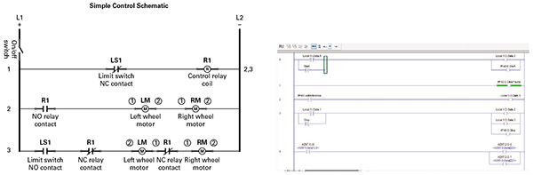
Figure 10-3
On the left is a schematic done in the relay logic format and on the right is an example of a PLC program used to sort data

Slide 14
Allen-Bradley
Allen-Bradley, introduced its first PLC in 1970, called the PDQ-II
  In 1971, it rolled out the PMC (Programmable Matrix Controller), which still didn’t really fit the PLC bill
  In 1974, Allen-Bradley filed a patent for the first PLC with parallel processing and introduced the first CRT-based programming panel for PLCs
  In 1976, Allen-Bradley introduced remote I/O
  In 1986, Allen-Bradley rolled out the PLC-5, which is still found in industry today, and linked the PLC to the personal computer

Slide 15
Allen-Bradley cont.
The SLC 500 replaced the PLC-5 as the flagship for Allen-Bradley PLCs in 1991 and was still supported at the writing of this book
  In 1994, Allen-Bradley released the MicroLogix line, which was a reduced-capability system that used the same software as the SLC 500 systems
They are now focusing all of their energy on the ControlLogix (launched in 1997) and CompactLogix (launched in the early 2000s) lines

Slide 16
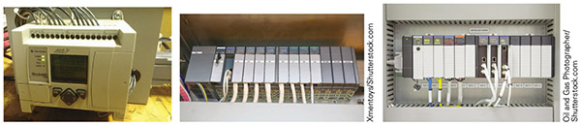
Figure 10-4
On the top left is an Allen-Bradley MicroLogix 1100; on the top right is an SLC 500; and in the left middle is a ControlLogix

Slide 17
Siemens
In 1974, Siemens debuted the Simatic S4 as the first soft programmable controller, beginning the rise of the PAC system
  The Simatic S5 was introduced in 1979 and became one of the most widely installed PLCs in the world
  In 1980, Siemens added its fail-safe controls technology to the S5, paving the way for the safety-oriented PLCs of today
  In 1994, Siemens released the Simatic S7 and Step 7 PLCs, with the Step 7 being a stripped-down, cheaper system for less complex applications
  In 1997, the company released the PCS7 controller for the S7 system, which combined PLC function with a distributed control system (DCS)
    DCS - a system in which autonomous controllers are distributed throughout the equipment, but there is a central operator supervisory controller
  The S7 remains Siemens’ flagship PLC, though it has been upgraded many times since its introduction in 1994

Slide 18
General Electric
General Electric (GE) also got into the PLC field with the PC-45, which was its designation for the Modicon 084
  GE had worked out a deal to market the Modicon 084 under its own label so the company could jump into the PLC game
  The first PLC of GE’s own design was the Logitrol, introduced in 1973
  In 1981, the company released the Series 6
  In 1983, GE released the Series 1, a small-size PLC that features removable cards instead of fixed I/O
  The Series 3 came out in 1985 and was in between the sizes of the Series 6 and Series 1

Slide 19
General Electric cont.
The 90-70 came out in 1987
  This large-size PLC is designed for complex applications requiring large numbers of I/O points and a large amount of memory usage
In 1988, GE released the Series 5, designed for mid-range PLC applications
In 1990, it launched the 90-30 model
  Small, sleek, and has more than 100 different I/O modules
  It is comparable to the Allen-Bradley SLC systems in size and capability

Slide 20
General Electric cont.
The VersaMax, released in 1997, is designed to work with remote I/O, a stand-alone PLC unit, or distributed control for as many as 256 I/O points with a processor boasting 12K of memory
In 2002, GE introduced the Series RX7i, which is a PAC-type system designed specifically to replace the 90-70
  The RX7i accepts 90-70 modules
In 2003, GE launched the Series RX3i PA- type system, which is smaller in form and designed to work well with networks, human‒machine interfaces (HMI), and process control

Slide 21
Omron
In 1972, Omron developed the SYSMAC PLC for use in Japanese automation
  It developed into a standard line with microcomputers by 1978
In 1983, Omron released the C-Series, an upgrade of the SYSMAC line
  The C-Series boasts more than 40 models, some of which are still in production
Omron’s production line at the writing of this book included:
  The NX, NX1P, and NJ, which are designed for motion, logic, safety, vision, and HMI control
  The CP1 for modular analog and digital I/O with serial communications
  The CJ1 and CJ2, designed as small, general-purpose PLCs, with the CJ2 having more function and enhanced performance relative to the CJ1

Slide 22
Basic Components of the PLC
PLCs have the following components:
  Inputs that provide information about the process
  Outputs that send power in one form or another to devices in the field
  Processor(s) to sort, store, and manipulate data
  A backplane or something similar to allow the various components to communicate

Slide 23
Inputs
The input portion of the PLC responds to voltage coming in from field devices and creates data in the processor accordingly
  Digital - the only states are 1 or 0
  Analog - the incoming value varies and that variance has a meaning
  Analog inputs can monitor voltage or current
  Common amperage ranges are 0 to 20 mA or 4 to 20 mA
  Common voltage ranges include 0 to 1 V DC, 0 to 5 V DC, 0 to 10 V DC, 1 to 5 V DC, ‒5 to +5 V DC, and ‒10 to +10 VDC
  Analog inputs typically use a word of data

Slide 24
Inputs cont.
Some PLCs use modules, which are removable devices designed to serve a specific purpose or function
  In PLCs that are not designed to accept modules, the inputs are limited to a set number and type
  Some modules feature a removable connection pad that the field wiring attaches to
  The types of input modules range from simple digital modules, to various types of analog modules, to specialty cards such as high-speed counters

Slide 25
Optical Isolation
Optical isolation - the power coming in lights up a light-emitting diode (LED) or similar light source that interacts with a photoresistor or other light-sensitive device
  When the light hits the resistor, the resistance value drops until voltage can flow through the circuit
  If someone makes an improper connection or a device shorts out, the only thing damaged is the light source
  The same circuit, if not the same LED, also illuminates either a specific LED on the front of the PLC module or a specific number on the input module

Slide 26
Outputs
The output portion of the PLC responds to data in specific locations in the PLC and opens or closes connections between terminals on the output and common connections
  The connections are made by standard relays or solid-state devices like triacs for AC or diodes for DC
    A triac output can show 120 V AC when it is not triggered and there is no actual flow
  An output acts on data from the PLC processor
  Outputs also use optical isolation
  The LED on the output card is illuminated when the connection between common and terminal is triggered
  Output cards come in the standard digital and analog formats, but a large number of specialty modules are also available

Slide 27
Specialty Modules
Some modules do not truly fit into either the input or the output category because they do a bit of both
  Communication modules and networking modules can bring data into the processor as well as transmit data out to other systems
  The PID module, which stands for proportional integral derivative, is a mathematical process used to vary an output to maintain a specific set point that requires both input data and the ability to send output data
  Safety modules have redundant connections so that if one connected path is lost, there is a backup and internal error reporting and testing functions that send data to the processor

Slide 28
Specialty Modules cont.
ASCII modules that transmit and receive data using a method similar to the way your keyboard sends data
BASIC modules are used to interface with bar-code readers, scales, modems, robots, and other such systems
Binary-coded decimal (BCD) modules work well and offer seven segment displays and thumb wheels
Combination modules - half of the terminals are inputs and the other half are outputs, but otherwise the modules work like regular I/O cards

Slide 29
Processor
The processor is the heart of the PLC; it is where all the data is manipulated based on the program
  In some PLCs, the processor is built into the unit and there is no real option to change it out for another one
  In the rack-style PLCs, which allow us to add or remove modules, the processor is often just another module
  Some PLC brands require the processor module to reside in a specific location

Slide 30
Processor LEDs
Most PLCs have LEDs that provide important information about the state of the processor
  The RUN light indicates that the PLC is in run mode and is capable of scanning the program and altering data
    If the RUN light is solidly lit, the processor is scanning the program and manipulating data as directed
    If it is flashing, it may be transferring memory or faulted out
  The OK or fault signal
    If the processor is running normally, the LED is solidly lit
    A flashing LED typically indicates some type of error condition that has stopped the scanning process

Slide 31
Processor LEDs cont.
Force is another LED found on many processors and something pretty serious in its own right
  Force is a condition in which we set the state of data for an input or output, ignoring the actual field condition for inputs and the data result of the program for outputs
  If the force light is blinking, there are forces in the system, but they are not turned on at the moment
  If the light is solidly lit, that means forces are active and something is no longer under normal control

Slide 32
Processor LEDs cont.
Battery LED
  If the light is on, that means the battery is low
  If it is off, that means everything is good to go
Other LEDs may indicate the status of various communication paths or other important items specific to the processor in question
  With communications lights, often they blink when data is being transmitted back and forth and then go dark when nothing is happening

Slide 33
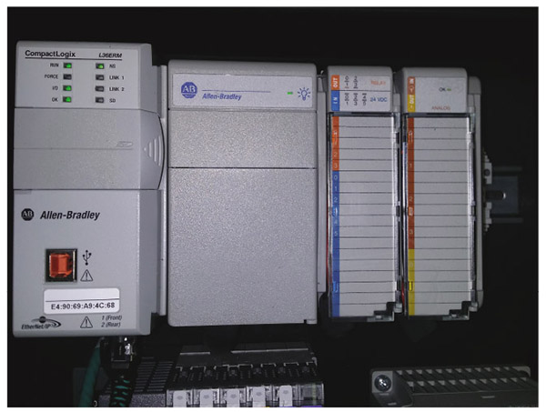
Figure 10-5
This is an Allen-Bradley CompactLogix controller. You can see it has LEDs for RUN, FORCE, I/O, OK, the SD memory card and several communication indicators.

Slide 34
Processor Modes
Most PLC processors have the following modes selected by a key or switch:
  Run mode - the processor scans the program and manipulates data
    In this mode, we can pull the program from the PLC to our interface device which we call an upload, but we cannot send a program from the laptop to the PLC in a download
  Remote mode (Rem) - in this mode, we can use the laptop to upload or download data
    We can also use the laptop to switch between remote run and remote program
  Program mode - in this mode, we can upload or download data, but the processor does not scan the program and the I/O does not update with changes

Slide 35
Processor
The memory for the system often lives on the processor module, or in the same area as the processor for fixed units
  Some of the newer PLCs have taken advantage of flash memory and often use an SD card of some type to store programs and other important data
  Sometimes there are pins to reset the processor to the factory settings, or to wipe the memory should someone set a password and then leave the company
Safety PLCs contain two processors that are identical in nature; they are set up so that if the primary processor fails, the secondary processor picks up where it left off without so much as a hiccup

Slide 36
Backplane
The backplane provides a path for power and communication between all the various modules or parts of the PLC
  For some PLCs, it is part of a rigid structure known as a rack—a metallic shell that the various modules fit into, with guide rails to keep everything straight
  A rack also provides physical protection to the modules with its metal frame and is a great place to attach the ground for everything
  The older backplane design was very much like that found in older computers, where you had to put devices in specific places
  The newer backplanes are designed to work like a network cable, providing the same communication and power to all the connected items

Slide 37
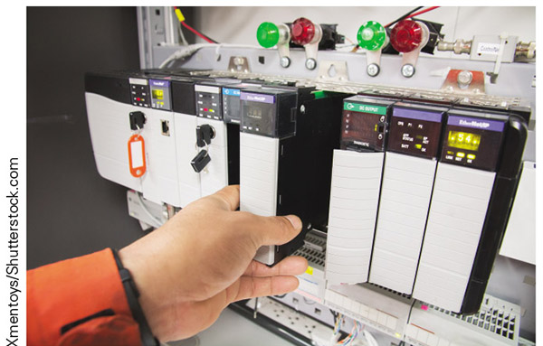
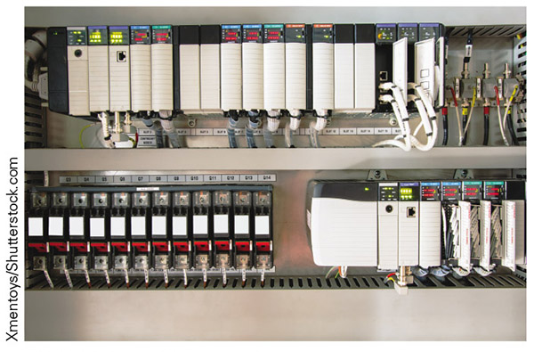
Figure 10-6
Figure 10-7
Here you can see a couple of rack style systems. On the left you can see someone adding a module and on the right you can see a couple of larger racks along with the ethernet connections they use to talk on the network.

Slide 38
Backplane cont.
Some PLCs use modules, but do not have a rigid rack structure
  With this type, a ribbon cable and connector setup or similar adds the new module to the group
  Often these connections are made at the side of the module, near the back, and locking tabs are used to hold everything secure
  With this more flexible arrangement, we depend on options such as DIN rail to mount the system and provide rigidity
When dealing with all-in-one PLCs, like the MicroLogix 1100 from Allen-Bradley, you will find that there is no external access to the backplane other than the main communication ports provided

Slide 39
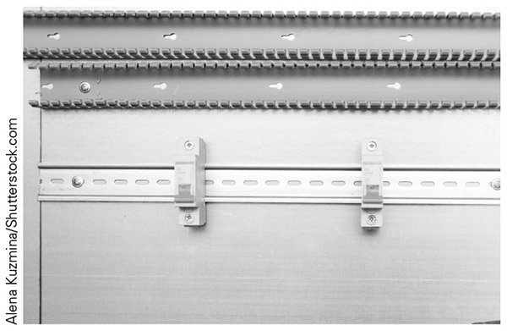
Figure 10-8
Here you can see some DIN rail, in the middle with the circuit breakers on it, and some wire tracks, the grey things at the top with all the notches.

Slide 40
Operation of the PLC
First and foremost, you must recognize that the PLC only processes data
One of the first keys to understanding the PLC is to understand how it processes information and the sequence in which this happens, which we call the scan cycle
  Some PLCs use a step-by-step scan cycle, whereas others rely on an asynchronous process

Slide 41
Step-by-Step
The first step is to check all the inputs
The next step in the sequential scan sequence is to read the program from top to bottom, left to right
  In doing so, the processor is looking for a path of true logic through the various input instructions
The third part of the scan cycle is to connect or disconnect output connections
In the fourth part of the scan cycle, the system checks for errors, determines how long the scan cycle took, and handles communications and anything else on the docket not covered in the other three steps

Slide 42
Asynchronous
Some PLCs use an asynchronous scan cycle in which the input step, program scan step, and output update step all have their own unique time tables and are happening simultaneously
  With an asynchronous scan, the input table may update a few times during the program scan, meaning that instructions with the same address can be true at one point in the program scan and false at another, all before the PLC reaches the end of the program
  If multiple rungs are controlling the same output bit box, when the output module updates there might be a 1 in the box at one time, causing the connection to close, and a 0 in the bit box the next time, causing it open once more

Slide 43
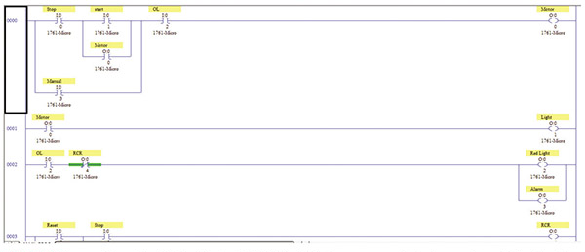
Figure 10-9
Here is an example of a PLC program that would determine functionality based on the true or false state of various instructions

Slide 44
Instructions
XIC – stands for ‘examine if closed’
  It looks at the address assigned for a 1 in the data bit
  If it finds a 1 it is true, otherwise it is false
XIO – stands for ‘examine if open’
  It looks at the address assigned for a 0 in the data bit
  If it finds a 0 it is true, otherwise it is false
OTE – stands for ‘output energize’
  If true logic comes into this instruction, it writes a 1 in the bit box address assigned
  If false logic comes into this instruction, it writes a 0 in the bit box address assigned

Slide 45
Timers
Timers have the following components:
  Preset (Pre): How long the timer will time for before it is considered done
  Accumulation (Acc): How long the timer has been timing
  Done Bit (DN): A bit box that is one or zero depending on how the timer uses it
  Timer Timing Bit (TT): A bit box that has the value 1 when the accumulator is counting and 0 at all other times
  Enable Bit (EN): A bit box that has the value 1 when true logic comes into the timer instruction and 0 whenever false logic comes into the timer instruction

Slide 46
TON
TON timer – delay on energize - when true logic comes in, the time accumulator starts counting and the DN bit is not 1 until the preset and accumulator are equal
  If false comes into the TON, everything resets, so the accumulator goes back to 0 and does not start to count again until true logic comes in
  If this happens before the accumulator and preset are equal, the DN bit never gets a 1 in the box

Slide 47
TOF
TOF timer – delay on deenergize - the DN bit becomes 1 as soon as true logic comes in and the accumulator does not start to count
  The timer remains in this state until false logic comes in, which is when the accumulator starts counting
  While the accumulator is counting, the DN bit stays 1
  When the preset and accumulator are equal, the DN bit changes to 0 and the TOF instruction stays in this state until true logic comes in and resets the accumulator count to 0 and the DN bit to 1

Slide 48
Retentative Timers
Retentative timers can be “delay on energize” or “delay on deenergize” types
These timers do not reset the accumulator based on the logic coming in
The only way to reset the accumulator to 0 with the retentative timer is with a reset instruction, abbreviated RES
The RES instruction is given the same address as the timer
When true logic comes into the RES instruction, it sets the accumulator to 0 for whatever it is addressed to

Slide 49
Latching Outputs
Output Latch (OTL): This instruction writes a 1 in the addressed bit box when true logic comes in and does nothing when false logic comes in
Output Unlatch (OUT): This instruction writes a 0 in the addressed bit box when true logic comes in and does nothing when false logic comes in
These instructions look like a regular OTE instruction with either an L or a U in the middle
They are used in pairs, as one can write a 1 and the other can write a 0

Slide 50
Communications
The specifics of making the connection will differ from brand to brand, but some basic components are fairly universal
First, you will likely need some kind of software to allow the PLC and your computer to talk
  The communication software translates the data for both systems and sets up the com port parameters, which is how we determine the method of communication used
  We can use an RS232 type of communication, or Data highway 485, or Ethernet, or any of several other methods that are specialized for the PLC in question
  Some programs will automatically detect settings and do the hard work for you, whereas others leave it to you to set all the parameters

Slide 51
Communications Issues
One pitfall in this process is setting up a communication path, but using the wrong cable or wrong port on the laptop or PLC
Another woe you may encounter is the case in which the cable you need to use has an RS232-type end and your laptop has just Ethernet or USB connections
  This will generally require some form of adaptor
A problem may arise when you reset the path to which the PLC is listening
  If you instruct the PLC to listen to a specific channel/method and you cannot communicate on this path, you will not be able to communicate with the PLC

Slide 52
Human-Machine Interfaces
Human-machine interface (HMI) - an industrial-grade touch-screen system
The HMI comes with a processor inside, runs specific software, and is designed to communicate with PLCs and other control devices in industry
The HMI has done for operator control what PLCs did for machine logic: It is replacing buttons, switches, keypads, and many other input devices
In many cases the only buttons left are those that are considered part of the hard-wired safety circuits for the equipment

Slide 53
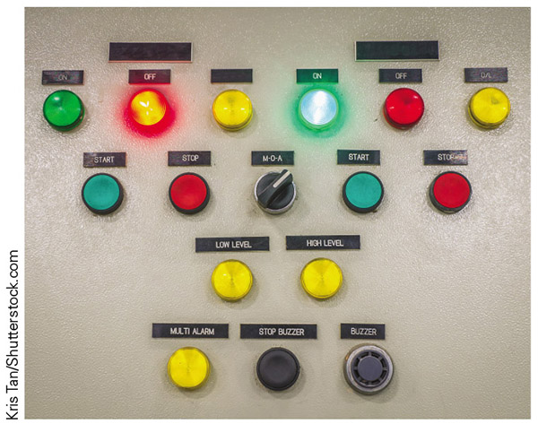
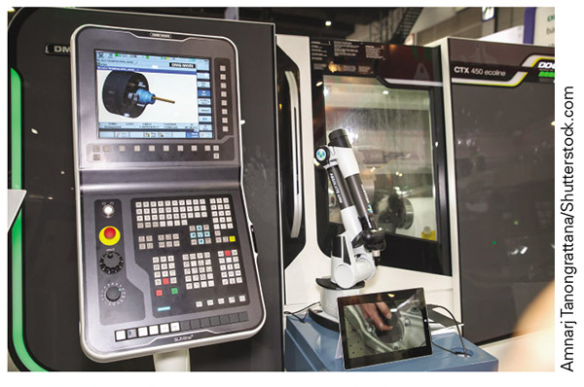
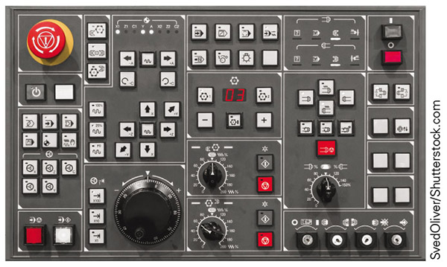
Figure 10-10
Figure 10-11
On the far left you can see a simple control panel with lights, switches and buttons. The other two are specialized control panels designed for CNC equipment with buttons that have specific functions.
HMIs have greatly replaced the type on the far left and are making inroads into other applications.
Figure 10-13

Slide 54
Human-Machine Interfaces cont.
With the HMI, the programmer uses software to create various graphical objects that appear on the screen, such as buttons, switches, charts, graphs, animations, tables, or other needed items
Once the graphical piece of the puzzle is complete, the next step is to tie it to data in some way
If you create two objects in the HMI that are linked to the same bit box in the PLC, you can get weird intermittent operation depending on which data the HMI sends and when it hits the PLC in the scan cycle

Slide 55
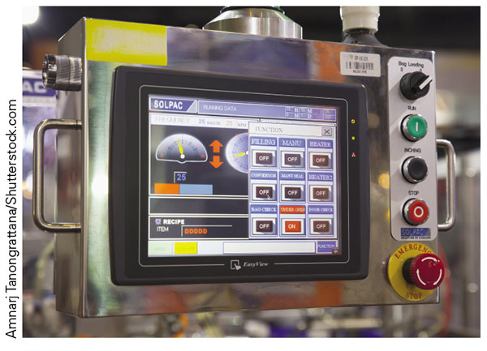
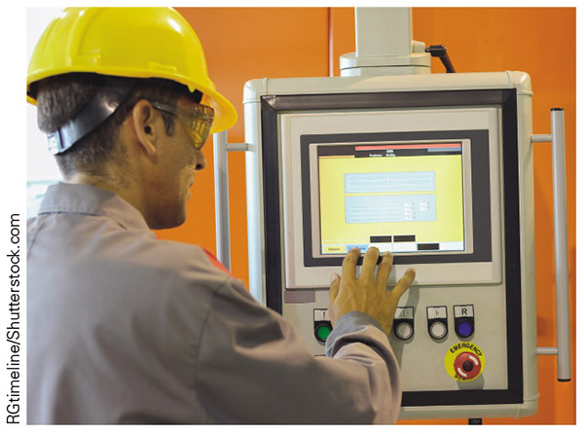
Figure 10-14
Figure 10-15
Here you can see a couple of examples of HMIs. Notice that there are still a few hard wired buttons in use for various safety reasons.

Slide 56
Human-Machine Interfaces cont.
Most HMIs have multiple user screens and all kinds of graphical elements, which means we can use graphs, gauges, tables, and so on to display data and add in all the buttons we could ever need
  We can add in keyboard interfaces that pop up on the screen, negating the need for a separate keyboard attached to the system
  Because the HMI is a large touchscreen, every graphical element can be interactive, adding more levels of functionality to the system
  You can also find HMIs in many of the modern teach pendants

Slide 57
Cell Phone
With the advancements in technology we can actually control industrial process with our cell phones
The specifics of cell phone control vary, as one might expect, but the basics are as follows:
  The PLC or controller is linked to the plant’s network and set up to work with remote signals
  The plant network is tied to the Internet and secured with passwords and the usual virus protections
  An app is developed for the type of smart device intended for use, similar to what is done for an HMI
  The app on the smartphone is linked to the plant’s network via the Internet and specific equipment via code
  Once the bugs are worked out, monitoring and control via the smart device become possible

Slide 58
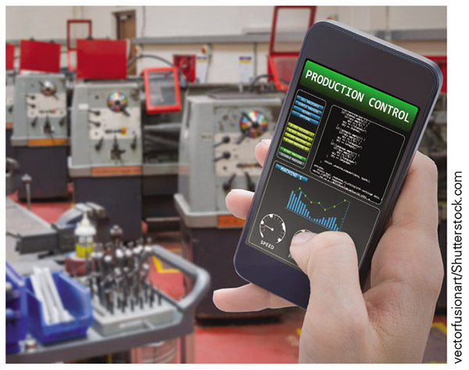
Figure 10-16
Here you can see what it might look like to control an industrial process using a cell phone.

Slide 59
IIOT
Industrial Internet of Things (IIOT) - the process of connecting everything in the plant to the network and then the network to Internet to increase flexibility
Many companies are having to examine the risks of getting hacked from the outside and determine how they can prevent this from happening
As industry figures out how to secure its networks better and reduce the risks, we will likely see an increase in the utilization of remote control for processes where it makes sense

Slide 60
Review
What is a PLC? You learned what a PLC is and what it does.
A brief history of PLCs. This section covered the rise of the PLC from a concept to the modern systems we use today.
Basic components of the PLC. We briefly introduced the main components of the PLC and saw how they work.
Operation of the PLC. This area covered the scan cycle, some of the basic instructions used in PLC programs, and thinking like a PLC.
Human-machine interfaces. You learned about some of the ways to control industrial equipment as well as the benefits of using HMI systems.

