Slide 1
Justifying the Use of a Robot
Chapter 12

Slide 2
Overview
WHAT YOU WILL LEARN
  Why we use robots instead of humans to perform some tasks
  Whether robots are taking humans’ jobs
  How to figure the return on investment for a robotic system
  How precision and quality figure into justifying the use of a robot
  How consumables are better used by robots
  How to justify using robots that can go places where humans cannot or should not go

Slide 3
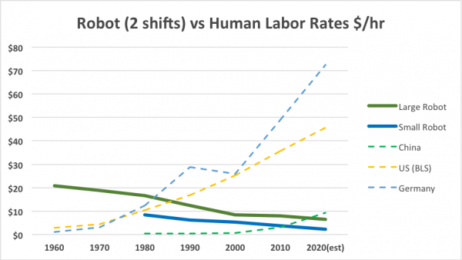
Robot vs. Human Labor
Robots are the perfect answer to many of the dull, dirty, difficult, or dangerous tasks people perform every day
Robots are methodically, unemotionally constant where people are not
Carlisle, B. (2018, January 26). Pick and place for profit: Using Robot Labor to save money. Robotics Business Review. Retrieved January 28, 2022, from https://www.roboticsbusinessreview.com/manufacturing/pick-place-profit-using-robot-labor-save-money/

Slide 4
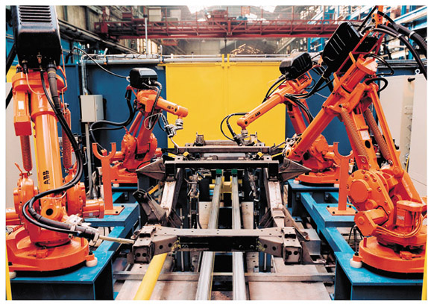
Robot vs. Human Labor cont.
Many industrial jobs fall into one or more of the four Ds of robotics
The cold, program driven efficiency of robots means it is never off its game due to emotional situations.
If we damage a robot, we can swap out a part with no greater concern than the time and money invested.
When discussing robots vs. human labor keep in mind:
  If the business is not profitable, it will not stay in business
  Every robot needs a support staff
  Many tasks are better suited to humans than robots

Slide 5
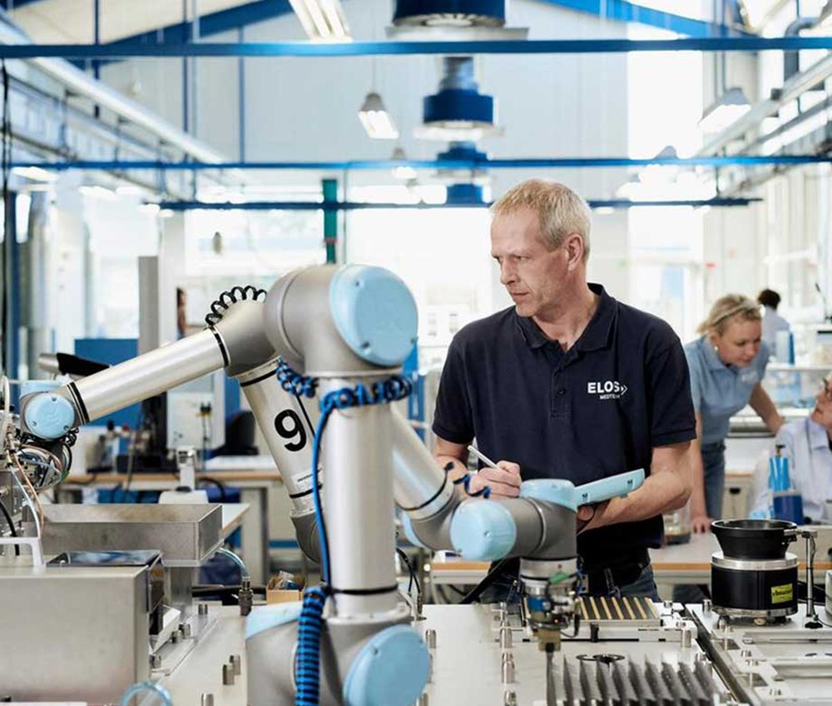
Robot vs. Human Labor cont.
While robots are taking over some jobs in industry, they are creating a whole new set of jobs for people with the technical skills necessary to run, program, and maintain the systems.

Slide 6
Return on Investment (ROI)
If we figure ROI on a cost savings versus human labor, then we simply figure the per-hour savings and use that to get the total hours needed to pay for the robot
Another factor in ROI is how long the robot will run after it pays for itself
Some systems come with a designated useful life from the manufacturer
There are numerous accounts of robots running long past the life stipulated by the manufacturer

Slide 7
ROI
Return on investment (ROI) is a measure of the amount of time that it takes a piece of equipment to pay for itself.
Inputs
Labor cost ($/hr)
Cost of equipment ($)
Hourly cost to operate ($/hr)
Operating hours per year
Calculations
Operational hours
  No. of operators
  No. of shifts
  No. of days per week
  No. of weeks per year
Labor cost ($/hr)
Equipment cost ($/hr)
Example

Slide 8
ROI
Example

Slide 9
ROI
Example

Slide 10
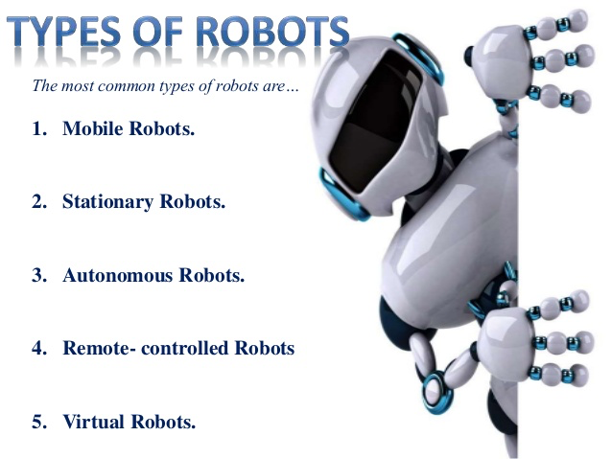
When Cost Outweighs Return
In cases where the cost outweighs the return we can:
  Forget the robot and continue to do it the way it is currently done
  Try to find a cheaper robot that will perform the task
  Figure out a new way to use the robot

Slide 11
Precision and Quality
Precision savings figure into the overall ROI of a robot
Robots can reach an exact point repeatedly error measured in the 0.0003 to 0.005 in.
Because robots can follow the same path repeatedly, all you need is to edit the program until you get the quality of part you want
Robots give operators with low skill levels the ability to produce complex parts
Quality savings figure into the overall ROI of a robot
  Each time a company scraps out a part, it costs money
  Each time a bad product leaves the factory, there is a good chance there will be a dip in customer satisfaction and potential sales
  Lack of precision requires larger spaces for various components and raises the overall cost of the product

Slide 12
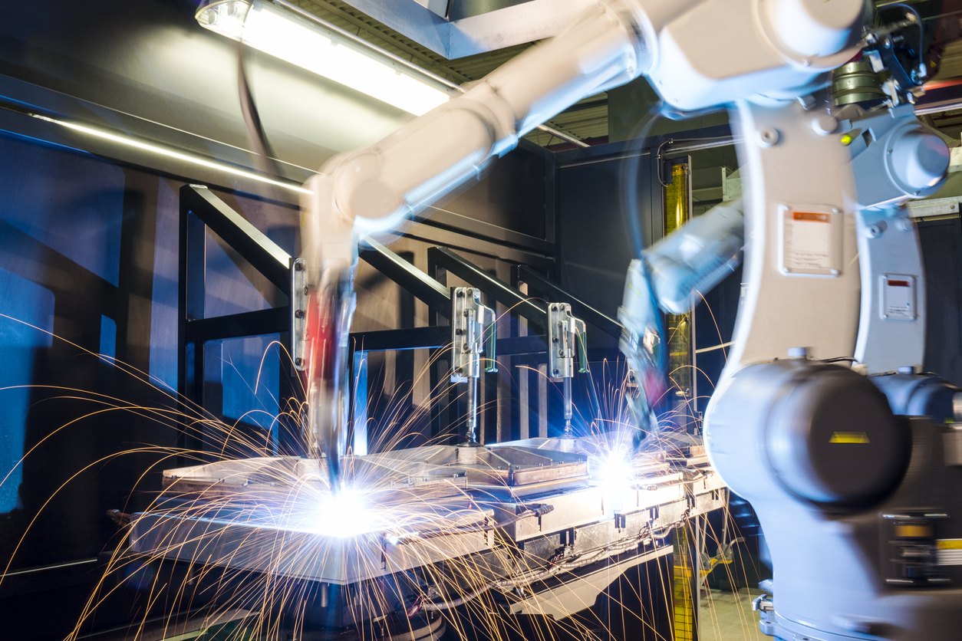
Precision and Quality cont.
Welding is one area where robots are highly used due to their consistency
A few hours of program adjustments can equate to weeks of near perfect parts

Slide 13
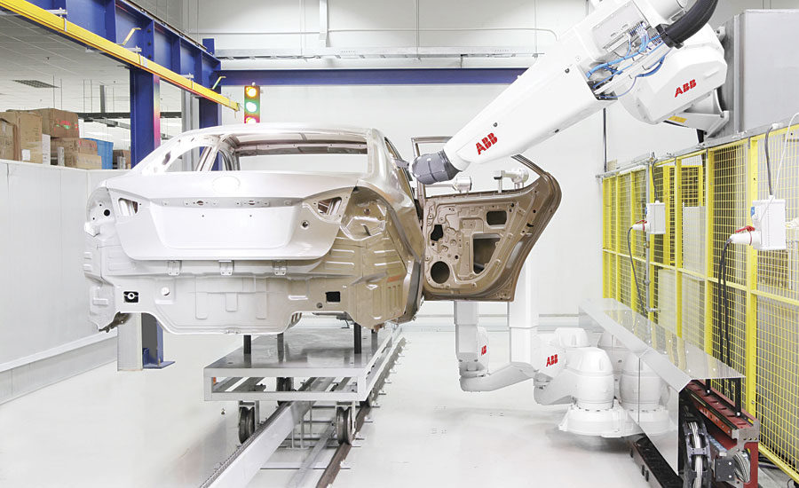
Use of Consumables
Robots often save on the consumption of raw materials used in the production process
In many applications, subtle changes in the speed of the process translate into savings in dollars or cost of materials used
Robots can work with materials that are hazardous to humans without the PPE
Painting is another good fit for robots. The paint fumes or dust do not bother the robot, they can save thousands per year in reduced waste, and they paint coats that are consistently even, which improves quality.

Slide 14
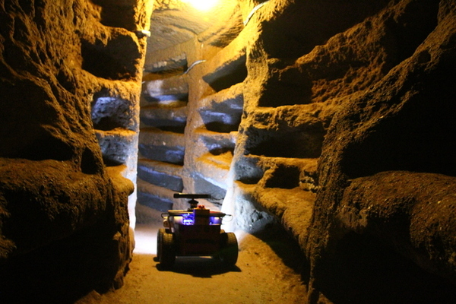
Hazardous Environments
One of the great benefits that robots have over people is that they are machines and not organic systems giving them the ability to survive and work in environments that are physically taxing, dangerous, or deadly to their human counterparts
Sometimes safety is the justification we need when ROI does not add up
Exploration of the catacombs of Rome – an environment so structurally unsound and thick with radioactive radon gas that most of it remains unexplored. It’s also full of challenges like poor lighting, steep slopes, and debris, just like you’d expect from underground cave systems dating back to 2 AD.
Rovina's robot maps hazardous environments autonomously. Geo Week News. (n.d.). Retrieved January 28, 2022, from https://www.geoweeknews.com/blogs/vol13no27-rovina-robot-maps-hazardous-environments

Slide 15

OSHA
Occupational Safety and Health Administration (OSHA) is responsible for ensuring that everyone has a safe and healthy working environment
  If someone dies on the job due to work-related factors, OSHA immediately inspects the facility and investigates the death to figure out why it happened and to prevent anyone else from being hurt or killed
  This is another good reason to use robots in hazardous locations

Slide 16
Review
Robot versus human labor. We considered the differences between using a robot and using a person to perform tasks from a justification standpoint.
Return on investment. ROI is all about the robot paying for itself, and the math that goes along with this payback.
Precision and quality. This section added a few more points the justification toolbox.
Use of consumables. Robots can save money by using less of the materials needed to produce things.
Hazardous environments. The dangers associated with a job can help to justify the use of a robot.

