Slide 1
Problem Statements

Slide 2
What a Problem Statement is Not
Symptom
We are to busy to do our job.
Solution
OTD is low so we need to increase inventory
Process
Product returns are too high due to quality and will be analyzing first and second level Pareto charts.

Slide 3
Questions for a Problem Statement
Who
who does it affect / does not affect.
What
what does it effect / does not affect.
How
how does it effect / does not affect.
When
when is it a problem / is not a problem.
Where
where is it a problem / is not a problem.

Slide 4
Be Concise
Focus on one problem
One or two sentences long
Does not suggest a…
Solution
Process
Symptom

Slide 5
Decent Problem Statement Examples
45% of the middle school students are off task 50% of the time during direct instruction.
90% of the time, only 10% of the 4th grade students complete their homework assignments on time.
60% of the choir students are not actively engaged in rehearsal activities 80% of the time.
Product Returns in 2009 were 5% of sales, resulting in a profit impact of $0.5 million and customer dissatisfaction. The target level is less than 1% of sales.
Suggest a refinement for this problem statement

Slide 6
Problem Statement
PKG OTD needs to increase to 95%.
Or… Packaging OTD is 6% below target.

Slide 7
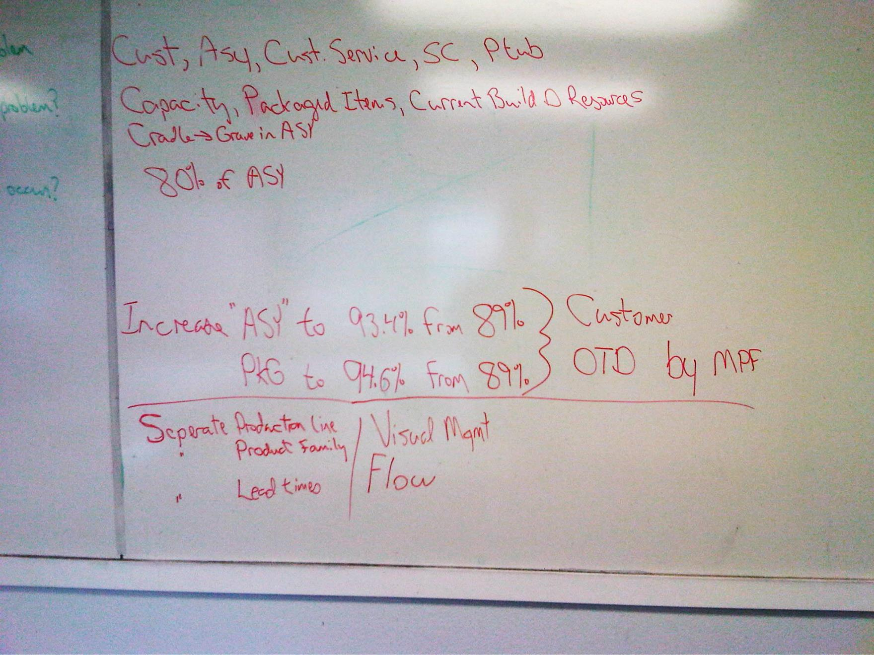
Who does it affect?
What does it affect?
When does it occur?
What measurements?
How to fix?

