Slide 1

Forging new generations of engineers

Slide 2
Tolerances

Slide 3
Variation is Unavoidable
No two manufactured objects are identical in every way. Some degree of variation will exist.
Engineers apply tolerances to part dimensions to reduce the amount of variation that occurs.

Slide 4
ANSI/ASME Standard
ANSI/ASME Standard Y14.5
Each dimension shall have a tolerance, except those dimensions specifically identified as reference, maximum, minimum, or stock. The tolerance may be applied directly to the dimension or indicated by a general note located in the title block of the drawing.
Notes:
ANSI is an acronym that stands for the American National Standards Institute.
ASME is an acronym that stands for the American Society of Mechanical Engineers.

Slide 5
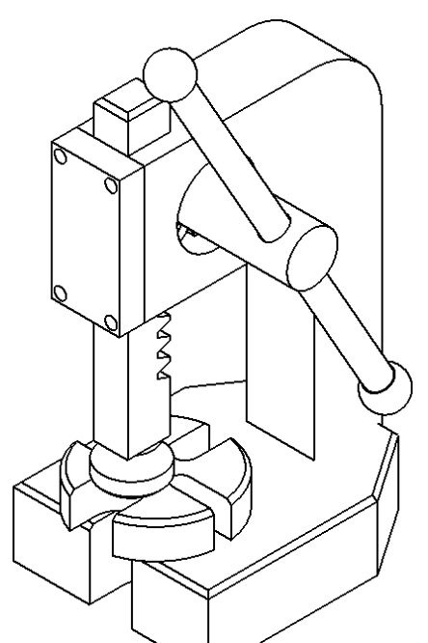
Tolerances
A tolerance is an acceptable amount of dimensional variation that will still allow an object to function correctly.

Slide 6
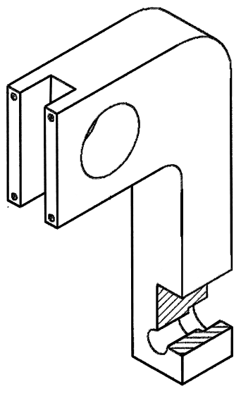
Tolerances
A tolerance is an acceptable amount of dimensional variation that will still allow an object to function correctly.

Slide 7
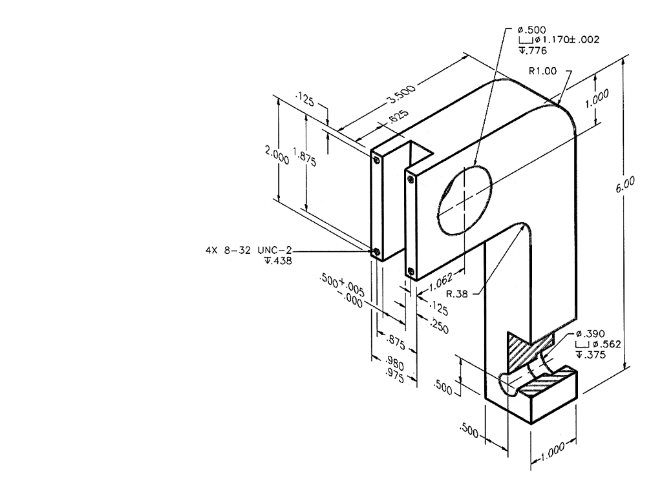
Tolerances

Slide 8
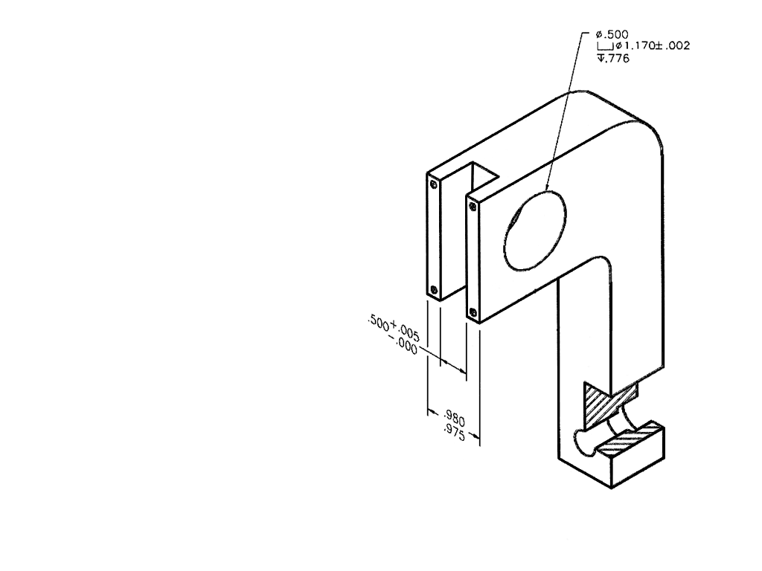
Tolerances
Three basic tolerances that occur most often on working drawings are: limit dimensions, unilateral, and bilateral tolerances.

Slide 9
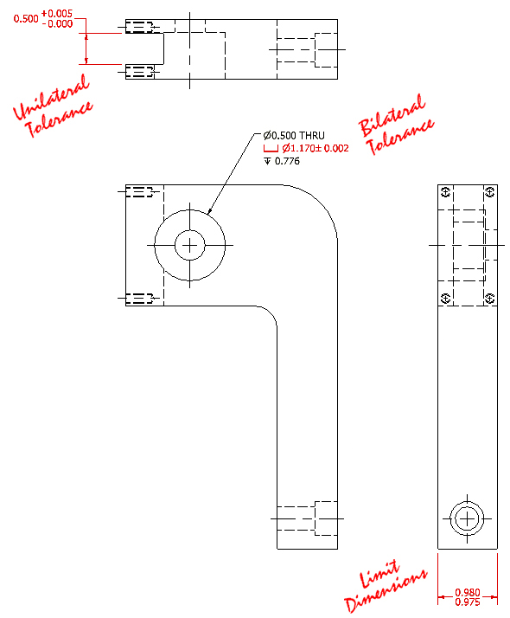
Tolerances
Three basic tolerances that occur most often on working drawings are: limit dimensions, unilateral, and bilateral tolerances.

Slide 10
Limit Dimensions
Limit dimensions are two dimensional values stacked on top of each other. The dimensions show the largest and smallest values allowed. Anything in between these values is acceptable.

Slide 11
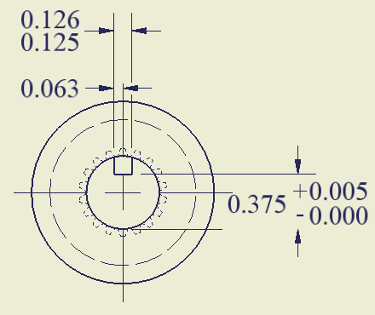
Limit Dimensions
These are limit dimensions,
because the upper and
lower dimensional sizes are
stacked on top of each other.

Slide 12
Unilateral Tolerance
A unilateral tolerance exists when a target dimension is given along with a tolerance that allows variation to occur in only one direction.

Slide 13
Unilateral Tolerance
This tolerance is
unilateral, because
the size may only
deviate in one direction.

Slide 14
Bilateral Tolerance
A bilateral tolerance exists if the variation from a target dimension is shown occurring in both the positive and negative directions.

Slide 15
General Tolerances
If no tolerances are specified at the dimension level, then general tolerances may be applied by deliberately controlling the number of values past the decimal point on each dimension.
Linear Dimensions
X.X = ± .020
X.XX = ± .010
X.XXX = ± .005
Angles = ± .5°

Slide 16
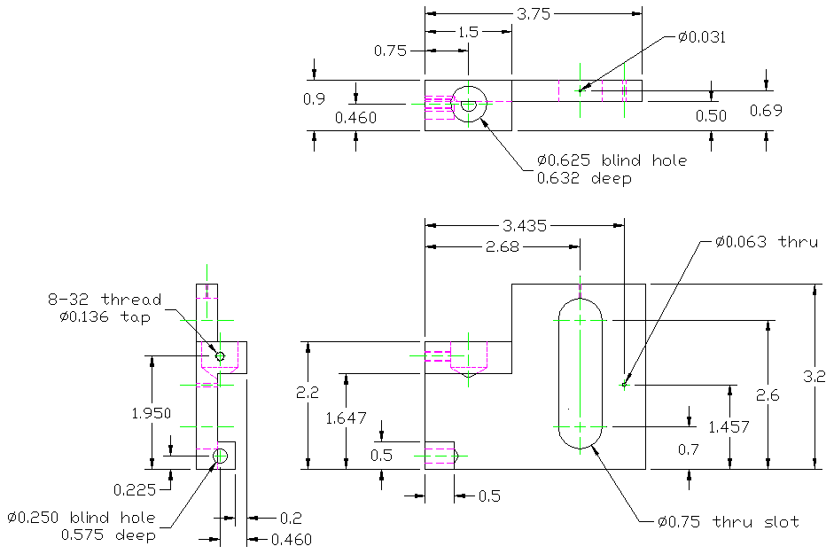
General Tolerances
Tolerances
X.X = ± .020
X.XX = ± .010
X.XXX = ± .005

Slide 17
Total Tolerance
The total tolerance is a value that describes the maximum amount of variation.
Tolerance = ±.010
Total Tolerance = .020
.020
.490
.500
.510
Target Dimension

Slide 18
Total Tolerance
A measuring device should be able to accurately measure within 1/10th of the total blueprint tolerance identified.
.020
.490
.500
.510
Target Dimension

Slide 19
Tolerances and Measuring
In this case, a measuring device should be able to take accurate measurements to within two thousandths of an inch.
Total tolerance =.020
1
x
=
10x =.020
x =.002
10
.020
X = the minimum accuracy of the measuring device

Slide 20
Three Types of Fit
There are three types of fit that should be considered when working with tolerances.
Clearance Fit- have limits of size so prescribed that a clearance always results when mating parts are assembled.
Interference Fit- have limits of size so prescribed that an interference always results when mating parts are assembled.
Transition Fit- have limits of size indicating that either a clearance or an interference may result when mating parts are assembled.

