Slide 1
Kaizen
Training for Operational Excellence

Slide 2
Agenda
Agenda
Introduction to Kaizen
Teamwork
Improvement Strategy
PDCA - the Practice of Kaizen

Slide 3
Introduction to Kaizen
Kaizen: A philosophy that helps to ensure maximum quality, the elimination of waste, and improvements in efficiency, both in terms of equipment and work procedures. Kaizen improvements in standardized work help maximize productivity at every worksite. Standardized work involves following procedures consistently and therefore employees can identify the problems promptly.
Toyota GB

Slide 4
Introduction to Kaizen
Why bother with Kaizen?
Toyota – Operating profit for 2016 was $25.34 billion for 10,165,000 cars sold.
VW – Operating profit for 2016 was $5.4 billion for 10,176,000 cars sold. Stated as ”its best-ever performance”
Notes:
Operating profit is the profitability of the business, before taking into account interest and taxes. To determine operating profit, operating expenses are subtracted from gross profit. Operating profit is a key number for managers to watch as it reflects the revenue and expenses that they can control.

Slide 5
Introduction to Kaizen
We cannot Kaizen without Standard Work and standard work is Not Training
Standard Work = Rules
The rule is you follow standard work until Kaizen

Slide 6
Introduction to Kaizen
Kaizen Principles
A Kaizen must satisfy one of the following principles to be considered Kaizen:
Improves Safety
Improves Quality
Reduces Waste

Slide 7
Agenda
Agenda
Introduction to Kaizen
Teamwork
Improvement Strategy
Kata - the Practice of Kaizen

Slide 8
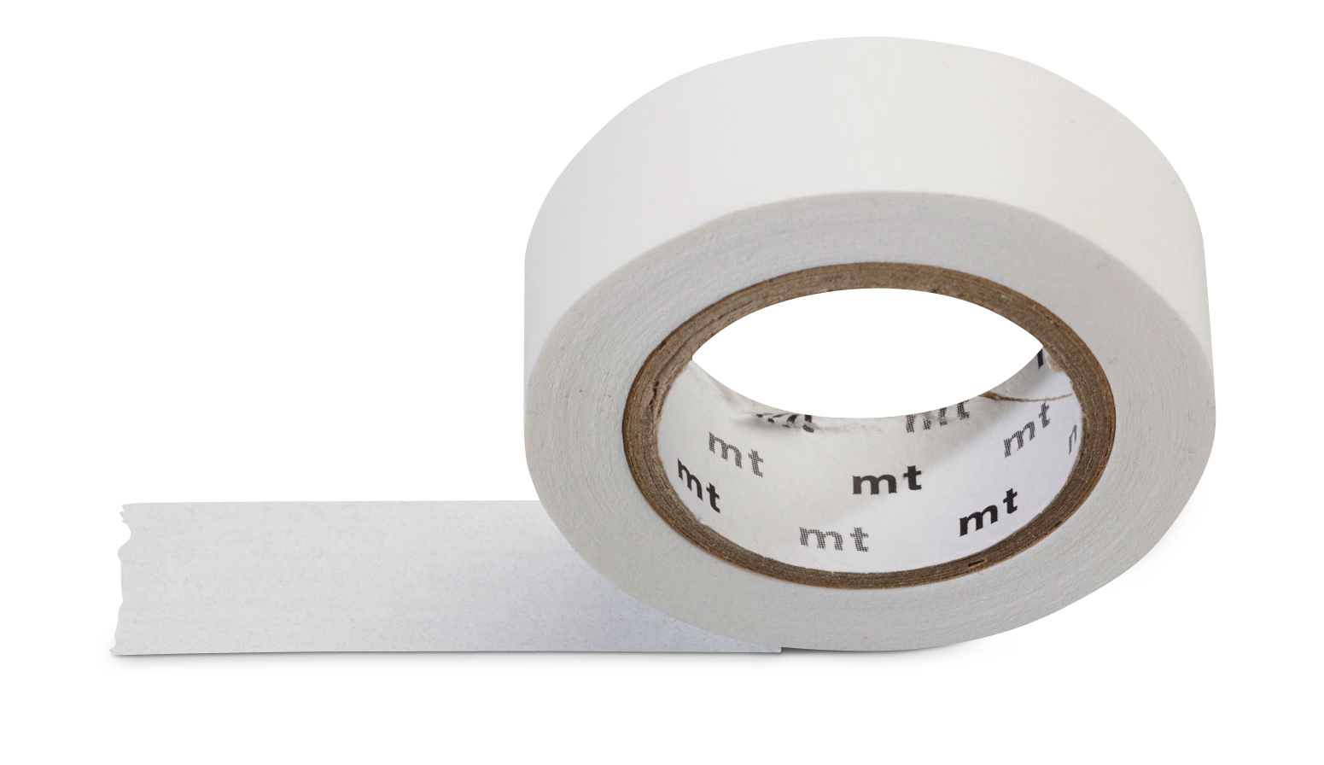
Teamwork
Marshmallow Challenge
Teams build the tallest free-standing structure in 18 minutes
20 sticks of spaghetti
1 yard of tape
1 yard of string
1 marshmallow

Slide 9
Teamwork
Marshmallow Challenge Explained

Slide 10
Agenda
Agenda
Introduction to Kaizen
Teamwork
Improvement Strategy
PDCA - the Practice of Kaizen

Slide 11
Unifying the Improvement Process
Improvement Strategy
True North
Direction
Tactical Plan
Execution Results
Daily Actions

Slide 12
Improvement Strategy
Improvement Method
Failure is proof that you are trying!

Slide 13
Agenda
Agenda
Introduction to Kaizen
Teamwork
Improvement Strategy
PDCA - the Practice of Kaizen

Slide 14
Two Skills Consistent Across ALL Contexts
PDCA Strategy
PDCA for DAILY IMPROVEMENT
Making Improvements
Developing People’s Improvement Skills
A consistent approach to making improvements unifies the organization’s efforts
Method of talent development through problem solving

Slide 15
PDCA Strategy
PDCA – Rules
There is no rank among team members
Keep an open mind to change
Don’t let “perfect” get in the way of “better”
Maintain a positive attitude
Reach for the mind before the wallet
Have Respect for each other
Ask “Why?”

Slide 16
PDCA Strategy
Kaizen - The Improvement Model
PDCA - The System of Individual Training
1
3
Get the Direction or
Challenge
Threshold of Knowledge
Establish
your Next
Target
Condition
2
4
Conduct Experiments
to get there
Grasp the Current
Condition

Slide 17
The Challenge
PDCA - Challenge
What’s the direction in which processes should be improved?
What is the overarching breakthrough challenge that each process should help achieve?
Process Team A
Target
Condition
Next
Target
Condition
Process Team B
Target
Condition
Next
Target
Condition
Challenge
Vision
A challenge typically pertains to more than one process in the organization or value stream.
Process Team C
Target
Condition
Next
Target
Condition

Slide 18
Setting Direction - The Challenge
PDCA - Challenge
Wouldn’t it be great if we could…
…have every customer calling in immediately get a live person - “Customer first time live”
…machine parts 1x1 directly in the assembly process - “Machine to assemble”
…paint parts 1x1 directly in the assembly process - “Paint to assemble”
…build one customer kitchen at a time and put it right on the truck - “Build to truck, kitchen at a time”
…have lab-test results done in 45 minutes, with no errors - “Know in 45”
…take 7 days from new patient referral to evaluation - “Just a week”
…assemble the day ordered, and ship the next day - “Same day, next day”

Slide 19
The Current Condition
PDCA - Current Condition
Understanding the Current Condition (Process Analysis) is about gaining an understanding of the current outcome performance and operation characteristics, or patterns, of the focus process so you can then define an appropriate next “Target Condition”.
You don’t have to get a perfect understanding of the current condition before proceeding to the next step.
Steps for Process Analysis of Current Condition
How is the process performing over time? (outcome)
What is the rate of demand and the desired rate of production?
Map the work pattern, measure exit cycles, graph fluctuations, record bullet points
Determine if there are equipment constraints
Determine how many people are necessary
Caution! The purpose of this process analysis is not to uncover problems, wastes or potential improvements.

Slide 20
The Target Condition…
PDCA - Target Condition
Describes a future state performance and process
Is not a solution or countermeasure, it is a description of a set of circumstances you want to reach by a specified date
Should not be something you know how to do
Ask yourself, if the problems were solved, what would my process look like?

Slide 21
The Target Condition
PDCA - Target Condition
A Target Condition IS NOT | Why
Words like these should not be in a target condition: “Minimize” “Reduce” ”Improve” “Increase” | No verbs in a target condition! That’s for how to get there, which comes later A target condition describes a desired pattern at a future point in time, not actions Transport yourself to the future state, the target condition as if you are already there
These are not target conditions: Apply 5S (Housekeeping & workplace organization) Install a barcode system Change the layout | There are countermeasures, which should not be confused with a target condition First describe how the process should operate Countermeasures are then developed as needed as you strive to reach that target condition
These kinds of statements alone are not target conditions: “A pull system” (kanban) “Milk-run material delivery” | Not enough detail A kanban or material delivery system can be a target condition, but you need to describe the pattern of how you want it to operate

Slide 22
PDCA - Target Condition
The Target Condition
Without a clear target:
With a clear target:
What should we do to improve?
What is keeping us from hitting the target?
Changeover Reduction?
Searching?
Shortages?
Variation?
Errors?
Kanban?
Mistake - Proofing?
Changeovers?
Moving Lines?
Ambiguity?
Visual Controls?
5S?
Standard Work?
The discussion becomes:
What is the best way to solve these problems?
Which leads us to the
appropriate countermeasures.

Slide 23
General Flow of Improvement
Kata Movement
Understand the Direction
Target is beyond knowledge threshold
Target Condition
Current Condition
Limits of current knowledge

Slide 24
General Flow of Improvement
Kata Movement
Understand the Direction
Target Condition
What is your target condition?
Current Condition
What is your actual condition now?
What obstacles are preventing you from reaching the target now?

Slide 25
General Flow of Improvement
Kata Movement
Understand the Direction
Target Condition
Current Condition
What is your next step or experiment and what do you expect?
When can we see what has been learned?

Slide 26
General Flow of Improvement
Kata Movement
Understand the Direction
Target Condition
Current Condition

Slide 27
General Flow of Improvement
Kata Movement
Understand the Direction
Target Condition
Current Condition

Slide 28
General Flow of Improvement
Kata Movement
Understand the Direction
Target Condition
Current Condition

Slide 29
General Flow of Improvement
Kata Movement
Understand the Direction
Target Condition
Current Condition

Slide 30
General Flow of Improvement
Kata Movement
Understand the Direction
Target Condition
Current Condition

Slide 31
General Flow of Improvement
Kata Movement
Understand the Direction
Old Target Becomes New Current Condition

Slide 32
General Flow of Improvement
Kata Movement
Understand the Direction
Target Condition
Current Condition

Slide 33
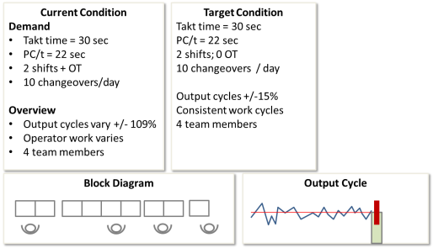
Coaching Cycle: 10-15 minutes / day
PDCA - Coaching
What is your target condition?
What is the actual condition now?
What obstacles are preventing you from reaching the target condition?
What is your next step? (start of PDCA cycle)
When can we go & see what you have learned?
Improvement Board
Coach
Learner
Set up one experiment!

