Slide 1
Leadership: The Adaptive Framework
University of Alaska
June 2017
Ronald Heifetz

Slide 2
Where are We: In the Development of “Leadership” as an Area of Study?

Slide 3
How Should We Define Leadership?
Leadership is not defined by:
The inputs of personal capacity, or
The instruments of authoritative power, and influence
Leadership is defined by:
The work that is needed
to solve tough problems and build capacity to thrive in a changing and challenging world.

Slide 4
Three Common Confusions of Leadership
Leadership = personal characteristics
Leadership = authority and influence
Leadership = value-free

Slide 5
We Confuse Leadership with Traits of Social Dominance

Slide 6
Social Dominance: Nature and Nurture
Social dominance tendencies in children are partly natural
But social dominance does not usually determine who will gain adult authority
And authority does not determine leadership

Slide 7
Leadership is better viewed as a practice, and not a set of personal characteristics

Slide 8
Distinguish Leadership from Formal and Informal Authority

Slide 9
Three Benefits to Distinguishing Leadership from Authority
We can study and guide the practice of:
Leadership with Varying Kinds of Authority
Leadership without Authority
We can encourage anyone to lead
The Practices of Authority

Slide 10
Properties of Authority
A service contract
Party A entrusts power to Party B for services
Formal or informal
Key components of the contract
Power
Trust
Service

Slide 11
Authority Relationships
Power
Entrusted
A
B
Service

Slide 12
Key Services of Authority
Direction
Protection
Order
Orientation to roles
Control of conflict
Norm maintenance

Slide 13
Trust
Predictability
Values
Competence

Slide 14
The Paradox of Trust
People will trust you when you fulfill their expectations for service
So what happens when you:
Deliver information that conflicts with those expectations?
Tell people what they may need to hear, but not what they want and expect to hear?

Slide 15
The Work of Leadership

Slide 16
View I
Power
a
Authority
Formal Authority
-Neustadt’s Powers
-Nye’s Hard Power
Informal Authority
-Neustadt’s Power
-Nye’s Soft Power
Management and Leadership
Coercion
Influence

Slide 17
View 2
Power
Authority
Formal Authority
-Neustadt’s Powers
-Nye’s Hard Power
Informal Authority
-Neustadt’s Power
-Nye’s Soft Power
Management
and
Leadership
Coercion
Influence

Slide 18
View 3
Work
Authority
Formal and Informal Authority
-Neustadt’s Powers and Influence
-Nye’s Hard and Soft Power
Management
Leadership
Adaptive
Technical

Slide 19
Distinguish Technical and Adaptive Work

Slide 20
Technical and Adaptive Work
KIND OF WORK | PROBLEM DEFINITION | SOLUTIONS & IMPLEMENTATION | PRIMARY LOCUS OF RESPONSIBILITY FOR THE WORK
TECHNICAL | CLEAR | CLEAR | AUTHORITY
TECHNICAL & ADAPTIVE | CLEAR | REQUIRES LEARNING | AUTHORITY & STAKEHOLDER
ADAPTIVE | REQUIRES LEARNING | REQUIRES LEARNING | STAKEHOLDER > AUTHORITY

Slide 21
Common Mistake
We treat adaptive challenges as technical problems
We do this for both political and personal reasons

Slide 22
Essential Questions of Adaptive Work
What cultural DNA do we keep?
What cultural DNA do we discard?
What innovative DNA will enable us to thrive in the new and challenging environment?

Slide 23
Sustainable Transformative Change is Adaptive
Cultural DNA
Conserved
Lost
New

Slide 24
Key Properties of Adaptive Work
Adaptive work demands responses outside the current repertoire.
Adaptive organizations are interdependent with their environment.
Sustainable success requires local adaptations to local environments.
Adaptive solutions are conservative as well as innovative.
The people with the problem are the problem, and the solution.

Slide 25
Key Properties of Adaptive Work
Adaptive solutions often lie within the society or organization.
Innovation toward adaptive change is experimental.
Solutions involve direct loss and indirect loss as people re-fashion loyalties and develop new competencies.
Adaptive work generates disequilibrium and avoidance because losses generate resistance.
Adaptive work takes more time than technical work.

Slide 26
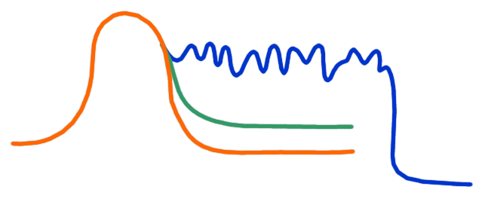
Technical and Adaptive Work
LIMIT OF TOLERANCE
PRODUCTIVE RANGE OF STRESS
DISEQUILIBRIUM
THRESHOLD OF LEARNING
WORK AVOIDANCE
ADAPTIVE CHALLENGE
TECHNICAL PROBLEM
TIME

Slide 27
Avoiding Adaptive Work
To avoid real and potential losses
By diverting responsibility or attention

Slide 28
Displace Responsibility
Look for a Big Man to fix the problem
Externalize the enemy
Attack authority
Divide the top team
Kill the messenger
Scapegoat

Slide 29
Divert Attention
Partial or Fake Remedies
Define the problem to fit our competence
Define the problem to make it somebody else’s
Misuse structural adjustments
Misuse consultants, committees, task forces
Deflect attention to side issues, irrelevant issues
Deny
Lie

Slide 30
Defining Leadership
Leadership is a practice
with and without authority
that mobilizes people and builds capacity
to make progress on adaptive challenges
in order to thrive in a changing and challenging world

Slide 31
Distinguish Management and Leadership

Slide 32
Management and Leadership
Management mobilizes the efficient coordination of complex technical problem-solving
Leadership mobilizes adaptive work: honoring the essential, discarding the expendable, and innovating to build new capacity

Slide 33
Operating from Authority Positions
Responsibilities | Mode of Operating
 | Managing | Leading
 | Situation
 | Technical | Adaptive
Direction | Define problems and solutions | Identify adaptive challenges and frame the key questions and issues
Protection | Shield the organization from external threat | Let the organization feel external threats within a productive range of distress
Order: | Restore order | Regulate disequilibrium -- within a productive range
Orientation | Clarify roles and responsibilities | Disorient current roles and resist pressure to orient people to new roles too quickly
Managing Conflict | Reduce conflict | Surface and use conflict productively
Shaping Norms | Maintain current norms | Challenge unproductive norms or let them be challenged

Slide 34
The Practice of Leadership
Near-Term
Mobilizing adaptive work
Long-Term
Building a culture of adaptability

Slide 35
A Strategy of Leadership: Mobilizing Adaptive Work

Slide 36
A Strategic Framework with Four Quadrants
 | System | Self/Role
Diagnosis | 1 | 2
Action | 4 | 3

Slide 37
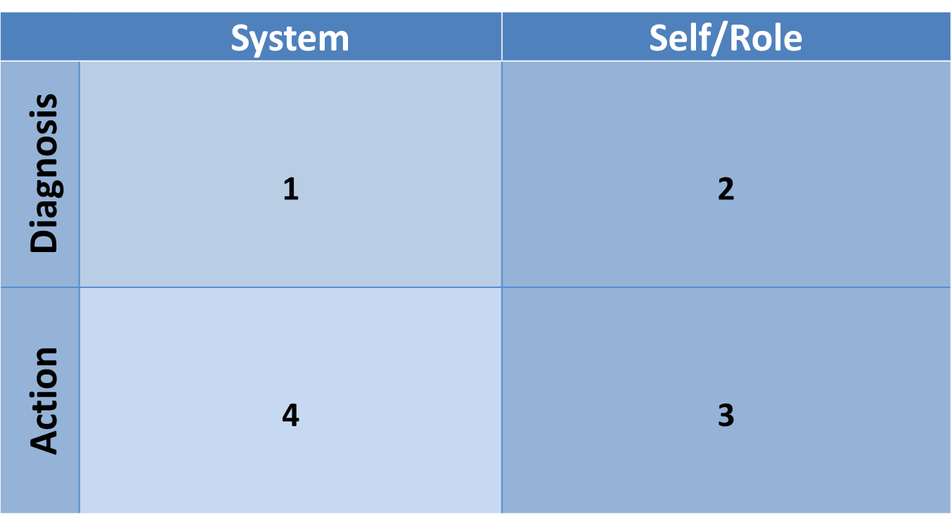
Quadrant 1: Analyzing The Work Systemically

Slide 38
Quadrant 2: Placing Yourself in the System

Slide 39
Quadrant 3: Managing Yourself

Slide 40
Quadrant 4: Taking Action

Slide 41
Quadrant 1: Analyzing The Work Systemically

Slide 42
Eight Strategic Tasks
Diagnosis
Get on the Balcony
Diagnose the Adaptive Challenges
Action
Keep Attention Disciplined
Give the Work Back to People
Build Trust
Regulate Stress
Generate More Leadership
Infuse the Work with Meaning

Slide 43
Get on the Balcony
Take an interpretive stance
Think politically
Zoom in and out iteratively, macro and micro
Consider the larger arc of change
Take time for reflection
Use partners
Reflect on your own pre-dispositions and loyalties
Whose water are you carrying?

Slide 44
Diagnose the Adaptive Challenges
Unbundle Technical from Adaptive challenges
Distinguish ripe from unripe issues
Identify the key stakeholders and their perspectives
Listen across and outside the organization
Look through authority figures to their constituents
Listen to the “song beneath the words”
Use conflict as a clue
Use your team dynamics as a case-in-point for clues

Slide 45
The Politics of Leadership
ADAPTIVE CHALLENGE

Slide 46
Quadrant 2: Placing Yourself in the System

Slide 47
Placing Yourself in the System
Placement
Mindsets of leadership
Anchoring yourself
Purposefulness
Maintaining Heart
Distinguishing Role from Self
Renegotiate Loyalties that Inhibit Diagnostic Inquiry
Practices to Stay Alive

Slide 48
Placement
You’ve been entrusted with power for services.
In analyzing your placement in the authorizing environment,
What is your authorization, i.e., what is your job?
Who are the sources of your authorization?
What are the expectations of each of these sources of authorization?
What are the cultural norms -- the unwritten rules of behavior -- that come with your authority?
What are the limits of your authority: What does your authority enable you to do? What does it not enable you to do?

Slide 49
Anchoring Yourself in Key Mindsets of Leadership
Conserve – essential values and capacity
Experiment – pervasively
Improvise – responsively
Scan – 360 degrees for new challenges
Model – consistent orienting values
Take losses – thoughtfully

Slide 50
Why Lead?
Service
The Form Doesn’t Matter
The Myth of Measurement

Slide 51
Sacred Heart
QUALITY OF HEART | BECOMES: | DRESSED UP AS:
INNOCENCE & IMAGINATION | CYNICISM | REALISM
CURIOSITY & DOUBT | ARROGANT CERTAINTY | AUTHORITATIVE KNOWLEDGE
COMPASSION | CALLOUSNESS | THICK-SKIN OF EXPERIENCE

Slide 52
Distinguish Role from Self

Slide 53
A Systems View of Yourself with Multiple Role Identities

Slide 54
Loyalties
Levels:
Professional
Social
Ancestral

Slide 55
Re-Negotiate Loyalties to Gain the Personal Freedom to Lead

Slide 56
Quadrant 3: Managing Yourself

Slide 57
Leading and Staying Alive
Get on the balcony
Seek confidants
Distinguish role from self
Listen
Manage your hungers
Anchor yourself
Purposes beyond measure

Slide 58
Quadrant 4: Taking Action

Slide 59
Eight Strategic Tasks
Diagnosis
Get on the Balcony
Diagnose the Adaptive Challenges
Action
Keep Attention Disciplined
Give the Work Back to People
Build Trust
Regulate Stress
Generate More Leadership
Infuse the Work with Meaning

Slide 60
Keep Attention Disciplined
Ask “who needs to learn what”
Frame the key challenges for each sub-group or faction
Sequence the issues
Keep key issues, questions and data at the center of attention
Counteract work avoidance patterns that divert attention

Slide 61
Give the Work Back to People
Place the adaptive work where it must be done
Encourage widespread experimentation
Model new norms to move from dependency to distributed initiative and responsibility
Cascade leadership practice to local level
Counteract work avoidance patterns that displace responsibility
Support rather than control

Slide 62
Leadership Generates Capacity, not Dependency

Slide 63
Build Trust
Provide presence and poise amidst uncertainty and travail
Keep the context ever present in people’s minds
Model the changed behavior
Listen, and acknowledge your own contribution to the problem
Disappoint expectations with honesty
Acknowledge losses
Receive anger with grace
Manage personal and organizational boundaries with utmost integrity
Learn publicly
Make good use of allies
Keep the opposition close
Accept casualties

Slide 64
The Holding Environment
Vertical and Horizontal Bonds of Trust
Authority
Social Capital

Slide 65
Regulate Stress
Strengthen the holding environment for cross-boundary work
Maintain a productive level of disequilibrium
Depersonalize the conflicts: distinguish role from self
Pace the work
Take the heat and hold steady
Presence and Poise: tolerate uncertainty, frustration, and pain
Maintain a collective sense of purpose

Slide 66
Generate More Leadership
Protect unauthorized voices of leadership
Control your reflex to squelch variant voices
Coach creative and challenging people for effectiveness
Tease out people’s intuitions and provide time for analysis
Protect people who name internal contradictions

Slide 67
Leadership Generates Leadership

Slide 68
Infuse the Work with Meaning – The Narrative
Develop and extensively communicate a narrative that:
Helps people comprehend the developments in their lives
Locates and orients each segment in a process
Articulates orienting values
Manages expectations for quick and easy solutions
Builds from and conserves the past
Names the losses and sustains people through transitional pain
Depersonalizes the conflicts
Engages people in their adaptive work
Calls forth people’s resourcefulness

Slide 69
Two Special Time Frames: Crisis and Culture Change

Slide 70
Crisis
Properties:
High Stakes
High Uncertainty
Urgency – Time Compression
Two Phases:
Acute Phase
Adaptive Phase

Slide 71
Acute Phase
Goal:
Stabilize the situation
Purpose:
Survive and buy time for Adaptive work

Slide 72
Acute Phase
Tasks:
Regulate Disequilibrium
Provide presence, structure, and hope
Speak to people’s experience
Maintain confidence and poise
Drive the organizational response
- Improvise to the extent possible
Frame the key issues for the Adaptive phase

Slide 73
Adaptive Phase
Goals: Short and Long-Term:
Meet the initial adaptive challenges
Build a more adaptive culture
Purpose:
To thrive in a changing and challenging world

Slide 74
Adaptive Organizations

Slide 75
Adaptive Organizations
Build a strong holding environment of vertical and horizontal bonds of trust
Build an ethos of shared responsibility
Sense early and respond quickly to the environment
Put the tough issues on the table
Reward and learn fast from ongoing experimentation
Encourage people to lead with and beyond their authority
Develop people daily

Slide 76
Discussion: Strategic Tasks
Get on the Balcony
Proposition: People often get swept up in the action and lose perspective.
How might you help yourself to reflect in the midst of action?

Slide 77
Discussion: Strategic Tasks
Diagnose the Adaptive Challenges
Proposition: People often confuse technical problems with adaptive challenges.
What are some diagnostic indicators to identify an adaptive challenge?

Slide 78
Discussion: Strategic Tasks
Keep Attention Disciplined
Proposition: People often avoid adaptive work by diverting attention away from the issues that generate frustration and conflict.
Give an example of an action you took to maintain disciplined attention.

Slide 79
Discussion: Strategic Tasks
Give the Work Back to People
Proposition: People often avoid adaptive work by displacing responsibility for tough issues away from themselves.
Give an example of an action you took to give the work back to the relevant stakeholders.

Slide 80
Discussion: Strategic Tasks
Build Trust
Proposition: Adaptive learning is inherently political.
Identify the relevant parties to a recent strategic initiative. What real or potential loss, disloyalty, or incompetence are you asking them to endure?

Slide 81
Discussion: Strategic Tasks
Regulate Stress
Proposition: Too much disequilibrium overwhelms people, not enough stagnates.
What actions can you take to raise and to lower the stress to keep it within a productive range?

Slide 82
Discussion: Strategic Tasks
Generate More Leadership
Proposition: Variant perspectives can become a source of creativity rather than a source of destructive conflict.
What could you do differently to protect variant perspectives among your colleagues and have them become a source of creativity?

Slide 83
Discussion: Strategic Tasks
Infuse the Work with Meaning
Proposition: People need to feel committed to the work they’re doing, in spite of the sacrifices.
How might you take further action to infuse work with meaning?

