Slide 1
Introduction to Industrial Robotics
Chapter 2

Slide 2
Overview
WHAT YOU WILL LEARN
  What an industrial robot is
  Some of the history behind modern technologies
  Key events leading to the modern industrial robot
  The four Ds of robotics
  Where and why we use industrial robots

Slide 3
What is an Industrial Robot?
The word robot was first used by Karel Capek in 1921 in his play R.U.R. (Rossum’s Universal Robots) and comes from the Czech word robota, which means “drudgery or slave-like labor.”
The Robotic Industries Association (RIA) defines an industrial robot as an automatically controlled, reprogrammable, multipurpose manipulator programmable in three or more axes, which may be either fixed in place or mobile for use in industrial automation applications

Slide 4
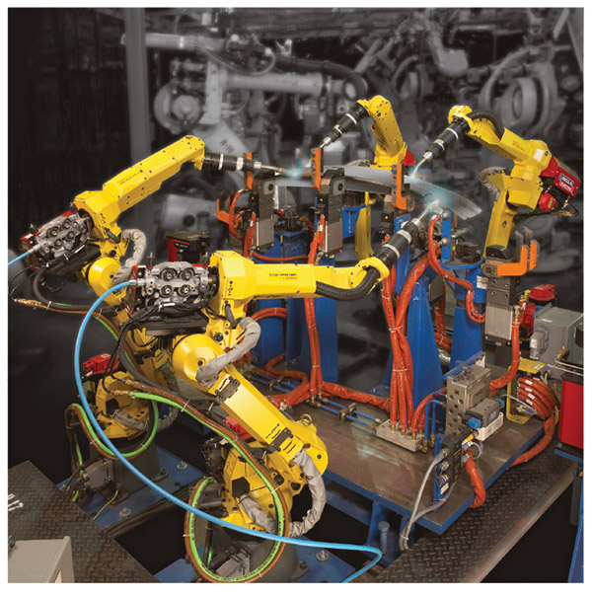
Figure 2-2
This is a perfect example of a robotic system that meets the RIA definition.
Systems like these are used all over the world to assist in the manufacturing process for a multitude of items.

Slide 5
A History of Technology
420 – Archytas of Tarentum creates a wooden pigeon that can fly under steam or compressed air power
1206 – Al-Jarzai Publishes a book on mechanical and automated devices heralded as the most complete collection of such information at the time.
1495 - Leonardo da Vinci Creates ‘Metal-Plated Warrior’, a suit of armor that sat up, open and closed its arms, moved its head, and open its visor

Slide 6
A History of Technology cont.
1525 – Hans Bullman credited with building the first real androids with human form
1620 – William Oughtred plots a logarithmic scale along a single, straight 2-foot-long ruler (slide rule)
1623 – Wilhelm Schickard invents the ‘Rechenuhr’, a four-function calculator that performs addition, subtraction, multiplication, and division

Slide 7
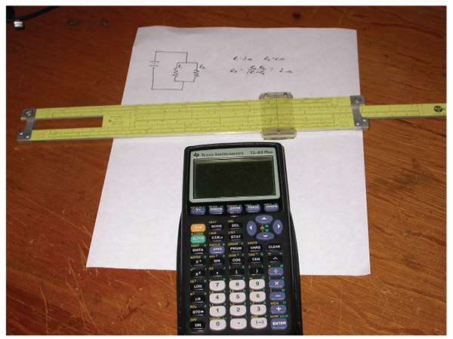
Figure 2-3
Here you can see a slide rule, which was in use from 1620 until the 1970s, when it was replaced with the scientific calculator, also show in the picture.
Our ability to describe a process or interaction mathematically often proceeds any great use of a discovery.

Slide 8
A History of Technology cont.
1679 – Gottfried Wilhelm von Leibniz develops and perfects the binary system of arithmetic
1746 –Pieter van Musschenbroek, a Dutch physicist, accidentally discovers the Leyden jar, a device for storing static charge and the predecessor of the modern capacitor
1752 –Benjamin Franklin conducts his famous kite experiment and proves that lightning is a form of electricity; this led to further experiments and several common terms still in use today

Slide 9
A History of Technology cont.
1771 – Richard Arkwright, Jedediah Strutt, and Samuel Need sets up the first true factory next to the river Derwent in Cromford, Derbyshire
1772 – Pierre Jaquet-Droz Builds ‘The Writer’, a child figure that writes with spacing and punctuation and is controlled by a programmable mechanical computing device of impressive complexity
1786 –Luigi Galvani used the Leyden jar to cause muscle contractions in the leg of a frog as part of his effort to understand how electricity affected animals

Slide 10
A History of Technology cont.
1800 – Alessandro Volta created the voltaic pile, a battery consisting of alternating disks of zinc and silver or copper and pewter separated by paper or cloth soaked in either salt water or sodium hydroxide
1804 – Joseph-Marie Jacquard invents the Jacquard loom, an automation system for looms utilizing a punch card control system
1810 – Friedrich Kaufmann creates a mechanical trumpet player controlled by a stepped drum

Slide 11
A History of Technology cont.
1827 – Georg Simon Ohm, a German physicist, gave the world Ohm’s law, a mathematical representation of how voltage, current, and resistance all interact
1831 – Michael Faraday discovered electromagnetic induction, the principle behind power generation as we know it today and the first consistent way to generate power via a means other than chemical interactions or static charges
1835 – Charles Babbage designs an analytical engine complete with processor and memory functions that many credit as the world’s firs general-purpose computer, even though the machine was not built

Slide 12
A History of Technology cont.
1839 – Sir William Grove creates the first fuel cell
1841 – James Prescott Joule stated Joule’s law, which we commonly know as the power formula today
1843 – Augusta Ada King publishes her notes on Babbage’s analytical engine, which are considered the first example of a computer program
1847 – Gorge Boole publishes his “Mathematical Analysis of Logic” which he later developed into what we call Boolean Algebra, a type of math widely used in the computing field

Slide 13
A History of Technology cont.
1873 – William Thomson develops a tide predictor that is a special purpose analog computer
1882 – Nikola Tesla creates the concept for the modern AC induction motor
1889 – Herman Hollerith patents his punch card driven tabulation machine used in conjunction with the 1890 census
1895 – Nikola Tesla designs the world’s first AC power plant at Niagara Falls

Slide 14
A History of Technology cont.
1898 – Nikola Tesla patents his design for a radio-controlled boat
1943 – Thomas H. Flowers and his group develop Colossus, credited as the world’s first electronic computer
1958 – Jack Kilby creates the first microchip, an invention crucial to the electronics field
1958 – FANUC ships the first commercial Numerically Controlled (NC) machine to Makino Milling Machine Co., Ltd

Slide 15
The Rise of the Industrial Robot
1892 – Seward Babbitt and Henry Aiken patents a crane with a gripper, designed primarily to help with moving metal billets
1941 – Harold Roselund directs the building of the first industrial robot for the DeVilbiss company, based off the patented design of Willard L.G. Pollard Jr.
1957 – Planet Company demonstrates PLANETBOT, their five axes, Hydraulically powered, polar coordinate arm at an international trade fair

Slide 16
The Rise of the Industrial Robot cont.
1960 – American Machine and Foundry ships the first VERSATRAN, a programmable robotic arm designed by Harry Johnson and Veljko Milenkovic
1961 – George Devol receives the patent for an arm type industrial robot that would be produced by the robotics company Unimate and used by GM
1967 – AMF ships a VERSATRAN robot to Japan for industrial use

Slide 17
The Rise of the Industrial Robot cont.
1968 – Kawasaki Robotics starts production of hydraulically powered robots under the Unimation License
1969 – Victor Scheinman designs the Stanford Arm, an all-electric computer controlled robotic arm used to assemble various parts during lab experiments
1971 – Intel Corporation develops a microprocessor that would later power the T3 robot
1973 –Cincinnati Milacron releases the T3 robot arm that Richard Hohn designed for them, which is credited as the first commercially available microcomputer controlled industrial robot

Slide 18
The Rise of the Industrial Robot cont.
1974 – David Silver designs the Silver Arm, which could assemble small parts using built in touch and pressure sensors
1974 – Leif Jonsson Takes delivery of ASEA’s (now ABB) all electric, microprocessor controlled robot for Magnussons, a company in Sweden.
1974 – FANUC Ltd. of Japan began to develop and install robots in its factories in Japan
1976 – KUKA built FAMULUS, its first six-axis industrial robot

Slide 19
The Rise of the Industrial Robot cont.
1976 – MOTOMAN begins as a robotic welding company in Europe
1977 – Victor Scheinman sells his company VICARM to Unimation, which ultimately leads to the development of the Programmable Universal Machine for Assembly (PUMA) robot
1977 – The FANUC cooperation is established in the United States
1979 – ASEA built its first welding robot

Slide 20
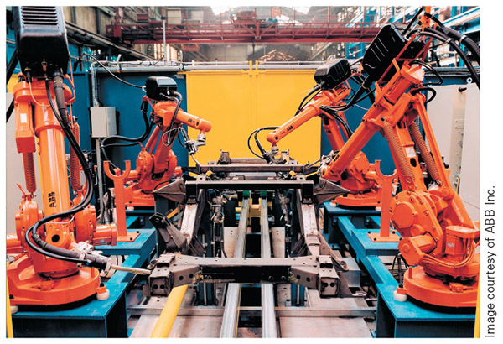
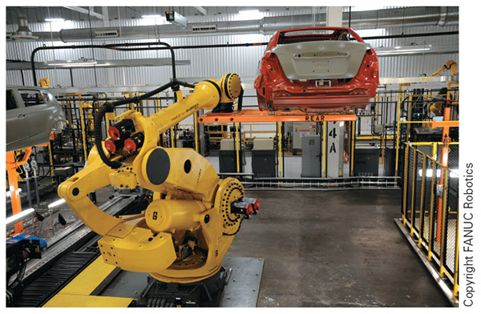
Figure 2-4
Figure 2-5
On the left you can see some modern day ABB robots hard at work. On the right you can see one of the largest robots FANUC makes moving a car body with ease.

Slide 21
The Rise of the Industrial Robot cont.
1978 – Hiroshi Makino develops the SCARA (Selective Compliant Articulated Robot Arm) at the Yamanashi University, which sold in the United States as the IBM 7535, holding the honor of being the first industrial Japanese robot
1979 – ASEA built its first welding robot
1981 – Dr. Robert J. Shillman leaves MIT to start COGNEX, a vision system company, that in 1982 released the world’s first industrial optical character recognition (OCR) system DataMan

Slide 22
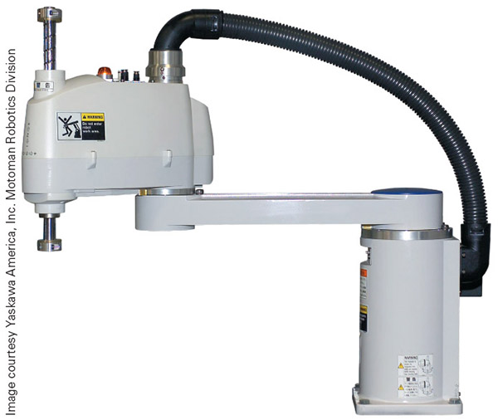
Figure 2-6
Here you can see a MOTOMAN YS650 SCARA style robot

Slide 23
The Rise of the Industrial Robot cont.
1982 – FANUC Corporation entered into a joint venture with General Motors known as GMFanuc
1983 – Adept Technology produces industrial robots, machine vision systems, and other automation equipment in the United States in the same year of the company’s creation
1984 – Takeo Kanade and Haruhiko Asada receives the patent for the first direct drive robotic system, greatly increasing the speed and accuracy of robotics

Slide 24
The Rise of the Industrial Robot cont.
1985 – Kawasaki begins their own global business as their collaboration with Unimation ends
1989 – The Staubli Group bought Unimation from Westinghouse, using it as the foundation of a new Staubli robotics division.
1990 – Cincinnati Milacron sold its robotics line to ABB
1992 – General Motors sold its share of the robotics company due to finical issues, and GMFanuc became FANUC Robotics Corporation, a wholly owned subsidiary of FANUC Ltd

Slide 25
The Rise of the Industrial Robot cont.
2000 – NASA Produces the first version of the Robonaut, a dexterous robot designed to work with astronauts
2004 – Aaron Edsinger-Gonzales and Jeff Weber design Domo for MIT
  a robotic research platform to advance human-robot interaction, utilizing a unique feedback system to make it safer for human interaction
2006 – MOTOMAN introduces a dual-arm robot with 13 axes, with all cabling run internally, and a human torso appearance

Slide 26
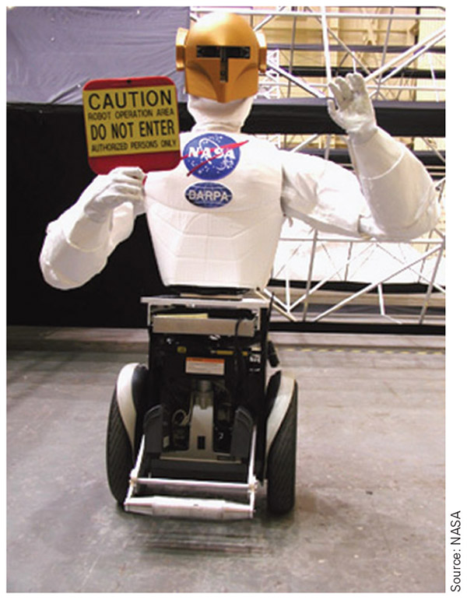
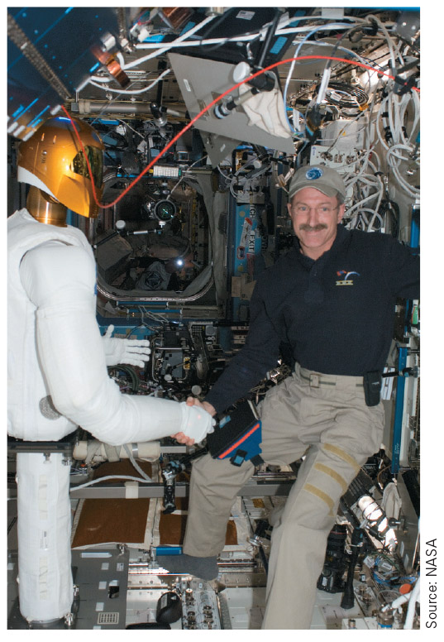
Figure 2-8
Figure 2-9
On the right is the Robonaut on its wheel base for added mobility. On the left, Robonaut performing the first human/robot handshake in space in 2012.
The torso is designed to move like a human body, giving it a wide range of functionality.

Slide 27
The Rise of the Industrial Robot cont.
2007 – NASA partners with General Motors to begin work on the Robonaut 2
2009 – MOTOMAN releases the DX100 controller that can control up to eight robots or 72 axes of movement
2012 – NASA’s Robonaut 2, a collaborative work of NASA and General Motors, completes the first human/robot handshake in space
2012 – Rethink Robotics releases Baxter, a low cost humanoid torso type robot designed to be easily taught tasks, work safely around humans, and require minimal setup straight out of the box

Slide 28
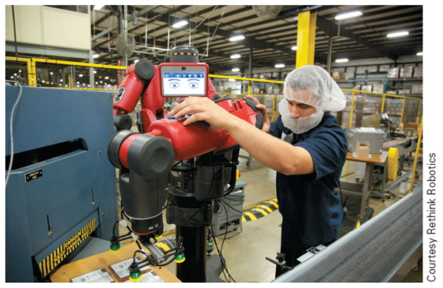
Figure 2-7
Here you can see Baxter at work in an industrial setting, cage free, along with a human operator.

Slide 29
The Rise of the Industrial Robot cont.
2013 – Multiple collaborative robot models were available, Motoman’s Dexter Bot, KUKA’s LBR iiwa, Universal Robots’ UR, and ABB’s dual-arm concept prototype.
2013 – NASA’s Johnson Space Center Engineering Directorate created the R5, commonly known as the Valkyrie robot, to compete in the 2013 DARPA Robotics Challenge Trials
2014 – Yaskawa Motoman’s dual-arm robot was in its fifth generation of development, Universal Robots doubled their sales, and he use of various robotic systems for welding applications expanded

Slide 30
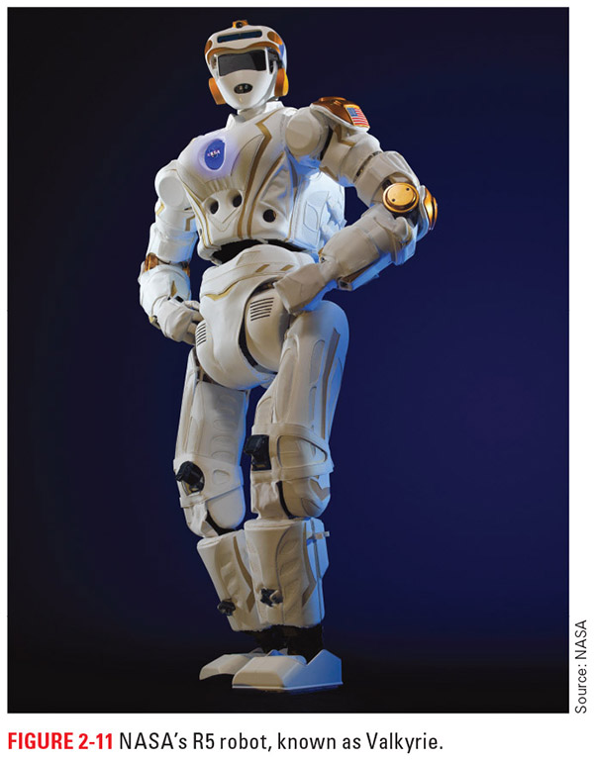
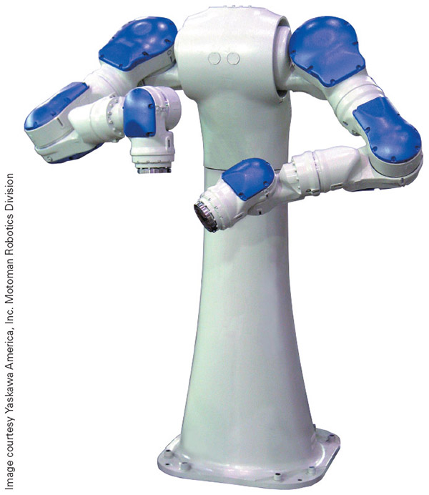
Figure 2-11
Figure 2-12
On the left you can see the R5, known as the Valkyrie robot, designed by NASA.
On the right is Yaskawa Motoman’s dual-arm robot.
Both of these are great examples of the advancements in robotic technology.

Slide 31
The Rise of the Industrial Robot cont.
2015 – Marked by a deeper focus on sensors, software, and tooling for the robot, rather than by advances in the core robotic system
2015 – Rethink Robotics released Sawyer, an arm-type robot that utilized the collaborative technology of the Baxter robot, but was designed as a better fit for industrial applications to open up new utilization markets
2015 – FANUC announced both a collaboration with Cisco in which Cisco devices will be embedded directly into FANUC’s robots for data collection and down-time prediction and the company’s best performance in sales and manufacturing to date

Slide 32
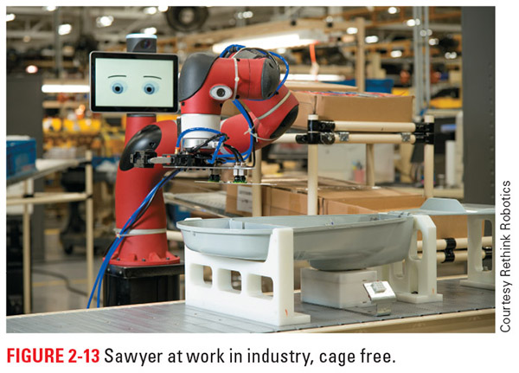
Figure 2-13
Here is Rethink Robotics Sawyer robot, optimized to work in industry and full of technology perfected in the Baxter model.

Slide 33
The Rise of the Industrial Robot cont.
2016 – FANUC continued its trend of connectivity and data usage started with the Cisco merger to create a Cloud-based system at GM’s Lake Orion facility
2016 – Yaskawa Motoman announced its partnership with Clearpath to develop a mobile machine tending and material movement solution
  This system consists of Clearpath’s OTTO 1500 self-driving vehicle with a Motoman MG12 robot mounted on top to allow for system reach and tooling options otherwise not possible

Slide 34
The Rise of the Industrial Robot cont.
2016 – The International Organization for Standardization (ISO) released ISO/TS 15066:2016, which specifies safety requirements for collaborative industrial robot systems
2016 – China International Robot Show (CIROS), ABB’s YuMi collaborative robot was named the 2016 best industrial robot and won a Golden Finger award

Slide 35
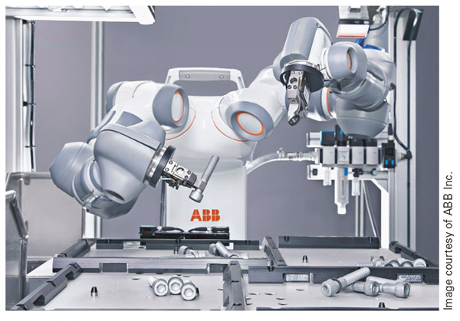
Figure 2-14
Here you can see ABB’s YuMi® robot, their collaborative robot that ABB promotes as the “world’s first truly collaborative robot”

Slide 36
Why Use a Robot?
The four Ds
  Dull, Dirty, Difficult, or Dangerous
The four Hs
  Hot, Heavy, Hazardous, and Humble
These two are similar in nature and a good summary of why we use robots

Slide 37
Dull/Humble
Tasks that are repetitive in nature and often require little or no thought
The danger to the human worker in these situations is often damage to the body due to doing the same thing over and over and over again for weeks, months, or years on end
Another danger with dull tasks is that the worker may become bored and not pay attention to what he or she is doing, which could lead to damage to the person, part, and/or machine

Slide 38
Dirty/Hot
Dirty tasks in industry involve processes that produce dust, grease, grime, sludge, or other substances that people would rather not get on them
The dirtiness of the job may affect worker satisfaction, which in turn can affect productivity, product quality, and the turnover rate (how often workers quit a job or leave an employer)
When using a robot in a dirty environment, the only real concern is damage to the mechanical parts of the robot

Slide 39
Difficult/Heavy
This consideration includes all the tasks in industry that humans struggle to perform
The construction of various machines and the processes involved in production at times require people to bend, twist, and move in ways that are difficult for the human body
Sometimes the difficulty arises due to a combination of position and weight
Sometimes it is simply difficult for workers to reach the point needed due to the physical limitations

Slide 40
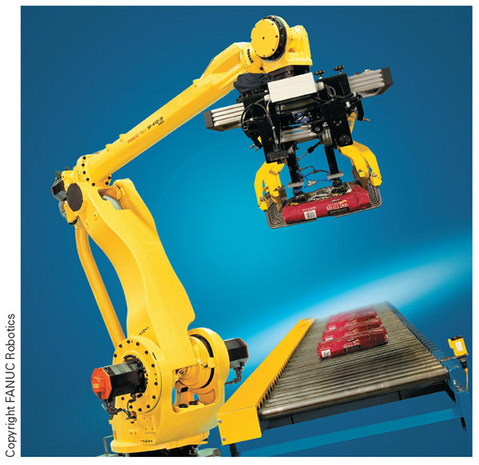
Figure 2-15
Here is a job that is both dull and difficult for humans to perform, a great fit for robotic applications.

Slide 41
Dangerous/Hazardous
These environments can be excessively hot, contain toxic fumes or radiation, involve working with unguarded machinery, or include any other condition that has a high risk of injury or illness for humans
A person may require months or years of medical assistance following an injury or illness and even then, never attain the quality of life he or she once had
Robots only require replacement of parts or a new system can be purchased

Slide 42
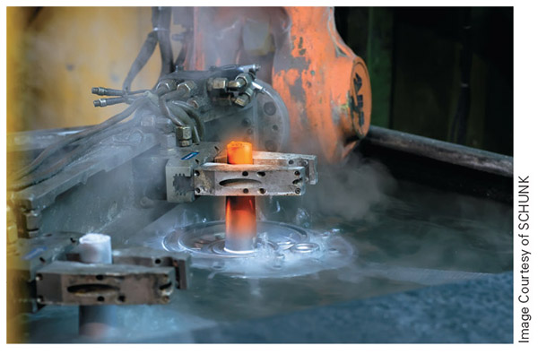
Figure 2-16
This is a perfect example of a dangerous/hazardous job! Notice the glowing hot metal and all the vapor coming off the bath around it.

Slide 43
Why Use a Robot? cont.
Precision: Robots have the capacity to perform tasks repeatedly with levels of precision that are difficult, if not impossible, for humans to match
  Many robots have tolerances ranging from 0.35 mm to 0.06 mm (0.014 in. to 0.002 in.)
Consistency: the ability to produce the same results or quality each time
Repeatability: the ability to perform the same motions within a set tolerance

Slide 44
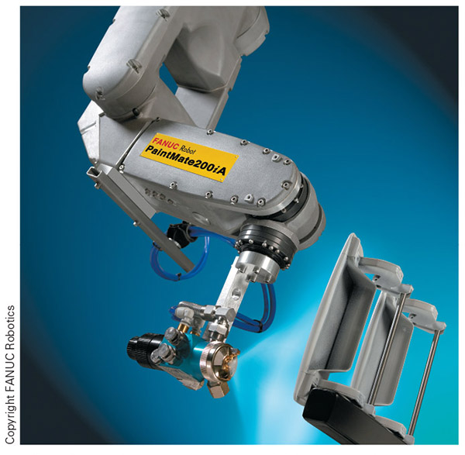
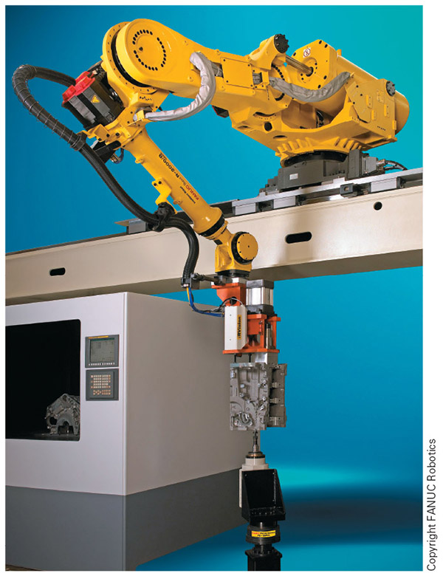
Figure 2-17
Figure 2-18
Here are a couple of applications where precision and repeatability are very important

Slide 45
Why Use a Robot? cont.
Cost savings:
  No fringe benefit costs
  Running costs as low as 42 cents per hour
  Lower scrap costs
  Faster production speeds
  Repeatable quality each time
  Collaborative systems with reduced safety needs
  Complex inspection of each part

Slide 46
Why Use a Robot? cont.
Flexibility
  New operation by changing tooling and program
  Ability to perform a wide range of operations such as weld, paint, inspect, pick and place, machine, polish, etc.
  Able to mimic most human motion

Slide 47
Review
What is an industrial robot? We defined the industrial robot and began our exploration of industrial robotics.
A history of technology. We explored some of the history outside of robotics that was specifically necessary to evolve the technology used by the modern robot.
The rise of the industrial robot. We focused on events in the timeline of industrial robotics, including the first industrial robot.
Why use a robot? we looked at some of the reasons behind robotic use in industry, including both human and technology factors

