Slide 1
Classification of Robots
Chapter 4

Slide 2
Overview
WHAT YOU WILL LEARN
  How to classify robots by their power source
  How to classify robots by their work envelope and the kind of reach they have
  How to classify robots by their drive system
  How the International Standards Organization (ISO) classifies robots

Slide 3
How are Robots Classified?
First we must define a unifying characteristic such as:
  Power source
  Shape of the work envelope
  Programming method
  By the type of jobs it is optimized for
  Type of drive system used to move the robot
  Or any other method useful for comparison
Often we refine a broad classification with other refining qualifications when determining the best robot for the job

Slide 4
Power Source
One of the common first sorting methods is power source
  Often this is matched up with what is readily available or required by the task
The three common industrial power sources are:
  Electrical
  Hydraulic
  Pneumatic

Slide 5
Electric
DC systems often provide greater torque, but may require more maintenance for the motors
  Brushed motors generate sparks and dust, both creating hazards to the process
AC is a common choice for industry and drives both stepper and servomotors
  Stepper motors move a set portion of the rotation with each application of power
  Servomotors are a continuous rotation type motor with built in feedback devices called encoders, which provide feedback about the motor’s rotational position

Slide 6
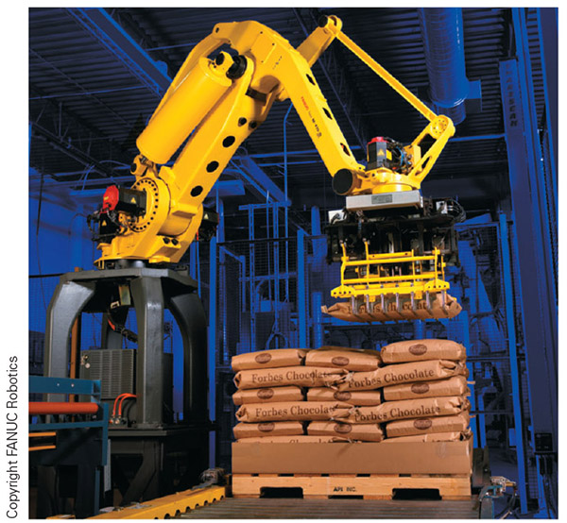
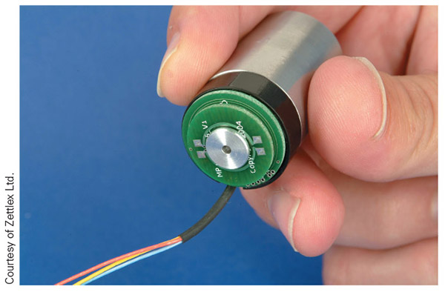
Figure 4-1
Figure 4-2
To the left you can see a FANUC robot run by servo motors (the black parts with red tops)
Above is an encoder used to provide positional information to the robot

Slide 7
Hydraulic
Hydraulic power is known for generating large amounts of force and is still used in robotics for heavy loads
  With the improvements in servo motors, the hydraulic robot is losing ground to comparative electric models
  On a side note, this system uses some other form of energy to generate the hydraulic pressure such as an electric motor and pump, but the robot will move via hydraulic means

Slide 8
Hydraulic cont.
There are some down sides to hydraulic robots:
  Hydraulic leaks
  Cost of oil
  Fire hazard (mostly as a mist)
  Increased maintenance
  Increased noise

Slide 9
Pneumatic
The largest problem with pneumatic robots is the difficulty maintaining position
  Because gas is compressible, stopping mid-stroke or mid motion leads to drifting
  The only sure way to hold position is to use some kind of hard stop and constant pressure
  Noise and leaks are another problem to contend with
  On the plus side, these systems are very fast and most industries have a ready supply of cheap pneumatic pressure
  Pneumatics are commonly used to power robot tooling

Slide 10
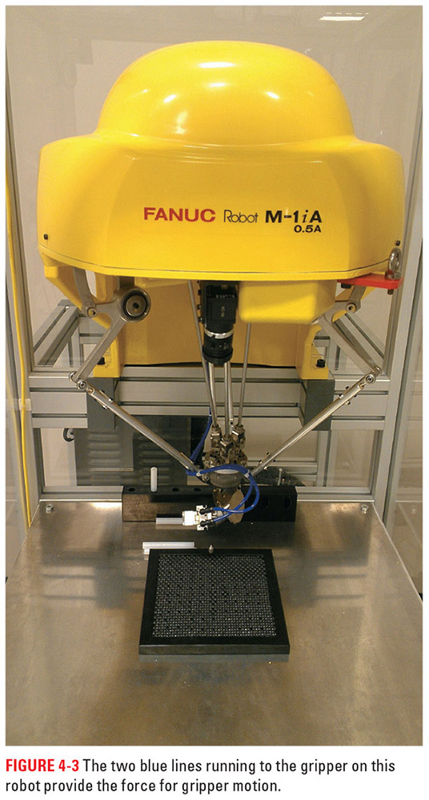
Figure 4-3
The blue hoses in this picture power the gripper action of the tooling attached to this FANUC Delta style robot

Slide 11
Geometry of the Work Envelope
Another common way of grouping robots is by the area they can reach or the work envelope
  Cartesian
  Cylindrical
  Spherical
  Articulated
  SCARA
  Horizontally Base-Jointed Arm
  Delta

Slide 12
Cartesian Geometry
These systems have a cubic or rectangular work envelope
  Many gantry-type robots fall into this group
These robots often have two or three major axes to move in:
  X is front to back
  Y is side to side
  Z is up or down
  When there are only two major axes, X is often the one omitted

Slide 13
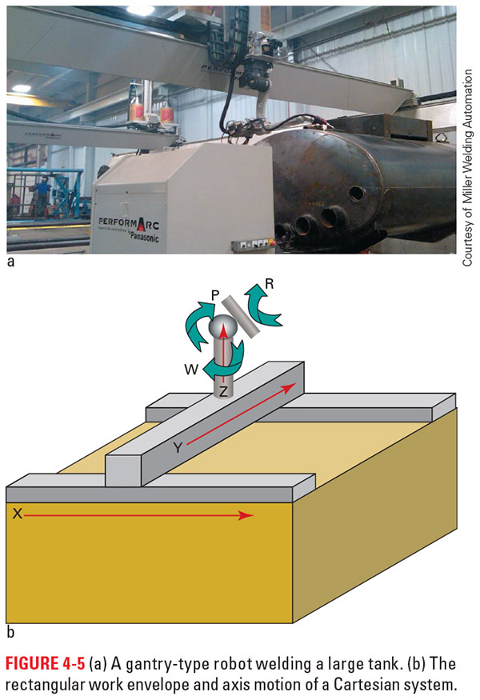
Figures 4-5a and b
Here you can see a gantry robot showing off the impressive coverage of the system. Below is a diagram of Cartesian motion

Slide 14
Cylindrical Geometry
The work envelope of these robots resembles a cylinder
  These robots commonly have a rotary axis on the base to spin the robot, two linear axes to move the tooling into the general work area, and then two or three minor axes for tooling orientation
  These systems are good for reaching deep into machines, save on floor space, and tend to have the rigid structure needed for large payloads

Slide 15
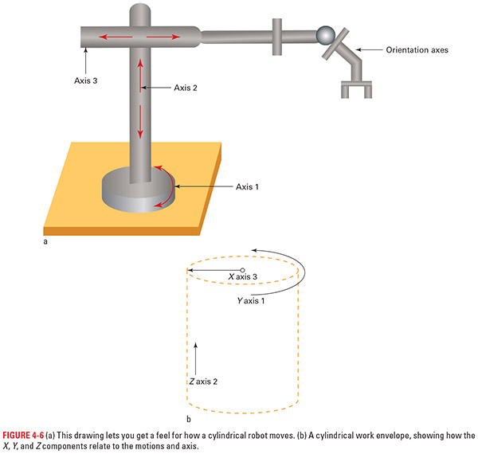
Figures 4-6a and b
Here you can see the basic layout of a cylindrical robot and to the right is the work envelope for said robot

Slide 16
Spherical Geometry
This robot’s work envelop is a ball, cut off by where the robot mounts
Spherical, or polar, geometry gives the user a wide range of options for robot positioning
The primary difference between cylindrical and spherical robots is that the spherical units have a long reach with a smaller size

Slide 17
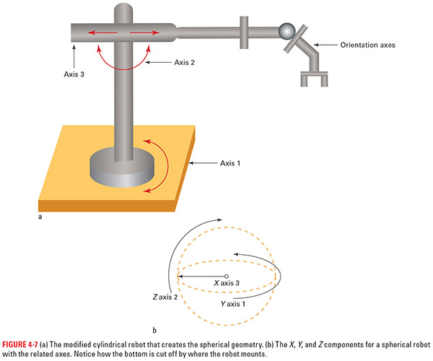
Figures 4-7a and b
Remember with the spherical robot you will not have the full ball, part of it will be cut off by what the robot mounts to and the surfaces around that

Slide 18
Articulated Geometry
Articulated robots have a spherical-type envelope that is constrained by the construction of the robot
  The articulated robot leaves linear motion behind for rotational motion at the various axes
  This robot is also known as jointed arm, revolute, and even anthropomorphic, because in many cases, its motions look very organic and lifelike
  It has a chunked-up portion of the spherical envelope due to the robot design and limitations of the system

Slide 19
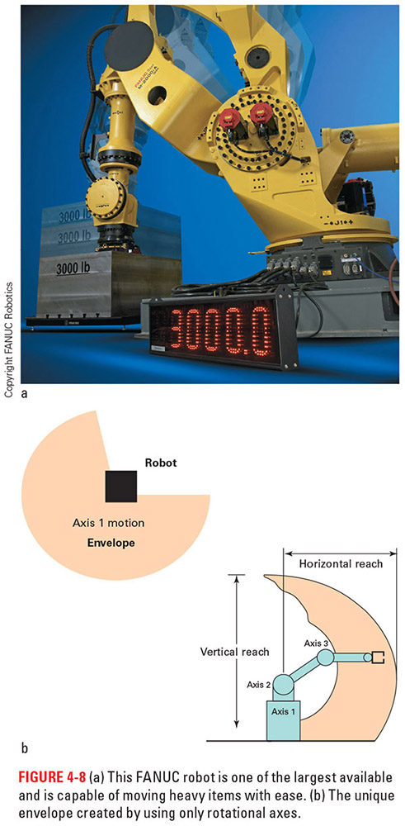
Figures 4-8a and b
Above is an articulated geometry robot, a favorite of industry; below is an illustration showing the work envelope of this type of robot

Slide 20
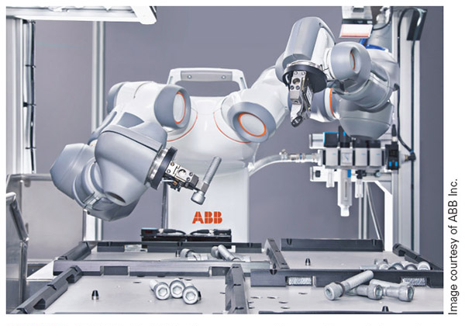
Figure 4-9
The YuMi® robot from ABB is a great representation of the newer style of articulated robots hitting industry. The dual articulated arm on a rotary torso gives the robot very human like motion. This is also a collaborative robot, which can work cage free.

Slide 21
SCARA
Selective Compliance Articulated Robot Arm (SCARA) is unique in that it combines Cartesian linear motion with the rotation of an articulated system, creating a new motion type
  SCARA has a cylindrical geometry with axes 1 and 2 moving in a rotational manner and axis 3 moving in a linear vertical way to manipulate the tooling into position while applying force
  The orientation of axes 1 and 2 provide horizontal rotation versus the vertical rotation of the other systems
  Another difference is that the wrist (or minor axes) usually only have one rotational axis
  SCARA robots are popular in the electronics field, where their motion and strengths seem to be a good fit for the tasks required

Slide 22
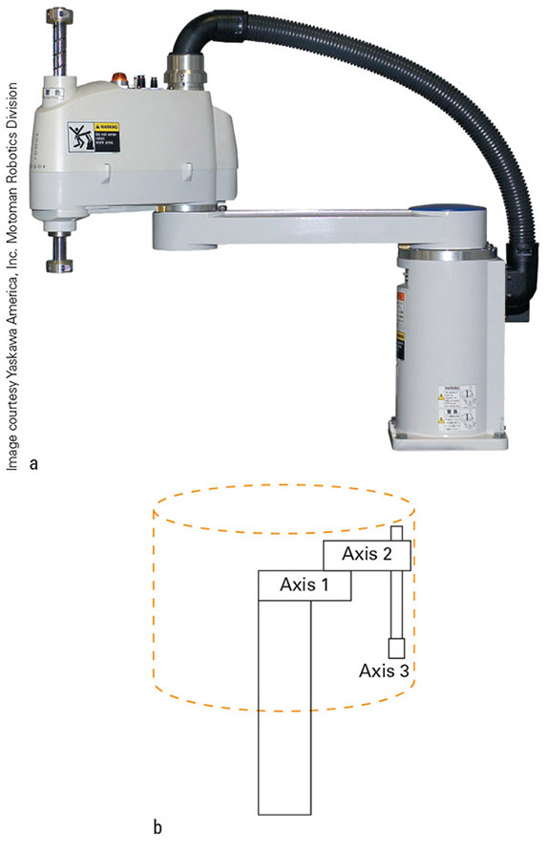
Figures 4-10a and b
Above is a SCARA robot and below is a diagram showing the motions of the different axes

Slide 23
Horizontally Base-Jointed Arm
This is an adaptation of the SCARA system, with axis 2 as the linear axis instead of 3
  Instead of the tooling rising up and down, as with the SCARA, this system moves the whole arm up and down
  These robots also tend to have normal minor axes complement of two or three versus the single rotational of the traditional SCARA types

Slide 24
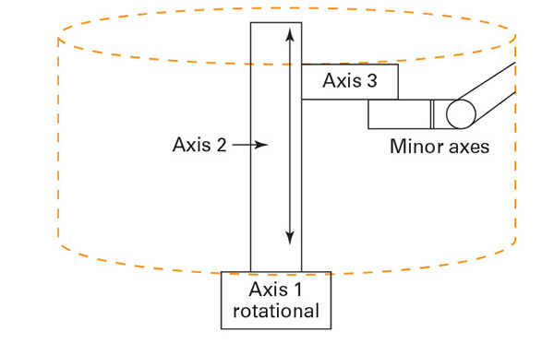
Figure 4-11
This configuration provides the power of the SCARA robot in the vertical direction with flexibility in tooling orientation that rivals any of the other systems we have looked at

Slide 25
Delta
Delta robots have become popular in industry and 3D printing over the past few years due to their speed and unique design
The system is made up of three vertical arms coming to a pyramid-type point at the tooling below
The result of this arrangement, due to the sweeping motion of the three major axes, is a cone similar to an acorn or the nose cone of a rocket
The majority of the work envelope is closer to the base of the robot; the envelope narrows as the tooling is moved farther away from the overhead unit

Slide 26
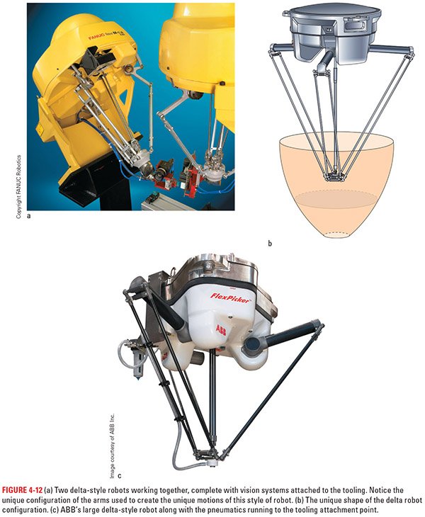
Figure 4-12c
Figure 4-12b
On the left is an example of a Delta style robot and to the right of it you can see the work envelope for this type of robot

Slide 27
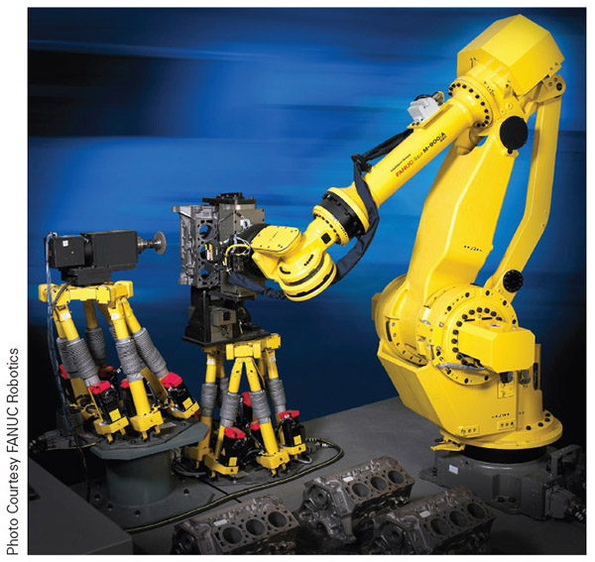
Figure 4-4
Figure 4-12a
On the left you can see a couple of Delta style robots working with an articulated arm style; above we have two Delta style robots working together

Slide 28
Drive Systems: Classification and Operation
Another way we classify robots is how the motors connect to the robot to move it
There are two broad categories in this field:
  Direct drive
  Indirect drive
Direct-drive systems have the rotating shaft of the motor connected directly to the part of the robot they move
  The torque (rotational force) of this system is the same as the motor as there is nothing to modify the system between the motor and robot

Slide 29
Reduction-Drive
Reduction-drive systems alter the output of the motor shaft via mechanical means
  As a rule, these systems slow the speed of the rotational shaft in order to increase the torque or force of the system
  They can also change the direction of rotation or turn rotational motion into linear motion
  These systems often require more maintenance, as they have additional moving parts

Slide 30
Belt-Drive
Belt drives utilize a flexible continuous loop known as a belt to transfer power from the motor to the output of the system
By changing the size ration between the drive pulley which is connected to the motor or force and the driven pulley which is connected to the output of the system we can alter the torque produced
Because of the precision required of most industrial robots, the belt of choice is the synchronous belt that has teeth at set intervals along its length

Slide 31
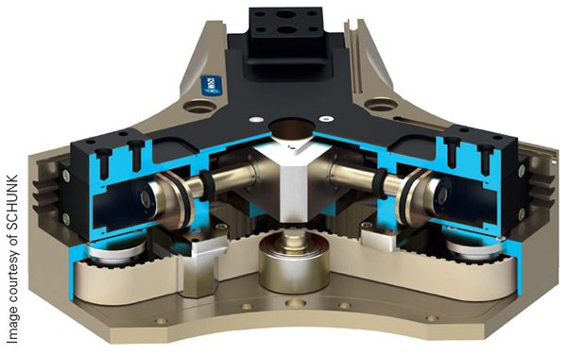
Figure 4-13
A synchronous belt used to drive a gripper system for a robot. Notice the teeth on the white belt at the bottom of the cutaway image. This is similar to the setup used for robotic axis drives.

Slide 32
Chain-Drive
For the most part, chain-driven systems work in the same way as belt-driven systems, with a few exceptions:
  These systems use sprockets, which have teeth designed to fit into the links of the chain instead of pulleys
  The a chain, usually made of metal, connects the drive sprocket to the driven sprocket
  Like the synchronous belt, chains do not slip, but they do wear out

Slide 33
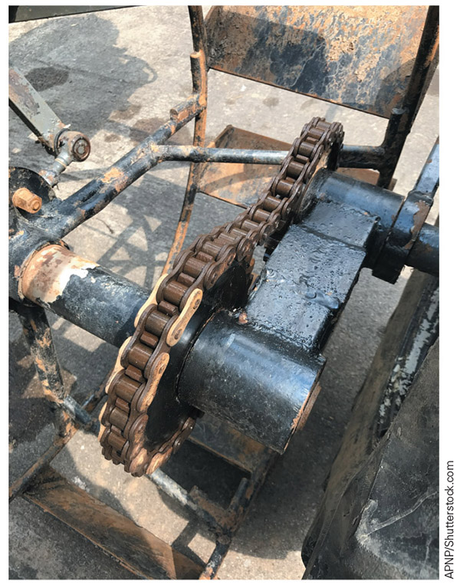
Figure 4-14
While this system is not from a robot, it does show the components of a chain system as well as the slack that develops over time

Slide 34
Gear Drive
Gears come in many shapes, sizes, and varieties, but they all have cogs, or teeth, which are projections that match up or mesh with similar projections on other gears to transmit force
Drive Gear – the one supplying power
Driven Gear – one tied to the output
Gear train or transmission – two or more gears connected together

Slide 35
Gear Drive cont.
Idler gears are extra gears added to a system to change the direction of rotation on a dedicated shaft, not an output shaft
If there is an even number of total gears in a drive system, the last gear will rotate opposite the input gear
If there are an odd number of total gears in a system, the last gear will turn in the same direction as the input gear

Slide 36
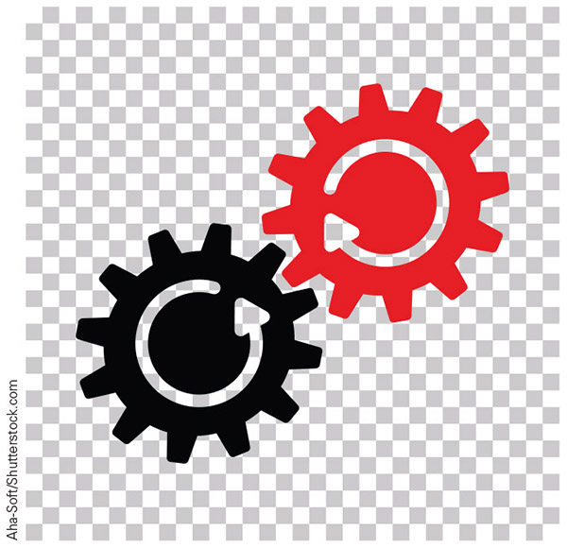
Figure 4-15
An even number of gears means the output will turn opposite the input

Slide 37
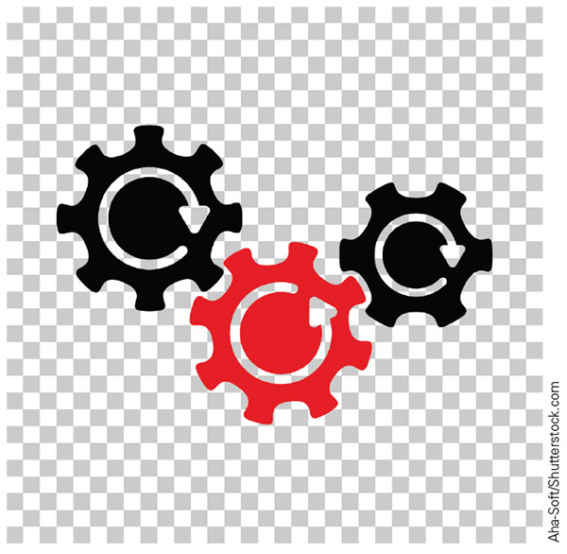
Figure 4-16
An odd number of gears is required to have the output, or driven gear, turn in the same direction as the input, or drive gear

Slide 38
Gear Drive cont.
Compound gears - two or more gears on the same shaft, often made from one solid piece of material
  One of the gears in a compound gear will be a driven gear, while the other(s) will be a drive gear
  This is because one or more of the gears in the compound arrangement serves as the power source for a completely new gear train
  Multiple gears on the same shaft must rotate in the same direction

Slide 39
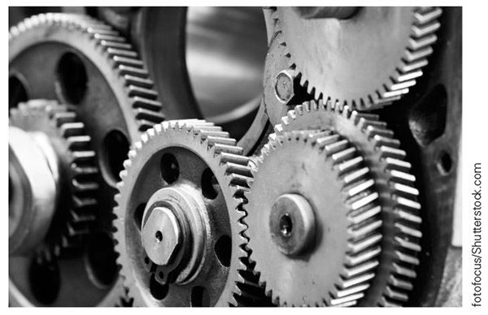
Figure 4-17
This is part of a gear transmission system, which includes compound and spur gears. Spur gears are made by taking a round or cylindrical object and cutting teeth into the edge.

Slide 40
Harmonic Drive
Harmonic drive - a specialized gear system that uses an elliptical wave generator to mesh a flex spline with a circular spline that has gear teeth fixed along the interior
  The circular spline is typically the driven portion of the system
  The flex spline only contacts the circular spine at two points that are 180 degrees apart
  The wave generator is inside the flex spine, but is usually separated from the flex spine by ball bearings

Slide 41
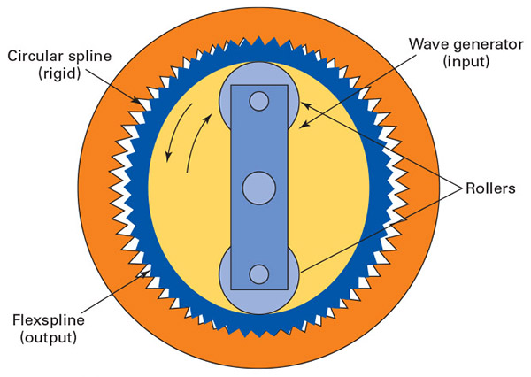
Figure 4-18
This system can generate torques up to 320:1 and has no backlash

Slide 42
Ball Screw
Ball screws -a large shaft with a continuous tooth carved along the outer edge and a nut or block that moves up and down the length of the shaft
  The prime mover connects to the shaft either directly via a coupler or through a belt, chain, or gear-drive system, with all the options that creates
  The block or nut that moves along the ball screw usually rides along the tooth via ball bearings and attaches to whatever is being moved

Slide 43
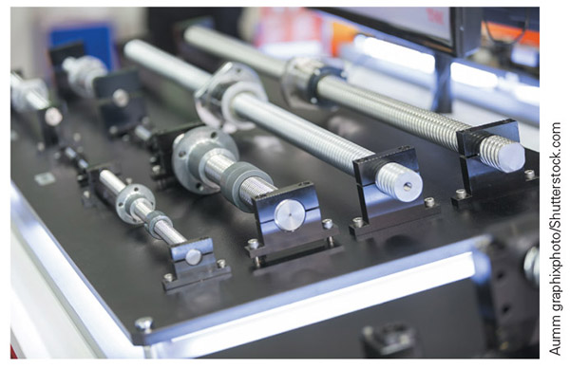
Figure 4-19
Ball screws come in a wide variety of sizes and lengths to meet the application needs

Slide 44
ISO
International Standards Organization (ISO) - an organization that develops, updates, and maintains sets of standards for use by the industries of the world
  An ISO certification guarantees that a company is making its products according to a defined set of specifications for quality, safety, and reliability, giving customers peace of mind
ISO defines an industrial robot as an “actuated mechanism programmable in two or more axes with a degree of autonomy, moving within its environment, to perform intended tasks” (Harper, 2012).

Slide 45
ISO Industrial Classification
The ISO classifications for industrial robots are:
  Linear robots
  SCARA robots
  Articulated robots
  Parallel robots
  Cylindrical robots
  Others
ISO 8373:2012 is where you will find the ISO classifications for industrial robotics along with the information needed to work safely with these systems

Slide 46
Review
How are robots classified? This section discussed why we classify robots and some of the broad categories one might use.
Power source. This section was the first grouping for robots we examined and it looked at some of the strengths and weaknesses of each category.
Geometry of work envelope. This section showed how we can group robots by their work envelop as well as talking about their axes of movement.
Drive systems. This section covered the difference between direct drive and various indirect drive systems used to move robots.
ISO classification. Here we explored how ISO groups the robot and discovered that industrial robots are classified by how they mechanically work, giving us nearly the same groupings as we found in the geometry section.

