Slide 1
Programming and File Management
Chapter 6

Slide 2
Overview
WHAT YOU WILL LEARN
  The basic evolution of the robot programming language
  The five different levels of programming languages
  The key points in planning out your program and what each step entails
  What singularity is
  What subroutines are and how they help the programming process
  The difference between local and global data

Slide 3
Overview cont.
WHAT YOU WILL LEARN
  The basics of writing a program and the main motion types available
  How several common logic sorting commands work
  How to test a program that you have written, including what to look for
  What to do when the robot is ready for normal operation, including some potential sources of problems
  How to manage the data of the robot to ensure proper operation and save yourself time and effort down the road

Slide 4
Programming Language Evolution
Robot program - the list of commands that run within the software of the robot controller and dictate the actions of the system based on the logic sorting routine created there in
  A program is only ever as good as the person who creates it
  Often programs are modified several times before considered ready to go
Programming languages - the rules governing how we enter the program so the robot controller can understand the commands

Slide 5
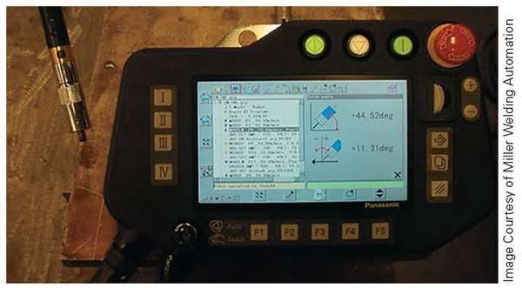
Figure 6-1
This is the program to control a Panasonic welding robot

Slide 6
The First Robot Computer Programs
The first approach for computer programming of the robot involved using a language designed for the needs of the robot
  The result was a programming language or technique that was great for controlling the robot, but difficult for users to work with
  Complaints from users made this a short-lived method

Slide 7
The Next Approach
This time, the manufacturers started with a known computer language, such as BASIC or Fortran, and added commands to control the robot
  The result was a language that computer programmers of the day understood with data processing capability
  From the programmer’s side of things, this was terrific
  It was not the optimal way to control the robot

Slide 8
The Winner
Manufactures found a way to give users the best of both worlds by creating programming languages that combined the efficiency of those specifically designed for the robot with the established programing flow provided by common computer languages
  These hybrid languages continue to evolve
  Today, we have systems that no longer require the user to have a computer programming background

Slide 9
The 5 Programming Language Levels
Level 1: No processor
Level 2: Direct position control
Level 3: Simple point-to-point
Level 4: Advanced point-to-point
Level 5: Point-to-point with AI

Slide 10
Level 1: No processor
These systems lack computer or processor control
  Punch cards
  Peg drums
  Relay logic
  Similar systems lacking a digital processor
To change the operation of these systems, one must physically change something in the system

Slide 11
Level 2: Direct position control
This level requires the programmer to enter the positional data for each axis as well as all the motion, processing, and data gathering commands required to create a program
  This is the most basic level of processor control and the most labor-intensive for the programmer
  This type of programming requires knowledge of the position of each axis when the robot is in the desired location

Slide 12
Level 3: Simple point-to-point
The programmer must still enter the motion type, data gathering, and other aspects of the program but does not manually enter the positions
  It is common practice to write the basic program offline, with each position having a label but no coordinate data
  The programmer then uploads the program into the robot and physically moves the robot to each point to record the positional data

Slide 13
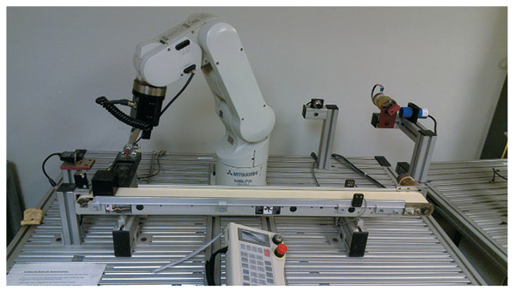
Figure 6-2b
Level 3 systems are still around today, like the Mitsubishi system pictured. If you work with these systems, you will likely need specialized training on the robot and software it uses.

Slide 14
Level 4: Advanced point-to-point
With level four languages, writing a program is as simple as creating a new program, entering a string of points with the proper motion label to reach those points, and testing out the program
  There is no need to memorize the larger number of movement and logic commands that are required by simpler programing methods
  The programmer has to determine the key points of the program, how the robot moves between those key points, and any logic filters that might be necessary

Slide 15
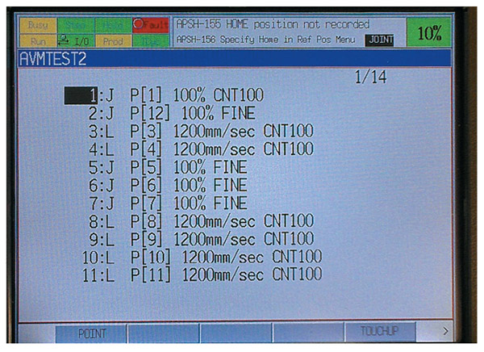
Figure 6-3
Level 4 programs, like the one pictured, are the common way we program robots in industry currently and you can learn the basics of this style of programming in about 40 hours

Slide 16
Level 5: Point-to-point with AI
The newest advancement in computer programming is the addition of Artificial Intelligence (AI) to advanced point-to-point
  This takes the convenience of level four languages and adds the ability of correction for error as well as advanced teaching methods
  Level five systems use vision or some other advanced sensing method to determine the difference between where the system should be versus the taught position and makes the offset
  Some level 5 systems allow users to physically grab the robot and move it into whatever position they desire during teaching

Slide 17
Planning
The process of writing a program begins with planning
  You need to have a game plan in place before you start writing a program
  The level of planning depends on the complexity of the task that you have in mind for the robot
  This is a multistep process

Slide 18
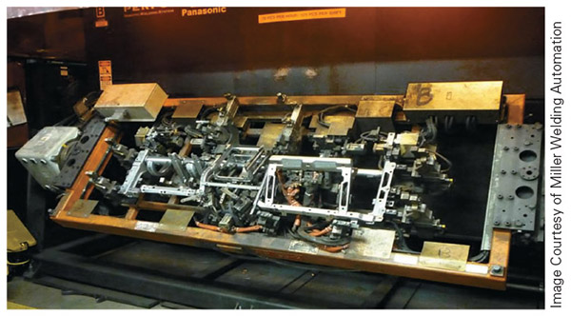
Figure 6-4
When building a program for a complex environment like the one in the picture, proper planning is a must for programming success

Slide 19
Step One: Goal Setting
Step one: What do you want the robot to do?
  Before you can start to plan, you have to know what the goal is
  Take the time to figure out what you want the robot to do, from start to finish
  Make sure that the tasks you have in mind are not beyond the system’s capabilities

Slide 20
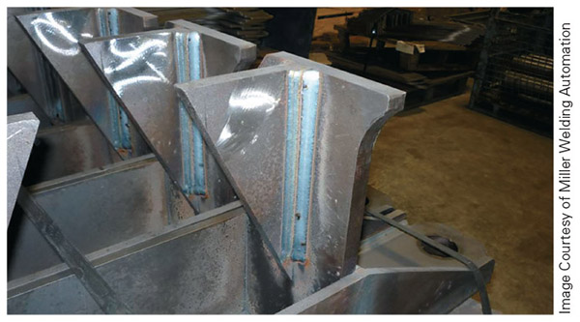
Figure 6-5
Without proper planning multipass welds like these may look nice, but end up having functional flaws

Slide 21
Step Two: Task Mapping
Step two: Task mapping
In this step you will ask yourself the following questions:
  Which kind of tooling does the robot need?
  How should the robot move between points?
  Does the robot need to avoid any obstacles?
  What is the robot doing at each point?
  What is the robot doing between each pair of points?
  Do any conditions or other factors in the process need to be addressed?
  Is the process logical?

Slide 22
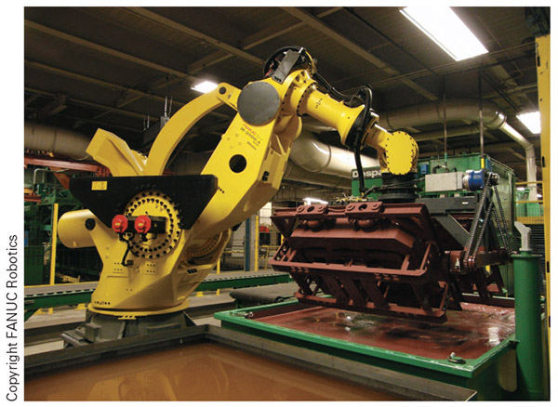
Figure 6-6
Make sure the tooling matches the task(s) you plan for the robot to perform

Slide 23
Motion Instructions
A motion instruction contains up to five parts:
  Type of motion
  Position
  Speed
  Termination
  Options
The specifics of these will depend on the system
Here is an example of a FANUC motion instruction:
  JOINT P[X] 100% FINE

Slide 24
Movement Types
Joint motion is point-to-point, where all the axes involved move either as fast as they can or at the speed of the slowest axis, with no correlation between the separate axes involved
Linear motion is where the controller moves all the axes involved at set speeds to insure straight-line movement
Circular motion is the formation of arcs and full circles as described by no less than three points
  For arcs or part of a circle, you need to teach at least three points: the start point, middle point, and end point
  For a full circle, you will need at least four points

Slide 25
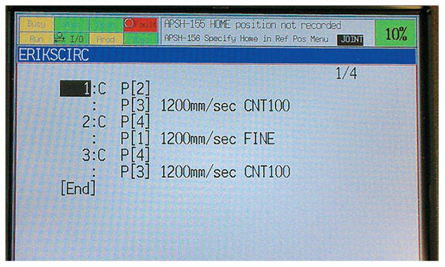
Figure 6-7
Here is a circular program for a FANUC robot

Slide 26
Movement Types cont.
Weave motion is straight-line or circular motion that moves from side to side in an angular fashion while the whole unit moves from one point to another
  To program this kind of motion, you must set two additional points besides the normal required points for linear or circular motion
  These two points determine how far to each side of the normal motion the robot weaves as well as the distance it moves forward between weaving motions

Slide 27
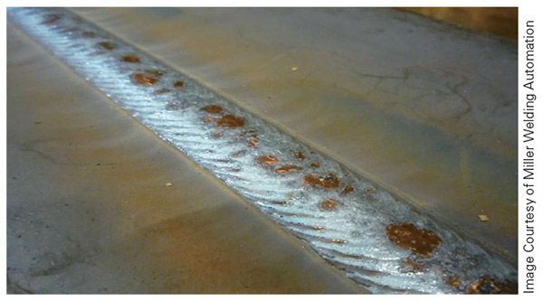
Figure 6-8
Weave motion, often used with welding, allows the robot to expand the path of the weld and cover more area

Slide 28
Position
A position is handled internally by the robot as a combination of numbers, one for each axis, representing location and orientation of the end-of-arm tooling
  X is the distance in millimeters along the x-axis from the origin of the frame.
  Y is the distance in millimeters along the y-axis from the origin of the frame.
  Z is the distance in millimeters along the z-axis from the origin of the frame.
  W (yaw) is the rotation in degrees around the x-axis of the tool.
  P (pitch) is the rotation in degrees around the y-axis of the tool.
  R (roll) is the rotation in degrees around the z-axis of the tool.

Slide 29
Speed
The speed designator that determines how fast the robot will move along the prescribed path
  A percentage of the maximum speed of the robot
    JOINT P[X] 100% FINE
  Millimeters per second (mm/s)
  A process-related parameter (e.g., in./s of weld)
  Something else robot, application, or manufacturer specific

Slide 30
Termination
The termination type may significantly influence robot motion path, but is not used by all manufacturers, and differs from manufacturer to manufacturer when it is used
  Both FANUC and ABB use fine termination to stop the robot at the end of the motion, but each uses a different termination type for continuous termination
  FANUC uses CNT for continuous where ABB uses Z
  Continuous motion usual results in the robot getting near the taught point, but not actually hitting/stopping at it

Slide 31
Obstacles
Look for anything that the robot might hit along the way
The commonly overlooked item here is the fixturing
  Fixtures hold parts in place for various industrial processes by clamping or holding them in some manner
Make sure not to leave tools and other objects in the work envelope, as they may be in the robot’s path

Slide 32
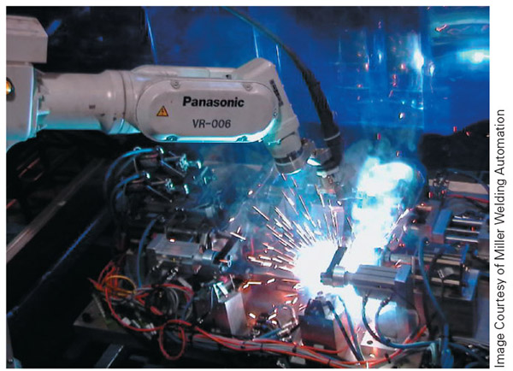
Figure 6-9
Complex fixturing often makes it difficult to accomplish all the tasks needed during an operation. In these situations it may take a fair amount of time to solve all the clearance vs. needed motion issues.

Slide 33
What is the Robot Doing at Each Point?
You have to know why you set each point to make sure that the robot does what you want
  Does the robot stop at that point?
  Does it open or close a gripper at that point?
  Do we need to turn on a welder, paint sprayer, glue dispenser, or other device?
  Do we need the robot to hit that point exactly or just get near it?

Slide 34
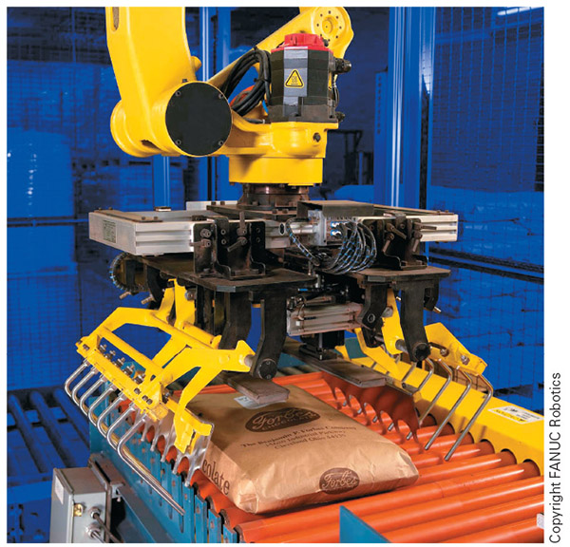
Figure 6-10
If this robot performs tasks out of sequence, there is a good chance that it will damage the bag of chocolate it is working with

Slide 35
What is the Robot Doing Between Each Point?
This often determines the motion type between points and other program specifics
  As a rule, movement between points for staging purposes is at full speed, while movement during tasks is slower
  Staging points are positions that get the robot close to the desired point but are still a safe distance away, allowing for clearance and rapid movement

Slide 36
Other Factors to Consider
This is the step in the planning process where you factor in such things such as sensors, waiting for machines to finish their part of the process, singularities, and anything else that might affect the program
Singularity is a condition in robotics where there is no clear-cut way for the robot to move between two points
  It results from lining up two axes, such as 4 and 5, in a straight line, with one of the axes (usually axis 5) at zero degrees, so that the robot could go two different ways to reach the programmed point

Slide 37
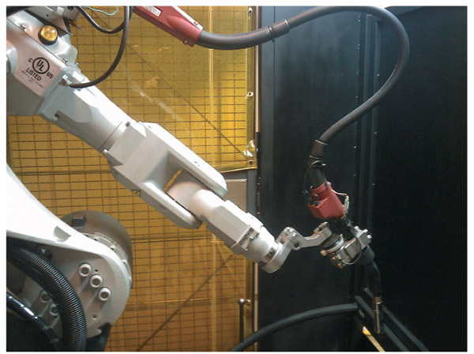
Figure 6-11
Here is an example of the dreaded singularity. This condition can ruin welds, damage parts, and be a danger to you during the testing process.
Move axis four or five 10 to 15 degrees and this problem will usually go away

Slide 38
Is the Process Logical?
A program is a set of logical steps, so if you have an illogical plan of operation, your program is likely to fail
  Make sure that your movements flow in a way that makes sense and not just whatever you happened to program first
  Make sure you have the events sequenced properly
  Make sure you have added in the necessary steps for any data collection or looping of sections of the program as needed

Slide 39
Subroutines
Subroutines - a sequence of instructions grouped together to perform an action that the main program accesses for repeated use
  The purpose of using subroutines is to reduce the lines of code in a program and to make it easier to write programs
  There is not a specified limit on the lines of code in a subroutine, but often these programs are much smaller than the operating program

Slide 40
Functions
Global functions are variables, subroutines, and other code or data accessible by any program that you create on the robot
Local function means that only one program can access the data
  Most of the positions that you create while writing a program are local data
Macros - an adaptation from the computer science world, where macro instructions invoke a macro definition to generate a sequence of instructions or other outputs
  Some systems call global subroutines macros
  Macros are often accessible as stand alone operations initiated by a button or sequence of buttons

Slide 41
Writing the Program
This is when you must know how your particular robot works, how the controller organizes information, and most importantly, how to build a program for the specific robot that you are using
Once a person learns how to program one type of robot, they tend to learn new styles of programming quickly

Slide 42
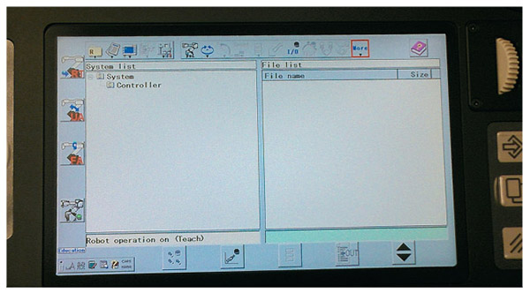
Figure 6-12
Here you can see the setup for a Panasonic welding robot. These systems have a file structure that is very similar to the Windows operating system.

Slide 43
Writing the Program cont.
Start with your global subroutines if your system allows for such
  Oftentimes, this step has already been done as part of the initial robot setup, especially in the case of tooling subroutines
  When creating subroutines, make sure to test them out before you just assume they are good to go

Slide 44
Writing the Program cont.
Next you will start the main program
The specifics of this depend on the system, but the common options are:
  Naming the program
  Determining the program type
  Designating the frame
  Picking the proper tooling
  Designating offset tables to reference

Slide 45
Picking the Frame
A frame is a set of three planes at right angles to each other, and where the three planes intersect is the origin of the frame
  A frame provides both the robot and the programmer with a reference point in establishing positional data
  The terms frames and coordinate systems are interchangeable when used in reference to robot movement
World frame - a Cartesian system based on a point in the work envelope where the robot base attaches
If you change the reference frame after creating the program and saving points, there is a high probability that your taught points will change

Slide 46
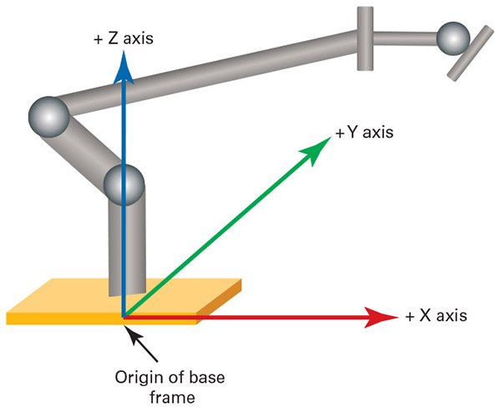
Figure 6-14
This drawing illustrates the positive directions for a world frame

Slide 47
The Right-Hand Rule
Right-hand rule - a way to determine robot motion while using a Cartesian-based frame (e.g., the World frame), with the thumb, forefinger, and middle finger
Orient yourself in the same direction that the robot is facing and, using your right hand, stick your thumb up, point your forefinger straight ahead, and point your middle finger toward the left side of your body at a ninety-degree angle to the forefinger
  Your thumb is pointing in the positive direction for the z-axis
  Your forefinger is pointing in the positive direction for the x-axis
  Your middle finger is pointing in the positive direction for the y-axis

Slide 48
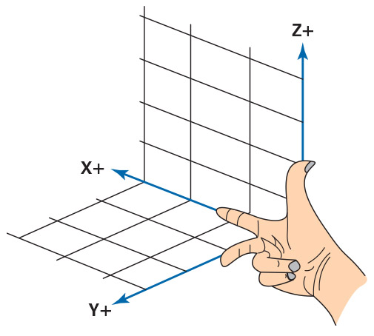
Figure 6-13
Your index finger should point in the same direction that the robot faces, which is the same direction as the main part of the work envelope

Slide 49
User Frame
User frame - a specially defined Cartesian-based system in which the user defines the zero point and determines the positive directions of the axes, including the option of straight-line motions moving at an angle instead of along the flat lines of the World frame
  The right-hand rule is useless with the User frame
  We typically define User frames in relation to fixtures or other points of interest within the robot’s work envelope to make setup and movement easier for the programmer

Slide 50
Tool Frame
Tool frame - establishes the location and orientation of the end-of-arm tooling (EOAT) for the robot software and the direction of motion for the x-, y-, and z-axes; it also affects payload and inertia calculations
Tool center point (TCP) - the reference point where the robot is moving through space
  When you set a point, you are basically storing information that records the location of the TCP

Slide 51
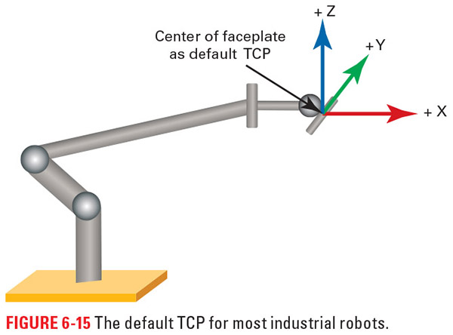
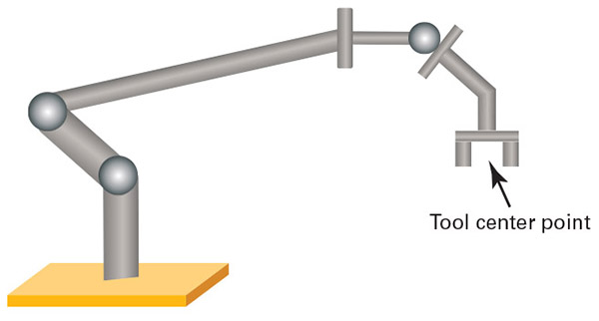
Figure 6-15
Figure 6-16
Without tooling, the TCP is generally defaulted to the center of the last robot axis where the tooling attaches. Once a tool is added the TCP is often set to the point of contact/action or some other point of interest for the tooling.

Slide 52
Joint Frame
Joint frame - moves only one axis at a time while in manual mode, with the positive and negative directions determined by the setup of each axis’ zero point
  This is the perfect mode to test each axis of the robot independently and, in the case of problems, determine which specific axis is making noise or moving oddly
  The downside of using the Joint frame is the fact that the only linear movements of the robot involve those axes that are linear in nature
  For many robots, if the zero reference point(s) are lost this is the only frame it will move in

Slide 53
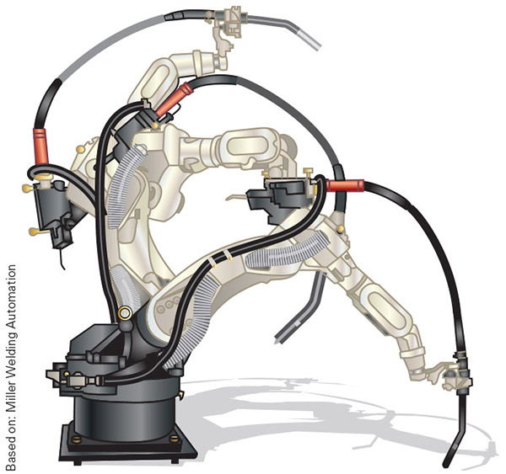
Figure 6-17
This is an example of the type of motion you can expect from Joint frame motion

Slide 54
Final Touches on Program Creation
Once you have set the main parameters and double-checked any other variables in the program creation process, such as offset tables, you are ready to finalize the creation of the program
Finalization saves the parameters set during program creation and allows you to start teaching the specified points and set the logic of the program
Before you finalize the creation of the program, it is a good idea to add in descriptions, if possible

Slide 55
Program Instructions
A program consists of two kinds of instructions: motion control instructions and program control instructions
The various program control instructions available usually fall into the following categories:
  Branching
  Looping
  Register
  Input/output
  Arithmetic
  Call
  Data structures

Slide 56
Branching
Branching instructions cause the program to jump to another point in the program and are classified into two broad types: conditional branching and unconditional branching
Unconditional branching instructions simply cause the program to go to another instruction to continue execution
  JUMP or GOTO fall into this category
Conditional branching instructions test for specific program conditions before executing a branch
  IF THEN or SELECT fall into this category

Slide 57
Looping
Looping instructions cause the program to repeat a series of instructions either for a specified number of times or until a specific program condition is met
There are three common types of looping instructions:
  for/do (FOR…DO) - causes a program to repeat a series of instructions for a specific number of cycles or times
  repeat (REPEAT) - performs a series of instructions, and then tests a program condition to determine whether it should repeat the instructions
  while (WHILE) - tests a program condition to determine whether it should execute a series of instructions, and executes the instructions if the condition is satisfied

Slide 58
Register
Register instructions allow the programmer to use arithmetic registers to store and manipulate data
May be used as part of other instructions, such as conditional branching instructions or looping instructions, and are sometimes included within arithmetic instructions
Registers are a place to store numbers that the program can manipulate, usually for logical sorting or data reporting reasons

Slide 59
Input/Output
Input/output instructions are used to monitor conditions and cause actions in the robotic system as well as whatever else it is connected to
Input instructions check the value of program input data and are often tied to sensors, registers, and other places where data is stored in the controller based on either real-world situations or programmed outcomes
Output instructions are used to cause an action or write data somewhere

Slide 60
Arithmetic
Arithmetic instructions are used to perform arithmetic operations
All basic functions are available in most robots—addition, subtraction, multiplication, and division
Some systems may offer trigonometric functions, roots, and powers

Slide 61
Call
call (CALL) instruction - used to call other programs from a main program and can be considered a type of unconditional branching instruction
  Calls another program and turns control of the robot over to that program, which then executes its instructions
  When the called program ends, the controller returns to the original program and continues with line of instruction under the call command

Slide 62
Data Structures
Data structure - a collection of related items used to control a process, often arranged in a table format
When we use structures to control robot motion and/or other process parameters, it is easy to make adjustments to the system
While it may take some time to change structures or create new structures as the demands of the task change, it is time well spent in the long run

Slide 63
Saving Your Program
Another crucial part of the program-creation process is saving your data
  Save early, save often, save your data!
  Saving the program every 10 minutes is a good recommendation
Until you actually save your program, what you have is a theoretical program vulnerable to human and system error

Slide 64
Testing and Verifying
Once you finish writing a program it is crucial to test it for proper operation
The system you are working with will determine what testing options you have at your disposal, but most industrial systems offer a manual step-by-step testing method and a continuous testing mode

Slide 65
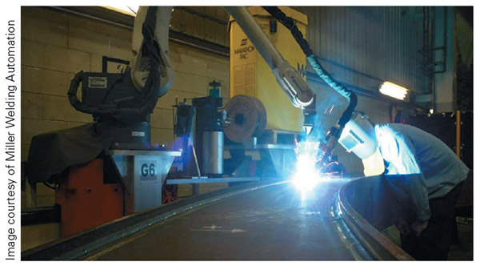
Figure 6-18
Be aware of tooling operation during the testing phase. The last thing you want is tooling to engage when you are not properly protected.

Slide 66
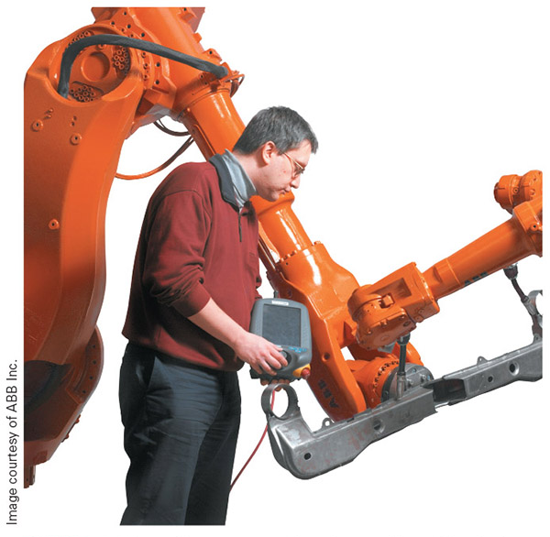
Figure 6-19
If you are inside the robot work envelop during testing, remember to take the teach pendant with you

Slide 67
Step Mode
Step mode - the robot advances through the program one line at a time and requires you to press a button on the teach pendant keypad before it reads the next line of the program and responds
  Most systems will let you step forward and backward in the program so you can bounce between two lines of code if you need to watch the motion over again
  You can stop the motion by releasing the dead man’s switch or, in the case of systems where you have to hold down a button on the key pad, by releasing the button

Slide 68
Continuous Mode
Continuous mode - once you start the program in manual continuous mode, it runs through the program until:
  You stop it by releasing a button or dead man switch
  It reaches the end of the program
  Something causes the system to alarm out
Some motions in your program cannot happen in the space allotted if the robot moves slowly
  Typically you will get an alarm when you run into this situation
  If you okay the movement, the next robot move will likely be a full speed instead of the safer slow speed

Slide 69
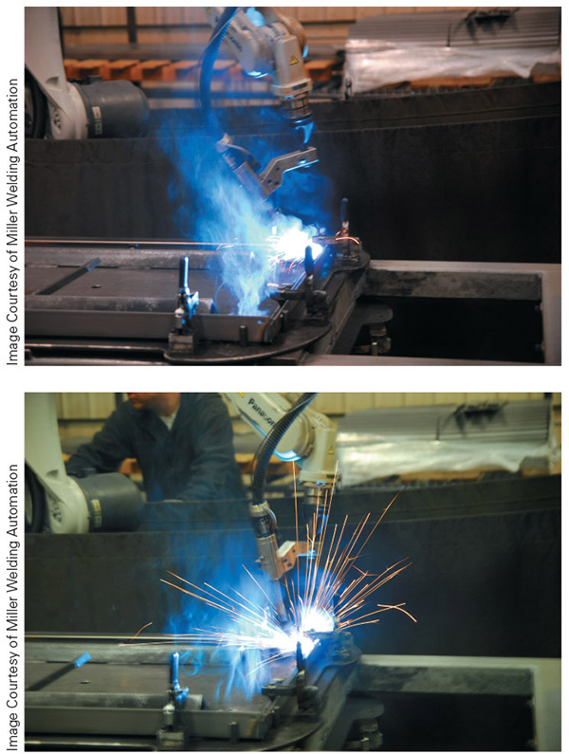
Figure 6-20
When the robot makes a considerable change in the tooling positioning over a short distance, as pictured, this will likely require a full speed move, even during manual testing

Slide 70
Normal Operation
Once you have completed writing and testing the robot program, the next step is to hit the green start button and let the robot get to work
  When running a new or edited program for the first time in automatic mode, make sure that you watch the robot go through the program a couple of times before you consider it ready to run with limited supervision

Slide 71
Normal Operation cont.
Once you are running a verified program, it does not mean that the robot no longer needs human help
  Variances in parts can cause problems with pickup and placement
  Tooling and fixtures wear with use
  Positioning can change
  Parts can move

Slide 72
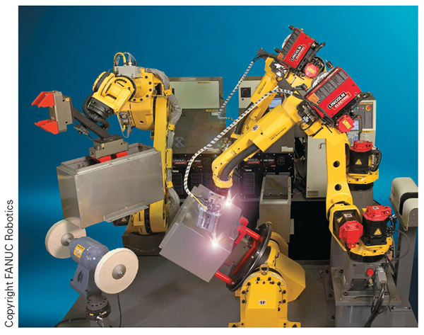
Figure 6-21
It takes proper planning, programming, testing, and monitoring to keep robotic systems like the ones pictured producing good parts

Slide 73
File Maintenance
Most robot controllers do not write programs to a storage device unless specifically instructed to
  Most manufacturers provide some way to back up data and programs from the robot. Often, you can set the time interval for this to occur.
You may be able to sort the various files in the controller as well, to find needed data quickly

Slide 74
File Maintenance cont.
Delete programs that are no longer beneficial
  Memory in the robotic system is finite and eventually you will run out of room
  Before you delete a program make sure to save an external copy if possible
Make sure you keep track of what automated backup systems are doing
  You may have to manually go in from time to time and delete old backups so there is room for new/current backups

Slide 75
Review
Programming language evolution. We looked at the five levels of programming languages and considered how each of them works. We also explored the evolution of digital programming.
Planning. Planning is intended to make sure we know what we are doing before we write the program.
Subroutines. Subroutines are small programs and sections of code that we use repeatedly during the course of operation.

Slide 76
Review cont.
Writing the program. We looked at the process of writing a program, including the types of motions you can expect to use and some of the common logic instructions.
Testing and verifying. It is essential to double-check your program for proper operation during and after the process of writing the program, but before running the system in automatic mode.
Normal operation. This section covered normal operation, including the human responsibilities during this phase.
File maintenance. Just as we manage the data on our computers, so too must we manage the data and files in the robot.

