Slide 1
ADAPTIVE LEADERSHIP
Accomplishing Change
Gary Freiberg
Notes:
Adaptive leadership is the act of taking a team, a company, a city, a country through a change that is the result of external pressures that could render the group ineffective.

Slide 2
Inspiration
“Many leadership books are all about inspiration but downplay the perspiration. We respect how tough this work is. We know too many people with scars to show for their efforts. We have scars ourselves and harbor no illusions.”
Ronald A. Heifetz & Marty Linsky - Leadership on the Line
Notes:
“Many leadership books are all about inspiration but downplay the perspiration. We respect how tough this work is. We know too many people with scars to show for their efforts. We have scars ourselves and harbor no illusions.”

Slide 3
Why People Don’t Exercise Leadership
Leadership is dangerous, you can lose your job, the respect of your teams and the influence of your position
When the going gets very tough, it can be hard to keep your spirit alive
Leadership is a risky activity that requires telling others what they need to hear, not what they want to hear
Companies often promote individuals (who have a combination of authority and management) who don’t push the boundaries that upset or make others uncomfortable - Ironically, these people are often called leaders
Leadership is an activity, a behavior, a full contact sport - it is a lot of work

Slide 4

Adaptation
Adaptive leadership is the practice of mobilizing people to tackle tough challenges and thrive. The concept of thriving is drawn from evolutionary biology, in which a successful adaptation has three characteristics:
it preserves the DNA essential for the species’ continued survival
it discards (reregulates or rearranges) the DNA that no longer serves the species’ current needs
it creates DNA arrangements that give the species’ the ability to flourish in new ways and in more challenging environments
Leadership mobilizes adaptive work: honoring the essential, discarding the expendable, and innovating
Successful adaptations enable a living system to take the best from its history into the future.
Determine what practices are core to the future and which are obstacles
Run smart experiments and test new practices
Integrate new
practices
Notes:
What reasons require us to adapt?

Slide 5
Challenges - Adaptative vs. Technical
Adaptive Challenges include problems that cannot be solved through expertise, know-how or SOP’s. Required tools include experiments, new discoveries, and adjustments. People cannot make the adaptive leap without learning new ways, changing their attitudes, values and behaviors.
Technical Challenges have the necessary authoritative expertise, the know-how and procedures to solve the problem. Required tools include standard lean tools.

Slide 6
Adaptive Leadership = Problem Solving
What aspiration do you have for your team?
Leadership Opportunity
What is your current reality?

Slide 7
Adaptive Leadership
Adaptive leadership is specifically about change that enables the capacity to thrive
Successful adaptive changes build on the past rather than jettison it
Organizational adaptation occurs through experimentation
Adaptation relies on diversity
New adaptations significantly displace, reregulate, and rearrange some old DNA
Adaptation takes time
Notes:
Example of this in the past year? Steven Op’s URS.

Slide 8
Adaption Notes
Most common source of leadership failure?
Treating Adaptive Challenges like Technical Problems
Leadership requires disturbing people, but at a rate they can absorb!
How do you tell the difference between the two?
  If it deals with hearts & minds its Adaptive
  Process of exclusion - you have tried all the technical and still have a problem
  Persistent conflict - people have not accepted the losses of the change
  Continued crisis indicates adaptive issues are festering
Distinguish Technical from Adaptive Challenges
Challenge | What’s the Work? | Who Does the Work?
Technical | Apply current know-how | Authorities
Adaptive | Learn new ways | The people with the problem
Notes:
Process of exclusion - if you’ve thrown all the technical options at it and it still isn’t ‘fixed’…

Slide 9
Hard Question
Annual Pricing Review How much do we need to increase the customers price?
Why can’t we reduce our costs to maintain our customers price?

Slide 10
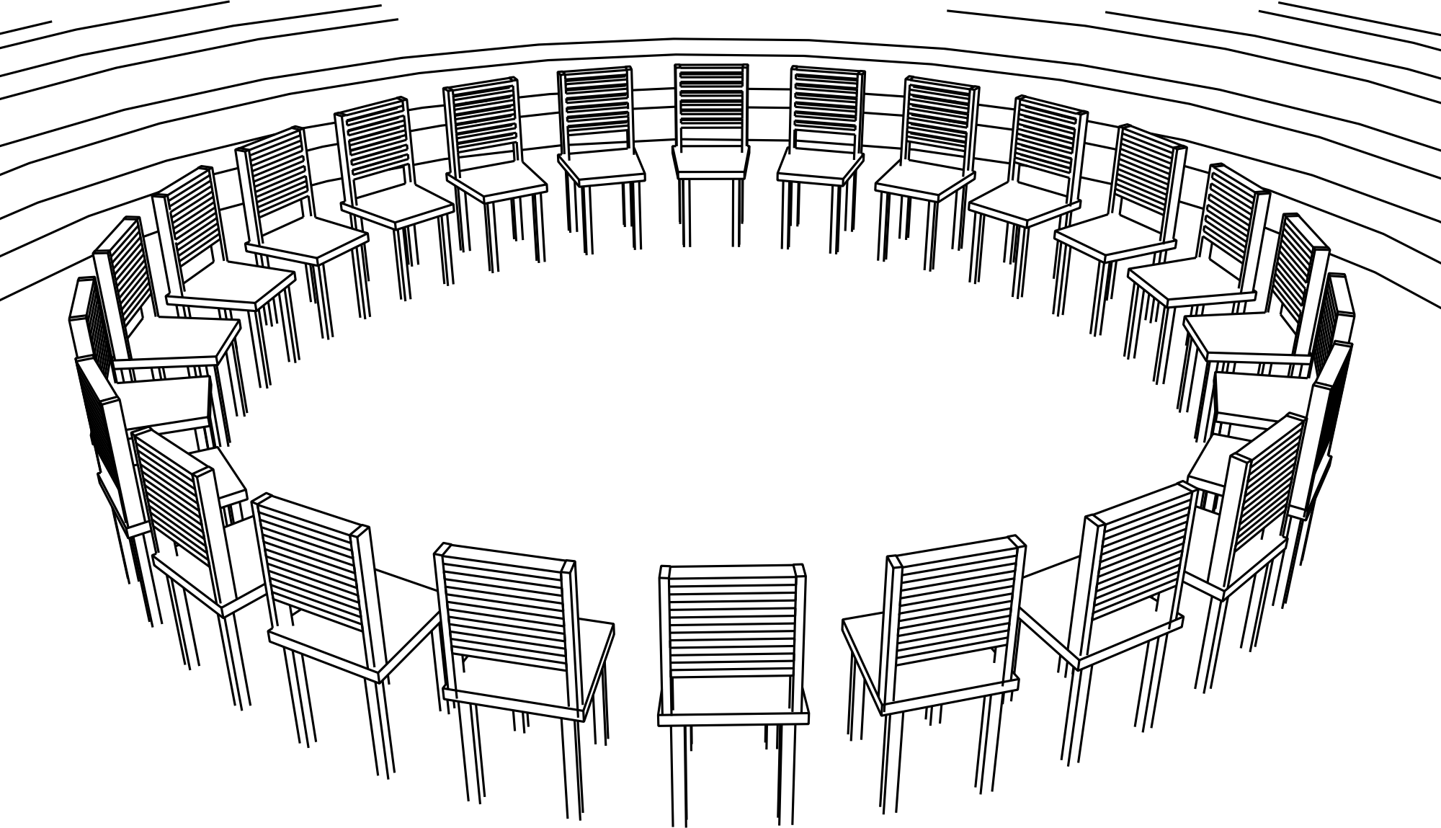
Leadership is Dangerous
Maggie & Lois
Notes:
“Maggie Brooke grew up on a small reservation in which nearly everyone older than twelve drank alcohol. She became sobered in her twenties and spent more than a decade leading her people toward health. Now a grandmother in her forties and a tribal elder, Maggie tells a story about Lois, the woman who first inspired her to try to do something about the alcohol dependency among her people.
“Twenty years ago I used to baby-sit for Lois, who lived in a neighboring band within our tribe. Once a week I’d go the few miles to her community and take care of Lois’s little ones. But after about two months, I started to wonder, ‘What could Lois possibly be doing every Tuesday night? There’s not much to do around here in these villages.’ So one evening after Lois left to go to the meeting lodge, I packed up the children and went over to the lodge to find out what she was doing. We looked through a window into the lodge and saw a big circle of chairs, all neatly in place, with Lois sitting in a chair all by herself. The chairs in the circle were empty. I was really curious so when Lois came home that evening, I asked her, ‘Lois, what are you doing every Tuesday night?’
Lois said, ‘I thought I told you weeks ago, I’ve been holding AA (Alcoholics Anonymous) meetings.’ So I asked her back, ‘What do you mean you’re holding meetings? I went over there tonight with the children and looked through the window. We watched you sitting there in that circle of chairs, all alone’.
Lois got quiet—‘I wasn’t alone,’ she said. ‘I was there with the spirits and the ancestors; and one day, our people will come’. Lois never gave up. Every week she set up those chairs neatly in a circle, and for two hours, just sat there.
‘No one came to those meetings for a long time, and even after three years, there were only a few people in the room. But ten years later, the room was filled with people. The community began turning around. People began ridding themselves of alcohol. I felt so inspired by Lois that I couldn’t sit still watching us poison ourselves.”
Lois and then Maggie had to become sober themselves
The women challenged their friends, families, and neighbors to change their lives
They asked their communities to exchange alcohol for an intangible idea for their future
The women were mocked and marginalized spending years feeling out of place
So ostracized that even holidays became lonely, solitary events
For a long stretch of time, they spent weekends off the reservation to find people they could talk to
They put themselves at risk, as well as key relationships with neighbors, friends, and family
Eventually they succeeded, but for a long time, they could not know and could have lost everything

Slide 11




Faces of Danger
When exercising leadership, you risk getting:
Marginalization (verb) - to relegate to an unimportant or powerless position within a society or group
Diversion (noun) - the act or an instance of diverting or straying from a course, activity, or use
Attack (verb) - to set upon or work against forcefully
Seduction (noun) - the act of seducing
When people resist adaptive work, their goal is to shut down those who exercise leadership in order to preserve what they have.”

Slide 12
Ideas for Enacting Change
Acknowledge Their Loss - People who oppose what you are trying to accomplish are usually those with the most to lose by your success
Create a Holding Environment - An environment to contain and adjust the heat generated by addressing difficult issues - “War Room”
Control the Temperature - Status quo delta generates tension & produces heat
    Raise the heat to get people to sit up, pay attention and deal with the real threats
    Lower the temperature as necessary to reduce the counterproductive tension
Pace the Work: Change is an emotional rollercoaster, let your ideas seep out

Slide 13
Graphical Control of Heat
Work Avoidance
Adaptive Challenge
Limit of Tolerance
Productive Range
“Holding Environment”
Disequilibrium
Threshold of Learning
Work Avoidance
Technical Challenge
Time
Based on R. Heifetz. and M. Linsky. Leadership on the Line, Harvard Business School Press, Boston, MA, 2002, pg 108.
Notes:
Personnel that are above the ‘Limit of Tolerance’ and those below ‘Threshold of Learning’ sound the same.

Slide 14
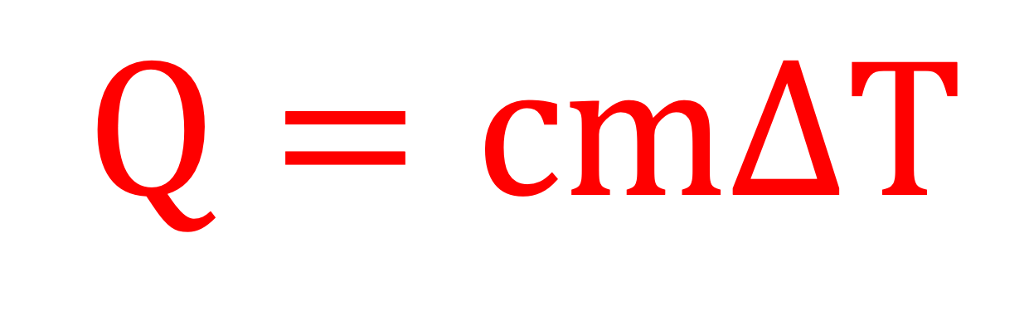
How to Control the Heat
Raise the Temperature
Lower the Temperature
Draw attention to the tough questions
Give people more responsibility than they are comfortable with
Bring conflicts to the surface
Protect the gadflies and oddballs
Address the technical aspects of the problem
Establish a structure for the problem-solving process
Temporarily reclaim responsibility for the tough issues
Employ work avoidance mechanisms
Slow down the process of challenging norms and expectations
$$Q=cmΔT$$
heat
added
specific
heat
mass
change in
temperature

Slide 15
Ideas for Enacting Change
Show Them the Future - If people can glimpse the future, they are less likely to fixate on what they may have to shed
Place the Work Where it Belongs - Phil Knight, Scotty Pippen and the 1994 Playoffs
Exercising Leadership Involves Interventions - Meant to calm some and disrupt others, four types are:
    Observations - statements that reflect to people their behavior or to describe current conditions
    Questions - “What is going on here?” may have the effect of giving the work back to the group
    Interpretations - Inherently provocative and may lack accuracy but can bring out hidden issues “I don’t think this conflict is really about X”
    Actions - Every action has an immediate effect but sends a message, actions communicate

Slide 16
The Process
Get on the Balcony
Diagnose the Adaptive Challenges
Keep Attention Disciplined
Give the Work Back to People
Build Trust
Regulate Distress
Generate More Leadership
Infuse the Work with Meaning
Notes:
This vision of the future perpetuated for the next 25 years.

Slide 17
References
Heifetz, R. A., & Linsky, M. (2002). Leadership on the Line: Staying Alive through the Dangers of Leading (1st ed.) [E-book]. Harvard Business Review Press.
Heifetz, R. A. (2021). Leadership without Easy Answers [E-book]. Harvard University Press (2 Nov. 1994).
Heifetz, R. A., Linsky, M., & Grashow, A. (2009). The Practice of Adaptive Leadership Tools and Tactics for Changing Your Organization and the World (1st ed.) [E-book}. Harvard Business Press.
Ulstad, V. (2019). Fundamentals of Adaptive Leadership Make Progress on Wicked Problems in a Complex Environment [Slides].
Heifetz, R., University of Alaska, (2017). Leadership: The Adaptive Framework [Slides].
Heifetz, R., American College or Education, (2016). Leadership: The Adaptive Framework [Slides].
Notes:
This vision of the future perpetuated for the next 25 years.

