Slide 1
Automation Sensors
Chapter 7

Slide 2
Overview
WHAT YOU WILL LEARN
  How limit switches work and how to select the right one
  How inductive proximity switches work
  How capacitive proximity switches work
  How photoelectric proximity switches work
  How tactile sensors work and the information they give robotic systems
  Different ways to detect unexpected impacts of robotic systems
  Some of the different ways we monitor temperature
  How to monitor fluid flow

Slide 3
Overview cont.
WHAT YOU WILL LEARN
  The basics of fluid level monitoring
  How a pressure gauge works
  Which types of encoders are available and how robots use them for positioning
  How robots use microphones to track sound
  How robots use ultrasonic sensors to see
  Things to keep in mind when connecting sensors to the robot
  How to pick the right sensor for the job

Slide 4
Limit Switches
Limit switch - a device activated by contact with an object that changes the state of its contacts when the object exerts a certain amount of force
  It consists of a body, which houses and protects the electrical contacts, and some type of actuator, which moves with physical contact
  Larger units have their actuators attached as a separate unit on the limit switch body, known as a head unit, allowing for options in actuator orientation

Slide 5
Limit Switches cont.
Limit switches have a range of force and motion required for activation:
  Slight movements requiring 0.2 newton of force
  Large movements requiring about 20 newtons of force
  A newton is a common measurement of force and the metric equivalent of the English pound

Slide 6
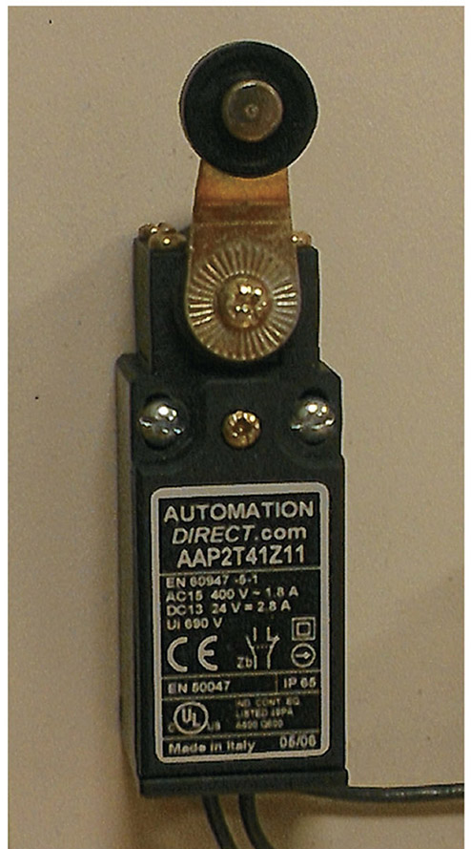
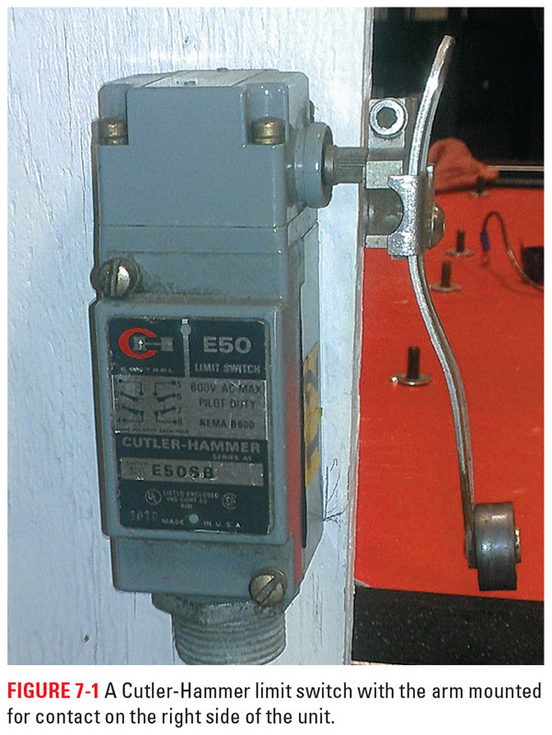
Figure 7-2
Figure 7-1
Here are a couple of examples of limit switches you might see used in conjunction with industrial robotic systems

Slide 7
Selecting Limit Switches
There are three main things you need to know when selecting a limit switch:
  How much amperage the contacts must withstand
  How much force the object contacting the limit switch can generate
  How fast the switch needs to respond
Standard limit switches and smaller micro limit switch - can usually handle up to 10 or 20 amps of current
  These are often used in safety systems and with larger robotic systems
Subminiature micro switch - good for 1 to 7 amps on average

Slide 8
Proximity Switches
Proximity switch - a solid-state device that uses light, magnetic fields, or electrostatic fields to detect various items without the need for physical contact
  Solid-state device - a unit made up of a solid piece of material that manipulates the flow of electrons without any moving parts
  A common range for DC prox switches is 10 to 30 VDC
  A common range for AC is 20 to 264 VAC
  Some prox switches can work on either AC or DC voltage; a common range for these is 24 to 240 V

Slide 9
Inductive Proximity Switch
Inductive proximity switch - uses an oscillating magnetic field to detect ferrous metal items
  The oscillator, the part of the prox that creates this rapid positive sine wave pulse, connects to a coil of copper in the end of the prox, generating a magnetic field from the end of the prox switch
  Inductive prox switches only create the positive portion of the waveform and have thousands of cycles per second
  Prox switches with a low-strength magnetic field can sense items at a maximum distance of 0.06 in. or 1.5mm,
  Stronger inductive prox switches can sense metal items up to 0.4 in. or 10 mm away

Slide 10
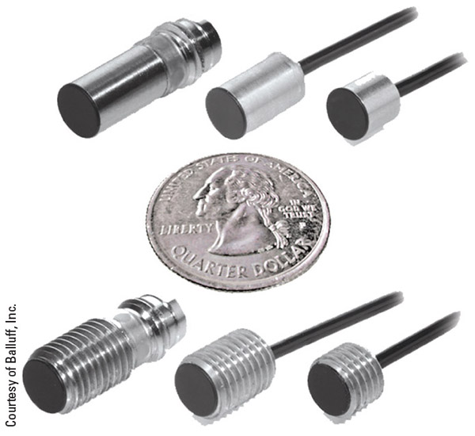
Figure 7-3
Here are some micro sized inductive prox switches that would be a great fit for robotic needs in tight spaces

Slide 11
Inductive Proximity Switch cont.
When a metal part enters the magnetic field of the inductive prox it generates eddy currents in the part
  Eddy current is a flow of electrons created by the magnetic field moving across a ferrous metal item
  The eddy currents and their induced magnetic fields draw enough power from the oscillator that eventually it can no longer create an oscillating field
  A separate unit in the prox known as the trigger unit looks for the oscillation to die down to a certain level and it then activates the output(s) of the prox accordingly

Slide 12
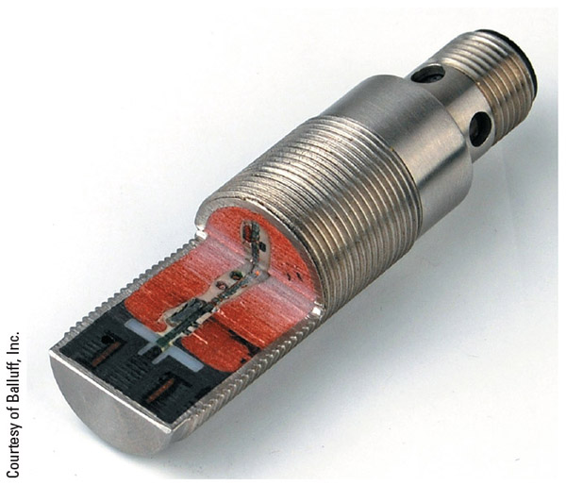
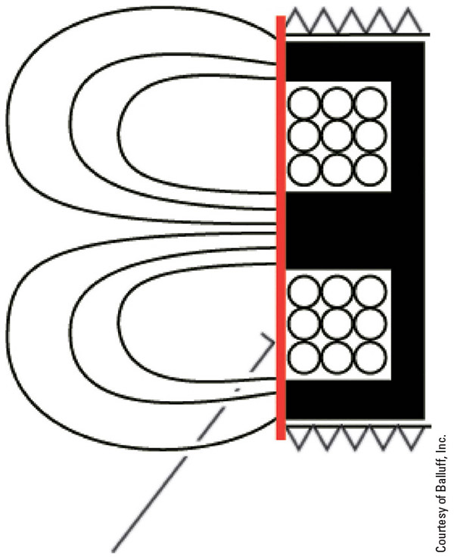
Figure 7-4
Figure 7-5
Here you can see a cutaway showing you the interior of the inductive prox switch along with a representation of its magnetic field (the copper core is inside the black resin)

Slide 13
Capacitive Proximity Switches
Capacitive proximity switches work using the same principle as capacitors
  The switch provides the electrostatic field
  Air is the insulating material or the dielectric
  The object being sensed provides the conductor that finishes the capacitive circuit
  Unlike the inductive prox, the capacitive prox will interact with materials that are both magnetic and nonmagnetic

Slide 14
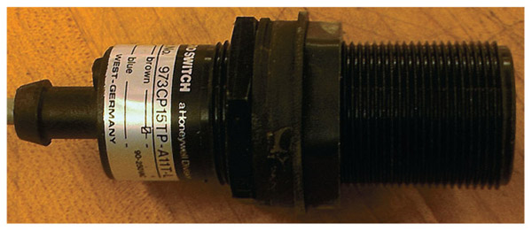
Figure 7-6
Here you can see a capacitive prox switch. Many of the capacitive prox switches have plastic housings while the inductive tend to be made of metal.

Slide 15
Capacitive Proximity Switches cont.
The capacitive prox works just the opposite of the inductive prox in that the oscillation of the circuit begins when the item sensed enters the electrostatic field, and it dies off when no object is present
  The capacitive prox has an adjustment on the switch that allows the user to vary the electrostatic field and change the distance from which it interacts with objects
  It is possible to set the switch to detect items inside cartons, boxes, or other packaging materials

Slide 16
Photoelectric Proximity Switches
Photoelectric proximity switches detect levels of light, sense objects via reflected or blocked beams, and detect colors via an emitter that sends out a specific wavelength of light and a receiver that looks for that wavelength to return after it has interacted with the surrounding environment

Slide 17
Photoelectric Proximity Switches cont.
The typical sequence for a photoelectric switch is as follows:
  An oscillator module turns the transmitter, usually an infrared LED, on and off at high speeds
  The light either travels in a straight line to the receiver or is reflected by some surface
  The receiver, when the correct light strikes it, transmits signals to the internal components of the switch
  If a threshold is met, the switch changes the state of contacts or passes along information to another process. This threshold value is adjustable in many sensors, and this adjustment is crucial for small, fast-moving parts.
  If the wrong frequency or type of light enters the receiver or if not enough of the transmitted light makes it to the receiver, the switch does not change conditions or passes on only partial information

Slide 18
Through-beam
Through-beam photoelectric sensors separate the transmitter and the receiver into different units, placed opposite each other
  The system is often set up to change state when the signal is broken
  With the use of a laser beam, this system can cover distances of approximately 300 feet (92 m)
  Heavy dust or other airborne particles are less likely to interfere with the sensor when lasers are used
  The transmitter and the receiver must be in a straight line with each other

Slide 19
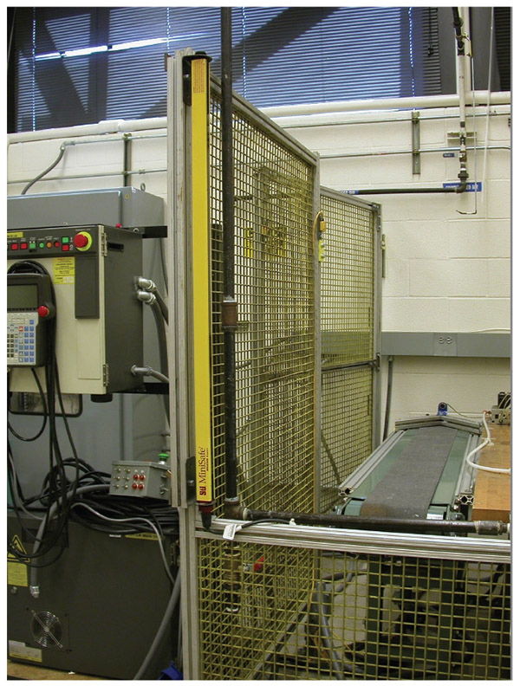
Figure 7-7
Here you can see one half of a light curtain, which is the common name for the emitter and receiver separated setup.

Slide 20
Retroreflective
Retroreflective photoelectric sensors place the transmitter and the receiver in one assembly, and often use something like a bicycle reflector to return the emitted light to the receiver
  The range in this application is a maximum of approximately 165 feet (50 m)
  Shiny parts may return enough light in some applications to keep the sensor from changing state
  A polarizing filter projects the transmitted light in one plane only, so it requires a corner-cube type of reflector to return the light to the receiver—something the shiny part cannot accomplish

Slide 21
Diffuse
Diffuse photoelectric sensors also house both transmitter and receiver in one unit, but in this case only a small amount of returned light is needed to activate the sensor
  Instead of a reflector, the part is what returns the light
  A diffuse photoelectric sensor can detect a certain feature or marking on the parts via a specific amount of reflected light
  Because such a sensor works with just a partial reflection of the emitted light, the maximum range is approximately 40 inches (1 m)

Slide 22
Light Level Detection
With the light level detection photoelectric sensor, we can tune out or ignore the background, differentiate between parts on a background, and even detect transparent objects
  The sensor analyzes the light coming back to the receiver and determines whether it has been affected or altered in any way
  It can differentiate between a rough, raw part and a smooth, finished part
  Proper calibration is a must with a light level detection sensor
  Dusty conditions or changes in ambient light may be a problem

Slide 23
Color Detection
Color detection photoelectric sensors analyze the light coming into the receiver to determine the color or a color difference in parts
  This sensor can find the edge between parts of different colors
  Changes in the ambient light will change the light returning to the switch and the reading, so the sensors require recalibration

Slide 24
Hall-effect sensors
Hall-effect sensors respond to magnetic fields and can produce either a digital on/off type signal or a varying analog signal, depending on the sensor and application
  When used in a digital application, such sensors are “off” with there is no magnetic field and “on” when a magnetic field of sufficient strength passes over the sensor
  With the analog variety, the output increases with the strength of the magnetic field interacting with the sensor

Slide 25
Tactile and Impact
Tactile - the ability to sense pressure
  Tactile sensing is about determining how much force is being applied and the same kinds of sensing tasks that skin performs for the human body
Impact - the robot contacts an object in the intended movement path
  Impact sensing is concerned with detection of collisions and shutting down or modifying the motion of the system to prevent damage to both whatever is hit and the robot

Slide 26
Tactile Sensors
Tactile sensing is accomplished in several ways:
  Simple buttons that activate when depressed and disengage when released
    A subminiature micro limit switch or push button is often the switch of choice for this type of operation
  Complex arrays of sensors that closely mimic the function of human skin in the amount of information they provide
  A tactile sensor must “touch” the part it is sensing. Otherwise, it is a different type of sensor

Slide 27
Complex Tactile Sensors
Complex tactile sensors use arrays or organized groups of sensing elements to gather information about contact with objects
  Each element of an array is an individual sensor that provides information about how it is interacting with the part
  Simple systems consist of elements that have a digital type of output, either on or off, 1 or 0
  High-end complex tactile sensors also provide information on how much force the system applies to the part, temperature, or other deeper information

Slide 28
Complex Tactile Sensors cont.
Complex tactile sensors have a variety of options for sensing changes in force, such as changes in voltage, resistance, capacitance, and magnetic flux
  The common factor in all these elements is that change in the shape of the element causes a change in the output of that element
  Systems that have complex tactile systems standards should require little more than calibration from the user
  Calibration is a process that ensures a precision system performs properly and provides for any adjustments needed

Slide 29
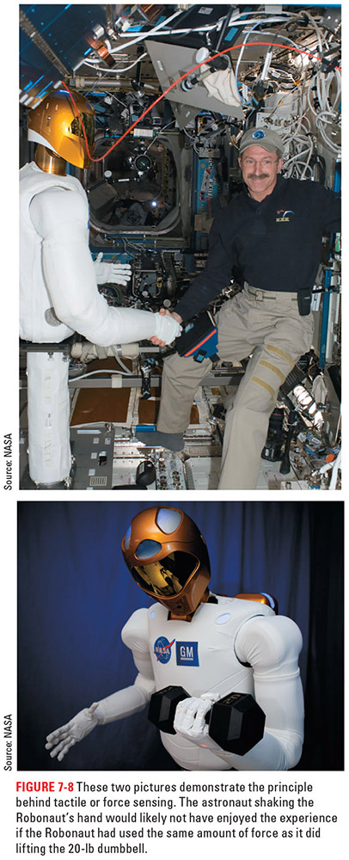
Figure 7-8
The Robonaut uses its tactile sensors to make sure it doesn't hurt the astronaut it is shaking hands with as well as to receive data about things it is working with.

Slide 30
Impact Detection
Impact detection plays a crucial role in minimizing or preventing damage to the robot as well as equipment and people around the robot
  Initially, impact detection was all about keeping the robot and other equipment safe
  It was not until 2012 that this technology advanced enough for the robot to work without the isolation cage and beside its human counterparts in industry
  Today, we typically either monitor the amperage the motor uses or insert sensing devices designed to detect impacts

Slide 31
Impact Detection cont.
When the system uses the amperage draw of the motors to monitor for impact, it creates a very accurate system that has great sensitivity
  These systems are complex and require high-level math
  With this method a system may shut down due to excessive payload or noise in the system
    Noise - the mathematical difficulties in properly calculating the torque required at the start of motor motion for robot movement
  Anything that causes the motor to use excessive amounts of current can cause an impact alarm

Slide 32
Stopping the Robot
Once an impact is detected the robot must stop to prevent damage
One of the tactics is to E-stop the robot and lock it in place
  The robot will still be moving after the detected impact for a short period of time before the full stop occurs
  A secondary concern is the strain this causes to the internal systems of the robot

Slide 33
Stopping the Robot cont.
Many robots now disengage the motor from the joints until the system can come to a full stop
  This reduces the force the robot has to stop
  It reduces the energy of the impact
  It also reduces the stress on the robot’s internal systems
  This type of response requires an advanced force reduction system coupled with specialized programming and sensors

Slide 34
Temperature Sensors
When selecting a temperature sensor, we have to look at the temperature range of the process, the measurement procedure, and the precision requirements for the reading
Every sensor has a maximum temperature it can handle
Sometimes the sensor needs to be watertight
If the sensor’s smallest reading is to the single degree, then we can keep the system only within a degree or two of our set point

Slide 35
Thermocouples
Thermocouples are temperature sensors that work off the principle of a small DC millivoltage generated when the junction of two dissimilar metals are heated
  For an accurate reading, the cold junction needs to remain at a constant temperature so we can calibrate the system correctly
  To protect the wires of the thermocouple, they are placed inside a metallic tube. The walls of the tube are referred to as the sheath, and the end is called the tip of the probe.
  The American Society for Testing and Materials has created calibration charts for these thermocouples

Slide 36
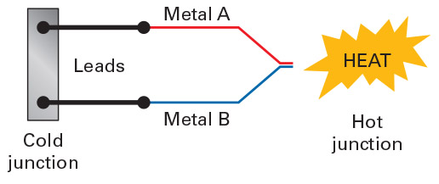
Figure 7-9
This graphic shows the basic construction of the thermocouple

Slide 37
RTDs
Resistance temperature detectors (RTDs) are based on the principle of a linear increase in resistance that occurs when a metal is exposed to heat
  By supplying a steady voltage to this device, we can use the decrease in current flow through the sensor to determine to which the temperature it is being subjected
  Platinum works the best for this application
  One concern with RTDs is the need to ensure the wires coming from the sensor have adequate insulation to account for the temperature in which the sensor will work as well as the distance from sensor location to signal processing

Slide 38
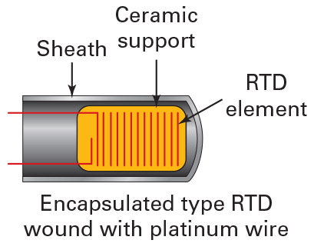
Figure 7-10
A grid of this wire is placed on a ceramic support element so there is a larger area subjected to the temperature to be measured; this element is often trimmed with a laser to create a specific resistance, thereby calibrating the device

Slide 39
Thermistors
Thermistors are resistors that experience a consistent change in resistance with a change in temperature
  These sensors can have either a negative temperature coefficient (NTC), in which case an increase in temperature causes a decrease in resistance
  Or a positive temperature coefficient (PTC), in which case an increase in temperature causes an increase in resistance
  Thermistors as a group cover a temperature range of ‒100˚C to +300˚C (‒148˚F to +572˚F), but no single thermistor covers this entire range
  Their accuracy is between 0.1˚C and 1.5˚C, making them fairly accurate sensors in their temperature range

Slide 40
Semiconductor Temperature Sensors
Semiconductor temperature sensors, sometimes known as integrated circuit (IC) temperature sensors, use semiconductor diodes that rely on temperature-sensitive voltage rather than current characteristics to determine temperature
  By using two identical solid-state transistors, we can use the voltage output to measure temperature
  The range for these sensors is typically ‒55˚C to +150˚C (‒67˚F to 302˚F)
  The accuracy is ±0.2˚C to 0.3˚C

Slide 41
IR Temperature Sensors
Infrared radiation (IR) temperature sensors detect the heat of an object by measuring the infrared radiation created, which is a long wavelength of light below the human scale of vision
  These are noncontact sensors, so we can put a little distance between the sensor and the item measured
  The distance to spot ratio tells you how many feet away from the object the sensor must be to measure a 1-foot radius circle; the best sensors have a 300:1 ratio
  IR temperature sensors can measure temperatures in the range of ‒60˚C to 1500˚C (‒76˚F to 2732˚F) and at best have an accuracy of ±1˚C, with ±2% being the more common accuracy

Slide 42
Fluid Sensors
A fluid is a substance in which the particles can move past one another, conform to the shape of their container, and continually deform under an applied shear stress
Flow is a term used to describe the motion of a fluid, and it can be measured with some type of sensor
  When measuring flow, we have to find a way to convert the kinetic motion of a fluid into a measurable electric signal

Slide 43
Flowmeters
Turbine flowmeters use a propeller- or turbine-type assembly placed inside the fluid to generate a signal via a magnetic pickup sensor positioned nearby, but outside of the fluid
Target flowmeters place a disk or similar shape in the fluid and use the force of the fluid flow to deflect the target and generate a signal
Sail flowmeters work on the same basic principle, but instead of a round disk for the fluid to strike, a triangular or rectangular flag is dragged along by the fluid flow
Magnetic flowmeters, also known as induction flowmeters, measure the change in voltage induced in the passing fluid

Slide 44
Level Sensors
Float sensors use something the liquid can lift to determine level
Capacitive level sensors work on the same basic principle as the capacitive prox switch, with one exception: instead of the fluid acting as the second electrode, the liquid is the dielectric
  When three or more probes are used in capacitive level sensors, one probe is longer than the rest, and serves as the main electrostatic source
  The next longest probe is the low-level probe
  The third probe, the shortest of the three, is the high-level probe

Slide 45
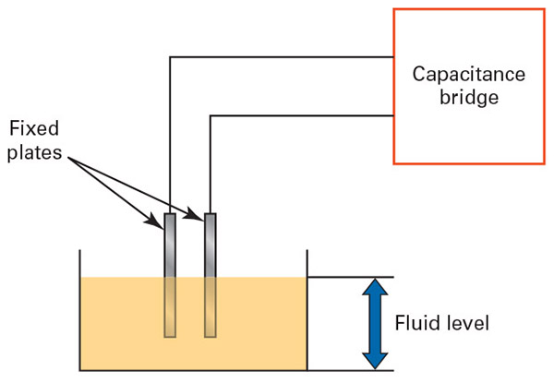
Figure 7-11
This figure demonstrates the basic operating principle of a two-probe capacitive level sensor

Slide 46
Pressure Sensors
Plunger pressure gauges use a plunger that is exposed to system pressure, a bias spring, a pointer, and a calibrated scale to measure pressure
Bourdon tube gauges use a thin-walled, slightly elliptical, cross-sectioned tube bent in a C shape, which is tied directly to the system, to read pressure

Slide 47
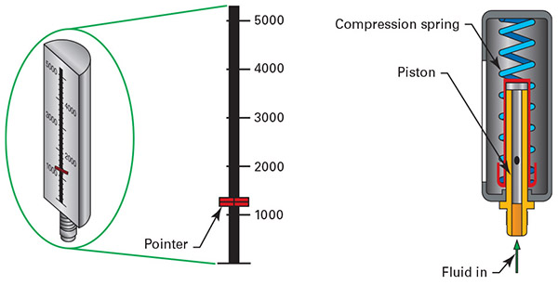
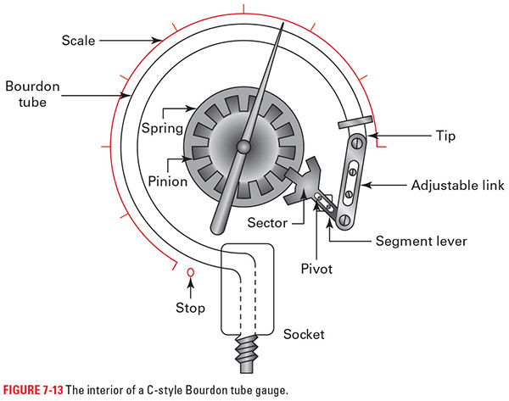
Figure 7-12
Figure 7-13
On the left you can see the make up of a plunger pressure gauge and on the right the Bourdon tube variety

Slide 48
Pressure Sensors cont.
Bellows gauges use thin-walled tubing that can expand or retract in reaction to pressure, with the bellows portion often being augmented by an internal spring
Diaphragm gauges use a thin membrane, often made of metal in a capsule arrangement, to move the indicator assembly
Piezoelectric pressure transducers use crystals that generate electricity in reaction to pressure to generate an analog signal
Pressure switches react to system pressure and, at some determined point, change the state of contacts inside the system
Pressure relief valves are valves set to either vent pressure or return fluid to the tank in case the pressure exceeds a set point

Slide 49
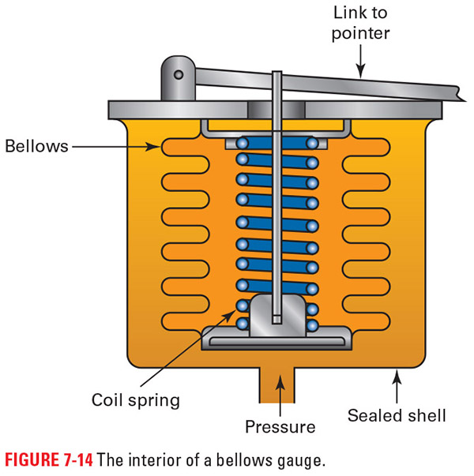
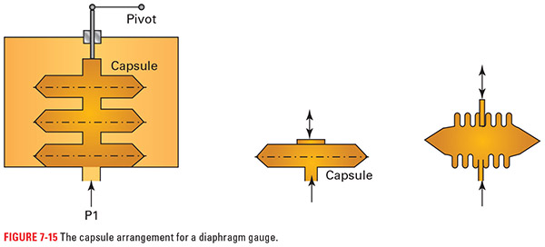
Figure 7-14
Figure 7-15
On the left you can see the inner workings of a bellows type pressure switch and on the right is the diaphragm sensor

Slide 50
Position
Open-loop systems work on the assumption that the control pulse, whatever it may be, activates the motion system, and the robot performs as expected
Closed-loop systems send out the control pulse, whatever it may be, to initiate movement and then receive a signal back that confirms movement and in many cases in which direction and how far

Slide 51
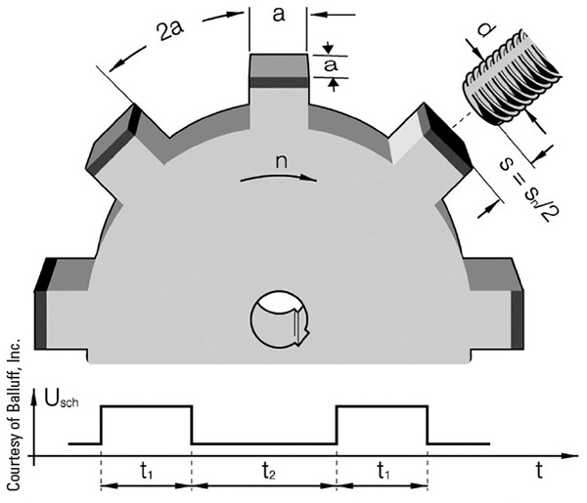
Figure 7-16
Here is a simple feedback system where a prox switch monitors and sends back information each time a projection passes near the sensor

Slide 52
Encoders
Motor encoders are devices that directly monitor the rotation of a motor shaft and turn that information into a meaningful signal
A simple encoder may use the Hall-effect sensor by attaching a disk with a specific number of magnets evenly spaced around the edge where they can activate a Hall-effect sensor

Slide 53
Incremental Encoders
Incremental optical encoders consist of a disk that has either holes for light to pass through or special reflectors to return light, an emitter, a receiver, and some solid-state devices for signal interpretation and transmission
  Because we are using light, it is possible to make the divisions on the rotating disk extremely small
  By adding a second row of reflectors or light windows, offset from the pulse count, it can determine the direction of rotation by comparing the signals from the two rings
  Adding a special area called the zero pulse allows for counting of full rotations as well

Slide 54
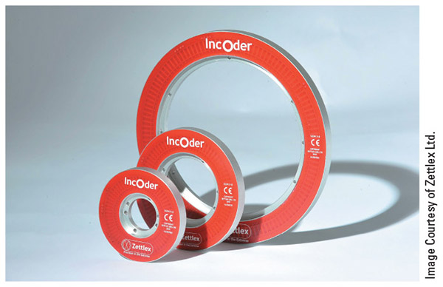
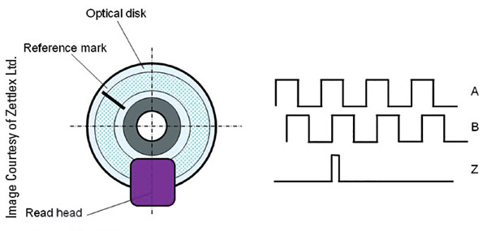
Figure 7-17
Figure 7-18
Here you can see some examples of optical encoders as well as a drawing of the signals they produce

Slide 55
Absolute Encoders
Absolute optical encoders add enough emitters and receivers, usually four or more in total, to give each position of the encoder its own unique binary address
  A binary address is a unique set of 1s and 0s that the controller can understand and use
  These encoders have more internal parts, cost more, and require more of the controller’s processing power
  These give the system accurate data about the specific position of the motor as well as the direction it is moving

Slide 56
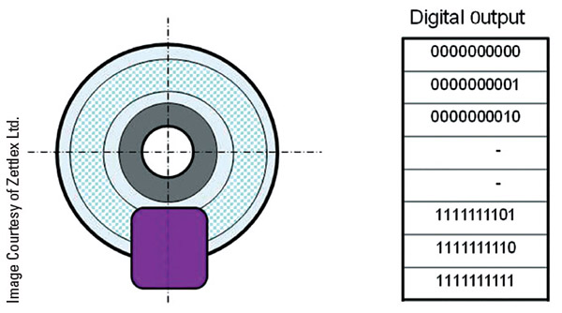
Figure 7-19
Here you see the type of output the system receives from an Absolute Optical encoder

Slide 57
GPS
Global Positioning System (GPS) systems determine geographical position based on the time it takes to receive signals from three or four separate satellites in orbit around the Earth
  Mobile robotic vehicles can use GPS to navigate to program locations
  For outdoor applications, GPS navigation works well
  When indoors most robots need visual references that they can detect with cameras, something a laser can interact with, or devices that broadcast a signal that the robot can interact with for positioning

Slide 58
Sound
For sound detection, a robotic system needs:
  A microphone
  The proper hardware
  The necessary programming so that the robot can turn the signal from the microphone into something useful
  With these elements in place, we can record patterns of sound and use them as triggers for robot actions

Slide 59
Sound Location
To detect where a sound came from, add multiple microphones to the robot so that the controller can compare signal strengths and determine a probable location for the sound’s origin
  Usually add microphones in even-numbered pairs
  Two is the minimum with four or six being common

Slide 60
Ultrasonic Sensors
Ultrasonic sensor - similar to the photo eyes or photoelectric prox switches except that they are emitting and receiving sound instead of light
  The emitter sends out a high-frequency sound pulse
  This strikes objects and then returns to the ultrasonic sensor
  The receiver measures the amount of time that it takes the sound wave to return and uses this to calculate the distance
  Industrial ultrasonic sensors operate between frequencies of 25 kHz and 500 kHz, and the sensing distance is inversely proportional to frequency

Slide 61
Ultrasonic Sensors cont.
Another use for ultrasonic sensors is the detection of air leaks
  Small air leaks emit a high-frequency sound that we cannot hear, but that the ultrasonic detector can pick up with ease
  Obviously, in this application, the sensor does not need an emitter because we are looking for sources of high-frequency sound
  This usually requires several spatial points detecting the sound to determine the exact location

Slide 62
Connection to the Robot
A sourcing signal input provides the positive connection or DC voltage (usually 24 V) to the input module
A sinking signal input provides the negative connection or ground to the input module
Analog signals are converted to a digital signal called a word, which consists of a number of data bits and a sign bit
Optical isolation works by creating a dead zone where the only connection between the internal electronics and the outside connections is light

Slide 63
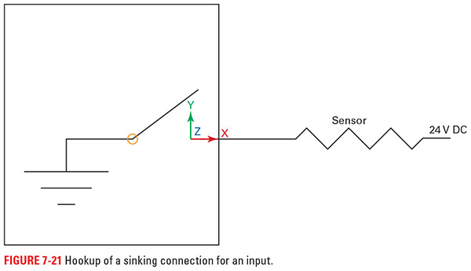
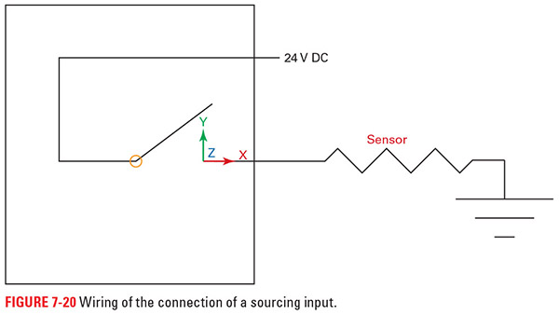
Figure 7-21
Figure 7-20
On the left you can see sourcing where the positive is supplied and on the right sinking, where the negative is supplied

Slide 64
Connection to the Robot cont.
There are three main things to verify when making connections to or from the robot/controller:
  Make sure it is the right type of voltage, AC or DC
  Make sure it is the right level of voltage
    Too much can cause damage and too little will likely not trigger the input or run the output
  Make sure it is the right type, digital (on or off) or analog (a range)
    When the signal is analog, make sure it is the right type of signal for the card it is tied to and the device it works with

Slide 65
Sensor Selection Criteria
A number of criteria must be considered when selecting a sensor:
  What are you measuring
  Operating environment
  Fail-safe requirements
  Accuracy
  Type of output
  Cost versus performance

Slide 66
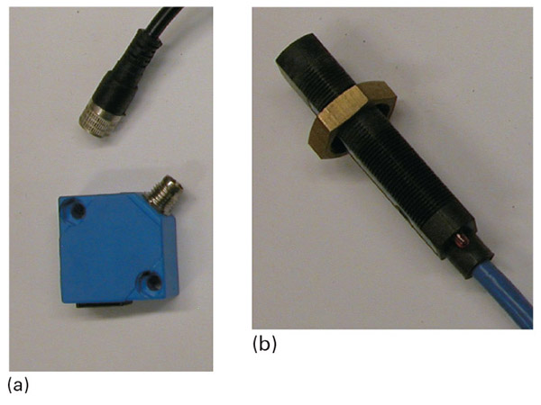
Figure 7-22
A very common consideration is whether to use a solid cable, on the right, or a quick connect cable, on the left

Slide 67
Review
Limit switches. We looked at one of the basic switches used to sense the presence or absence of objects.
Proximity switches. This section detailed the different types of prox switches available as well as the basics of their operation.
Tactile and impact sensors. We looked at two sides of the force-sensing question along with some of the ways of sensing force.
Fluid sensors. We looked at flow, level, and pressure sensing methods.

Slide 68
Review cont.
Position sensors. We use these sensors to determine where the robot is in space as well as where it is moving to.
Sound sensors. This section covered the standard sound detection sensors as well as ultrasonic sensing.
Connection to the robot. We covered sinking and sourcing signals as well as a few other considerations to keep in mind when hooking up sensors.
Sensor selection criteria. This section had some guidelines to keep in mind when picking out sensors.

