Slide 1

Welcome to Training Within Industry:
    History of TWI
    TWI Job Instruction Training
    Q & A

Slide 2
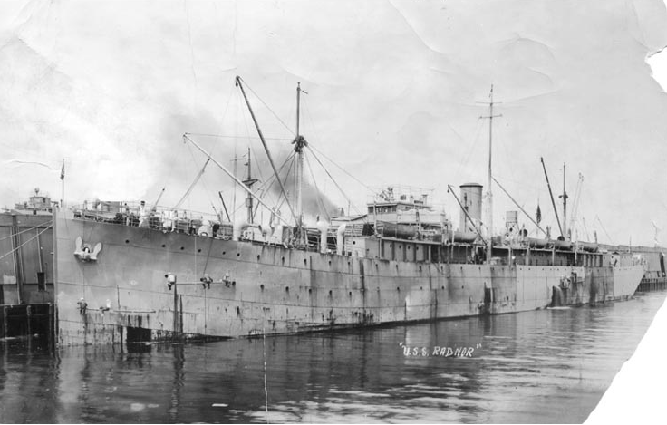
TRACING THE ROOTS OF TWI….
WWI SHIP BUILDING INDUSTRY

Slide 3
TRACING THE ROOTS OF TWI….
WWI SHIP BUILDING INDUSTRY
At the beginning of WWI, United States had 37 Steel Shipyards &
24 wood shipyards
~50,000 people employed in 1915 in Shipbuilding
Defense Department sized we needed 10x that many shipbuilders
Turned to Industry trainers & teachers to develop a program to
accomplish what seemed to be the impossible….
Train 500,000 – which was accomplished by 1918!
Helped win the war!

Slide 4
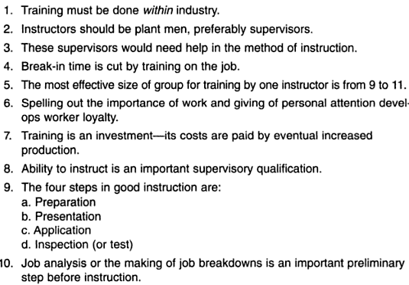
Also accomplished was an astounding amount of learning in the skill of field instructions….

Slide 5
War Manpower Commission & TWI Service
Developed for WWII starting in 1940
Mission: Support 11 million Soldiers to become the “Arsenal of Democracy”
Trained over 1.7 Million people at 16,511 companies in the US alone

Slide 6
Some History on TWI
TWI helped win the war!
War ended in 1945, TWI Service was closed
US had market domination…1/2 the goods sold in the world were US made
TWI faded away…

Slide 7
Some History on TWI
Opposite problem in Japan
TWI introduced by the US Occupational Authority in the late 40’s
Used to help rebuild the industrial base and promote Democracy
Used by many Japanese companies…

Slide 8

Some History on TWI
Toyota adopted TWI in the early 50’s
They still use it today, almost unchanged
One of the foundations of TPS, or Lean Manufacturing

Slide 9
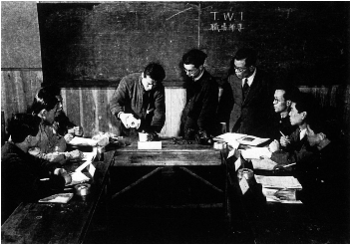
TWI IN JAPAN – 1950

Slide 10
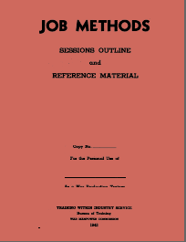
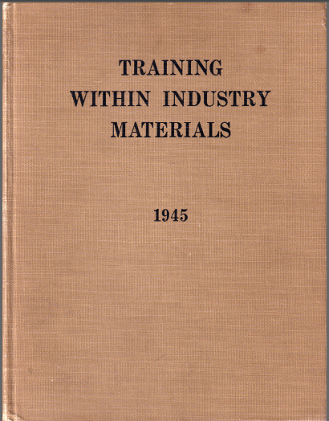
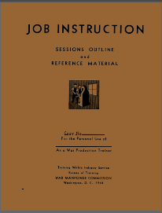
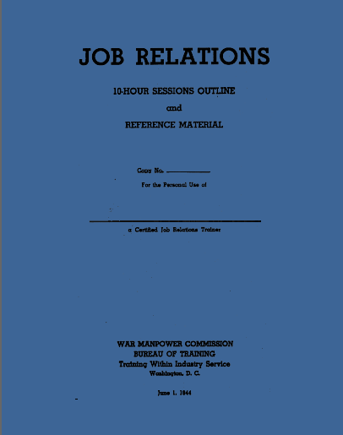
What is TWI?
3 J-Programs

Slide 11
What is TWI?
Developed by the U.S. Government to increase WWII production, by standardized
techniques, training, and continuous improvements in order to maximize the potential
of every worker.
Job Instruction (JI): Structure for effective training, to eliminate the waste
caused by varied work practices.
Job Methods (JM): Structure for job improvement, listing each step and
questioning why, what, where, when, who & how which leads to ideas
towards improvement.
Job Relations (JR): Structure for how to promote teamwork and resolve
basic worksite communication problems.

Slide 12
What is TWI?
Developed by the U.S. Government to increase WWII production, by standardized
techniques, training, and continuous improvements in order to maximize the potential
of every worker.
Job Instruction (JI): Structure for effective training, to eliminate the waste
caused by varied work practices.
Job Methods (JM): Structure for job improvement, listing each step and
questioning why, what, where, when, who & how which leads to ideas
towards improvement.
Job Relations (JR): Structure for how to promote teamwork and resolve
basic worksite communication problems.

Slide 13
What is TWI?
Developed by the U.S. Government to increase WWII production, by standardized
techniques, training, and continuous improvements in order to maximize the potential
of every worker.
Job Instruction (JI): Structure for effective training, to eliminate the waste
caused by varied work practices.
Job Methods (JM): Structure for job improvement, listing each step and
questioning why, what, where, when, who & how which leads to ideas
towards improvement.
Job Relations (JR): Structure for how to promote teamwork and resolve
basic worksite communication problems.

Slide 14
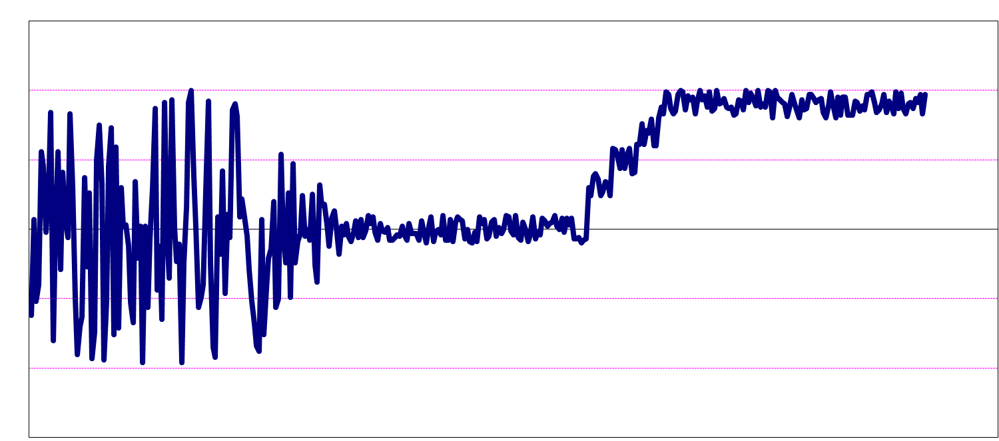
Training Within Industry…
Variability Causing Unstable Performance
Reduce Variability With Standard Work
Improve Performance From Stable Baseline
Job Instruction
- Develop Standard
Train Each Person
Job Methods
Question Every Detail
Improve Standard
Job Relations
Encourage Innovation
Solve People Problems
…it’s that simple

Slide 15
TWI Job Instruction (J.I.)
5 days – 2 hours per day
8 – 12 Participants
“Lean by Doing”
Informal “at ease” Atmosphere
Participant Manuals
Each Participant – Demonstration (using JBS’s)
Post Demo Feedback
Breakdown each Demo

Slide 16
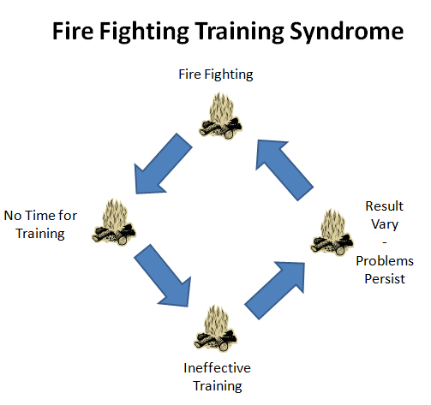
Obstacles to Training

Slide 17
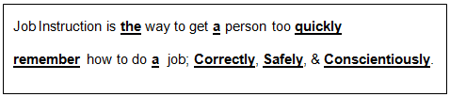
The Objective of TWI Job Instruction:
Group Activity:
Tell & Showing Demo - Inadequate Instructions

Slide 18
The Objective of TWI Job Instruction:
Job Instruction Motto:
“If the person has not learned, the instructor has not taught”
Group Activity:
TWI JI Demo - Adequate Instructions

Slide 19
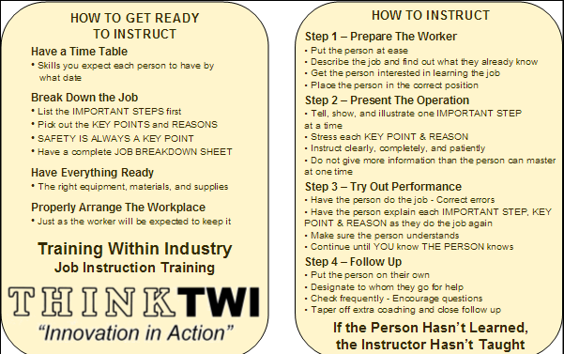
TWI Job Instruction Card

Slide 20
The Purpose of Job Breakdown Sheets:
To help organize the operation in the Instructor’s mind
To remind the Instructor of the order and details of all the important steps
and key points
3. To document Standard Work
Group Activity:
Breaking Down the Fire Under Writer’s Knot

Slide 23
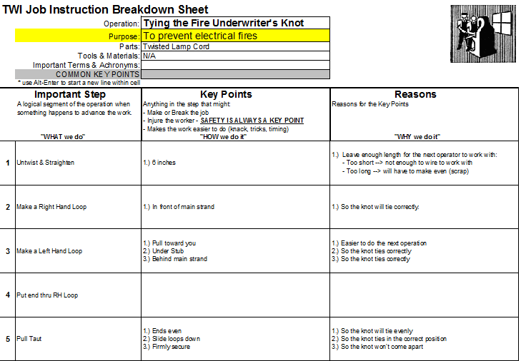

Slide 24

Questions ???

Slide 25
http://www.youtube.com/watch?v=PYzuchDBvCs

