Slide 1
A3 Reporting
Standardized Storytelling

Slide 2
The A3 Method
The Toyota tool known as A3 refers to the international paper size that is roughly the size of a 11x17-inch (tabloid) paper used in the United States. The A3 format is used by Toyota as the template for different types of reports such as:
  Problem Solving Report
  Strategy Report
  Status Report
  Proposal Report

Slide 3
An A3 Report Can:
clearly tell a story, especially when you wish to simplify or clarify a complicated issue
be used as a jumping off point for Kaizen or other continuous improvement activities
provide a clear and concise method of reporting information
be used to teach problem-solving
create efficient working environments
Most importantly, the A3 achieves operational learning!

Slide 4
The A3 Method
A3’s are deceptively simple consisting of a sequence of seven boxes that are utilized in the following method:
  Background - establish the business context and importance of a specific problem
  Current Condition - describe the current conditions of the problem
  Goals/Targets - identify the desired outcome
  Analysis - analyze the situation to establish causality
  Propose Countermeasures – describe how to improve the problem
  Plan - prescribe the actions for getting it done
  Follow-up - map out the follow-up process

Slide 5
A3 Template

Slide 6
A3 Document Translation Example

Slide 7
A3 Document Translation Example
A3s tell a story, a story that includes a standard layout, a beginning, a middle, and an end. This method is used to communicate both facts and meaning in a commonly understood format.
There is no one fixed, absolute, correct template. Regardless of setting, it is always the underlying thinking that matters.

Slide 8
Example
A3 Document Translation Example
A3 Document Translation Example

Slide 9
Example
A3 Document Translation Example
A3 Document Translation Example
Current conditions are always derived from the gemba. Real facts about the real work are derived from careful investigation by the owner.
Defining the problem simply represents the most important part of any A3.
A3s employ visual methods to share the information and thinking. This helps condense the key facts into meaningful visual shorthand.

Slide 10
Example
A3 Document Translation Example
A3 Document Translation Example
Quality – 0 defects at launch
- Rework less than 10%
Delivery - 100% on-time
- Level weekly volume
- Consistent short lead time with predictable delivery
Cost - 10% decrease – rework down: overtime down

Slide 11
A3 Document Translation Example
Once you have the problem stated, the development of goals reflect the performance of the change from the current state to the future state.
How do we know when we are done? We’ve either met our targets or we’ve gotten as close as we can without a large capital expenditure (for example).
Quality – 0 defects at launch
- Rework less than 10%
Delivery - 100% on-time
- Level weekly volume
- Consistent short lead time with predictable delivery
Cost - 10% decrease – rework down: overtime down

Slide 12
A3 Document Translation Example
Quality – 0 defects at launch
- Rework less than 10%
Delivery - 100% on-time
- Level weekly volume
- Consistent short lead time with predictable delivery
Cost - 10% decrease – rework down: overtime down

Slide 13
A3 Document Translation Example
A problem is something that presents itself as a barrier to the organizations ability to achieve it’s goal.
Articulating the problem requires the owner to identify the gap between the current condition and the desired performance at any given time.
The root cause of the gap is identified by examining how the work is currently being performed and asking why the problem occurs.
Qu - Rework less than 10%
ality – 0 defects at launch
Delivery - 100% on-time
- Level weekly volume
- Consistent short lead time with predictable delivery
Cost - 10% decrease – rework down: overtime down
Clear definition provides effective countermeasures.

Slide 14
A3 Document Translation Example
Quality – 0 defects at launch
- Rework less than 10%
Delivery - 100% on-time
- Level weekly volume
- Consistent short lead time with predictable delivery
Cost - 10% decrease – rework down: overtime down

Slide 15
A3 Document Translation Example
A problem is something that presents itself as a barrier to the organizations ability to achieve it’s goal.
Articulating the problem requires the owner to identify the gap between the current condition and the desired performance at any given time.
The root cause of the gap is identified by examining how the work is currently being performed and asking why the problem occurs.
Quality – 0 defects at launch
- Rework less than 10%
Delivery - 100% on-time
- Level weekly volume
- Consistent short lead time with predictable delivery
Cost - 10% decrease – rework down: overtime down

Slide 16
A3 Document Translation Example
Quality – 0 defects at launch
- Rework less than 10%
Delivery - 100% on-time
- Level weekly volume
- Consistent short lead time with predictable delivery
Cost - 10% decrease – rework down: overtime down

Slide 17
A3 Document Translation Example
Quality – 0 defects at launch
- Rework less than 10%
Delivery - 100% on-time
- Level weekly volume
- Consistent short lead time with predictable delivery
Cost - 10% decrease – rework down: overtime down
Midterm Review | Ensure ongoing collaboration
Prelaunch Review | Monitor system weekly, all metrics, especially quality and delivery

Slide 18
A3 Document Translation Example
Quality – 0 defects at launch
- Rework less than 10%
Delivery - 100% on-time
- Level weekly volume
- Consistent short lead time with predictable delivery
Cost - 10% decrease – rework down: overtime down
Midterm Review
Ensure ongoing collaboration
Prelaunch Review
Monitor system weekly, all metrics, especially quality and delivery

Slide 19
A3 Document Translation Example
The A3 Problem Solving template lays out an entire plan, large or small, on one sheet of paper
It should be visual and extremely concise
It should tell a story, laid out from upper left-hand side to lower right, which anyone can understand
What is important is not the format, but the process and thinking behind it
It fosters dialogue
It develops problem solvers

Slide 20
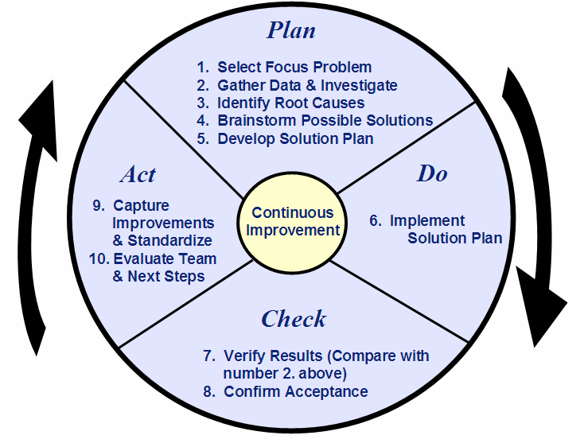
Plan– Do – Check - Act
Notes:
^{Process Coach Training}
^{Instructor Notes}
Corporate Training & Development
Contact: Dianne Douville – (978) 750-2534
^{Module 8-20}
^{December 2005 – Rev. 1}

Slide 21
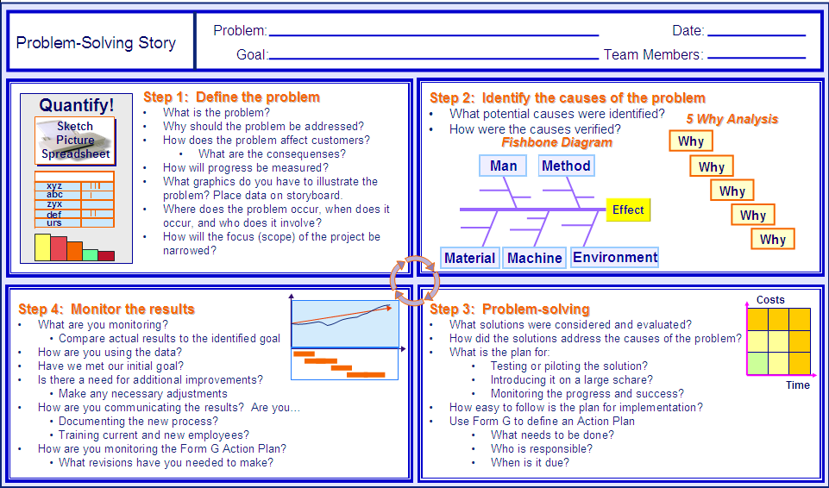
Problem-Solving Story
Notes:
^{Process Coach Training}
^{Instructor Notes}
Corporate Training & Development
Contact: Dianne Douville – (978) 750-2534
^{Module 8-21}
^{December 2005 – Rev. 1}
Backgroupd is shortened to the Problem, Target condition/Goal Statement is abbreviated to goal
Step 1 is analagous to the problem statement
Step 2 is Root cause analyses
Step 3 is the Implementation plan
Step 4 is the Follow up

Slide 22
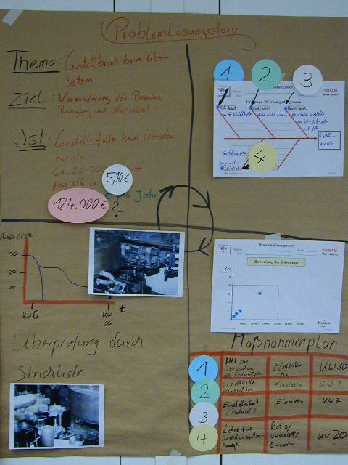
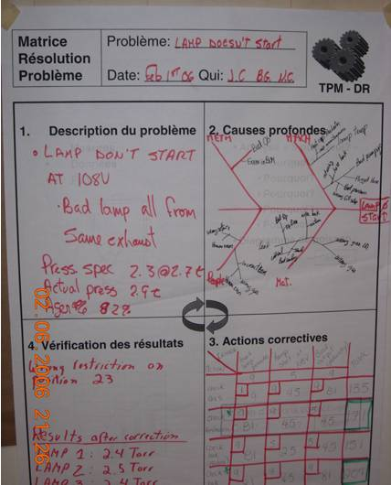
Daily Management Meetings

Slide 23
A3s are deceptively simple
A3 reports, and more importantly the underlying thinking, embody a critical core strength of a lean company
A3s serve as mechanisms for managers to mentor others in root-cause analysis and scientific thinking, while also aligning the interests of individuals and departments throughout the organization by encouraging productive dialogue and helping people learn from one another

