Slide 1
Training for Problem Solving
Exceptional People – Exceptional Processes – Exceptional Value

Slide 2
“We can not solve our problems with the same level of thinking that created them.”
                – Albert Einstein

Slide 3

Agenda
Introduction
    Course Objectives
    Definitions and Background
The Problem-Solving Process
Simulation
Toolbox Review

Slide 4

Training Objectives
Upon completion of this training, you will be able to:
  Define the problem
  Identify potential causes for the problem
  Prioritize & evaluate potential causes (i.e. light switch)
  Implement the solution
  Monitor your results

Slide 5
What is Root Cause Analysis?
Root Cause Defined:
  Root – the basic cause, source, or origin of something
  Cause – a person or thing that gives rise to an action, phenomenon, or condition
    Physical cause – material items (e.g. mold) failed in some way
    Human cause – people did something wrong or did not do something that was needed (e.g. layer pack)
    System cause – a process or policy that people use to decide or do their work is faulty (e.g. injection molding process)
  Analysis – detailed examination of anything complex to determine its essential features

Slide 6
Benefits
By eliminating the root cause…
You save time and money because…
Problems are not repeated
Rework, retest, reinspect, and cost-of-quality is reduced
Problems are prevented in other areas
Communication improves between groups
Process cycle times improve (no rework loops)
We secure long-term company performance and profits
$$ Less rework = Increased profits! $$

Slide 7
Example of Root Cause
Not knowing the root cause can lead to costly “Band aids”
  Problem Statement: Washington’s monuments are becoming severely stained and coarse due to excessive cleaning of the monuments – Why do we have to clean the monuments so often?
    Because there is a lot of bird poop in and on the monuments – Bird poop? Why so much bird poop?
    Because there are a lot of spiders, moths and wasps for the birds to eat - Why are there so many spiders, moths and wasps?
    Because millions of midges are attracted to the monuments where they poop and lay their eggs, which stain our monuments – Interesting, why are midges attracted to our monuments?
    Midges are ‘crepuscular’ meaning they are most active at twilight and drawn to the monument's lights when, at twilight, they are turned on!
Solution: Turn lights on an hour after twilight

Slide 8
When To USE?
When PROBLEMS Occur!
What Kind of PROBLEMS are we talking about?
Excess Inventory
Out of Control Process
Supplier Defects
Computer issues
Scrap Problems
Audit Finding
medical errors
Human Error
Machine Defects
Safety Issues
Missed Deliveries
Overspending Budget
Workmanship Defects

Slide 9
One Approach to Solving Problems
Yes
Is it
Working?
No
Don’t Mess With It!
Yes
Did You
Mess With
It?
YOU IDIOT!
No
You’re In Trouble!
Anyone
Else Know?
Yes
Yes
Will It
Blowup In
Your Hand?
No
Can You
Blame Someone
Else?
No
No
Can You Hide It?
It’s Been Nice Working With You!
Look The Other Way!
Yes
No Problem!

Slide 10

But Who’s to Blame?
A “no blame” environment is critical
Most human errors are due to a process error
A sufficiently robust process can eliminate human errors
Placing blame does not correct a root cause situation
  Questions to consider:
  Is training appropriate and adequate?
  Is documentation available, correct, and clear?
  Are the right skillsets present?

Slide 11
Our Approach to Problem-solving
Develop Problem Statement
Scope the Problem with
IS/IS NOT
Answer Questions with 5-Why
Develop Hypothesis, using Affinity Diagrams, to Answer Questions
Organize Options for Prioritization using Fishbone
Perform Experiments using PDCA
Standardize Results
Verify and Validate

Slide 12
Corrective Actions
3 Types of Corrective Action:
    Immediate Action:
      Act quickly to address the impact of the problem so that the “customer” is not impacted further
    Permanent Root Cause Corrective Action(s):
        Take action to eliminate the error on the affected process or product
    Preventive (Systemic) Root Cause Corrective Action(s):
        Take action to Prevent the error from recurring on any process or product

Slide 13
Examples of Corrective Actions
Immediate
All product being produced is re-inspected by another worker for same type of problem
Permanent
We made a design change to the mold to correct this problem
Preventive
We updated our mold design guidelines to avoid the use of this design feature on future designs
If ”Preventive” is not addressed, the problem will return!!

Slide 14
Permanent vs Preventive
Permanent
Preventive
Train employee on proper machine use
Change product design to make parts easier for manual assembly
Specific customer documents, critical to a project, are identified with red folders
Update all customers with latest software revision to fix a problem
Fallen patient is given a full-time assistant to provide help around hospital
Employee fired for ethical violation
Training a required for new employees
Add change to design guideline to ensure inclusion in future designs
All documents that are critical to projects are identified with red folders
Check for ‘bugs,’ add to checklist and perform verification prior to rev. release
Develop a process to identify “at risk” patients for falls
Provide ethics training to all employees

Slide 15
“If I had one hour to save the world, I would spend fifty-five minutes defining the problem and only five minutes finding the solution.”
– Albert Einstein

Slide 16
S1: Develop Problem Statement
What is a Problem Statement?
A problem statement describes the gap between our current condition and our expected condition. Key to a problem statement is the ‘absolute’ or ‘relative’ measure of the gap.
Absolute Measurements
Relative Measurements
Pressure at transfer is 13000 PSI
Part flash measures 0.014"
Screw Speed is 1100 RPM’s
Our goal is to produce 15 boxes of assemblies every shift
My shoulder hurts at the end of the day
I finding more parts on the floor
The core breaks every time we run this mold
Shoulder hurts when I leave work
PROBLEM GAP
Shoulder does not hurt when I get to work

Slide 17
S1: Develop Problem Statement
*A Problem Well Stated is a Problem Half Solved!
There is a method for Problem Statement Development, it is based on the 5W’s:
What is the problem that needs to be solved?
Why is it a problem?
Where and How often is the problem observed?
Who is impacted by the problem?
When was the problem first observed?
*Charles Kettering, Head of Research at General Motors from 1920 - 1947

Slide 18
S1: Develop Problem Statement
What is the problem that needs to be solved?
  We incorrectly insert light pipes in the mold
Why is it a problem?
  The part cannot be used in our customers final assembly
Where and How often is the problem observed?
  At our customers facility while assembling the parts; it occurs every time we run this process
Who is impacted?
  Our company because this failure results in returns and rework to correct and our customer who loses faith in our ability to produce their parts – this ruins future opportunities
When was the problem first observed?
  Our first defect was identified in 2014

Slide 19
S1: Problem Statement
Our Statement
  For many years we have been inserting light pipes (over-molding) into mold 01-0832 and by doing so our customers receive product that cannot be assembled causing us RMA’s, customer ill will and operator frustration which is the result of a difficult manufacturing process.

Slide 20
Simulation Facts
Mold 172201
Length runs out of spec on the low side
Process was validated 4 years ago
We run this job twice a month
We have never received a return for this product
Inspectors spend ‘gobs’ of time remeasuring every time this job runs
Technician state they cannot affect the feature with the process
Every run we place parts into MRB
Technicians ignore the problem when inspectors notify them that they are running on the low side of the specification
We spend $500 on rework every time this job runs
Engineers roll their eyes when the technician tells them of the problem
We are always late shipping these parts because the parts go to MRB and get reworked
This customer is a very important customer to us

Slide 21
Problem Statement Simulation

Slide 22
S2: Scope Problem
IS and IS NOT?
The IS / ISNOT tool is used to apply boundaries around our problem
When a problem cannot be solved quickly by an individual, use a team!
  Team is to consist of SME’s
  The team consists of a small group of people (4-6) with process and product knowledge, available time and authority to correct the problem
  Must be empowered to “change the standard”
  Should have a designated Champion
Placing Light Pipes Incorrectly in the Mold
IS | IS NOT
Is dependent on the operator | Is not a machine problem
Is dependent on the part design | Is not a mold problem
Is dependent on the process | Is not dependent on a specific person
 | Is not dependent of a specific shift

Slide 23
S2: Scope Problem
Key Ideas for Team Success
  Team is accountable until the problem has been solved
    Tasks can be delegated but the team is accountable for driving ALL activities to completion
  Clearly define roles and responsibilities
  Identify internal and external customer needs
  Ensure the right expertise has been assigned to the team
  Ensure appropriate levels of the organization have been communicated to
  Clearly define objectives and outputs
  Solicit input from everyone!
  Meeting location?
      Gemba – Where the issue has occurred
      If not practical, meet as close to where the issue occurred

Slide 24
Problem Scope Simulation

Slide 25
S3: Questions - Actions
Immediate actions MUST isolate customers from the issue
Immediate actions are usually “Band-aid” fixes
    100% sorting of parts
    Re-inspect before shipping
    Rework
    Recall parts/documents from customer or storage
Immediate actions are TEMPORARY corrective actions
    Temporary corrective actions are very costly, but necessary
    Temporary actions will be discontinued only when a permeant corrective action has been implemented
Verify that the immediate action is effective and that it DID NOT create other issues
    Run Pilot Tests
    Experimentation, simulations, data analysis, …

Slide 26
S3: Questions – Whys
The 5-Why problem-solving method identifies potential root causes
Utilizing this method will provide direction, for action, through the collection and analysis of data
When we get ‘stuck’ on a “Why,” we can use Affinity diagrams and Ishikawa diagrams (fishbones) to ‘un-stick’ us
5-Why’s are not required, it may take 2-Why’s, 8-Why’s or…
The “Why” process works like a funnel, if the funnel begins to inversely expand then stop – you have ventured into other potential causes
How do you use 5-Why’s?

Slide 27

S3: 5-Why Video
https://www.youtube.com/watch?v=SrlYkx41wEE

Slide 28
Why Simulation

Slide 29
S4: Develop Hypothesis
Why are they
out of spec?
What do you do when you don’t know the answer to the next why?
Listen to the words or phrases the team is using as they are trying to answer the question ‘Why?’ Words such as ‘guess’ ‘maybe’, ‘I think’ are key indicators that they should stop what they are doing and investigate that ‘Why’
Note: there is a tool that can help you with this task, the Affinity Diagram
Parts out of specification
Why are they at the low end of the spec?
The parts run at the low end of the spec
?

Slide 30
S4: Develop Hypothesis
Affinity Diagrams
Affinity Diagrams are idea generators used to help team’s group and define their ideas associated with a problem they are trying to resolve.
Capture
Group
Label
Try it out!
Break into two teams
You get 5 minutes to write down, on post-its, why we run at the lower spec.
Take all the post-its and ‘bunch’ them by common headings
You have developed an affinity diagram

Slide 31
Hypothesis Simulation

Slide 32
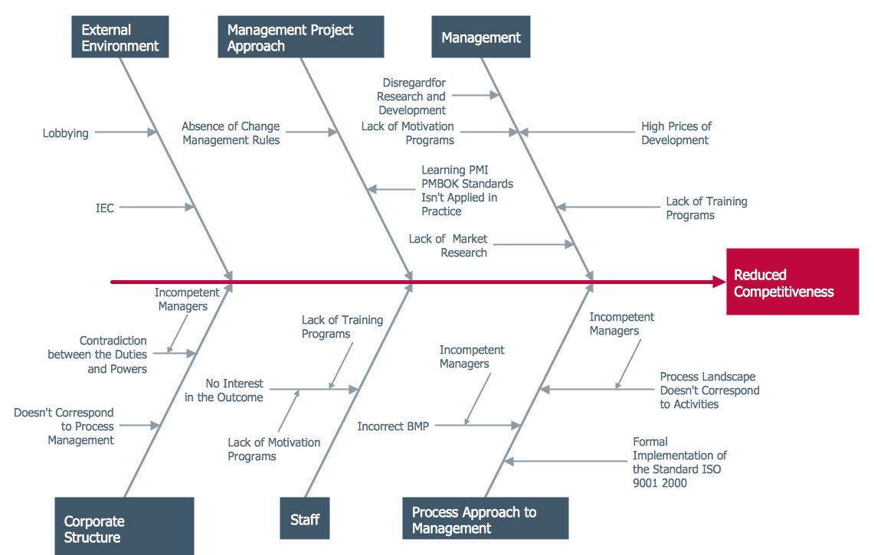
S5: Organize and Prioritize
Affinity to Fishbone
Fishbone diagrams are used to organize and prioritize ideas generated during brainstorming
From here, pick an item to test (experiment) that could answer ‘Why’ you’re stuck
Try it out!
Break into two teams
You get 5 minutes to produce a fishbone from your affinity diagram
You have organized and prioritized your ideas on a fishbone diagram

Slide 33
Organize & Prioritize Simulation

Slide 34
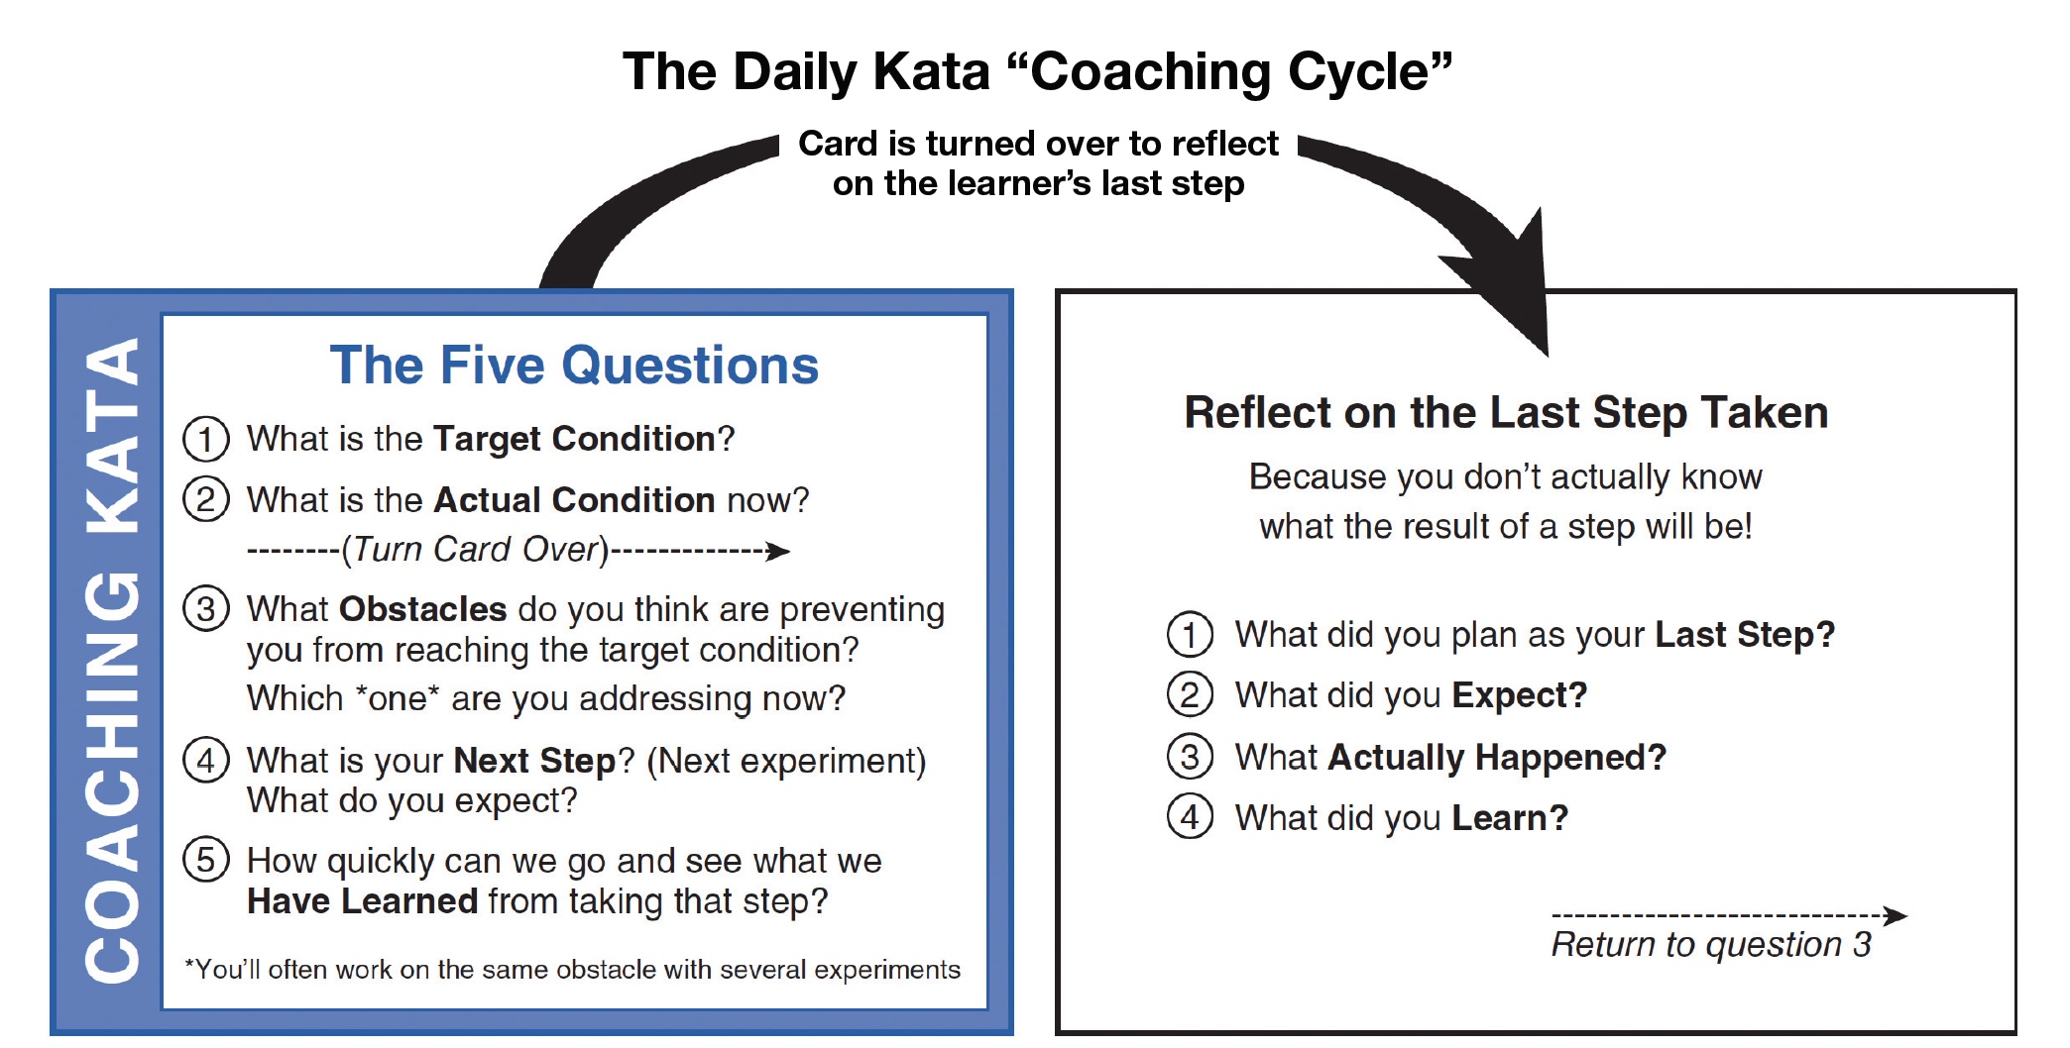
S6: Experiment
The process of experimentation is the PDCA cycle (Plan-Do-Check-Act). The process is best taught using the Kata method which consists of answering the following questions:

Slide 35
S6: Experiment
How do you know when your experiment is over? By answering the questions, you were stuck on OR you have found the root of the problem.
Notes on experiments:
You know you have found the root when the team can, at will, turn the symptom on and off (i.e., light switch)
Team members see issues from a similar perspective
Studies, Ideas and solutions are documented
Team is accountable for all activities regarding the solving of the problem and all activities are closed

Slide 36
Kata Worksheet
36

Slide 37
Experiment Simulation

Slide 38
Responsibility vs Accountability
Responsibility
Accountability
Responsible for completing a task within a broader process
Ownership of completing the task can be delegated to others
“Doer” - the person responsible for doing the work
Works on the activity
Entrusted with the task
Assigned to do the work
Accountable for ensuring all tasks within a broader process are completed
Ownership of the process CANNOT be delegated to others
“Where the Buck Stops” – person accountable to make sure work is done
Owns the activity
Liable for any faults
Assigned to ensure work is complete and to standard

Slide 39
S7: Standardize
Standardize: “to bring into conformity with a standard especially in order to assure consistency and regularity.”
Merriam-Webster
How do we build a standard?
  Make certain all tasks defined in the plan are completed
  If the plan is compromised, most likely the solution will not be effective
  If changes were made to tooling, update the tooling prints and database
  If changes were made to the process, update process documentation
  If changes were made to the methods, update the work instructions
  If criteria was changed, update the criteria
  Once the process is updated, train those who manage the process

Slide 40
S8: Verify and Validate
Verification vs. Validation
(Before) (After)
Verification
      Assures that at a point in time, the action taken will actually do what is intended without causing another problem
Validation
      Provides measurable evidence over time that the action taken worked properly and the problem has not recurred
Methods for Verification and/or Validation
      Experimentation
      Simulation
      Data collection and analysis

Slide 41
S8: Verify and Validate
Verify the actual results met the expected results
If symptom cannot be turned “on/off” or if the problem reoccurred, go back to step S4 and perform a PDCA cycle
If problem did not recur, celebrate your team success!
Document the improvement and publicize the team's effort
What future actions are need to ensure the root cause has been eliminated?
  Who will collect and analyze the data?
  What type of data will be collected?
  How long will we collect the data?
  How will the data be analyzed?
  What results will be deemed acceptable?

Slide 42
Kaizen Teian
Problem:
Solution:
Team:
Tools Used:
Results:
Production Supervisor:
Production Manager:
Date:

Slide 43
Kaizen Teian
Date:
Team:
Before Kaizen
Problem:
Solution:
After Kaizen
Results:
43

Slide 44
Discussion
Thoughts – Ideas - Disbelief

