Slide 1
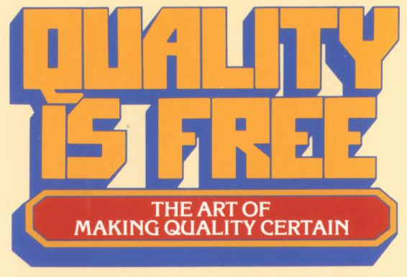
Philip Crosby
Presented by Matt Danda
EECS814 Fall 2007

Slide 2
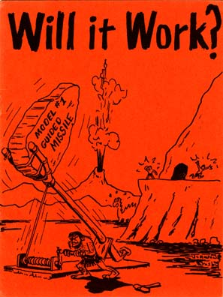
Agenda
Introduction to Phil Crosby
Definition of Quality
Quality Improvement Program
Managing Quality in the 21st Century

Slide 3
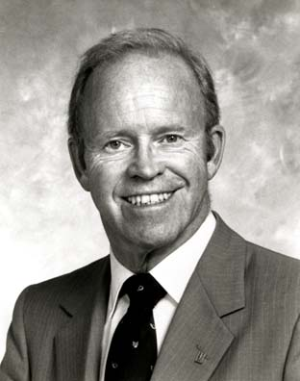
Biography of Phil Crosby
June 18, 1926—
August 18, 2001
One of the most highly respected and sought-after quality management consultants and educators
14 years as corporate VP and director for quality for the ITT Corporation
1979 started consulting group Philip Crosby Association, Inc.
1979 published Quality is Free.

Slide 4
Quality is Free
The book set off a revolution in corporate thinking
Shifted the responsibility for the quality of goods and services from the quality control department to the corporate boardroom
Attacked the entrenched notions of ‘good enough’ and Acceptable Quality Levels (AQL)
Introduced Zero Defects as the only acceptable performance standard, setting the stage for the Six Sigma movement that followed in later years.

Slide 5
Why is Quality Free?
The road to perfect goods and services is through prevention, not inspection.
Identifying and eliminating the causes of problems reduces rework, warranty costs, and inspection.
Creating quality goods and services does not cost money, it saves money.

Slide 6

Definition of Quality

Slide 7
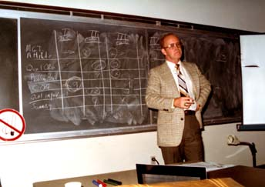
Crosby’s Quality Quiz
10 short questions about the definition of quality
Prerequisite to discussing Crosby’s Absolutes of Quality

Slide 8
Question #1
Quality is a measure of the goodness of the product that can be defined in ranges such as fair, good, excellent. (T/F)
FALSE
  Quality means conformance to requirements…
  And nothing else.

Slide 9
Question #2
The economics of quality requires that management establish acceptable quality levels as performance standards. (T/F)
FALSE
  There is no such thing as economics of quality.
  It is always cheaper to do the job right the first time.
  The only standard is ZERO DEFECTS.

Slide 10
Question #3
The cost of quality is the expense of doing things wrong. (T/F)
TRUE
  Quality is free
  Nonconformance is what wastes assets

Slide 11
Question #4
Inspection and test operations should report to manufacturing so they can have the tools to do the jobs. (T/F)
FALSE
  You will not have accurate reading of defects.
  Personnel involved will not receive proper training or the appreciation they need
  In this situation, inspectors become sorters and expeditors

Slide 12
Question #5
Quality is the responsibility of the quality department. (T/F)
FALSE
  Quality departments measure and report conformance, demand corrective action, encourage defect prevention, teach quality improvement, and act as the conscious of the operation.
  Work is the responsibility of those who get paid doing it.

Slide 13
Question #6
Worker attitudes are the primary cause of defects. (T/F)
FALSE
  Workers perform like the attitude of management. They are like a mirror.
  An experienced quality auditor can talk with a general manager for five minutes and guess his outgoing quality within 1 percent.

Slide 14
Question #7
I have trend charts that show me the rejection levels at every key operation (T/F)
This had better by TRUE
  If you don’t know what the defect level is, how do you know when to get mad?

Slide 15
Question #8
I have a list of my 10 biggest quality problems
FALSE
  There is no such thing as a quality problem.
  Problems should be identified according to the department responsible for corrective action (manufacturing, purchasing, design, etc.)
  It is political disaster to for a quality department to identify “quality problems.”

Slide 16
Question #9
Zero Defects is a worker motivation program. (T/F)
FALSE
  Zero Defects is a standard that no one can misunderstand
  “Make it right the first time” versus
  “Do the best you can.”
  Which is more effective?

Slide 17
Question #10
The biggest problem today is that the customer doesn’t understand our problems. (T/F)
FALSE
  The customer doesn’t have to understand.

Slide 18
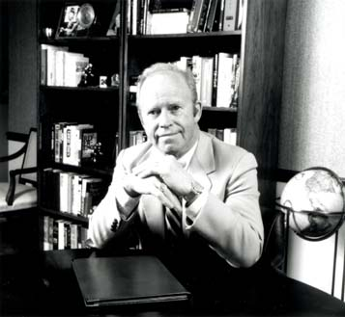
Absolutes of Quality Management

Slide 19
Absolutes of Quality Management
Absolutes answer four questions
  What is quality?
  What system is needed to cause quality?
  What performance standard should be used?
  What measurement system is required?

Slide 20
First Absolute
The definition of quality is conformance to requirements
  Quality means conformance, not elegance or goodness
  “Do It Right the First Time (DIRFT)”
  Management has 3 tasks related to this:
    Clearly establish requirements
    Supply means to meet requirements
    Spend time helping employees meet requirements
  In software—invest in quality requirements

Slide 21
Quality Requirements
Software requirements must conform to the requirements for software requirements:
  Correct
  Complete
  Unambiguous
  Consistent
  Traceable
  Modifiable
  Verifiable
  Prioritized

Slide 22
The Second Absolute
The system of quality is prevention
  The system for causing quality is prevention, not appraisal.
  An error that does not exist can’t be missed.
  Secret of prevention is to look at process and identify opportunities for error
  Prevention in software engineering is the result of a good process including early inspections, reviews, testing

Slide 23
The Third Absolute
The performance standard is zero defects
  Not a “motivational” program. It is a management standard tells people what is expected of them.
  Employees perform to the standards of the leaders.
  Mistakes caused by two factors:
    Lack of knowledge. Knowledge can be measured in deficiencies corrected through tried-and-true means.
    Lack of attention. Must be corrected by the person himself or herself. An attitude problem.

Slide 24
The Fourth Absolute
The measurement of quality is the price of nonconformance
  Traditional quality measurements are technical in nature, however, they need to be converted to numbers that management understands.
  Price of Conformance. All expenses necessary to make things right. Quality functions, prevention efforts, quality education.
  Price of Nonconformance. All expenses involved in doing things wrong. Cost of fixing problems, correcting orders, correcting products, warranties.

Slide 25
Four Pillars for Making quality certain
Management participation and attitude
  Overcome traditional definition of quality
Professional quality management
  Must be at same level as other departments
Original programs
  Numerous programs at unit level
  Takes 4-5 years for concepts to take hold
Recognition
  Shining star of the entire integrity system

Slide 26

14 Step Quality Improvement Program

Slide 27
Step one: Management commitment
Use the Quality Management Maturity Grid
  A logical method of identifying the maturity level of an organization
  Attempts to remove any emotional attachment to an organization when determining its maturity level

Slide 28
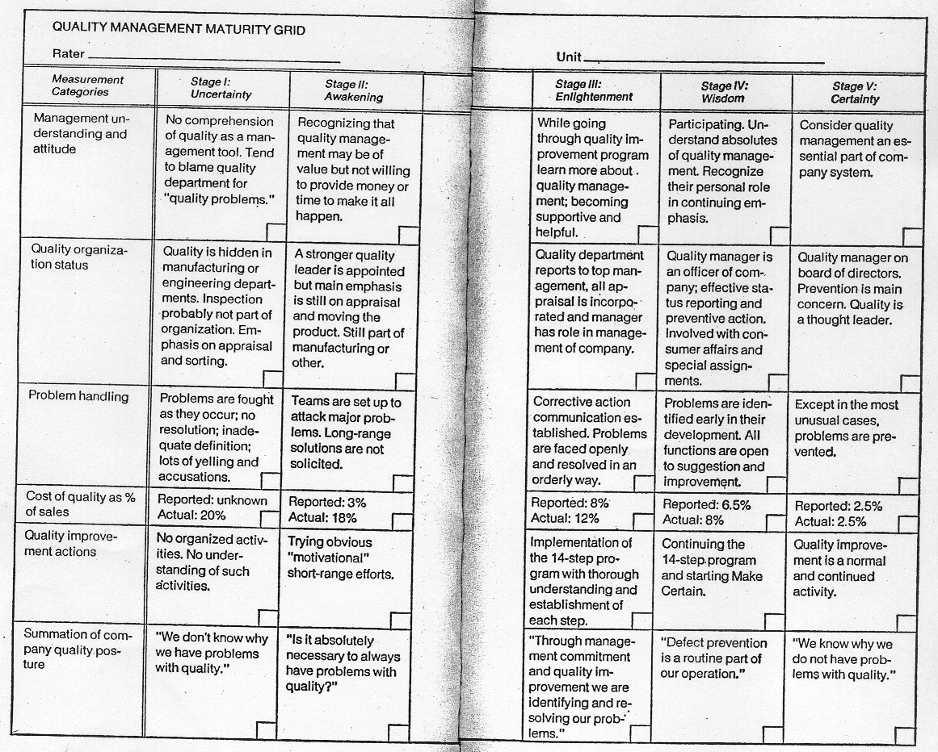

Slide 29
Step two: The quality improvement team
Runs the quality improvement program
Responsibilities of team members
  Lay out the quality improvement program
  Represent their department on the team
  Represent the team to their department
  Cause the decisions on the team to be executed in their department
  Contribute creatively to the execution of the improvement activity

Slide 30
Step three: Quality measurement
To provide a display of current and potential nonconformance problems in a manner that permits objective evaluation and corrective action.

Slide 31
Step four: The cost of quality
To define the ingredients of the cost of quality, and explain its use as a management tool.
Cost of Quality:
  Prevention costs
  Appraisal costs
  Failure costs

Slide 32
Step five: Quality awareness
To provide a method of raising the personal concern felt by all personnel in the company toward the conformance of the product or service and the quality reputation of the company.

Slide 33
Step six: Corrective action
To provide a systematic method of resolving forever the problems identified in previous action steps.
  Problems that have been identified must be documented and resolved formally
  Pareto principle: attack biggest problems first
  Eliminate a problem in such a way that it never comes back

Slide 34
Step seven: Zero defects planning
To examine the various activities that must be conducted in preparation for formally launching the Zero Defects program.
  Because of the significance of the launch, management must ensure that it is handled effectively.

Slide 35
Step eight: Supervisor training
To identify the type of training that supervisors need in order to actively carry out their part of the quality improvement program.
  Supervisors at every level will be communicating the program to their team
  Each supervisor must thoroughly understand the program

Slide 36
Step nine: Zero Defect (ZD) day
To create an event that will let all employees realize through a personal experience that there has been a change.
  All associates in the company must participate
  Making it fun and glitzy is okay
  Celebrate its anniversary in the future

Slide 37
Step ten: Goal setting
To turn pledges and commitments into action by encouraging individuals to establish improvement goals for themselves and their groups.
  Goals should be set by personnel rather than supervisors
  Don’t necessarily need schedule-related goals because performance will improve naturally as other quality goals are reached

Slide 38
Step eleven: Error-cause removal
To give the individual employee a method of communicating to management the situations that make it difficult for the employee to meet the pledge to improve.
  Enable associates to freely communicate problems to management

Slide 39
Step twelve: Recognition
To appreciate those who participate.
  Non-financial rewards are best
  Workers want to be appreciated

Slide 40
Step thirteen: Quality councils
To bring together the professional quality people for planned communication on a regular basis.

Slide 41
Step fourteen: Do it again
To emphasize that the quality improvement program never ends.
  Create an all-new quality team
  Will take a higher level of innovation and thought
  Essential that program continues

Slide 42
Applying these concepts
Crosby writes that "acceptable quality level" is not an acceptable management standard.
Every step has to be done with thought and understanding--everyone must be aware of how their piece fits into the big picture.
It is not a motivation method, it is a performance standard
Must be a personal commitment
Must be personally directed by top management

Slide 43

Managing Quality in the 21st Century

Slide 44
Centurians
Those who manage in the 21st Century
Due to changing rules in the work force, in the 21st century:
  Management is really going to have to learn to be good at its job. No more tolerance for inefficiency or failures.
  Personal communication strengths will be basis to managerial success.
  Won’t have the luxury of “pretend work” common in corporate structures.
  Everyone will have to focus on what is useful.

Slide 45
Principles of completeness
Cause employees to be successful.
Cause suppliers to be successful.
Cause customers to be successful.

Slide 46
Management systems grid
Five different types of management systems, all with varying levels of effectiveness:
  Third reich
  Banana republic
  Constitutional monarchy
  American republic
  21st century completeness

Slide 47
Management Systems Grid
 | Third Reich | Banana Republic | Constitutional Monarchy | American Republic | 21st Century Completeness
Organizational Policy | The boss makes it up each day | Might makes right | Rule by the elite | The balance of power | Consent of the governed
Requirements Definition | The boss announces it each day | No one knows for sure | Governed by agreements of leadership | Described in depth | Clear description
Education | Teaching people to serve the organization | Not much of a concern | Available by class | Available to all as capable | Everyone keeps learning
Performance Measurement | What makes the boss happy | Stay useful and alive | Those who serve well | Meet requirements | Climate of consideration
Purpose of Organization | To glorify the leader | To make the junta rich | To have an orderly life | To keep people free | To make citizens successful
Copyright, Philip B. Crosby, 1991.

Slide 48
Key Points
Quality is much too important to be left to the quality control department
Senior management must commit to quality if things are to change
Doing things right the first time adds absolutely nothing to the cost of a product or service.

Slide 49
Thoughts on Crosby and software engineering
Focus on software process improvement at all stages of development
Correctness built in by use of formal specification, design, and verification
Quality must be championed by management and extend to all levels of staff throughout entire life cycle
Crosby’s Maturity grid compares to CMM levels (Ad-hoc, Repeatable, Defined, Managed, Optimizing)

Slide 50
Thoughts on Crosby and software engineering
Can still apply to Agile methods
  Focus on creating good requirements
  Development focuses on the conformance to those requirements
  Egoless developers critical to process
Developers must have strong partnership with Information Systems (IS) to support information needs and metrics

Slide 51
References
P. Crosby, Quality is Free, Mentor, 1979.
P. Crosby, Quality Without Tears, McGraw-Hill, 1984.
P. Crosby, Completeness: Quality for the 21st Century, Plume, 1992.

