Slide 1
Vision Systems
Chapter 8

Slide 2
Overview
WHAT YOU WILL LEARN
  Where vision technology began and some of the milestones along its evolution
  The basic parts of a vision system, and the role of each part
  How the vision system turns data about light into something useful
  The differences between various types of light sources
  Different placements for illumination, and the benefits of each
  How we can use vision systems for measurement

Slide 3
History of Vision Systems
We can track image capturing and enhancement back to a pinhole camera that dates from 500 BCE
The first camera for photography is credited to Loui Daguerre, a French inventor, who created the Daguerreotype camera in 1839
This first cathode ray tube (CRT) was a glass envelope that contained an electron gun and a fluorescent screen in a vacuum, and had some means of accelerating and deflecting electrons
  Invented in 1897 by German scientist Karl Ferdinand Braun

Slide 4
History of Vision Systems 1907-1926
In 1907, Russian scientist Boris Rosing proposed of a method to turn the CRT into a television
Around the same time (1908), but working completely separately, Alan Archibald Campbell-Swinton published a letter on producing television using the CRT
  He subsequently expanded on this idea in a lecture in 1911 in London
  Swinton’s system used the CRT to both project and record images
  In 1926, Swinton attempted to prove his theory by projecting an image onto a selenium-coated metal plate that the CRT scanned to

Slide 5
History of Vision Systems 1927-1930
In 1927, Taylor Farnsworth demonstrated the image dissector, the first working video camera that utilized a version of Swinton’s experimental system
From 1924 to 1930, Russian researcher Oleg Vladimirovich Losev published a series of papers that detailed a comprehensive study of the light-emitting diode (LED) and its applications

Slide 6
History of Vision Systems 1950s
The earliest machine vision systems date back to the 1940s and 1950s, but were primarily used by the military to analyze reconnaissance photograph images and (later) early satellite images
In 1950, the Vidicon tube was introduced by the RCA Corporation
  It was developed by P. K. Weimer, S. V. Forgue, and R. R. Goodrich
  The target material of this video tube was a photoconductor material, representing a major advancement in the image recording field

Slide 7
History of Vision Systems 1950s cont.
James J. Gibson introduced mathematical models that detailed optical flow computations on the pixel level
  His models were based on his observations that humans do not analyze the images we receive as raw data, but instead compare them to what we know
  Gibson’s ideas were considered a bit radical at the time, but they laid the foundation for modern machine vision
1958 - Jack Kilby created the first microchip

Slide 8
History of Vision Systems 1960s
Between 1960 and 1963, Larry Roberts wrote his thesis on how to extract 3D information from 2D views
  Lead to his PhD
  Many consider him to be the father of computer vision
Jean Serra and Georges Matheron introduced ground-breaking math for dealing with binary images
  Their work was expanded to grayscale images and led to the creation of a mathematics foundation based on their work in Paris, France

Slide 9
History of Vision Systems 1960s cont.
1963 C. T. Sah and Frank Wanlass published a conference paper that introduced the CMOS principle to the world
  A principle that Wanlass would later patent and RCA Research laboratories would first produce
  CMOS—an acronym for “complementary metal oxide semiconductor”—is a combination of p-type and n-type metal oxide semiconductor field-effect transistors (MOSFETs) used to create logic gates and other solid-state circuits

Slide 10
History of Vision Systems 1969
Azriel Rozenfield published his book Picture Processing by Computer, in which he described many of the vision algorithms still in use today
Willard S. Boyle and George E. Smith invented the CCD, which was made up of pixels constructed of metal oxide semiconductor (MOS) capacitors that converted the light photons falling onto them into electrons
  CCDs work similarly to the way a solar panel operates: The photons knock electrons out of the silicon portion of the pixel, and they collect in the pixel’s capacitor, creating an analog type of signal

Slide 11
History of Vision Systems 1970s
1971 - William K. Pratt and Harry C. Andrews founded the USC Signal and Image Processing Institute (SIPI), dedicated to advancing image processing
1971 - Thomas B. McCord and James A. Westphal built the first digital camera, which they would patent in 1972
1973 - Fairchild Semiconductor began commercial production of the CCD, and Fairchild Camera and Instruments Corporation released the first commercially available CCD camera

Slide 12
History of Vision Systems 1970s cont.
1974 - Bryce E. Bayer created the Bayer filter mosaic, which enabled a single CCD or CMOS sensor to capture any color, thereby negating the need for dedicated color pixels
  The Bayer filter pattern is 50% green, 25% red, and 25% blue, which mimics the way our eyes perceive color and is the basis of filters we still use today
1977 - Fairchild Imaging Systems released the first CCD capable of night vison
1978 - David Marr developed an approach to turn 2D images into 3D images by building them from the bottom up

Slide 13
History of Vision Systems 1980s
1981 - Robert J. Shillman introduced the first industrial optical character recognition system, which gave machines the ability to read
1985 - the first digital imaging processor was released by Pixar Corporation in California
1986 - Kodak released the first megapixel CCD, which had a 1.4-megapixel capacity
  1987 - the first megapixel digital cameras hit store shelves
1986, Stanley R. Sternberg introduced his theory on mathematical morphology
  This suggested new ways to process grayscale image data, which improves color recognition

Slide 14
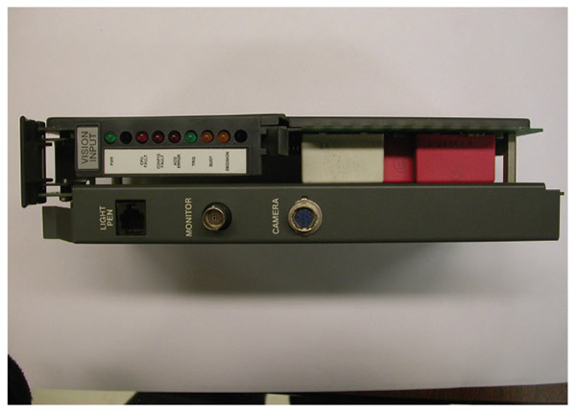
Figure 8-1
An example of a machine vision process board— one of the great advancements of the 1980s

Slide 15
History of Vision Systems 1990s
LEDs are used for lighting
  Lighting can make or break vision processes
In 1994, SanDisk introduced CompactFlash (CF) as a storage medium
  Became the go-to technology for storing images, among other kinds of data
1997 - the first CMOS digital camera was sold by Sound Vision, based in Boston, Massachusetts
By the end of the decade more than 100 companies were selling vision systems

Slide 16
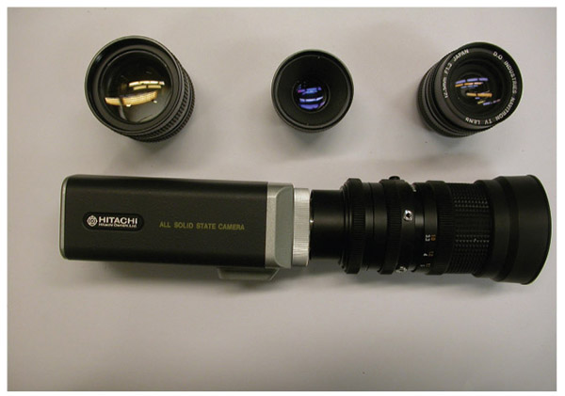
Figure 8-2
An older vision system, along with some lenses that it might use

Slide 17
History of Vision Systems 2000s
2005 - Sony introduced its first smart camera
  This camera housed everything needed to take and process images
  All one needed to do was hook it up to the controller to pass data
2008 - The technology had improved to the point that we began to work toward 3D image capture
  Microsoft released Photosynth, which can create a 3D image from several 2D images
Today image systems can identify parts, take measurements to gauge quality, create 3D scans, provide their own light and processing, and detect problems that human eyes could never find

Slide 18
Components of a Vision System
Most vision systems include the following basic components
  Imaging device
  Lens
  Processor
  Communication
  Light source
  Extras

Slide 19
Imaging Device
Imaging devices, or cameras, are the heart of a vision system, where the light is captured and turned into some form of electrical signal that we can transmit
Most of today’s vision systems use either CMOS or CCD technology, with CMOS quickly becoming an industry favorite
In 1D scanning, also called line scanning, the imaging device uses a single line of the CCD or CMOS element to gather the picture

Slide 20
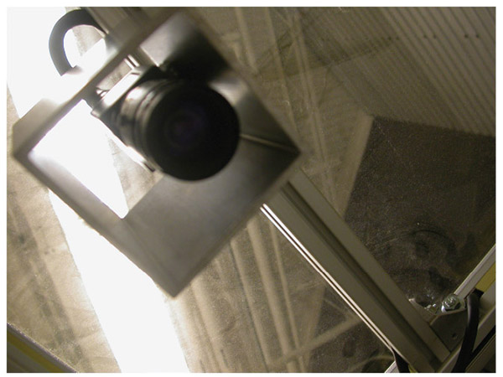
Figure 8-3
A close up of a camera used in a work cell to monitor things

Slide 21
Imaging Device cont.
With 2D scanning, also known as area scanning, the imaging device has an array of CCD or CMOS elements, giving the system the ability to take a picture of an entire area or object all at once
  Another measure of an array is the number of grayscales it can detect, referred to as the depth of the array
  Grayscale is any measurement of an element or pixel that is between zero, which is considered a full absence of light, and the maximum output, which is considered full light
To create 3D scans, we can use multiple cameras to take pictures of the same object and then process that data through special algorithms

Slide 22
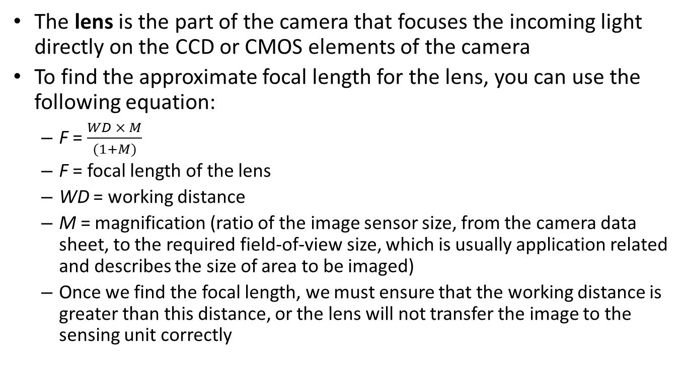
Lens
The lens is the part of the camera that focuses the incoming light directly on the CCD or CMOS elements of the camera
To find the approximate focal length for the lens, you can use the following equation:
  F = $\frac{WD × M}{(1+M)}$
  F = focal length of the lens
  WD = working distance
  M = magnification (ratio of the image sensor size, from the camera data sheet, to the required field-of-view size, which is usually application related and describes the size of area to be imaged)
  Once we find the focal length, we must ensure that the working distance is greater than this distance, or the lens will not transfer the image to the sensing unit correctly

Slide 23
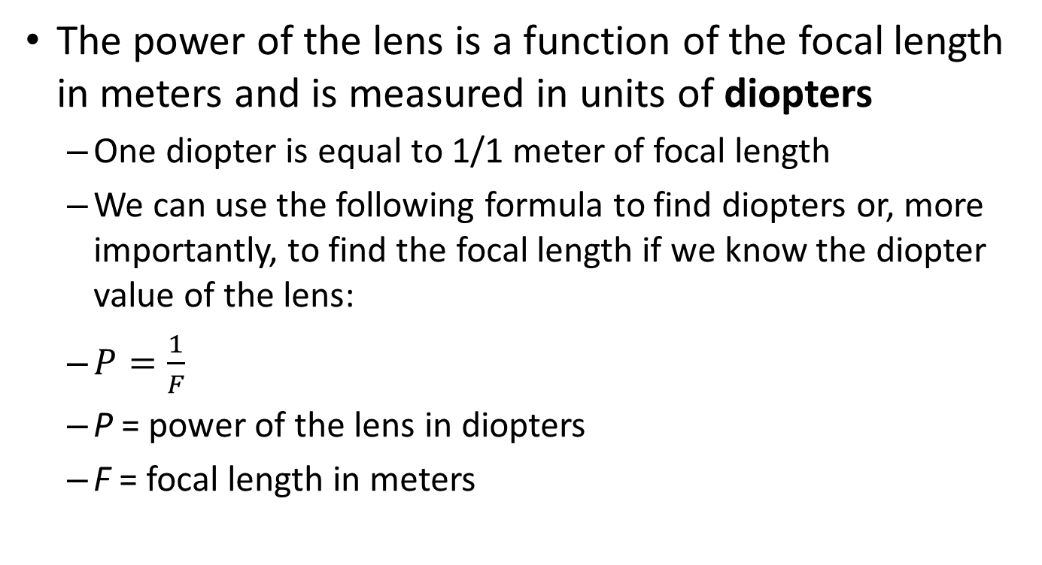
Lens cont.
The power of the lens is a function of the focal length in meters and is measured in units of diopters
  One diopter is equal to 1/1 meter of focal length
  We can use the following formula to find diopters or, more importantly, to find the focal length if we know the diopter value of the lens:
  $P=\frac{1}{F}$
  P = power of the lens in diopters
  F = focal length in meters

Slide 24
Processor
The imaging system processor is the portion of the vision system that takes the raw data from the sensors, usually in the form of voltage or current, and converts it into a digital signal that other controllers can use one frame or picture at a time
  In simple systems, the processor turns the analog signal from the imaging device into a set of binary numbers for processing by another system
  Advanced systems utilize a processor that converts the analog signal into binary data, runs image analysis algorithms, and perhaps compares the processed data to parameters or images supplied by the user to determine which information should be sent out

Slide 25
Processor cont.
Often vision systems supplied by the robot manufacturer have a dedicated card that fits into the robot controller for processing the vision application
  You may have to set dip switches (small on/off-type switches used to set options or parameters) or add jumpers (connections between two or more settings pins) to ensure proper operation
When dealing with third-party vision systems, communication issues are more likely to occur

Slide 26
Communication
The communications portion of the vision system is responsible for transmitting the refined data from the processor to the robot controller or other control system so it can respond appropriately
USB 3.0, coaxial cable, and wireless connections are popular ways of transmitting vision data
  Utilizing the CoaXPress protocol, we can reach transmission speeds of 6 Gbps (gigabits/second) over coaxial cable
  USB 3.0 is good for up to 5 Gbps
  Wireless connections top out at 1 Gbps on average

Slide 27
Communication cont.
For the communications portion of the vision system to work correctly, three important things must happen
  First, the information must be formatted for transmission in a way that the receiving system can understand
  Second, there has to be a transmission device that works for both the sending and receiving systems
  Third, all of the data has to reach the receiving unit in an intact state for storage and/or use

Slide 28
Light Source
The light source provides a specific type of light that strikes the object in a specific manner to facilitate taking an image
When choosing a lighting option, the user has to consider several key points:
  What is the environment like around the vision system?
  Which type of part are we working with?
  What are the specifics of taking the image?

Slide 29
Extras
Extras for vision systems include the various options and add-ons that might come with a system
  Spare or different cables
  Mounting brackets
  Display screen(s)
  Storage device(s)
  Network adaptors
  Automation sensors
  Filters that alter the light coming in
  Thermal imaging equipment

Slide 30
Image Analysis
Edge detection is the data sorting process in which the processor looks for sharp differences in the light values between elements or pixels and then uses the elements nearby to confirm that it has, indeed, found an edge
  This process works best with lighting situations in which there is a stark contrast between the part and the area around the part
  Once it finds a set of elements that meet the designated condition, it examines the pixels nearby to see if more of these stark differences are in evidence; it uses a mathematic formula to assign a probability value to those pixels

Slide 31
Image Analysis cont.
Clustering, sometimes knows as region growing, sorts data by finding elements that have a similar value and growing the clusters outward from there
  First determine all the pixels that have a different grayscale value than the background
  From there, the system uses math to pick a starting point, called the seed pixel
  Once it has created some kind of mathematical profile for the seed pixel, the system begins looking for pixels around it that share similar properties from a mathematical standpoint

Slide 32
Template Matching
Template matching involves comparing the processed data to data stored from a previous image
  Ideally, the template is a picture of the optimal object in the most probable position, making it easier to compare
  If a threshold value, often set by the user, is reached, then the new image is considered to be the right object and the system proceeds as programmed
  The template method tends to have problems when the new image is at a different scale or the object’s orientation varies from the template

Slide 33
Edge and Region Statistics
Edge and region statistics uses data about unique features of the object for comparison to the newly processed image to determine if it is the object and how it is oriented
  Center reference point from which all other points are described
  Major part axis
  Minor part axis
  Number of holes
  Angular feature relationships
  Perimeter squared divided by the area, which creates a unique mathematic value that is not affected by scale
  Object texture data

Slide 34
Algorithm Method
The algorithm method uses a specific mathematical formula to analyze the sample part and then compare newly processed image data to this initial calculation result
  They work similarly to the edge and region statistics method
  The user may not need to specify which features to look at or in other ways detail the system’s operation
  Your responsibilities as the user should be outlined in the literature that comes with the system as well as any training you receive

Slide 35
Lighting
Light is a form of electromagnetic radiation that is broken into three separate ranges
The lowest range is infrared, which is below the visible spectrum and is frequently used as a heat source
  The infrared part of the electromagnetic spectrum covers the range from roughly 1 mm to 750 nm
  Far-infrared: 10 μm to 1 mm
  Mid-infrared: 2.5 to 10 μm
  Near-infrared: 750 to 2500 nm

Slide 36
Visible Light
The next range is the visible spectrum of light, from red at the lowest wavelengths to violet at the high end of the spectrum
  Visible light wavelengths fall between 380 nm and 760 nm
  Red: 620 to 750 nm
  Orange: 590 to 620 nm
  Yellow: 570 to 590 nm
  Green: 495 to 570 nm
  Blue: 450 to 495 nm
  Indigo: 440 to 450 nm
  Violet: 380 to 440 nm

Slide 37
Ultraviolet Light
Above the range of visible light is the ultraviolet range, which is not commonly used in vision systems
  It resides above visible light on the electromagnetic scale, but below X-rays and gamma rays
  Near UV: 315 to 400 nm
  Middle UV: 280 to 315 nm
  Far UV: 180 to 280 nm

Slide 38
Types of Lighting
The following types of lighting are often used with vision systems:
  Incandescent
  Halogen
  High-intensity discharge
  Xenon
  Fluorescent
  Light-emitting diodes
  Laser

Slide 39
Figure 8-4
SOURCE | Strobe | Cost | Intensity | Life | Heat
Incandescent | Poor | Good | Fair | Poor | Poor
Halogen | Poor | Fair | Good | Poor | Poor
HID | Poor | Good | Good | Good | Poor
Xenon | Good | Poor | Good | Fair | Poor
Fluorescent | Poor | Good | Poor | Good | Fair
LED | Good | Good | Good | Good | Good
LASER | Good | Poor | Good | Good | Good

Slide 40
Incandescent Lights
Incandescent lights pass electricity through a tungsten filament or wire, which in turn produces heat and light
  By varying the electrical properties of the bulb or the supplied voltage, we can control the amount of light produced
  This type of bulb has fallen out of favor due to its inefficiencies and is giving way to LED lighting
  These bulbs do not strobe well
  They also tend to degrade or produce lower light levels over time with continued use

Slide 41
Halogen Lights
Halogen lights are the evolved form of incandescent lights that utilize a tungsten filament inside a pressurized, gas-filled bulb made of high-silica glass, fused quartz, or aluminosilicate
  The high-pressure gas inside the bulb increases the light output considerably
  They produce more heat than a standard incandescent bulb, enough to burn if touched
  They are a poor choice for strobing
  If you touch a halogen bulb, the oils left behind can cause an imbalance in the surface of the bulb, leading to an explosive rupture of the bulb!

Slide 42
HID Lights
High-intensity discharge (HID) lights use an arc tube filled with gas to vaporize mercury, sodium, metal salts, or other substances
  When current flows between two tungsten electrodes, it ionizes the gas and creates heat and pressure inside the tube
  As the heat and pressure build, more of the non-gas substance vaporizes and this produces an intense light
  Metal halide lamps producing up to 1500 watts
  HID lights usually have an inner arc tube and an outer protective bulb that helps to stop debris if the arc tube fails and protects the arc tube from the outside world

Slide 43
HID Lights cont.
These lights use an electronic or magnetic ballast with a capacitor to start the arc and then regulate the current of the system to prevent arc tube damage
  HID lights have a good duration of use, but the light generated depends on the materials used
  Many of these lights require several minutes to reach full output
  When you turn off a HID light, it may have to cool for several minutes before you can restart the lighting process

Slide 44
Metal Halide Lamps
Metal halide lamps are specifically used in photography applications
  They produce the greatest amount of light in the HID family, with their output being close to daylight frequencies
  They can produce too much light, causing problems with image applications where they provide the ambient lighting and override other lighting sources
  These lamps also take 5 to 10 minutes to warm up

Slide 45
Xenon Lights
Xenon lights also use tungsten electrodes and an arc tube filled with xenon gas to produce intense light
  As a flash lamp, a control circuit dumps charge from a capacitor across the electrodes, creating light that is 10 to 100 times brighter than an incandescent bulb and that lasts from 0.001 to 0.2 second
  This flash is often timed with the same pulse that captures the image, effectively freezing fast-moving parts for imaging or simply providing needed light
  When it is used as an HID application, the gap between the electrodes is kept very short, around 4 mm (0.2 inches), and a ballast system is need to start the arc and control current

Slide 46
Fluorescent Lights
Fluorescent lights produce light by using high-voltage electricity to excite gases inside a glass tube coated with a phosphor material, which gives off light when struck by the ultraviolet radiation released by the excited gases
  They can provide a diffuse light in colors ranging from cool whites to warm whites, which results in minimal glare from shiny objects
  The bulbs are fairly cheap and last a long time
  We cannot strobe these lights
  The ballast used to excite the gas in the tubes can cause radio interference and even fires when poorly installed or maintained
  Flickering can cause headaches, eye strain, a greenish or yellow hue to images, and inconsistent lighting

Slide 47
LED Lights
Light-emitting diodes (LED) are a special type of semiconductor with a p-n junction that emits light when current is applied, via energy released as photons when electrons from the n-type material cross the boundary and fill holes at a lower energy level in the p-type material

Slide 48
LED Lights cont.
The high-brightness (HB) white LED has opened new avenues and applications for LED lights
LEDs are inexpensive to create, emit specific colors of light, and consume very little power during operation
They run cooler than HID, incandescent, and halogen lighting systems, and can be strobed
The control circuit rarely causes any problems outside the lighting system
They can generate enough heat to damage their semiconductor material and may require heat sinks or fans to cool them

Slide 49
Laser Light
Lasers intensify light by circulating light between two mirrors—one curved mirror and one flat, partially reflective mirror known as the laser resonator
  They then amplify the light by use of a gain medium
  If we just circulated the light between the two mirrors, it would eventually fade out due to losses each time it is reflected
  The gain medium amplifies the light passing through it, intensifying it to the point that the light can break free of the output coupler mirror, which is only partially reflective, and exit the system
  Modern diode lasers provide a highly collimated light beam that is easily strobed and can be used to provide three-dimensional images

Slide 50
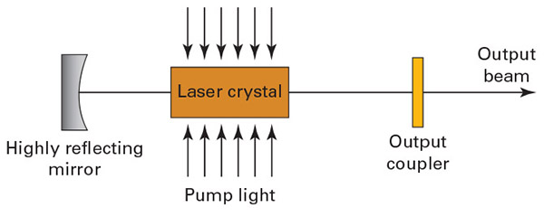
Figure 8-5
While oversimplified, this diagram shows the basic operating principle of a laser

Slide 51
Lighting Techniques
We will look at the following lighting techniques:
  Bright field lighting
  Axial diffuse lighting
  Diffuse dome lighting
  Dark field lighting
  Backlighting
  Structured lighting

Slide 52
Bright Field Lighting
Bright field lighting - the lighting system is applied such that a large portion—if not almost all—of the light from the illumination source is reflected from the object back into the camera
Partial bright field - one or two light sources are set at a greater than 45° angle to the object so that most of the light transmitted is reflected into the camera lens
Full bright field lighting - use either flat array lights, axial diffuse lighting, or diffuse dome lighting to rain light down on the object and return the maximum amount of light to the camera

Slide 53
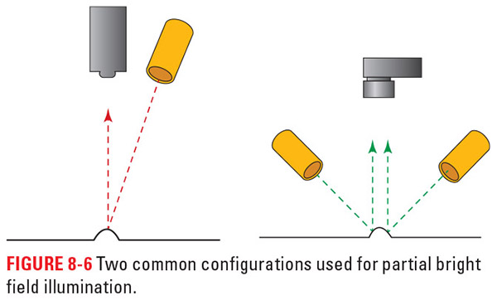
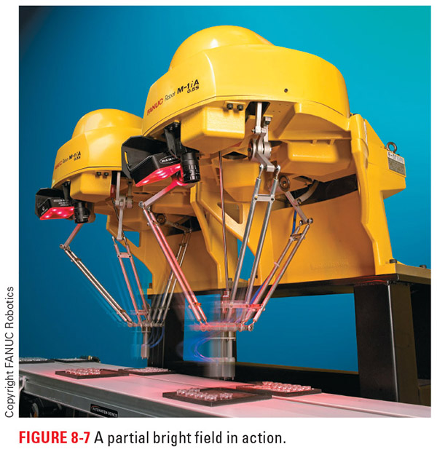
Figure 8-6
Figure 8-7
Here you can see partial bright field illumination setups

Slide 54
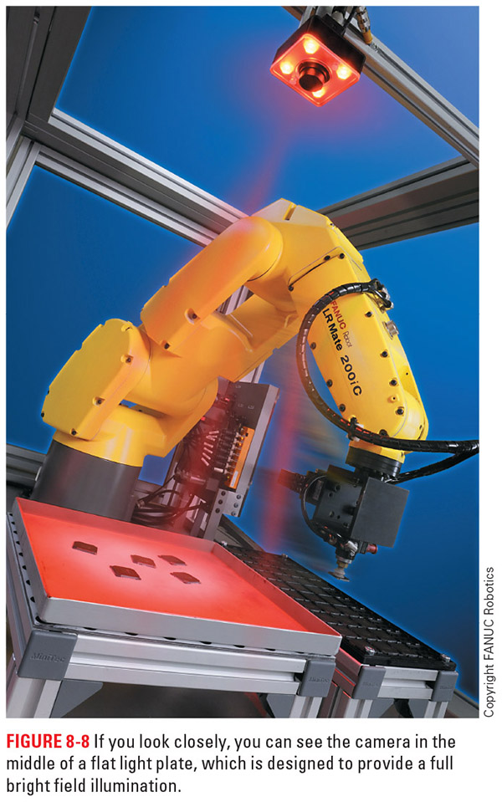
Figure 8-6
Figure 8-8
These images illustrate how a full bright field lighting system works

Slide 55
Axial Diffuse Lighting
Axial diffuse lighting - uses a light source set at 90° to the part; a mirror in line with the camera reflects the light straight down to the part, and then allows the returning light to pass through to the camera
  This technique is good for detecting flaws in flat, shiny surfaces and illuminating small cavities
  The mirror can produce a double image if it is too thick

Slide 56
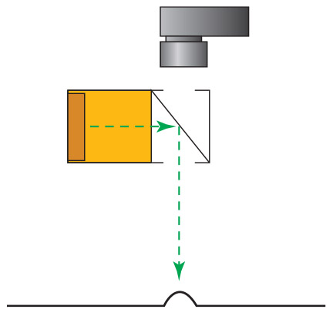
Figure 8-9
This graphic illustrates the setup for an axial diffuse lighting system

Slide 57
Diffuse Dome Lighting
Diffuse dome lighting - a light source is placed inside the surface of a partially reflective dome, with the camera focused on the object through a hole in the middle
  Sometimes referred to as “cloudy day illumination”
  This method is good for detecting flaws on rounded, shiny surfaces
  It helps to avoid hot spots (i.e., high-intensity light spots) and glare
  A downside of diffuse dome lighting is the dead spot of light where the camera hole is
  This method does not deliver the same intensity of light as the other methods

Slide 58
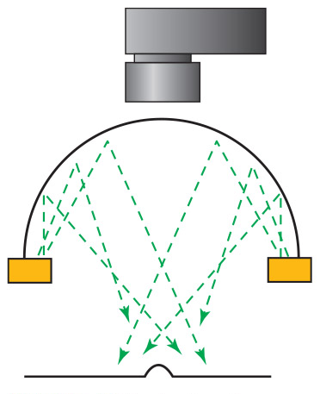
Figure 8-10
This graphic shows the basic configuration of a diffuse dome lighting setup

Slide 59
Dark Field Lighting
Dark field lighting - most of the light from the light source is reflected away from the camera, with the lighting usually at an angle of less than 45° or focused off the object
  Defects and certain features of the object catch the light and send it to the camera, making them show up in an otherwise dark background
  It is very good for detecting edges and mapping the topography of an object
  Some features may block the light and prevent reflection from areas of the part

Slide 60
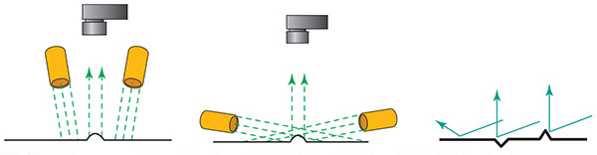
Figure 8-11
We have a few options for the lighting setup with dark field lighting, but the goal is depicted by the image on the far right

Slide 61
Backlighting
Backlighting techniques provide the greatest contrast, as the light source is placed opposite the camera, with the object between the two
  This creates a silhouette of the object without most of the surface detail, other than a bit of texturing at the edges
  This method is good for inspecting and measuring certain object dimensions, determining the presence or absence of features that can be backlit (such as holes), and finding an object’s location in the illumination field

Slide 62
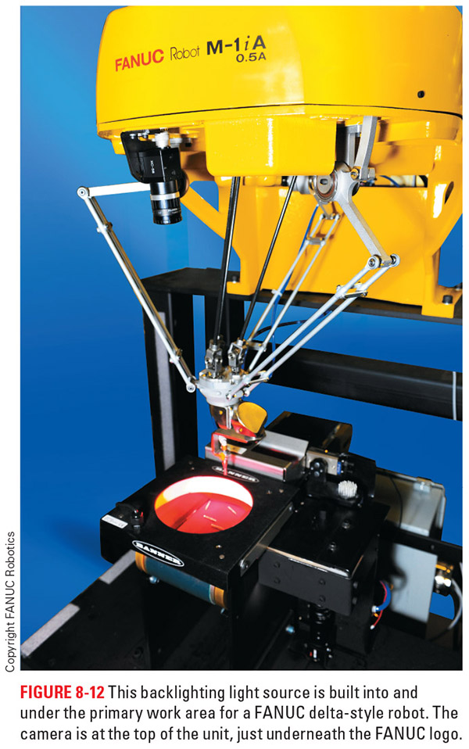
Figure 8-12
Here you can see a FANUC delta style robot using backlighting to get the job done. You can see the camera for the vision system on the front, center of the robot. It’s the black device pointed towards the illuminated field.

Slide 63
Structured Lighting
Structured lighting is a variation of partial front lighting that typically relies on a fiber-optic line light to capture object features or measure specific points
  Structured lights cover a specific, targetable area instead of creating a wide area or large spot effect
  This allows the user to illuminate only the part or area of the object that is of interest
  Fiber-optic light is fast and essentially heat free, but the fiber-optic material is made of glass

Slide 64
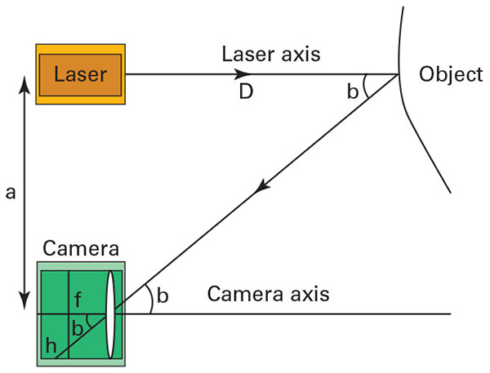
Figure 8-13
If we use a laser and set up a right triangle in which the laser, camera, and object are the three corners, we can triangulate the distance of the recorded light for measurement or as part of a point cloud used to create a three-dimensional image

Slide 65
3D Imaging
To create multiple points, we have to move the camera and laser setup or move the part to reach and map all the various points
Some systems use a laser line instead of a point for this purpose, so the camera can process multiple points from each position
The process of recording a cloud of points and then turning it into a 3D image usually takes several minutes and is a technology that is still evolving
Triangulation system are great for gauging continuous features on low-contrast parts

Slide 66
Tips and Tricks
Need to look for missing material?
  A good solution is to use axial diffuse bright field illumination
Looking for a specific colored feature?
  By using a specific wavelength of light, or color, you can hide or accent features
Want to see if there are any cracks in glass (or similar)?
  For this application, the dark field lighting method is helpful

Slide 67
Tips and Tricks cont.
Need to look inside blister or other clear packaging?
  The dome diffuse lighting technique would be a good fit here
Have a highly reflective part?
  Infrared light eliminates reflections
Looking for fluorescent material?
  Certain types of ink, glues, and other organic material will emit fluorescent light when exposed to ultraviolet light

Slide 68
Review
History of vision systems. This section gave some brief background information on the people and inventions that led to the modern vision system.
Components of a vision system. We looked at the various pieces of a vision system and discovered what each part does.
Image analysis. We looked at the basics of image analysis and explored a few ways to process images.
Lighting. This section covered both light sources and techniques for lighting parts. It serves as a starting point for exploring the complexities of lighting.

