Slide 1
Justifying the Use of a Robot
Chapter 12

Slide 2
Overview
WHAT YOU WILL LEARN
  Why we use robots instead of humans to perform some tasks
  Whether robots are taking humans’ jobs
  What a SWOT analysis is and how it is used
  How to figure the return on investment for a robotic system
  How precision and quality figure into justifying the use of a robot
  How consumables are better used by robots
  How to justify using robots that can go places where humans cannot or should not go

Slide 3
Robot vs. Human Labor
Robots are the perfect answer to many of the dull, dirty, difficult, or dangerous tasks people perform every day
Robots are methodically, unemotionally constant where people are not
Statistics that show that a midsized robot costs about 72 cents an hour to run while at the writing of this book, the minimum wage in America was $7.25 an hour

Slide 4
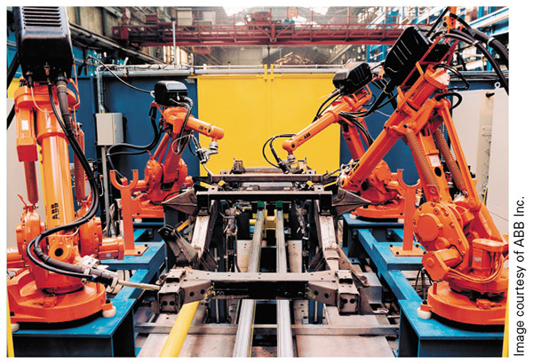
Figure 12-1
Many of the jobs in industry fall into one or more of the four Ds of robotics

Slide 5
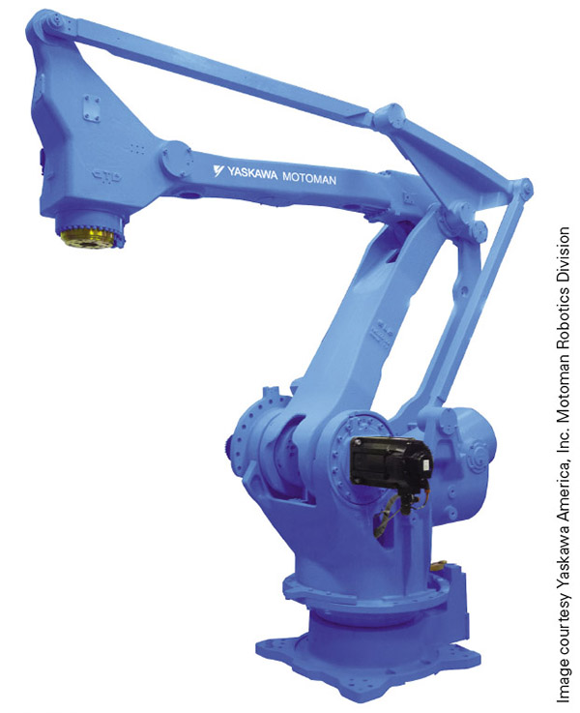
Figure 12-2
The cold, program driven efficiency of the robot means it is never off its game due to an emotional situation.
Plus, if we damage the robot we can swap out part or systems with no greater concern than the time and money invested.

Slide 6
Robot vs. Human Labor cont.
When discussing robots vs. human labor keep in mind:
  If the business is not profitable, it will not stay in business
  Every robot needs a support staff
  Many tasks are better suited to humans than robots

Slide 7
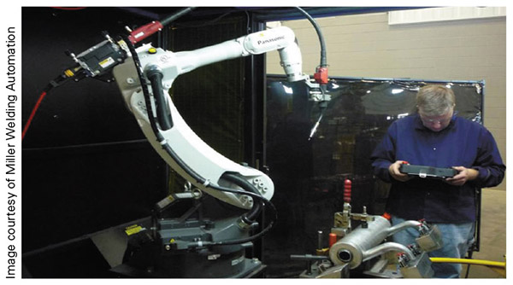
Figure 12-3
While robots are taking over some jobs in industry, they are creating a whole new set of jobs for people with the technical skills necessary to run, program, and maintain the systems.

Slide 8
SWOT Analysis
SWOT stands for strengths (S), weaknesses (W), opportunities (O), and threats (T)
SWOT analysis - a technique used to compare all of these factors to help with important financial and business decisions
We can break the analysis into the following steps:
  Determine the focus
  Do research
  List company strengths
  List company weaknesses
  List opportunities
  List threats
  Establish priorities
  Develop a strategy and execute it

Slide 9
Define the Focus
This step is where you set two or three objectives that you want to reach as a company
  This guides the various types of data collected and analyzed in the following steps of the process
  If the end goal is not yet clear or is a work in progress, then specific questions could be used instead
  There has to be some focus to the data gathered or you run the risk of just doing busy work gathering a bunch of information that has no clear use

Slide 10
Do Research
Learn all the ins and outs of your company’s business operations as well as how the company compares to its competitors
  This is a good time to get data on the cost of raw parts, labor costs, profit margins, number of hours spent manufacturing each part, and anything else that is beneficial for understanding the physical and financial sides of your business
  When you look into your competitors you can get general cost of goods sold, market share, information on new products about to hit the market, patents, and other information to help with comparisons

Slide 11
List Company Strengths
These include advantages your company has over its competitors and things your company does better (or best)
  Unique resources or materials purchased at a lower cost
  Strengths perceived by the general public
  Does the average consumer trust your product because your company is more than a hundred years old?
  Perhaps you have a top rating of some kind, which translates into buyer confidence
  Your facility’s location or the skill level of the employees may also factor in here

Slide 12
List Company Weaknesses
There are downsides to every business, and this step is where we log those disadvantages for the company in question
  Factors that are costing the company sales or market share, not owning the patents or intellectual property on which the product is based, or difficulty in getting raw materials
  High turnover rates, lack of skilled workers, low-quality production, and any image problems from the customer’s perspective
  The whole point of this step is to identify those factors that might be a problem in the process

Slide 13
List Opportunities
Next, it is time to find all the opportunities involved with the goals or question at hand
  This can range from new technology to increase the company’s manufacturing process to training opportunities to increase workers’ skills
  New products or changes in social patterns would fall into this area as well
  Generally, the opportunity side of things come from outside the company and should not include things listed as threats in the next step

Slide 14
List Threats
There will be threats to success, and that is what we document next
  Which challenges stand in the way of success?
  Are your competitors doing what you want to do already, or are they doing it better than you can for a while?
  Are there changes in technology or the related standards and specifications that could prove problematic?
  Does the company already have financial issues to deal with, such as low cash flow or high debt?
  Look at the negative side of the coin in a realistic, not fearful way

Slide 15
Establish Priorities
Now that we have our SWOT lists, it is time to put things in order of importance or priority
  The best strengths and opportunities go at the top of the list, while the lesser factors filter to the bottom
  For the weaknesses and threats, we put the ones with the worst impact at the top and the lesser evils toward the bottom
    This creates an easy-to-see hierarchy of information for the final step of the process

Slide 16
Develop a Strategy and Execute It
The last step of SWOT analysis is to take all this information, filtered through the initial questions or goals, and create a strategy
  In this step, we consider which strengths and opportunities are compatible with what we want to do, while simultaneously which threats and weaknesses we need to overcome to be successful
  At this point, you may discover that the original goal or action in question is not a good idea at this time
    If that is the case, take this opportunity to identify a new goal or objective that will get you closer to your original goal
    If the goal or objective offers too little return given all the challenges that must be surmounted, you might be off abandoning ship on that idea and looking for something else that would be a benefit

Slide 17
Return on Investment
Return on investment (ROI) is a measure of the amount of time that it takes a piece of equipment to pay for itself
  We calculate this by taking the operating cost of the equipment and subtracting it from the amount of money it saves
  Once we know the amount of profit or money made using the machine, we divide the total cost of the equipment by this number to determine how long it takes to pay for itself

Slide 18
ROI
If we figure ROI on a cost savings versus human labor, then we simply figure the per-hour savings and use that to get the total hours needed to pay for the robot
If we figure ROI on a part-by-part basis, we determine how many parts it needs to make to pay for itself
  We then turn this into a time scale using some correlation between parts produced and the time needed to produce them

Slide 19
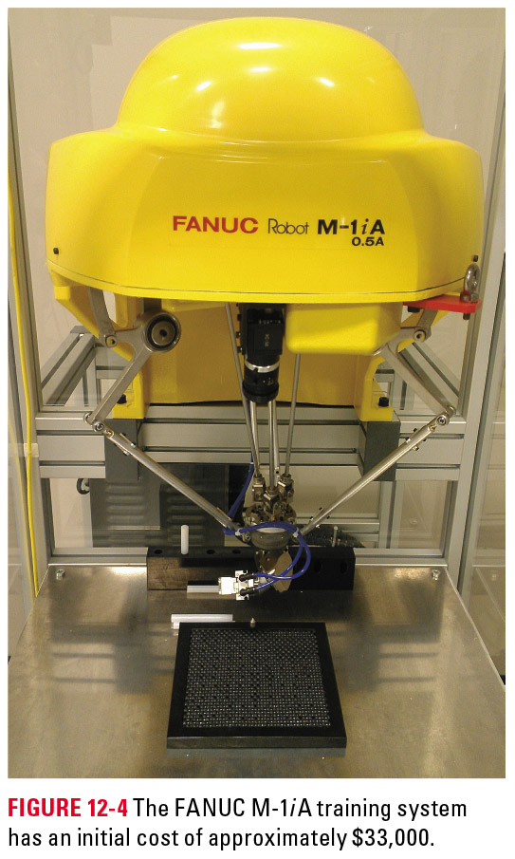
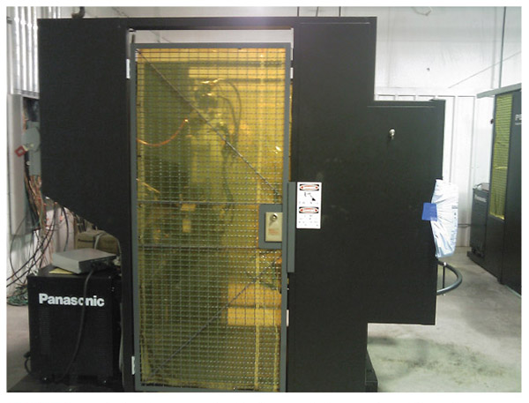
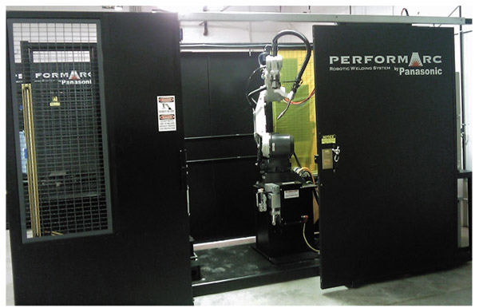
Figure 12-4
Figure 12-5
Figure 12-6
The systems here are arranged from least expensive to most, going left to right. On the far left is a Fanuc delta style robot, about $35,000, the middle is a PA55 from Panasonic, about $55,000, and the far right a 102S from Panasonic that is over $100,000.

Slide 20
ROI cont.
Another factor in ROI is how long the robot will run after it pays for itself
Some systems come with a designated useful life from the manufacturer
There are numerous accounts of robots running long past the life stipulated by the manufacturer

Slide 21
Cost Outweighs Return
In cases where the cost outweighs the return we can:
  Forget the robot and continue to do it the way it is currently done
  Try to find a cheaper robot that will perform the task
  Figure out a new way to use the robot

Slide 22
Precision and Quality
Robots have the ability to reach an exact point repeatedly with only the smallest of error, often within 0.0003 in. to 0.005 in.
Since robots can follow the same path repeatedly with only the smallest amount of error, all you need is to edit the program until you get the quality of part you want
Robots give operators with low skill levels the ability to produce complex parts

Slide 23
Precision and Quality cont.
Precision and quality savings figure into the overall ROI of a robot
  Each time a company scraps out a part, it costs money
  Each time a bad product leaves the factory, there is a good chance there will be a dip in customer satisfaction and potential sales
  Lack of precision requires larger spaces for various components and raises the overall cost of the product

Slide 24
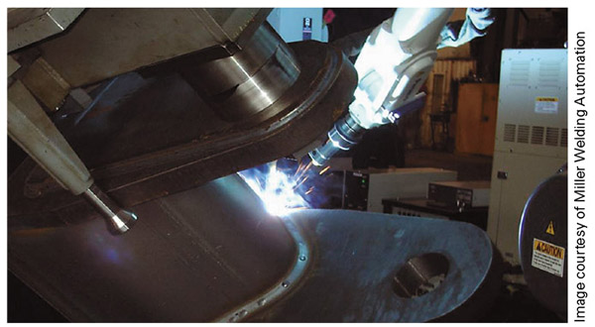
Figure 12-7
Welding is one area where robots are highly used due to their consistency. A few hours of tweaking a program can equate to weeks of near perfect parts.

Slide 25
Use of Consumables
Robots often save on the amount of raw materials used in the production process
In many applications, subtle changes in the speed of the process translate into savings in dollars or cost of materials used
Robots can work with materials that are hazardous to humans without the PPE

Slide 26
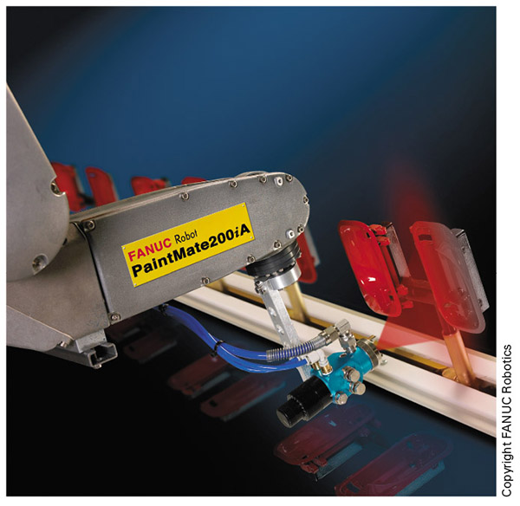
Figure 12-8
Painting is another good fit for robots. The paint fumes or dust do not bother the robot, they can save thousands per year in reduced waste, and they paint coats are consistently even, which improves quality.

Slide 27
Hazardous Environments
One of the great benefits that robots have over people is that they are machines and not organic systems
  This gives the robot the ability to survive and work without issue in environments that are physically taxing, dangerous, or deadly to their human counterparts
Sometimes this is all the justification we need for using a robot, especially in situations where the ROI math does not add up

Slide 28
Hazardous Environments cont.
Robots can go into some hazardous environments that people simply cannot such as:
  High pressure ocean depths
  Toxic or low-oxygen atmospheres
  Heavily irradiated spaces
  Areas too small for humans to fit

Slide 29
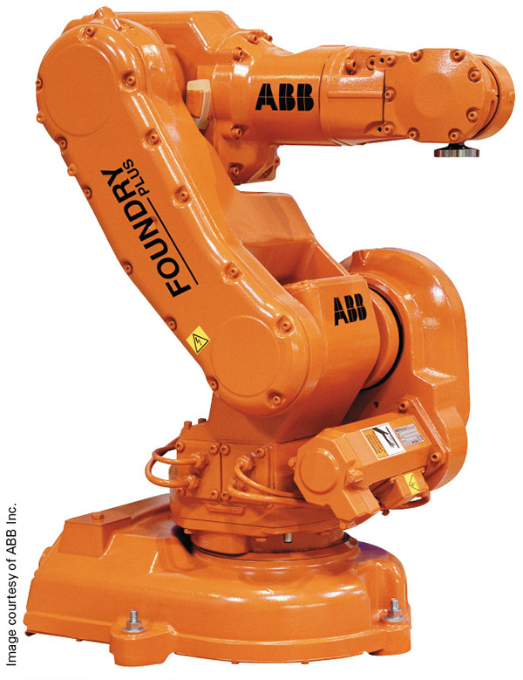
Figure 12-9
Here you can see and ABB foundry robot, used to work with heavy, hot, and unfinished metal parts

Slide 30
OSHA
Occupational Safety and Health Administration (OSHA) is responsible for ensuring that everyone has a safe and healthy working environment
  If someone dies on the job due to work-related factors, OSHA immediately inspects the facility and investigates the death to figure out why it happened and to prevent anyone else from being hurt or killed
  This is another good reason to use robots in hazardous locations

Slide 31
Review
Robot versus human labor. We considered the differences between using a robot and using a person to perform tasks from a justification standpoint.
Return on investment. ROI is all about the robot paying for itself, and the math that goes along with this payback.
Precision and quality. This section added a few more points the justification toolbox.
Use of consumables. Robots can save money by using less of the materials needed to produce things.
Hazardous environments. The dangers associated with a job can help to justify the use of a robot.

