Slide 1
Integration and Networking
Chapter 9

Slide 2
Overview
WHAT YOU WILL LEARN
  What an industrial network is
  Why we use networks
  The common wiring topologies
  The basics of common industrial recommended standards
  The basics of several common industrial communication protocols
  Some things to keep in mind when integrating the various components of a network

Slide 3
What Is a Network?
Network - the connection of two or more devices for the purpose of information sharing
Networks are used to:
  Share resources
  Coordinate machine function and motion
  Transmit data
  Allow for remote maintenance
The specifics of the network connections and the data flowing along those paths are primarily based on the application

Slide 4
Types of Networks
The primary configurations or topologies for nodes are:
  Bus
  Ring
  Star (also known as hub-and-spoke)
  Tree
  Mesh
Node - anything tied into the network, such as controllers, smart sensors with a processor, communication modules, smart switches that help with information transfer, computers, programmable logic controllers (PLCs), or anything else that can send and receive data

Slide 5
Bus Topology
Bus topology network - has one main cable called a trunk cable, with terminating resistors attached at each end
  The trunk cable carries data and power, with physical and electrical connections called a tap being found at various points along the trunk cable
  The tap is connected to a drop cable
  The drop cable may, in turn, have several taps along its length, allowing for node connections
In this type of network, data is sent along the trunk, and all nodes will receive the information
Specific address data is coded into the packet, so that only the node with the matching address can actually read and use the data

Slide 6
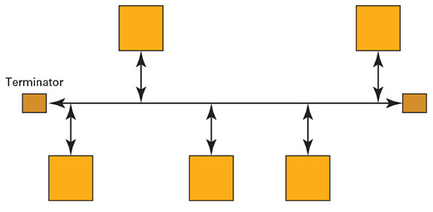
Figure 9-1
Advantages:
ease of adding or removing nodes
easy setup
use only small amounts of wire
Disadvantages:
a short or opening in the wire will cause part or all of the network to become inoperative
as you add either more nodes or length to the bus, the data transmission speed will slow down
  such a system is easy to crash

Slide 7
Ring Topology
Ring topology network - all the nodes connected in series to form a continuous loop or ring
This topology often uses a token, which is a bit of code that allows a node to transmit information
The token is passed from one node to the next along the ring
If the node with the token does not have data to send, then it just passes the token along

Slide 8
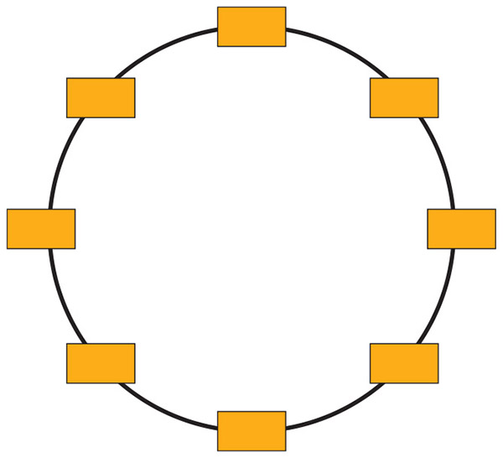
Figure 9-2
Advantage: information can travel in both directions, thereby reaching the intended node even if there is a break in the line
Disadvantage: slow transmission of data, as the token cycles through the network, and the requirement for a large amount of cabling

Slide 9
Star Topology
A star topology network uses a central connection point known as the hub node, which has connections (often hard-wired) leading to each separate device on the network
For the hub node, we can use a network hub, switch, or router
  A network hub, usually called just a hub, is basically just a repeater that sends the signal in to all the connected nodes
  A switch knows the address of each connected node and sends the packet only to the designated node, instead of doing a network-wide broadcast
  Routers are smart devices like switches; their connections can either be wired or wireless, depending on the application

Slide 10
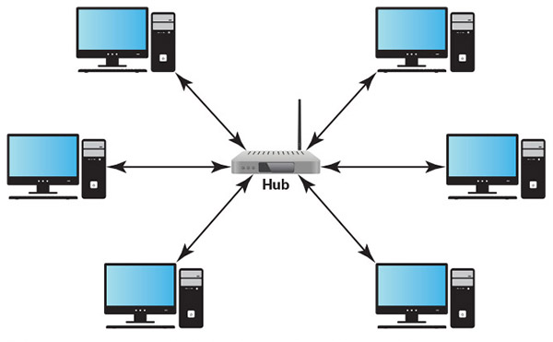
Figure 9-3
Advantages:
easy setup
easy troubleshooting
one bad cable does not crash the network
Disadvantages:
when cabled it uses a lot of wire
if we lose the hub node, that entire network section goes down

Slide 11
Tree Topology
A tree topology network is the combination of a bus network and multiple star networks, usually comprising three levels of devices
The first level or lowest level is the devices connected to the hub nodes
The second level or next level up is the hub nodes
The third level or top level is the main hub that controls the flow of data in the network

Slide 12
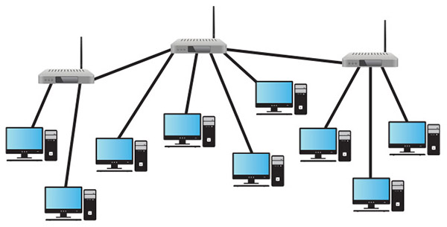
Advantages:
easy to expand
supports more devices than a pure bus, which is limited by transmission traffic, or a pure star, which is limited by the number of connections a hub can manage
Disadvantages:
the initial setup cost
the large amounts of cabling
a tier three node failure kills the whole system
Figure 9-4

Slide 13
Mesh Topology
Mesh topology network - multiple connections, where each node is connected to all or several nodes, with the ability to share information along those connections
A full mesh setup, each node connects with every other node
A partial mesh topology has nodes that connect to only three or four other nodes instead of all the other nodes
This has become the preferred method of setting up wireless networks
Signals can take multiple routes, making the network self-healing when a connection fails
Setup simply requires getting the device hooked into the local area network (LAN)
  A LAN covers a small area such as a business or manufacturing facility

Slide 14
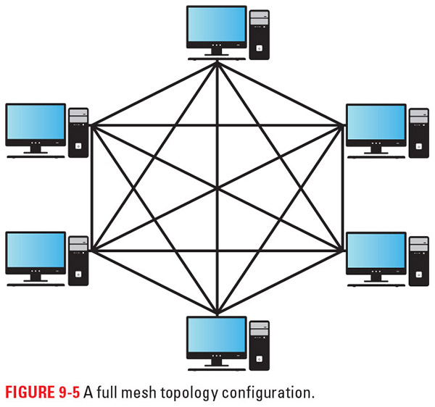
Figure 9-5
Advantages:
great way to bring Internet connectivity to areas where it would otherwise be unavailable
local information can pass directly from node to node, speeding up communication
Disadvantages:
if this system is hard-wired there is a huge amount of cabling to run
the initial setup can get complicated regardless of whether the network is wired or wireless

Slide 15
Network Connections
Wireless network - each node connects using built-in wireless technology, a wireless network card, or physical connection to a device that is connected to the wireless network
Wired connections - the broad choice is either copper wires or fiber-optic cabling
  Fiber-optic cabling provides for faster data transmission, as it uses light instead of electricity to transmit data
  Copper wires are more common because they are cheaper and easier to repair

Slide 16
Fiber-Optic Cables
Fiber-optic cables have a central core made of glass or plastic and data is transmitted in the form of a laser light signal through the length of the cable
  Equipment on the sending end converts data into light and similar equipment on the receiving end converts the light back into digital data
  The cable consists of a single fiber-optic core surrounded by a cladding protective material, which in turn is surrounded by an insulating jacket

Slide 17
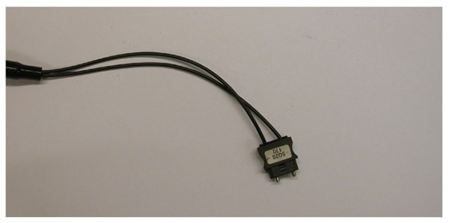
Advantages:
can transmit large volumes of data over long distances
are immune to electromagnetic noise
signals move at the speed of light
Disadvantages:
a bend radius that is too small may result in a kink in the cable—a sharp bend that causes damage to the fiber-optic material
any impact or excessive pressure can damage the cable and prevent light transmission
Figure 9-6

Slide 18
Data Transmission
Recommended Standards (RS) - designate specific pin connections and connector types to aid in the transmission of data
Simplex transmissions flow in only one direction, with no way to verify whether the data was received
Duplex transmissions flow in both directions and are the preferred transmission method for networks
  Full duplex - data is transmitted and received by devices simultaneously
  Half duplex - the system transmits or receives data, but does not do both at once

Slide 19
Data Transmission cont.
Noise—that is, voltage induced into the line by magnetic fields or radio waves—can create false signals and alter data transmissions
Twisted pairs, which is simply spiraling two wires together, minimizes noise
Shielding - wire mesh or metal foil that is connected to ground and placed around wires to prevent noise
  This creates a low-resistance path for the inductive force to travel down, thereby preventing it from passing through the wire and causing problems

Slide 20
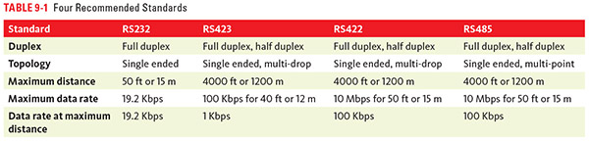

Slide 21
Data Transmission cont.
RS232 was introduced in 1962 and can still be found in industry today, though it is no longer the most popular method of data transmission
RS423 is similar to RS232, but adds half duplex operation and faster transmissions
RS422 can be single ended or multi-drop, meaning that one transmitter can talk to multiple receivers, but not all of them
  One transmitter can reach a maximum of 10 receivers
RS485 is the current favorite and is the next step up from RS422
  It can handle true multi-point communication, in which a transmitter can talk to any receiver

Slide 22
Cabling
Special cables with the correct number of wires or Cat5 (Category 5) and higher cable
  Both options use twisted pairs, come in shielded and unshielded varieties, and have various options for number of wires
Coaxial cable - a single copper wire conductor surrounded by a layer of insulation, which in turn is surrounded by a braided metal shield that is connected to ground, which in turn is covered by an outer jacket
Ribbon cable consists of a series of conductors laid parallel to each other in a common insulator, with one edge of the cable marked with a red stripe that usually connects to pin 1 on the connector

Slide 23
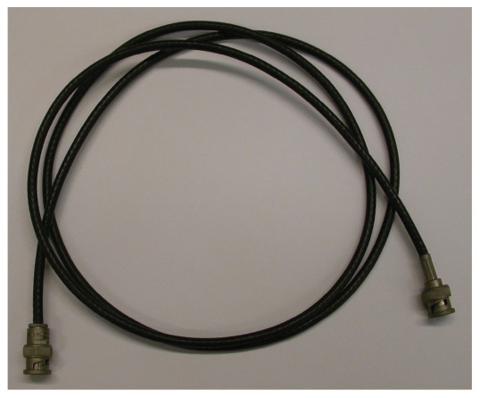
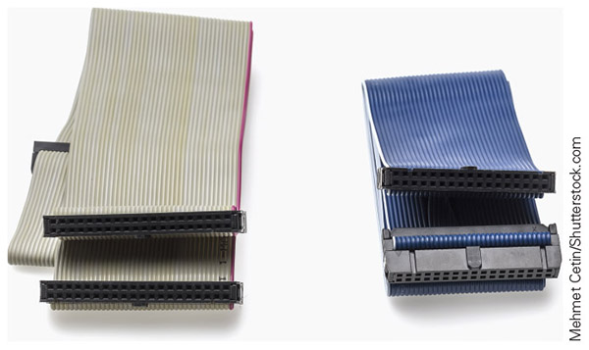
Figure 9-7
Figure 9-8
On the left is a coaxial cable and on the right a couple of ribbon cables

Slide 24
Connectors
Connectors—devices that are designed to fasten together and make electrical connections through cable wires being attached to their numbered internal pins
The DB or D-sub style come as DB9, HD15, and DB25 options, with the number designating how many pins are in the connector
Mini DIN connectors use a circular-style connector, usually with a guide pin or grove to prevent pins from being placed in the wrong spot

Slide 25
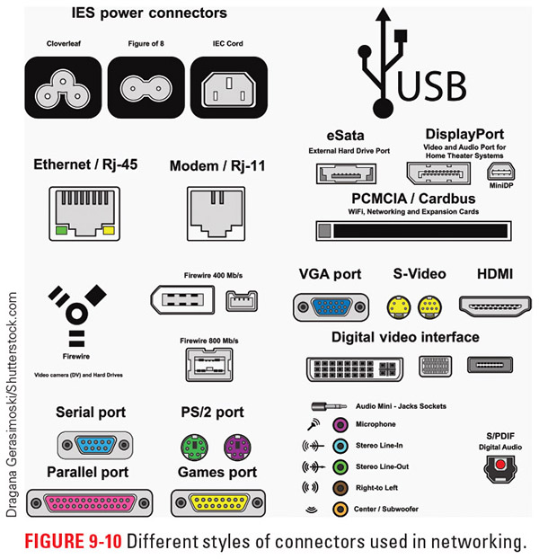
Figure 9-10
This image illustrates several types of connectors you may encounter in the field

Slide 26
Connectors cont.
RJ-style connectors are often used with Cat cables and Ethernet-type connectivity
  The RJ-45 connector is the most commonly used member of this group
  Other options include the 4-pin RJ-11, 6-pin RJ-12, 8-pin RJ-45, 10-pin RJ-45, and 8-pin shielded RJ-48
USB connectors include:
  A-type connector, which found in most computers and on flash drives
  B-type connector, which is the square-looking one found on some printers
  Micro family, which is often used to charge and connect cell phones

Slide 27
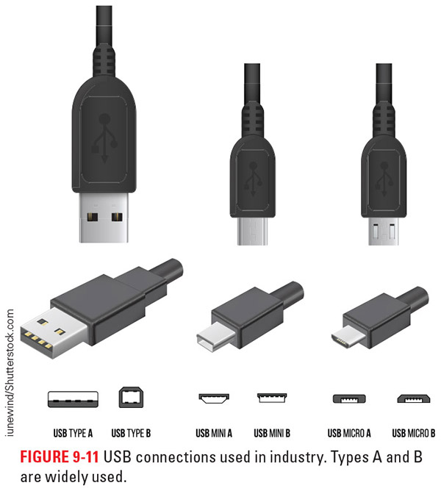
Figure 9-11
Here you can see examples of the various styles of USB connections

Slide 28
Adaptors
Adaptors - change the style of the pin out so that communication or power can flow
Commonly adaptors today include USB to a DB or Mini DIN connection
It is important to make sure the adaptor routes the information coming out of the system to the correct pins on the cable or disaster can follow

Slide 29
Communication Protocols
Protocols - a set of rules governing how data is sent, which voltages and currents are involved, how the data is read, and how packets are addressed, among other things
Protocols we will look at include:
  Foundation Fieldbus
  DeviceNet
  ControlNet
  Ethernet/IP
  Profibus
  ProfiNet

Slide 30
Fieldbus
Fieldbus is a generic term for a number of industrial network protocols designed to provide real-time control of various devices and work with all the common network topologies and encompasses the following network protocols:
  Foundation Fieldbus H1
  ControlNet
  Profibus
  ProfiNet
  Foundation Fieldbus HSE (High-Speed Ethernet)
  World FIP
  Interbus

Slide 31
DeviceNet
DeviceNet is based on a Controller Area Network technology that uses a bus topology
  It uses a trunk and drop line system with a 121-ohm terminator resistor at each end, and all cables surrounded by a grounded shield
  In the four-wire flat cable version, two wires provide power at 24 V DC and the other two wires transmit data using the RS485 standard
  The round thick and thin cables have five wires; the extra wire is used as a drain and is bare of insulation, similar to a ground wire
  DeviceNet networks support 64 addressable nodes and a maximum of 2048 field devices
  Each device has its own unique address. known as a media access control (MAC) address

Slide 32
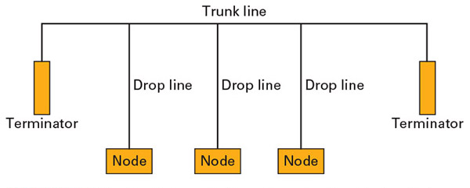
Figure 9-13
Here you can see the basic outline of a DeviceNet system:
Two fairly common problems encountered when setting up a DeviceNet network are inadvertent duplication of node addresses and use of multiple baud rates on one trunk line

Slide 33
DeviceNet cont.
The main controller, which uses one node, is called the master scanner
The speed of the slowest device determines the overall speed of the entire network
DeviceNet supports master/slave relationships, peer-to-peer relationships, and multicasting networks

Slide 34
DeviceNet cont.
Data can be sent on a DeviceNet network at one of three baud rates: 125 Kbps, 250 Kbps, or 500 Kbps
  The speed depends on the overall length of the trunk and the drop lines
  Generally, drop lines are limited to a maximum length of 20 feet (6 m) from the trunk
  For thin cable trunk lines, the length is limited to 328 feet (100 m) for all baud rates
  For thick cable trunk lines, the length is limited to 1640 feet (500 m) at 125 Kbps, 820 feet (250 m) at 250 Kbps, and 328 feet (100 m) at 500 Kbps
  For flat cable trunk lines, the length is limited to 1378 feet (420 m) at 125 Kbps, 656 feet (200 m) at 250 Kbps, and 246 feet (75 m) at 500 Kbps

Slide 35
ControlNet
ControlNet is another industrial networking protocol that supports multiple controllers, remote I/O racks, communication with DeviceNet subnetworks, and HMI
  Data transmission speed is approximately 5 Mbps at its maximum
  All devices on the network are capable of communicating with each other
  Data is primarily transmitted over coaxial cables or fiber-optic cables
  Each ControlNet network supports up to 99 nodes

Slide 36
Control Net cont.
The network is deterministic, which means we can set the minimum rate of data transfer within given parameters and the system will keep the timeline we set
It offers faster response times than traditional master/slave networks
Multiple masters can control the same I/O
Constant transmission times that are unaffected by devices leaving or entering the network
It can transmit over Ethernet, FireWire, and USB

Slide 37
Control Net cont.
The maximum distance of a ControlNet network depends on the number of nodes and repeaters in the line
  Each segment has a maximum length of 3280 feet (1000 m) with a maximum of two taps
  Every segment must have a terminating resistor at each end
  Every extra tap we add in past the first two decreases the segment distance via the following formula
    3280 ft – (53.4 ft × [number of taps ‒ 2])
    1000 m – (16.3 m × [number of taps ‒ 2])

Slide 38
Control Net cont.
The maximum number of taps allowed on one segment is 48, with a maximum length of 820 feet (250 m)
  We can create a new segment by adding in a repeater, which is a device that takes the signal from a segment and amplifies it for the new segment
  One tap must be added in for the repeater, leaving a maximum of 47 nodes for the segment
    This tap does not count as a node because these devices are not addressed with the controller

Slide 39
Ethernet/IP
Ethernet/IP is a network that uses the standard Ethernet protocol and Transmission Control Protocol/Internet Protocol (TCP/IP)
  One significant advantage of using TCP/IP is that data packets are routed the best way to their destination, so as to avoid data bottlenecks at either 10 Mbps or 100 Mbps
  Advantages over DeviceNet and ControlNet include:
    Transfer of large data files
    Network diagnostics
    Ability to perform controller operations
    Device configuration and programming

Slide 40
Ethernet/IP cont.
Ethernet/IP incorporates the open communication architecture known as Common Industrial Protocol (CIP) inside the standard network protocols used by the Internet
  CIP is an information transmission method that creates a common language among protocols
Ethernet/IP complies with the IEEE 802.3/TCP/UDP/IP standard, so much of the hardware is readily available
The maximum distance between a switch and a node when Cat5 cables are used is limited to 328 feet (100 m)
  The maximum distance between the switch and a node may vary when using other wired cables or fiber-optic cables

Slide 41
Profibus
Profibus uses the multi-drop type of network, with multiple devices on a single cable
  It is capable of sending process values, diagnostic information, device parameters, performance data, and other pertinent information across the network
  It comes with software tools for troubleshooting and engineering applications
  It works with intelligent field devices
  Profibus uses a general station description (GSD) file, which provides detailed information about the device that is readable by the configuration software

Slide 42
Profibus cont.
Profibus works with a bus or tree topology and allows a maximum of 32 stations or nodes per segment
  Can use a repeater to add segments and the recommendation is to include no more than 4 repeaters, creating a maximum number of 127 nodes per network
  Maximum cable distances range from 328 feet (100 m) for a single segment with copper cable to 78,740 feet (24 km) with repeaters and fiber-optic cable
  Transmission rates range from 9.6 Kbps to 12 Mbps, with 244 bytes of data being sent per message
  Data is controlled by polling in Profibus DP and Profibus PA and sent peer-to-peer in Profibus FMS
    Polling controls communication by having the master (requesting unit) send a signal asking the slave (sending unit) if it has any data to send. If the answer is yes, the data is transmitted from the sending/slave unit. If the answer is no, the master/requesting unit moves on to the next node.
    In peer-to-peer (P2P) communication, each node can talk directly to the others without having to go through a third node, such as the main controller, and can act as sender or receiver of data.

Slide 43
Profibus DP
Profibus DP (Decentralized Periphery) is a device-level bus that supports both analog and digital signals, and is generally designed for controlling a specific machine from inside the control cabinet
  It was originally developed to replace conventional I/O systems that required separate wires between a controller and the field devices
  It is designed to handle time-critical communication
  It communicates over RS-485 media at speeds between 9.6 Kbps and 12 Mbps, at distances from 328 feet (100 m) at the low end to 3937 feet (1200 m) with fiber-optic cable and repeaters
  Power is supplied to the field devices separately from the communication bus
  Multiple master nodes are possible with Profibus DP, but each slave is assigned a specific master node
    Multiple nodes can read from the slave device, but only the assigned master node can write to a slave node

Slide 44
Profibus DP cont.
Profibus DP has V1 and V2 extensions that add flexibility to this version of Profibus
  V1 extensions integrate the functionality of Profibus DP and Profibus FMS so they work seamlessly together, instead of as two separate systems
    This allows Profibus DP to work with newer, high-complexity equipment
  V2 extensions add a synchronization feature so multiple motion axes or multiple devices can work and coordinate using the same clock function
    It also adds publisher/subscriber messaging, which lets nodes talk on a one-to-one or one-to-many basis; these capabilities are helpful for coordinating multiple-axis motion

Slide 45
Profibus PA
Profibus PA (Process Automation) was designed specifically for the process industry, with the goal of replacing 4‒20 mA transmissions using a two-wire connection carrying power and data
  It is designed to work outside a specific machine mounted in a safe location where it can manage multiple processes at once
  Data is transmitted at 31.25 Kbps with a maximum length of 6233 feet (1900 m) on the Manchester Bus Powered (MBP) cable connected with M12 or gland screw connectors
  The power on the Profibus PA network is kept to an intrinsically safe level so only low, safe levels of power are released that will not ignite dangerous atmospheres
  Communication between Profibus DP and Profibus PA systems require a barrier converter to ensure the power on the PA network stays at safe levels

Slide 46
Profibus FMS
Profibus FMS (Fieldbus Message Specification) is used for communicating at the cell level, including with PLCs and industrial-grade personal computers (PCs), although it can also communicate at the device level
  This protocol uses an object dictionary that holds all accessible values that it can broadcast over the network as needed
  It uses peer-to-peer communication, which allows all nodes to designate themselves as a master if desired, but comes at a higher overhead in terms of byte price
  Profibus FMS uses the RS485 transmission standard over copper cable, with the maximum cable length set by the baud rate of transmission
    At 12 Mbps, the maximum distance per segment is 328 feet (100 m)
    At 1.5 Mbps, the maximum distance per segment is 656 feet (200 m)
    At 187.5 Kbps, the maximum distance per segment is 3280 feet (1000 m)
    From 93.75 Kbps to 9.6 Kbps, the maximum distance per segment is 3937 feet (1200 m)

Slide 47
ProfiNet
ProfiNet works seamlessly with standard IEEE802.3 Ethernet protocols and hardware and is an open industrial Ethernet standard
  Transmission speeds can exceed 100 Mbps on cables
  The protocol can work with gigabit hardware in a wireless setup to achieve even faster transmission speeds
  The TCP/IP channel is used for non‒real-time communication
  A special channel is used for real-time transmission of data related to critical events
  It works with all members of the Profibus family and uses software to create proxy connections to DeviceNet, ControlNet, and other protocols
  It uses a producer/consumer communication method
    This method can allow multiple devices to consume a single produced transmission

Slide 48
ProfiNet cont.
The maximum transmission distance for ProfiNet depends on the method used
  Twisted-pair copper cables have a maximum network length of 16,404 feet (5000 m), with a maximum segment length of 328 feet (100 m)
  Fiber-optic cables can reach a maximum network length of 492,125 feet (150 km) in single mode or 9842 feet (3000 m) in multi-mode
    A maximum segment length of 64 feet (50 m) for plastic fiber-optic cable
    328 feet (100 m) for glass fiber-optic cable
  For wireless transmission, the maximum coverage area is usually limited to 3280 feet (1000 m)
    Segments are limited 98 feet (30 m) between nodes indoors
    328 feet (100 m) between nodes outside

Slide 49
Foundation Fieldbus
Fieldbus is a digital communication system that use multi-point peer-to-peer communication
  Transmission size is 128 octets (8-bit units of data)
  It supports power over wired portions of the system and is intrinsically safe
  Real-time data transmission is possible as well as time-synchronized events
  It uses function blocks for control
    There are 21 types of standard blocks for data transfer available that users can modify with specific parameters
    Function blocks are joined together to form operational systems in a graphical way in the software
  Each device has a resource block, similar to the GSD
  When a new device is added to the network, it joins at one of four special default addresses specifically reserved for this purpose

Slide 50
Fieldbus H1
The wired version of Fieldbus, known as Fieldbus H1, is capable of data transmission speeds of 31.25 Kbps to a maximum wired distance of 6232 feet (1900 m) when #18 AWG individually shielded, twisted-pair wire is used
  This distance decreases to 656 feet (200 m) when two untwisted, nonshielded #16 AWG wires are used
  Each segment has a maximum of 32 devices without repeaters or a maximum of 240 devices with repeaters, with 4 to 16 devices per segment being the norm
  Each device must draw 8 mA from the segment at minimum
    Four-wire devices typically pulling 8.5 mA
    Most two-wire devices pulling 15 mA to 25 mA
    Segment maximum amperage is limited to 400 mA
  Voltage over the wires can range from 9 V to 32 V DC, but 24 V DC is typical
  Spurs typically have only one to three devices, with each device on the spur significantly reducing the maximum length of the spur

Slide 51
Fieldbus HSE
Fieldbus HSE is the Ethernet portion of the Fieldbus protocol and is an enhanced version of the IEEE 802.3 Ethernet standard
  In a typical Fieldbus system, the H1 portion works directly with the devices and the HSE portion links all the H1 networks together
  Fieldbus HSE transmits data at 100 Mbps and works with standard Ethernet equipment
  When wired the greatest distance possible is 6561 feet (2000 m) when using twin fiber-optic cable with 10BaseF Ethernet transmission
  HSE offers redundancy creating hundreds or even thousands of loops for information to get where it needs to go

Slide 52
Integration
Integration is the process of combining equipment and design elements to create a functioning system or work cell
A work cell is a logical grouping of equipment in which the processes flow seamlessly from one operation to the next, with the goal of improving quality and reducing per-part production times
Mechatronics—the combination of mechanical, electrical, and computer engineering fields into one multi-skilled discipline

Slide 53
Integration cont.
When we integrate systems, we have to take several things into consideration:
  The process involved
  The equipment involved
  The protocol(s) used
  The data tracked
  The work environment
    See Food for Thought 9-2 for an example of this process

Slide 54
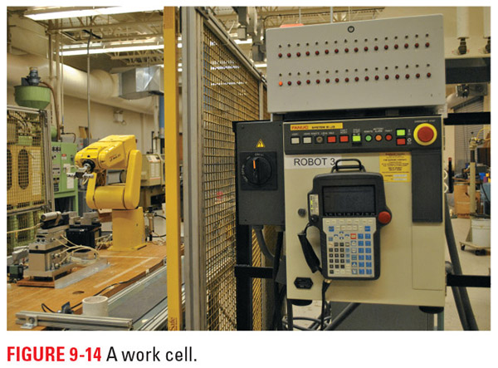
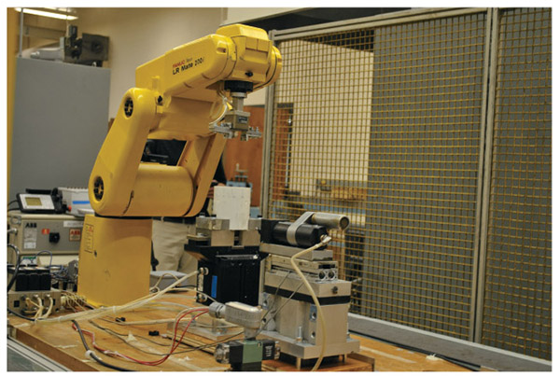
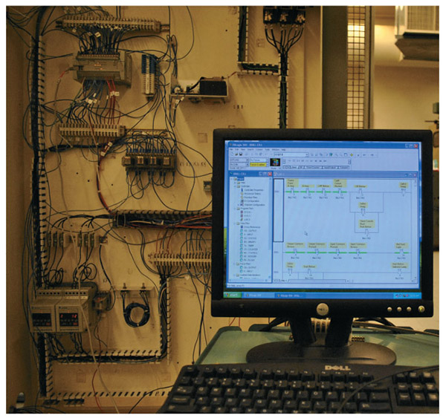
Figure 9-14
Figure 9-15
Figure 9-16
Here you can see some images of the various equipment that might be a part of a work cell and require integration to get everything working together correctly

Slide 55
Review
What is a network? We defined a network and identified the common tasks that networks perform in industry.
Types of networks. We explored the common wiring arrangements for networks as well as the more common recommended standards in use by industry.
Communication protocols. This section was all about the different ways we send data as well as some of the distance limitations involved with sending messages.
Integration. Integration focuses on getting everything to work together; we saw some of the things to consider along the path to an integrated system.

